Slide 1

Finance Society
September 10th 2014
Introduction and Calendar for Fall 2014

Slide 2
E-Board
Alexander Thalassinos
Co-President
(SMF)
Marc Schuman
Co-President
Sam Gudeon
CFO
(SMF)
Christina Groccia
VP of Member Relations
Bridget O’Malley
VP of Marketing
Brian Kavanagh
VP of Operations
Sam Waring
Co-VP of External Relations
Brendan Kavanagh
Director of Current Event Discussions
Kelly McCourt
Co-VP of External Relations
(SMF)
Yawei Tang
Marketing Committee
Shannon Hurley
Marketing Committee
Sean Phelan
Finance Committee
Lisa Mueller
Underclassmen Representative

Slide 3
Where does Finance Society Fit in the School of Business?
Finance Society
Classes
Interviews
Career
Past Experiences
Finance Society is the bridge that connects your academic life with your professional life
Put yourself ahead of the competition by being a more “polished” candidate
Gain a better understanding of how your classes translate into work related skills
Draw upon past experiences to better market yourself to future employers
Surround yourself with like-minded individuals passionate about going into finance related careers

Slide 4
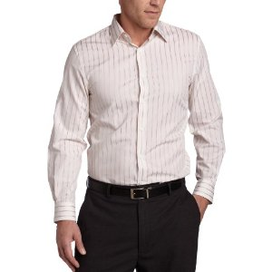


About Finance Society
Finance Society is one of the premier student-run organizations at the University of Connecticut. Since its inception in 2003, the Society has been at the forefront of assisting in the professional, educational, and social development of students interested in finance.
Our organization is an Academic Society; therefore our meetings will be required that you wear Business Casual attire to facilitate a professional environment
There are three types of meetings: employer presentations, current event discussions, and selected events
Meetings will take place every Wednesday or every other Wednesday at 6:30 pm in the School of Business room 211
Dues - $20 due to the 4th floor School of Business, outside the Finance Department

Slide 5

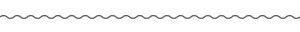


Benefits of Joining
Direct link to employers for internships and full-time jobs opportunities through employer presentations
Exposure to finance topics not discussed, or not thoroughly discussed in class, and how to use them for your career search
Access to member-only events designed to enhance key skills needed to ace the interview for an internship or job in the finance field
Develop a better sense of professionalism to set yourself apart from the competition
Participate in current event discussions to increase knowledge about the markets
Network with numerous employers, UCONN alum from various finance industries, as well as an experienced E-Board to increase knowledge about the industry
Resume

Slide 6
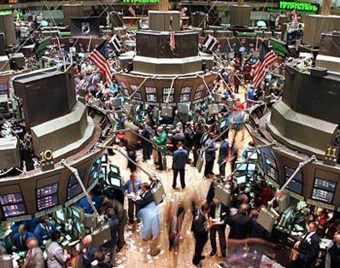
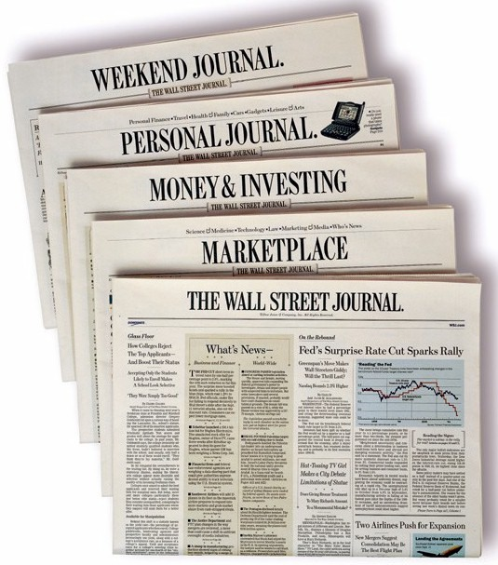
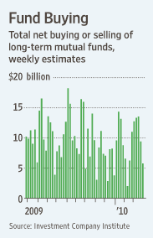

Current Event Discussions
Discussion of important news events that drive the market to build a better understanding of the economy
Learn underlying trends in the market and the significance of these developments
Tackle difficult technical interview questions using knowledge from topics discussed in meetings
Gain exposure to the stock market, bond market, emerging markets, and more in an environment geared to learning

Slide 7


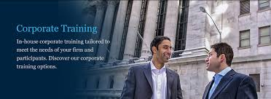
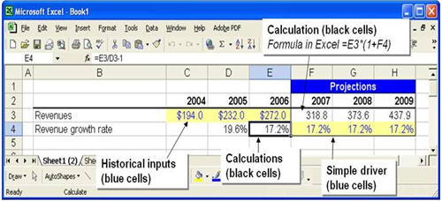
Financial Modeling – Pillars of Wall Street
Understand how to build a fully integrated model using the latest and greatest Excel shortcuts
Tackle the most up-to-date qualitative and technical interview questions
Increase your Microsoft Excel efficiency
Master the key financial valuation methodologies, including a detailed breakdown of the DCF model
  Day 1: Intro to Financial Statements
    Basic keyboard shortcuts, key modeling formulas, financial statement construction, and more
  Day 2: Financial Statements Analysis
    Analysis of Financial Statements
Source: AMT

Slide 8
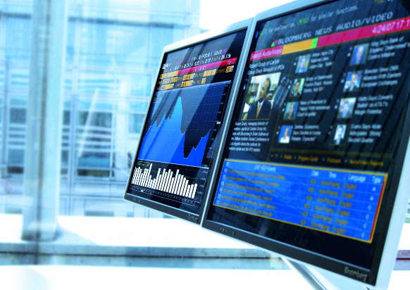
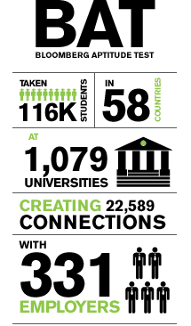
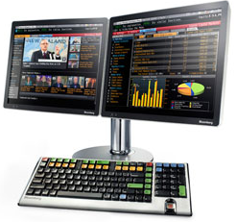
Bloomberg Aptitude Test
September 22, 2014
Bloomberg L.P. is a financial data analytics and media company with HQ in New York City that provides financial software tools, data services and news through the Bloomberg Professional Service (The Terminal) to companies within the finance sector around the world
The BAT aids employers in identifying and screening students who wish to pursue a career in business and finance. Test takers should have a general understanding of and familiarity with current events in business, finance, and economics. However, we are not assessing knowledge: we are assessing a person’s aptitude to be successful in these fields, regardless of background.
The Bloomberg Institute Talent Search is the tool that employers are using to find talented candidates for entry level full time and internship roles in finance. To date 1 in 5 Test Takers has been contacted.
Source: Bloomberg

Slide 9

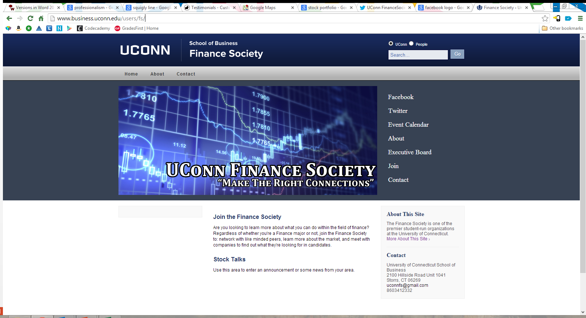

Connect with us!
Email: uconnfs@gmail.com
Twitter: @UconnFS
Facebook: https://www.facebook.com/groups/271407666212146/
Website: http://www.business.uconn.edu/users/fs/

Slide 10
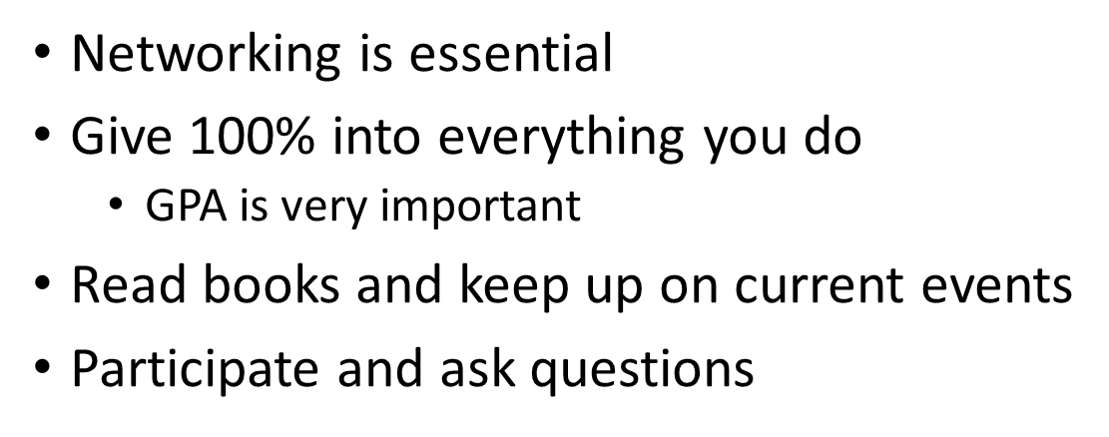
Advice

Slide 11

What is Finance?
The way in which money is used and handled
The system that includes the circulation of money, the granting of credit, the making of investments, and the provision of banking facilities

Slide 12











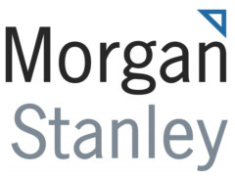

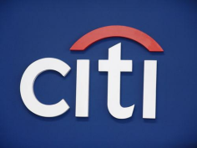



Understanding Finance and the Capital Markets
Investors
Investment Banks
Companies/Governments

Slide 13
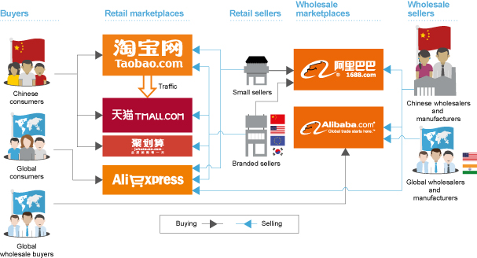
What is Alibaba (阿里巴巴)?
Notes:
http://www.nytimes.com/video/business/international/100000002865514/what-is-alibaba.html

Slide 14

What is Taobao (淘宝)?
Notes:
http://projects.wsj.com/alibaba/#chapter1

Slide 15
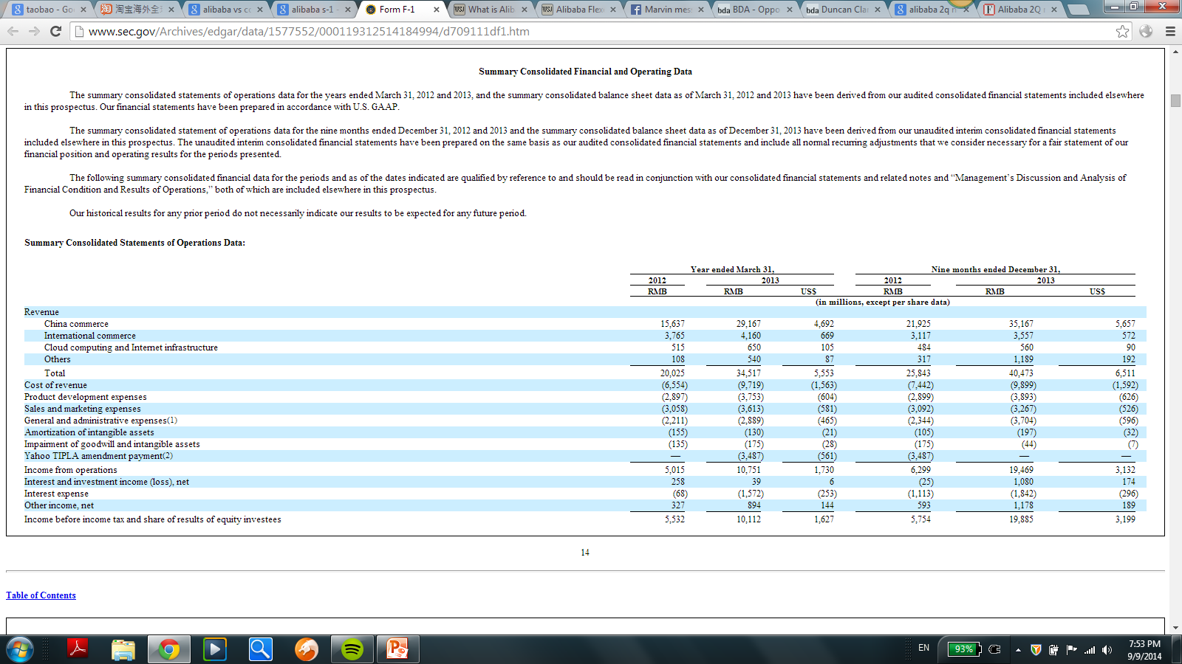
Financial Overview

Slide 16
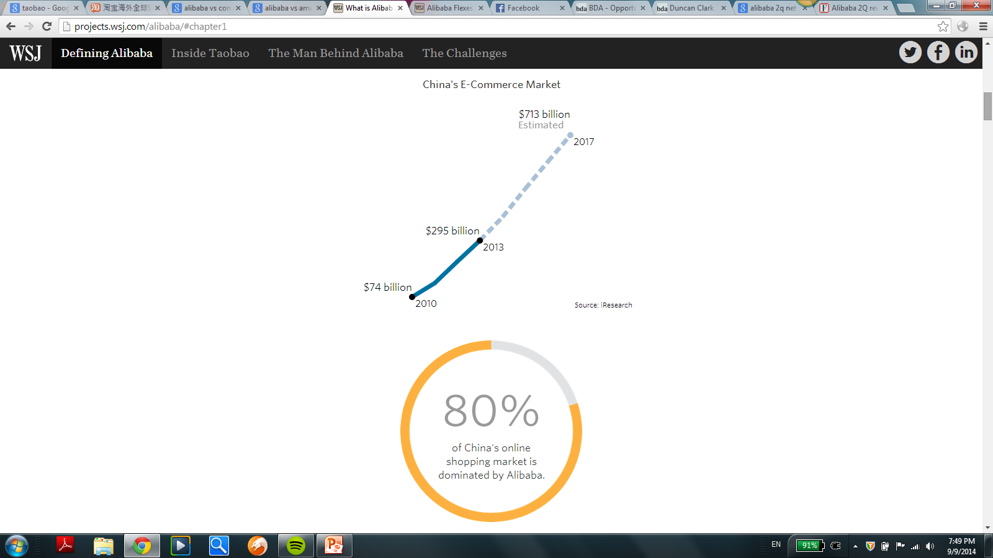
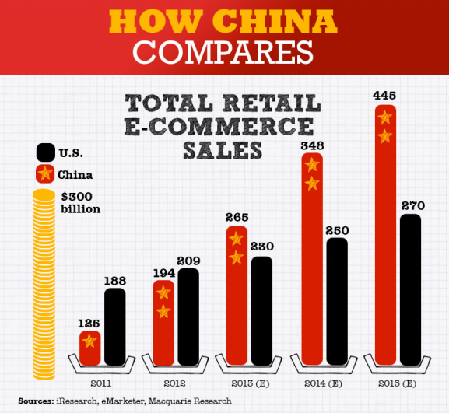
Chinese E-Commerce Market

Slide 17
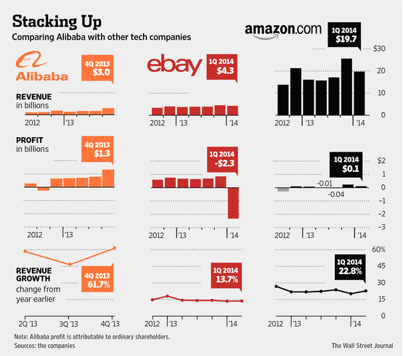
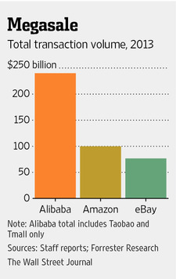
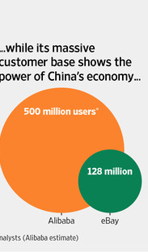
Versus US Counterparts
Notes:
-eBay’s $2.3 billion dollar loss was because of a one-time charge, a tax-charge to repatriate foreign cash (reported effective tax rate of 366% because of the tax repatriation)

Slide 18

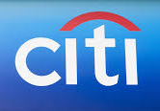


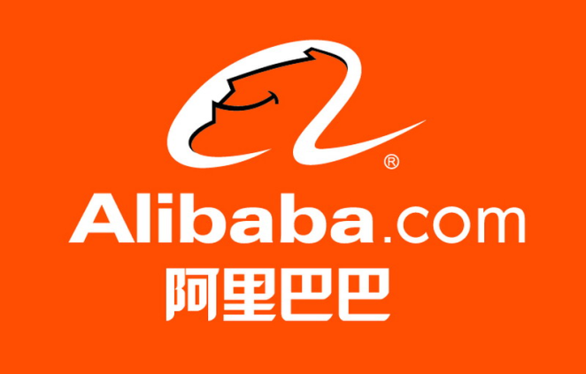



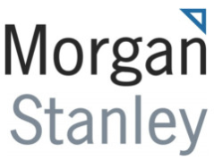
Alibaba IPO: Overview
Investors
Investment Banks
Company
Notes:
http://v.youku.com/v_show/id_XNzc3MzU5ODI0.html

Slide 19
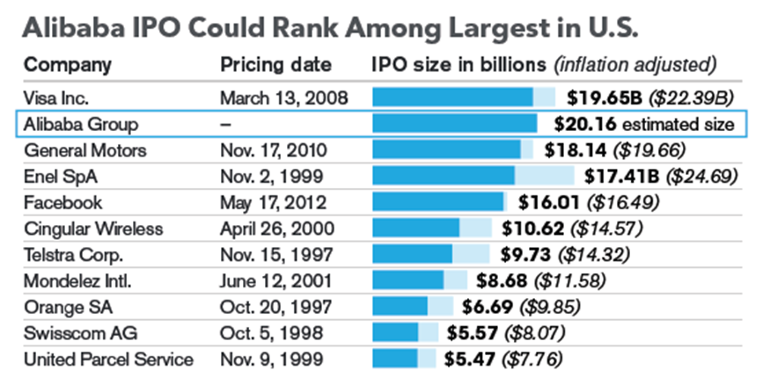
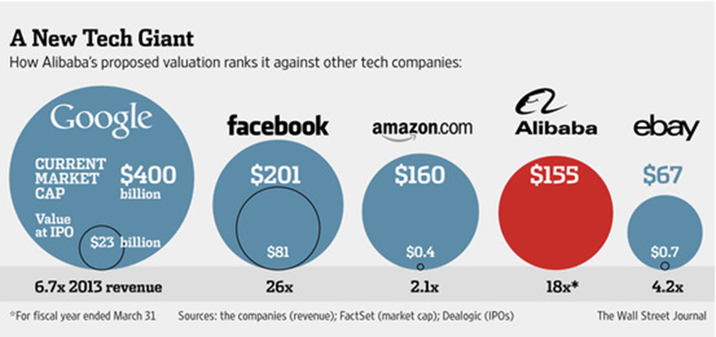
Alibaba: IPO Overview
According to F-1:
  Raise up to $24 billion
  Would value firm at $163 billion
  Will sell 320.1 million American depositary shares between $60 and $66 per share
Notes:
SEC Form F-1 is required to register securities issued by foreign issuers for which no other specialized form exists or is authorized

Slide 20
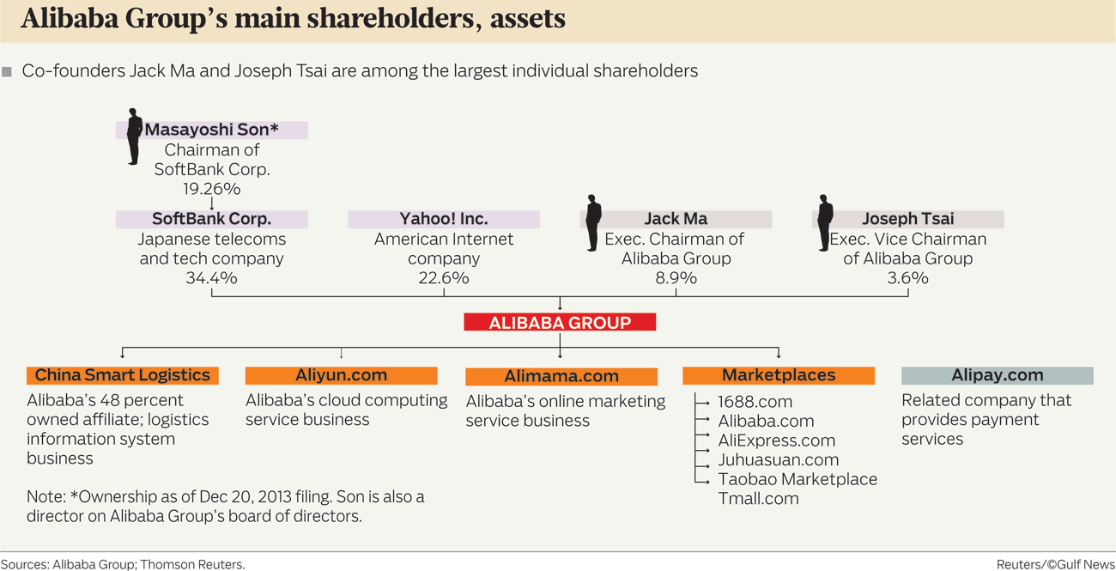
Alibaba IPO: Ownership Structure

Slide 21
Thoughts/Opinions for the future? Buy or avoid?

Slide 22
Questions?

