Slide 1
Finance Society Valuation Fundamentals

Slide 2
Different Methodologies
Trading Comparables
Transaction Comparables
Discounted Cash Flow (DCF)
Leveraged Buyout Analysis (LBO)

Slide 3
Trading Comparables
Relative valuation that uses trading multiples of comparables companies to value
Enterprise Value/Sales [EV/Sales]
Enterprise Value / EBIDTA [EV/EBIDTA]
Price/Earnings [P/E]
Minority Stake
Notes:
True Comparables are Rare
Based on Few Easy to Calculate Inputs
Assumes Market Values are Fair

Slide 4
Transaction Comparables
Relative valuation based on multiples of selected M&A transactions
Majority Stake
What is the difference between this and trading comps?
Control Premium
Notes:
Control Premium
Timing could not reflect market conditions
True comparables are Rare

Slide 5
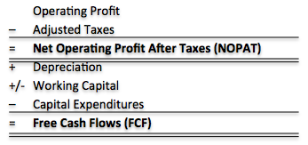
Discounted Cash Flow
Intrinsic Valuation
Discounted projected free cash flows and terminal value
WACC is the discount Rate (10%?)
Terminal Value= Final FCF * (1+g)/ (WACC-g)
Notes:
Highly Sensitive to Key Assumptions: Growth Rates, margins, WACC
Challenging to estimate especially after 5 years

Slide 6
Leveraged Buyout
Acquisition of a Company from a Financial Sponsor (Private Equity Firm)
Little Equity and Leverage to fund remainder of purchase price (90% debt to 10% equity)
Assets of the company being acquired are used as collateral for the high-yield loans
IRR to find maximum price to pay
Short term exit (5 years)
Notes:
Sensitive to projections and aggressiveness of operating assumptions
Majority Stake
Not A Passive Investor

Slide 7
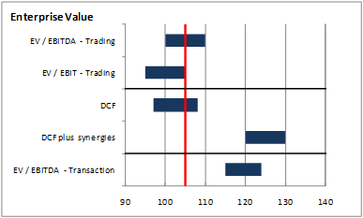
Football Field Chart

Slide 8
Understand The Business
Read the 10-K
Know the Business Model
What are The Risks?
How will this Company Grow?
Model It
Don’t Depend on this
Garbage In, Garbage Out

