Slide 1

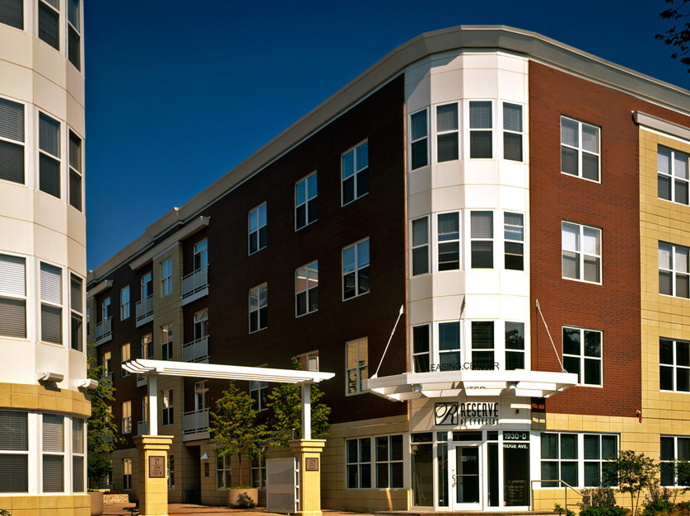
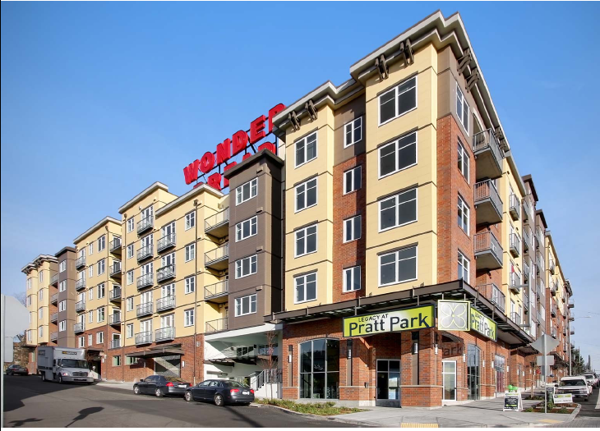
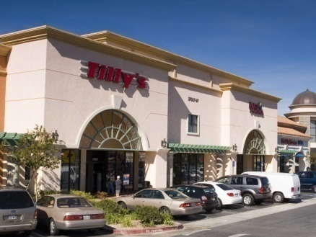
Hartford, Stamford Office Markets
Presented by:
Dags Chen, Cornerstone Research
May 9, 2013

Slide 2
National Office Vacancy
Historical Vacancy Rate by Quarter (%)
Since 2005
Low (2007) 12.4%
High (2010) 16.9%
Current 15.3%
Sources: CBRE Econometric Advisors (Q1 2013)
Notes:
1

Slide 3
Office Market Vacancy Across Connecticut
Historical Vacancy Rates by Quarter (%)
2013 Q1 Vacancy
Hartford 18.2%
Stamford 21.2%
U.S. 15.3%
Sources: CBRE Econometric Advisors (Q1 2013)
Notes:
2

Slide 4
Office Market Vacancy Across Connecticut
Historical Vacancy Rates by Quarter (%)
2013 Q1 Vacancy
Bridgeport 10.7%
Norwalk 13.1%
U.S. 15.3%
Sources: CBRE Econometric Advisors (Q1 2013)
Notes:
3

Slide 5
Hartford Office Fundamentals
Completions and Net Absorption as % of Total Inventory; Office Vacancy Rate
(Left Axis)
Sources: CBRE Econometric Advisors (Q1 2013)
Notes:
4

Slide 6
Stamford (Fairfield County) Office Fundamentals
Completions and Net Absorption as % of Total Inventory; Office Vacancy Rate
(Left Axis)
Sources: CBRE Econometric Advisors (Q1 2013)
Notes:
5

Slide 7
Commercial Property Price Recovery
Aggregate indices mask divergent pricing dynamics
Top chart shows monthly data through December 2012. Bottom chart shows quarterly data through 4Q12.
Sources: Moody’s Investor Services, Real Capital Analytics (RCA), Cornerstone Research (2-17-13).
Notes:
6

Slide 8
Hartford Office Transactions History
Transactions Timeline: Hartford Office Market
8 Farm Springs Road
200 Hopmeadow Street
State House Square
500 Enterprise Drive
City Place
900 Cottage Grove Road
HSB Building
2007
2008
2009
2010
2011
2012
2013
Sources: Real Capital Analytics (April 2013)
Notes:
7
Updated as of 7/9/2012

Slide 9
Stamford Office Transactions History
Transactions Timeline: Fairfield County Office Market
50 Mason Street
100 West Putnam
1 Stamford Plaza
145 Mason Street
800 Connecticut Ave
15 River Road
39 Old Ridgebury Road
2007
2008
2009
2010
2011
2012
2013
Sources: Real Capital Analytics (April 2013)
Notes:
8
Updated as of 7/9/2012

