Slide 1
Land Use Law Update
20th Annual Commercial Real Estate Conference
Dwight Merriam
Robinson & Cole LLP

Slide 2
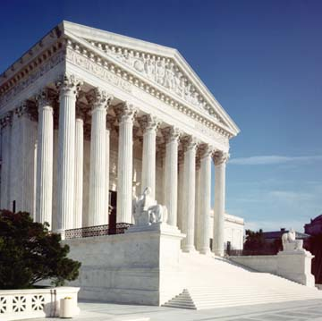
Stop the Beach Renourishment The big case in the U.S. Supreme Court

Slide 3
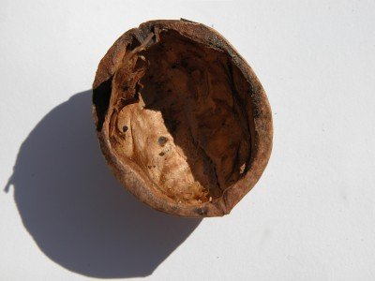
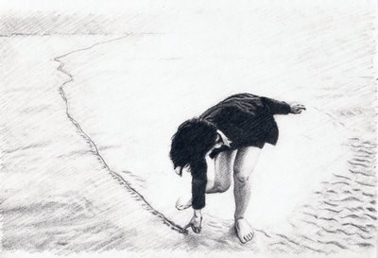
In a nutshell
Can the government set a fixed line forever separating public lands from private lands?

Slide 4
A takings case.
You know the typical regulatory takings case…

Slide 5
This is a different animal.
It’s a judicial taking…

Slide 6
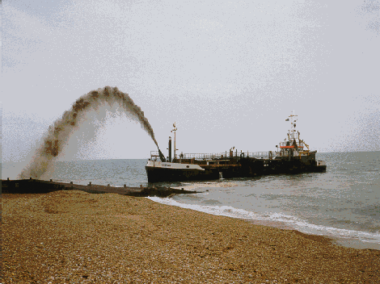

Slide 7
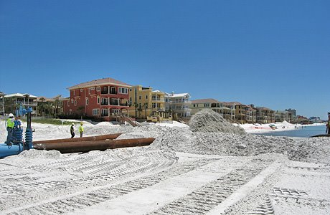

Slide 8
Miami

Slide 9
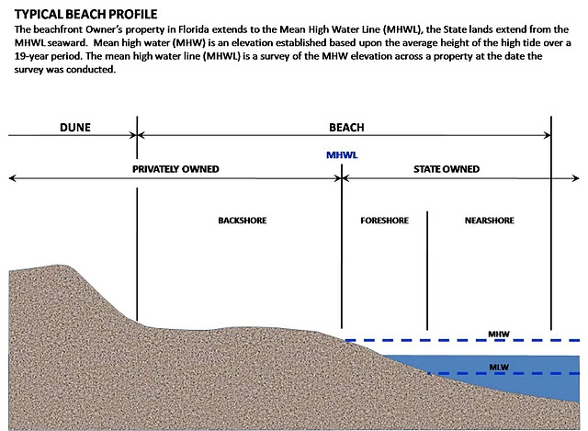

Slide 10
Here’s what I said last year, even before the oral argument…

Slide 11
A guess at the outcome.
Justice Sotomayor goes with the government.
Florida upheld.
Statute can establish a background principle.
No taking or a taking that is not compensable.

Slide 12
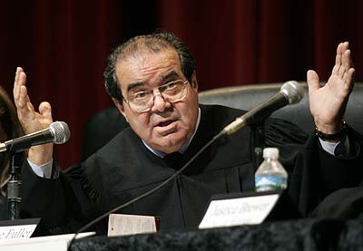
The decision
No taking
There is no taking unless petitioner can show that, before the Florida Supreme Court’s decision, littoral-property owners had rights to future accretions and contact with the water superior to the State’s right to fill in its submerged land. Though some may think the question close, in our view the showing cannot be made.

Slide 13
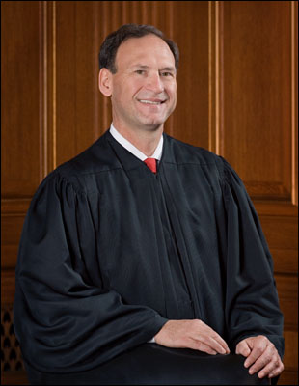
The 4-4 split
Judicial takings
Scalia, Roberts, Thomas and Alito

Slide 14
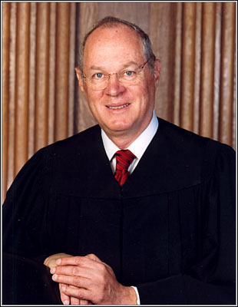
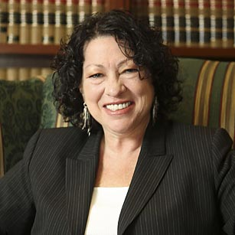
Kennedy-Sotomayor

Slide 15
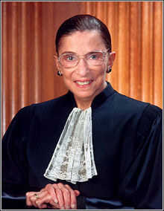
Breyer-Ginsburg

Slide 16
Says Scalia:
One cannot know whether a takings claim is invalid without knowing what standard it has failed to meet. Which means that JUSTICE BREYER must either (a) grapple with the artificial question of what would constitute a judicial taking if there were such a thing as a judicial taking (reminiscent of the perplexing question how much wood would a woodchuck chuck if a woodchuck could chuck wood?), or (b) answer in the negative what he considers to be the “unnecessary” constitutional question whether there is such a thing as a judicial taking.

Slide 18
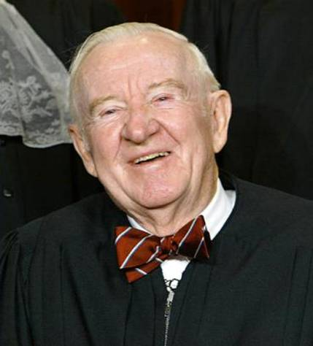
Stevens?

Slide 19
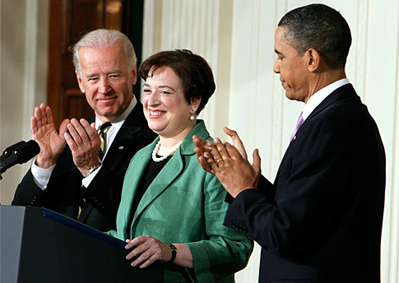
Kagan?

Slide 20
2009 Zoning and Planning Law Report Awards

Slide 21
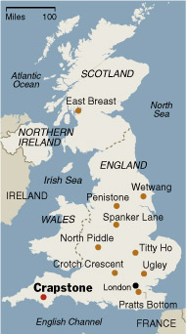
Don't-Laugh-We-Live-There Award

Slide 22
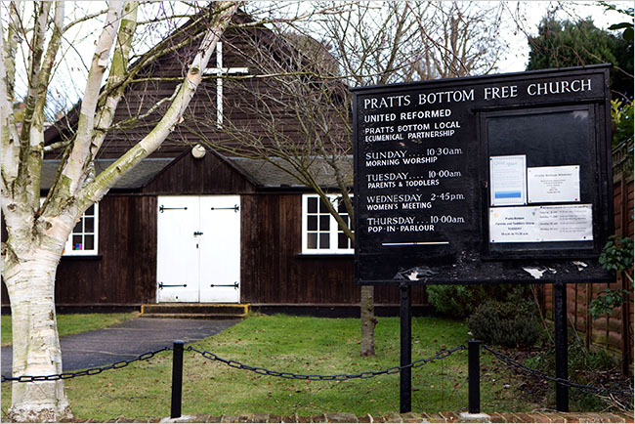

Slide 23
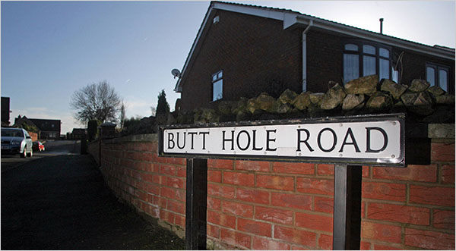

Slide 24
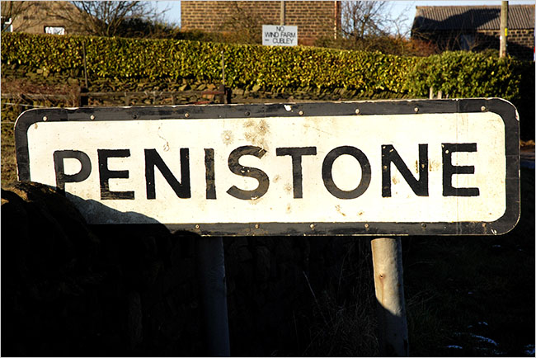

Slide 25
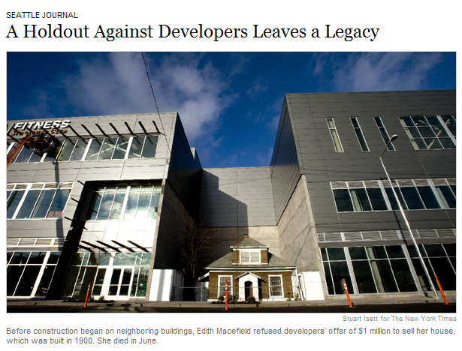
Holdouts

Slide 26
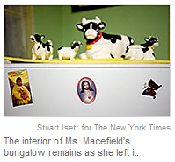

Slide 27
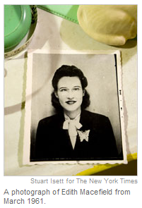

Slide 28
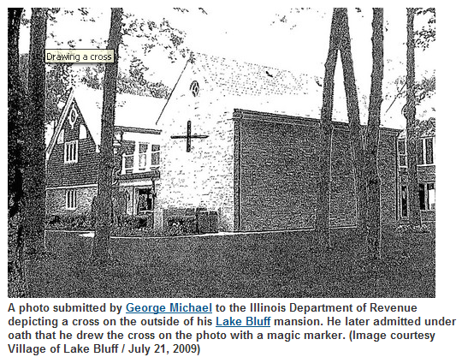
Tax dodge

Slide 29
The Connecticut Cases

Slide 30
Red 11 v. Fairfield

Slide 31
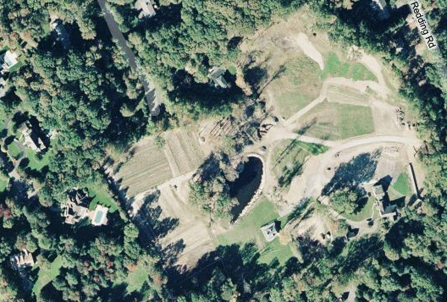

Slide 32
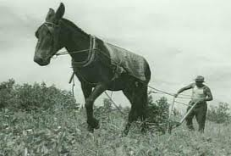
Lesson Learned
Be careful in using the agricultural exemption from wetlands regulation.

Slide 33
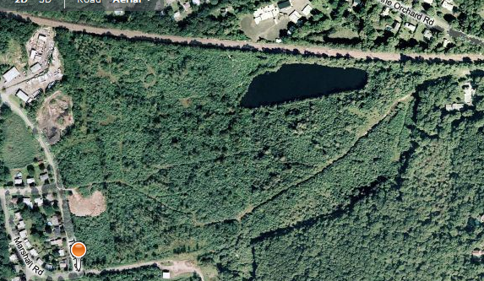
New England Estates v. Branford

Slide 34
Lesson Learned
Use documentation to insure creation of constitutionally-protected property rights.

Slide 35
Hespeler v. Ledyard

Slide 36
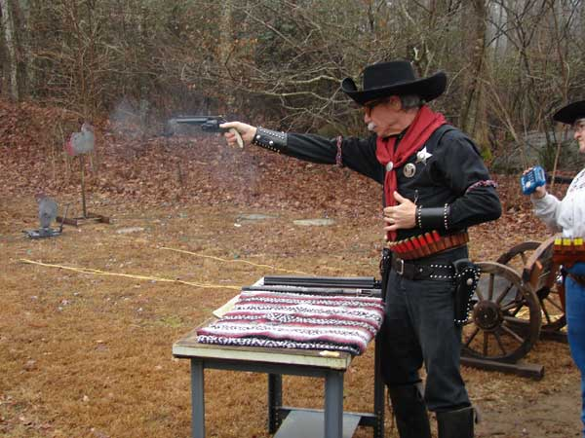

Slide 37
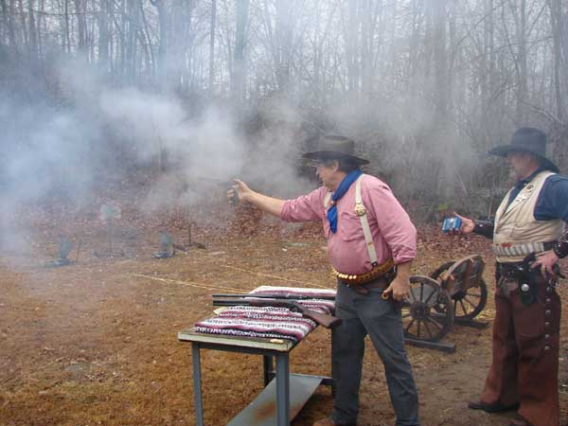

Slide 38
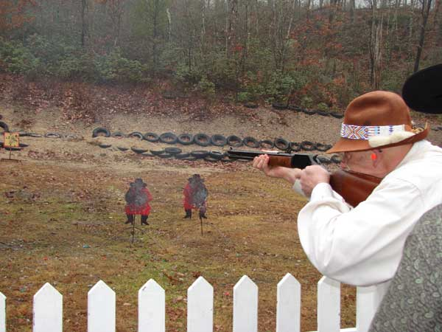

Slide 39
Lesson Learned
No “state-created danger” and no liability for the town – so think “due diligence” and “public and private nuisance”

Slide 40
Buttermilk Farms v. Plymouth

Slide 41
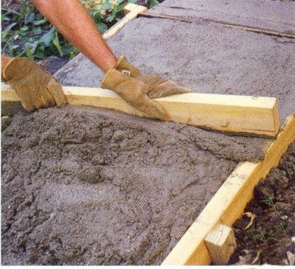
Lesson Learned
Off-site improvements for subdivisions cannot be required….but town can build them and charge you.

Slide 42
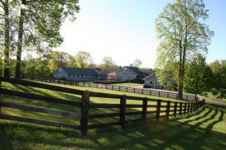
Abel v. PZC New Canaan

Slide 43
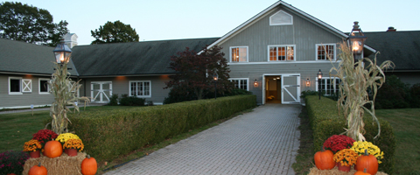

Slide 44
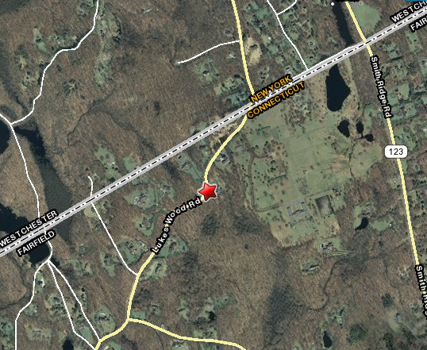

Slide 45
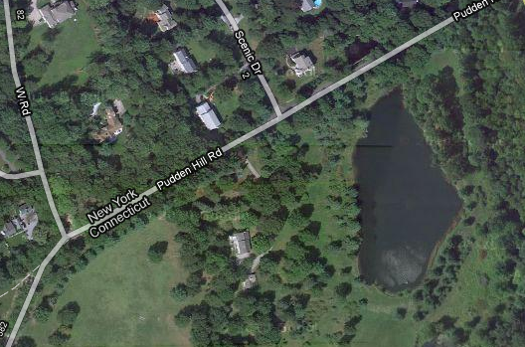

Slide 46
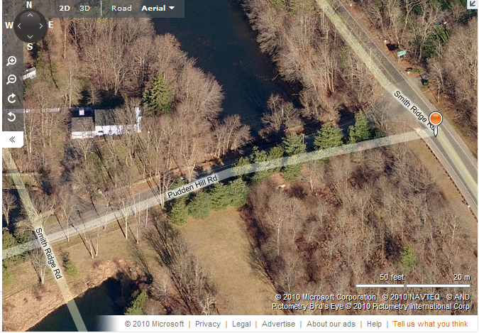

Slide 47
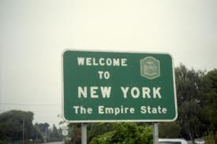
Lesson Learned
An out-of-state owner may be an abutter and can appeal.

Slide 48
fini

