Slide 1
University of Connecticut MBA SMF Presentation March 6, 2014
George Cerwinski, Lead Manager
Pornpong Lueang-A-Papong, Portfolio Manager
Robert Shedrawy, Treasurer/Secretary
Xin Wang, Technology Manager
Jonathan Coombes
Murali Kuchipudi
Yan Zhu

Slide 2
Agenda
Executive Summary
Investment Process: Philosophy & Strategy
Our Portfolio Performance
Interesting Stocks
Conclusion
Looking ahead

Slide 3
Executive Summary
Management period: Sep. 13. 2013 — Feb. 28 . 2014
S&P 500 Benchmark
Shift in focus from top down in first semester to bottom up in second semester
Market Themes:
Domestic economy: Three years of uninterrupted economic growth & falling unemployment
Political circumstances: Government shutdown, Affordable Care Act, crisis in Ukraine
Total Return of $158,322
9.93% (Our Portfolio) VS. 11.19% (SP 500)

Slide 4
Investment Process

Slide 5
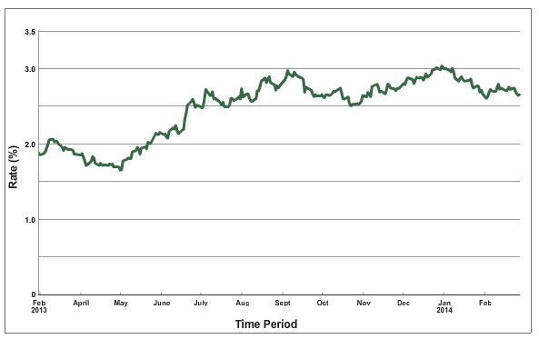
Investment Process
10 yr. Treasury Rates 2013-2014
3 – 5 years Investment Time Horizon
10 Sectors Diversified
100% Equity
Philosophy and Strategy
Fall: Hybrid Selection
Spring: Bottom-Up Selection
Source: U.S. Department of The Treasury

Slide 6
Strong & sustainable business model
Well-balanced/diversified business units
Strong and predictable earnings
- ROA and ROE
- P/E and PEG ratios
- Operating margins
- Leverage ratios
Outstanding amongst peers
Intrinsic value > market value
- Human Rights
- Business Ethics Policy
- ESG Disclosure
- Equal Opportunity
- Emission Reduction
- Environmental Disclosure Score
Corporate social responsibility

Slide 7
Investment Process
26 Stocks
Sector | No.
Technology | 4
Financials | 4
Health Care | 5
Energy | 3
Consumer Discretionary | 2
Consumer Staples | 3
Industrial | 2
Material | 1
Utilities | 1
Telecom | 1

Slide 8
Portfolio Performance

Slide 9
Period Performance Review
$158,322 gain
9.93% return
126 bps behind S&P

Slide 10
Weekly Return Analysis
Period Analysis | Winning | Losing | Coherent | Incoherent
Number | 11 | 13 | 20 | 4
Percentage | 45.83% | 54.17% | 83.33% | 16.67%
Avg. Difference | 0.20% | -0.26% | -0.07% | 0.03%

Slide 11
Risk Adjusted Ratios
Less risky portfolio than benchmark
Sharpe ratio and Treynor ratio slightly below benchmark
 | MBA SMF | S&P 500
Total Return | 9.93% | 11.19%
Mean Weekly Return | 0.40% | 0.45%
Geometric Weekly Return | 0.40% | 0.44%
Standard Deviation | 1.11% | 1.22%
Sharpe Ratio | 0.36 | 0.37
Beta | 0.92 | 1.00
Treynor Ratio | 0.00436 | 0.00450
Jenson’s Alpha | -0.0168%
Source: Bloomberg, Team calculation

Slide 12
Benchmark & Portfolio Asset Allocation
As of Feb 28th, 2014

Slide 13
Portfolio Attribution Analysis
Source: Bloomberg

Slide 14
Top and Bottom 5 as of 2/28
Top 5 Holdings | % Weight
DICK'S SPORTING GOODS | 5.05
PRICELINE.COM INC | 5.05
COVIDIEN PLC | 4.91
BLACKROCK INC | 4.88
KLA-TENCOR CORPORATION | 4.84
Bottom 5 Holdings | % Weight
CASH | 0.11
ALCOA INC | 1.29
VERIZON COMMUNICATIONS | 2.22
UNITED PARCEL SERVICE | 2.27
PEPSICO INC | 3.11
% Holding
Top 5 gain | % gain
Alcoa Inc. | 29.65
UnitedHealth Group Inc. | 13.58
Halliburton Company | 12.08
Altera Corporation | 11.64
CVS Caremark Corporation | 11.48
Top 5 loss | % gain
Ford Motor Company | -15.03
Verizon Communications Inc. | -5.52
United Parcel Service, Inc. | -4.84
General Electric Company | -4.16
PepsiCo, Inc. | -3.96
% Gain / loss

Slide 15
Most Interesting Holdings

Slide 16
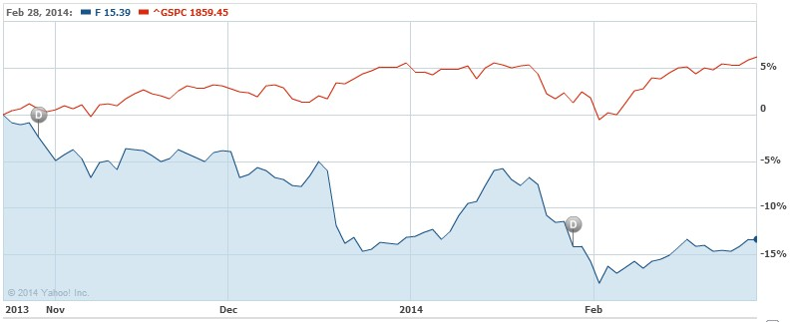
Ford Motor Co. (F)
Investment Thesis
Only U.S automaker to weather financial crisis intact
One Ford Plan: fix balance sheet, improve vehicle portfolio
Highest ROE 28.5% in the industry
Strong sales and profits support our high intrinsic value
Possible Factors Affecting Price Decline
Speculation and concern over CEO’s possible departure
Disappointing January Sales (Weather Related)
Stop Loss executed at $15.30 due to risk management and stronger security alternatives
Source: Yahoo Finance
Sector: Consumer Disc Industry: Auto Makers Market Cap: $60.91B | Price @2/28/2014: $15.39 Purchase Price: $18.00 52 Week Range: $12.11 - $18.02 | Intrinsic Value: $26.89 Market Cap at Intrinsic Value: $102.6B Realized Loss: (15.03%)

Slide 17
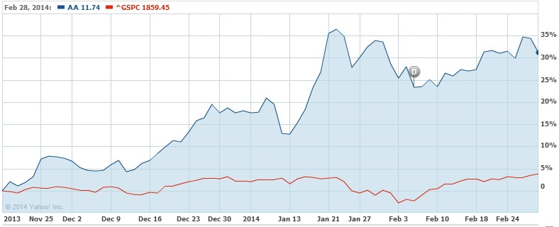
Alcoa (AA)
Investment Thesis
Poised to be lowest cost fully integrated Aluminum Producer
Strengths in downstream business insulates business from volatile Aluminum prices
Improving economic climate indexes in Asia, EU, and NA bode well for metals demand
Factors Affecting Price Growth
Upgrade from JP Morgan, among others, to overweight/over-perform citing predicted upswing in Aluminum prices
Cost cutting initiatives and closing of burdensome smelting facilities
Worldwide economic improvement is leading to increasing demand for Aluminum
Domestically Auto and Airline manufacturers
Source: Yahoo Finance
Sector: Materials Industry: Mining/Aluminum Market Cap: $12.61B | Price @2/28/2014: $11.74 Purchase Price: $9.05 52 Week Range: $7.63 - $12.32 | Intrinsic Value: $16.27 Market Cap at Intrinsic Value: $17.43B Unrealized Gain: 29.65%

Slide 18
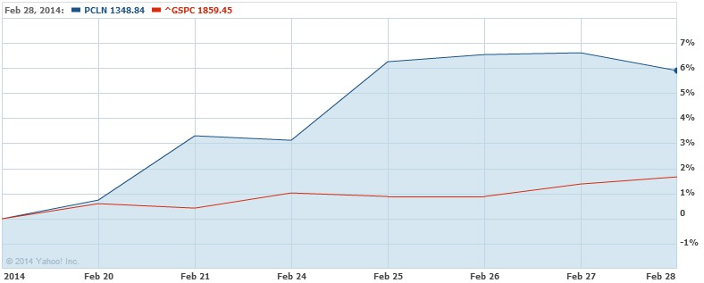
Priceline (PCLN)
Investment Thesis
Seizing international market share by successful acquisitions
Booking.com’s success in Europe and fast growth in other newer markets; Agoda.com strengthens its position in the Asia-Pacific market
Offline marketing campaigns in Booking.com in U.S., Canada, Australia, U.K. and other markets as well as other brands
Investments in Mobile Execution and Innovation areas, such as “Name Your Own Price” and “Express Deal”
Factors Affecting Price Growth
Q4 and full year 2013 Earning Announcement on Feb 20, 2014
Source: Yahoo Finance
 | 2012 | 2013
Booking.com's Mobile Bookings | $ 3 billion | $ 8 billion | 160%
Net Income | $ 1.42 billion | $ 1.89 billion | 33%
EPS | $28.48 | $37.13 | 30%
Sector: Consumer Discretionary Industry: Internet Retail Market Cap: $65.83B | Price @2/28/2014: $1,348.84 Purchase Price: $1,286.94 52 Week Range:$677.72-$1375.41 | Intrinsic Value: $1,659.05 Market Cap at Intrinsic Value: $82.95B Unrealized Gain: 4.80%

Slide 19
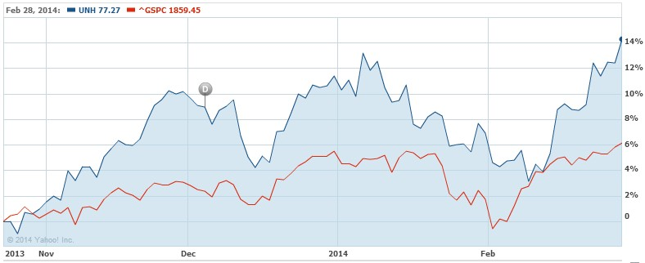
United Health Group (UNH)
Investment Thesis
The largest player in Managed Care industry with its high speed growth
Company's growth in EPS (normalized earnings) from $2.77 in 2008 to an estimated $4.93 for 2013
The growth opportunities due to Affordable Care Act
From 2012, the company made several acquisitions and expand to international markets
Factors Affecting Price
Reasonable earnings that didn't please Wall Street on Oct 17, 2013 (losses of 5%)
Afford Care Act brings potential of increased enrollment, expansion and broader coverage to UnitedHealth Group
Source: Yahoo Finance
Sector: Health Care Industry: Managed Care Market Cap: $76.43B | Price @2/28/2014: $77.27 Purchase Price: $68.03 52 Week Range: $75.80-77.71 | Intrinsic Value: $114.42 Market Cap at Intrinsic Value: $117.5B Unrealized Gain: 13.58 %

Slide 20
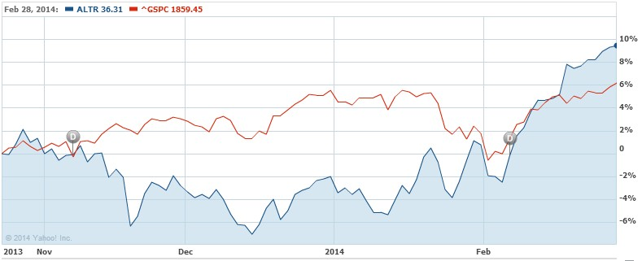
Altera (ALTR)
Investment Thesis
China’s build out of LTE broadband wireless
Exclusive partnership with Intel
Taking market share from ASICs
Strong leadership in Structured ASIC market
Factors Affecting Price
Fourth quarter earnings and sales beat estimates
Share buy back
Positive news from sell side analysts
Source: Yahoo Finance
Sector: Technology Industry: Semiconductors Market Cap: $11.53B | Price @2/28/2014: $36.31 Purchase Price: $32.52 52 Week Range: $30.62 - $39.18 | Intrinsic Value: $51.11 Market Cap at Intrinsic Value: $16.23B Unrealized Gain: 11.64%

Slide 21
Conclusion

Slide 22
What We Learned
Valuation techniques
Advantages of a bottom-up approach
Liquidation and cash management plan
Training tools

Slide 23
Looking Ahead
Continue training (Bloomberg tour in April)
Continue to monitor the performance and risks of portfolio
Potential Meeting with First-Year MBA Candidates

Slide 24
Q & A

Slide 25
Appendix

Slide 26
 |  |  | Port
 |  |  | # | % Wgt | Mkt Val | Pos | Px Close | Crncy
MBA SMF 2014 |  |  | 27 | 100.00 | 1,727,719
 | Cash |  | 1 | 0.11 | 1,912
 |  | USD |  | 0.11 | 1,912 | 1,912.16 | 1.00 | USD
 | Consumer Discretionary |  | 2 | 10.22 | 176,618
 |  | DICK'S SPORTING GOODS INC |  | 5.11 | 88,362 | 1,633.00 | 54.11 | USD
 |  | PRICELINE.COM INC |  | 5.11 | 88,256 | 65.00 | 1,357.79 | USD
 | Consumer Staples |  | 3 | 10.97 | 189,555
 |  | CVS CAREMARK CORP |  | 3.63 | 62779 | 870 | 72.16 | USD
 |  | ESTEE LAUDER COMPANIES-CL A |  | 4.23 | 73008 | 1080 | 67.6 | USD
 |  | PEPSICO INC |  | 3.11 | 53768 | 680 | 79.07 | USD
 | Energy |  | 3 | 11.85 | 204767
 |  | HALLIBURTON CO |  | 3.6 | 62150 | 1116 | 55.69 | USD
 |  | SCHLUMBERGER LTD |  | 3.87 | 66928 | 723 | 92.57 | USD
 |  | TESORO CORP |  | 4.38 | 75689 | 1492 | 50.73 | USD
 | Financials |  | 4 | 16.91 | 292188
 |  | BLACKROCK INC |  | 4.92 | 85015 | 278 | 305.81 | USD
 |  | JPMORGAN CHASE & CO |  | 3.25 | 56123 | 990 | 56.69 | USD
 |  | MSCI INC |  | 4.34 | 75067 | 1717 | 43.72 | USD
 |  | WELLS FARGO & CO |  | 4.4 | 75983 | 1650 | 46.05 | USD
 | Health Care |  | 5 | 20.57 | 355312
 |  | AETNA INC |  | 4.59 | 79343 | 1110 | 71.48 | USD
 |  | AMGEN INC |  | 3.28 | 56617 | 460 | 123.08 | USD
 |  | COVIDIEN PLC |  | 4.89 | 84538 | 1185 | 71.34 | USD
 |  | JOHNSON & JOHNSON |  | 4.15 | 71718 | 785 | 91.36 | USD
 |  | UNITEDHEALTH GROUP INC |  | 3.65 | 63097 | 830 | 76.02 | USD
 | Industrials |  | 2 | 5.44 | 94001
 |  | GENERAL ELECTRIC CO |  | 3.17 | 54825 | 2150 | 25.5 | USD
 |  | UNITED PARCEL SERVICE-CL B |  | 2.27 | 39176 | 410 | 95.55 | USD
 | Information Technology |  | 4 | 17.28 | 298547
 |  | ALTERA CORP |  | 3.67 | 63438 | 1750 | 36.25 | USD
 |  | EBAY INC |  | 4.46 | 77125 | 1322 | 58.34 | USD
 |  | INTL BUSINESS MACHINES CORP |  | 4.29 | 74108 | 400 | 185.27 | USD
 |  | KLA-TENCOR CORPORATION |  | 4.85 | 83876 | 1291 | 64.97 | USD
 | Materials |  | 1 | 1.29 | 22352
 |  | ALCOA INC |  | 1.29 | 22352 | 1858 | 12.03 | USD
 | Telecommunication Services |  | 1 | 2.22 | 38285
 |  | VERIZON COMMUNICATIONS INC |  | 2.22 | 38285 | 806 | 47.5 | USD
 | Utilities |  | 1 | 3.14 | 54182
 |  | AMERICAN ELECTRIC POWER |  | 3.14 | 54182 | 1088 | 49.8 | USD
Portfolio Snapshot as of 2/27/2014

Slide 27
Portfolio Beta
Stock betas range from 0.63 – 1.52

