Slide 1
Writing & Scoring Items that Ask Students to Reason Mathematically
Shelbi K. Cole, Ph.D.
August 19, 2014

Slide 2
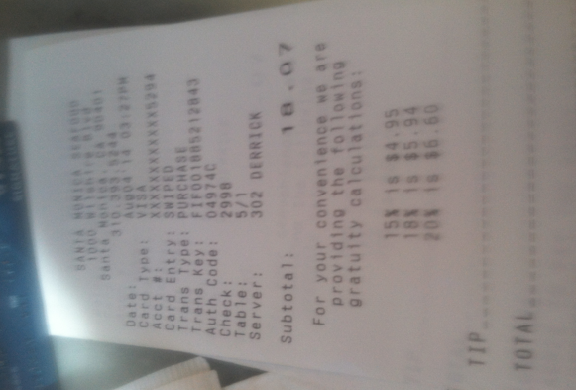
Why teach kids to reason mathematically?
Because trusting the world to do the math for us is a bad idea.

Slide 3
Overview
Summary of Smarter Balanced Mathematics Assessments
Focus on Mathematical Reasoning
Developing & refining scoring rubrics that align to the problem’s purpose
Task development time

Slide 4
The CCSSM Requires Three Shifts in Mathematics
Focus strongly where the standards focus
Coherence: Think across grades and link to major topics within grades
Rigor: In major topics, pursue conceptual understanding, procedural skill and fluency, and application with equal intensity
Notes:
Here are the three shifts – the same shifts we’ve been examining together this week. We’re going to continue to build on these shifts as they have implications for assessment.

Slide 5
Content readiness for college and career

Slide 6
Claims for the Mathematics Summative Assessment
Overall Claim for Grades 3-8
“Students can demonstrate progress toward college and career readiness in mathematics.”
Overall Claim for Grade 11
“Students can demonstrate college and career readiness in mathematics.”
Claim #1 - Concepts & Procedures
“Students can explain and apply mathematical concepts and interpret and carry out mathematical procedures with precision and fluency.”
Claim #2 - Problem Solving
“Students can solve a range of complex well-posed problems in pure and applied mathematics, making productive use of knowledge and problem solving strategies.”
Claim #3 - Communicating Reasoning
“Students can clearly and precisely construct viable arguments to support their own reasoning and to critique the reasoning of others.”
Claim #4 - Modeling and Data Analysis
“Students can analyze complex, real-world scenarios and can construct and use mathematical models to interpret and solve problems.”

Slide 7
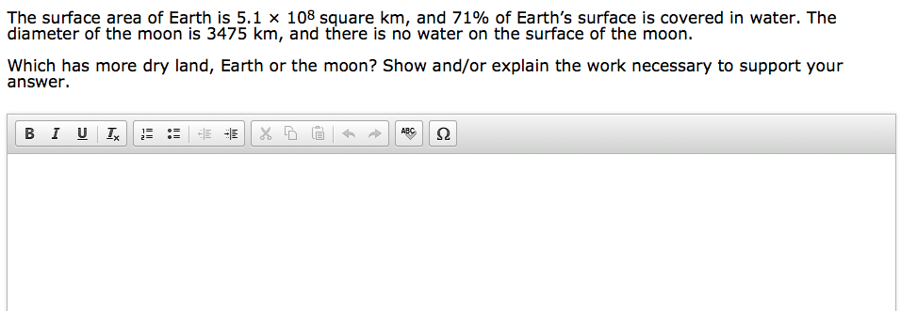

Slide 8
Sample Response
As a starting point, I can calculate a surface area greater than that of the moon by finding the surface area of a cube with edge length equal to the diameter of the moon. Doing this would give 6 x 3475^2, or about 72.5 million square kilometers. Since 71% of Earth’s surface is covered with water, about 29% is dry land. 29% of 5.1 x10^8 is about 148 million square kilometers. Since 148 million is more than double 72.5 million (which is an over estimate), there is clearly more dry land on Earth.

Slide 9
For Discussion
How would including the formula for surface area of a sphere change the mathematical reasoning demand of the item?

Slide 10
Shift #1: Focus Strongly where the Standards Focus
The shape of math in A+ countries
Mathematics topics intended at each grade by at least two-thirds of 21 U.S. states
Mathematics topics intended at each grade by at least two-thirds of A+ countries
¹ Schmidt, Houang, & Cogan, “A Coherent Curriculum: The Case of Mathematics.” (2002).
Notes:
There are no detailed labels here because I want you to see visually that the overall shape of math topics in A+ countries and those typical in the US (pre-Common Core) is different.
Each row is a math topic, like fractions, or congruence.
In 2/3rds of the high-performing countries, the foundations are laid and then further knowledge is built on them. The design principle is focus and coherent progressions.
In the U.S., the design principle is to teach everything every year that can possibly be taught… as well as many things that cannot.

Slide 11
Shift #1: Focus Key Areas of Focus in Mathematics
Grade | Focus Areas in Support of Rich Instruction and Expectations of Fluency and Conceptual Understanding
K–2 | Addition and subtraction - concepts, skills, and problem solving and place value
3–5 | Multiplication and division of whole numbers and fractions – concepts, skills, and problem solving
6 | Ratios and proportional reasoning; early expressions and equations
7 | Ratios and proportional reasoning; arithmetic of rational numbers
8 | Linear algebra and linear functions
Notes:
Focus in the Common Core Standards means two things. What is in versus what is out, but also what the main focus of the standards are for each grade. This chart shows what the major focus areas are for K-8 math. These are the concepts which demand the most time, attention and energy throughout the school year. It is through focus in these key areas in K-8, that students will be best be prepared for further studies of math in HS and consequently, college and career ready.
It is important to note that these are not topics to be checked off a list during an isolated unit of instruction, but rather these priority areas will be present throughout the school year through rich instructional experiences.

Slide 12
Grade 7 Example
In grades 6 and 7, proportional relationships are a crucial pivot from multiplicative reasoning to functional thinking; sets stage for 8.F.
Meanwhile, probability in grade 7 has potentially misleading grain size—uses almost twice as many words as for proportional relationships standards.

Slide 13
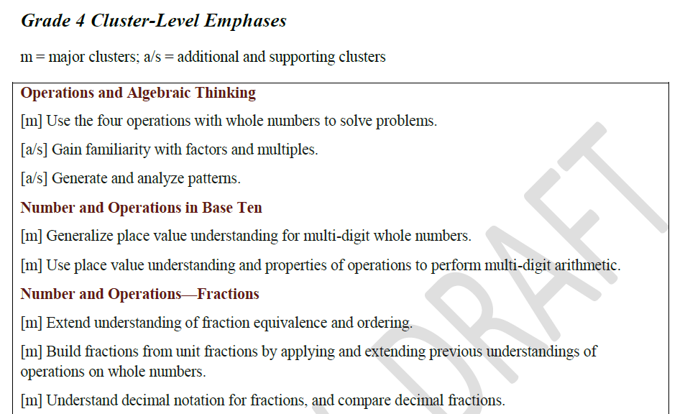
Shift #1: Focus Content Emphases by Cluster
The Smarter Balanced Content Specifications help support focus by identifying the content emphasis by cluster. The notation [m] indicates content that is major and [a/s] indicates content that is additional or supporting.
Notes:
The emphases charts make visible the intended focus and coherence of the subject matter by identifying the major work (focus) and the supporting and additional work (coherence within and across)
Need to discuss how “major” work was chosen and why it is important
For example, here are some connections between supporting and major.
Gain familiarity with factors and multiples: Work in this cluster supports students work with multi-digit arithmetic as well as their work with fraction equivalence.

Slide 14
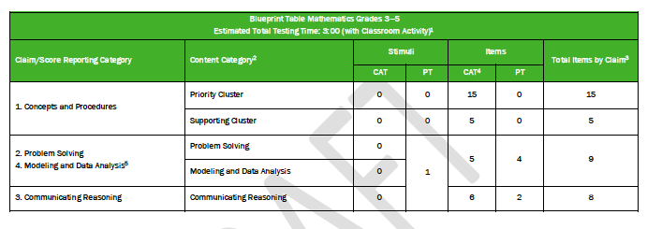
Attending to Focus: Test Blueprint

Slide 15
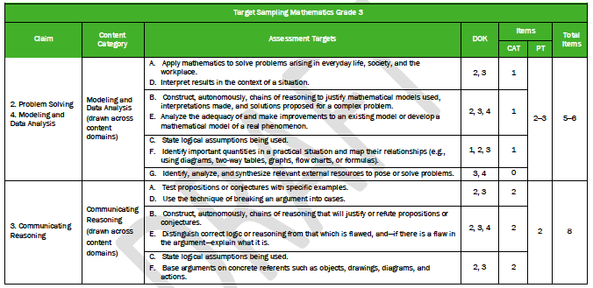
Attending to Focus: Test Blueprint

Slide 16
Attending to Focus: Choosing High Priority Content for Claim 3

Slide 17
Shift #2: Coherence
Think Across Grades, and Link to Major Topics Within
Grades
Carefully connect the learning within and across grades so that students can build new understanding on foundations built in previous years.
Begin to count on solid conceptual understanding of core content and build on it. Each standard is not a new event, but an extension of previous learning.
Notes:
{Read slide}
In the second shift of coherence, we take advantage of focus to actually pay attention to sense-making in math. Coherence speaks to the idea that math does not consist of a list of isolated topics.
The Standards themselves, and therefore any resulting curriculum and instruction, should build on major concepts within a given school year as well as major concepts from previous school years.
Typically, current math curriculum spends as much as 25% of the instructional school year on review and re-teaching of previous grade level expectations – not as an extension – but rather as a re-teaching because many students have very little command of critical concepts.
Just as there are two ways to look at focus, there are two elements of coherence: The coherence across grades and the coherence that links topics to the major work of the grade.

Slide 18
Shift #2: Coherence Think Across Grades
4.NF.4. Apply and extend previous understandings of multiplication to multiply a fraction by a whole number.
Grade 4
5.NF.4. Apply and extend previous understandings of multiplication to multiply a fraction or whole number by a fraction.
5.NF.7. Apply and extend previous understandings of division to divide unit fractions by whole numbers and whole numbers by unit fractions.
Grade 5
6.NS. Apply and extend previous understandings of multiplication and division to divide fractions by fractions. 6.NS.1. Interpret and compute quotients of fractions, and solve word problems involving division of fractions by fractions, e.g., by using visual fraction models and equations to represent the problem.
Grade 6
Notes:
Here you see some of the international data that informed the development of the CCSSM. On the left you see a coherent progression of multiplication and division of fractions over three grade levels.
On the right you see excerpts from the Common Core that address fractions with purpose and direction. The term “apply and extend previous understandings…” is a sure sign of the expectation within a progression of concept development.
Looking at the progression of multiplying and dividing fractions, you will see that over these 3 years the students are building on previous knowledge and not just repeating the same thing each year. You’ll see that in 4th grade students apply and extend previous understandings of multiplication to multiply a fraction by a whole number. In 5th grade that knowledge and skill is extended to multiply a fraction or whole number by a fraction. Also in 5th grade, students extend previous understandings of division to divide unit fractions by whole numbers and the reverse. In 6th grade, students will continue to build on the foundations laid and will divide fractions by fractions. These are clear and carefully laid progressions.

Slide 19
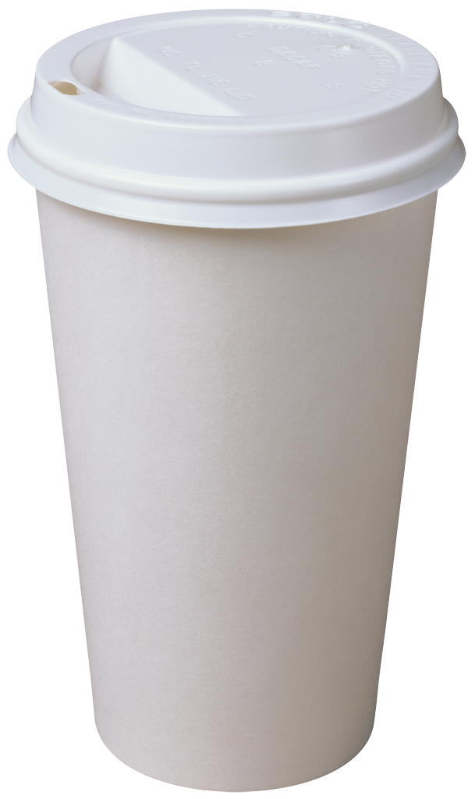
Math Break
Explain how you could use a cup with markings every 2 oz. (as shown) to measure 1 2/3 cup.
16 oz
12
8
4
Which standards is this attending to? At which grade level is explaining this problem a reasonable expectation?

Slide 20
Shift #3: Rigor In Major Topics, Pursue Conceptual Understanding, Procedural Skill and Fluency, and Application
The CCSSM require a balance of:
Solid conceptual understanding
Procedural skill and fluency
Application of skills in problem solving situations
Pursuit of all threes requires equal intensity in time, activities, and resources.
Notes:
{read slide}

Slide 21
Shift #3: Rigor Required Fluencies for Grades K-6
Grade | Standard | Required Fluency
K | K.OA.5 | Add/subtract within 5
1 | 1.OA.6 | Add/subtract within 10
2 | 2.OA.2 2.NBT.5 | Add/subtract within 20 (know single-digit sums from memory) Add/subtract within 100
3 | 3.OA.7 3.NBT.2 | Multiply/divide within 100 (know single-digit products from memory) Add/subtract within 1000
4 | 4.NBT.4 | Add/subtract within 1,000,000
5 | 5.NBT.5 | Multi-digit multiplication
6 | 6.NS.2,3 | Multi-digit division Multi-digit decimal operations
Notes:
This chart shows a breakdown of the required fluencies in grades K-6.
Fluent in the particular Standards cited here means “fast and accurate.” It might also help to think of fluency as meaning the same thing as when we say that somebody is fluent in a foreign language: when you’re fluent, you flow. Fluent isn’t halting, stumbling, or reversing oneself.
The word fluency was used judiciously in the Standards to mark the endpoints of progressions of learning that begin with solid underpinnings and then pass upward through stages of growing maturity.
Some of these fluency expectations are meant to be mental and others with pencil and paper. But for each of them, there should be no hesitation about how to proceed in getting the answer with accuracy.

Slide 22
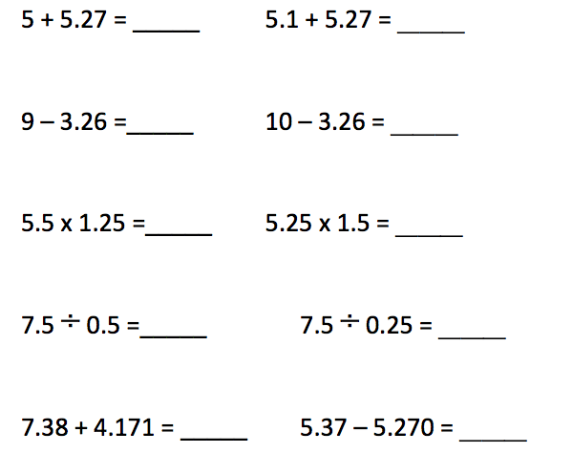

Slide 23
A Balanced Assessment System
Summative assessments
Benchmarked to college and career readiness
Teachers and schools have information and tools they need to improve teaching and learning
Common Core State Standards specify
K-12 expectations for college and career readiness
All students leave high school college and career ready
Teacher resources for
formative assessment practices
to improve instruction
Interim assessments Flexible, open, used for actionable feedback

Slide 24
Using Computer Adaptive Technology for Summative and Interim Assessments
Increased precision
Provides accurate measurements of student growth over time
Tailored for Each Student
Item difficulty based on student responses
Increased Security
Larger item banks mean that not all students receive the same questions
Shorter Test Length
Fewer questions compared to fixed form tests
Faster Results
Turnaround time is significantly reduced
Mature Technology
GMAT, GRE, COMPASS (ACT), Measures of Academic Progress (MAP)

Slide 25
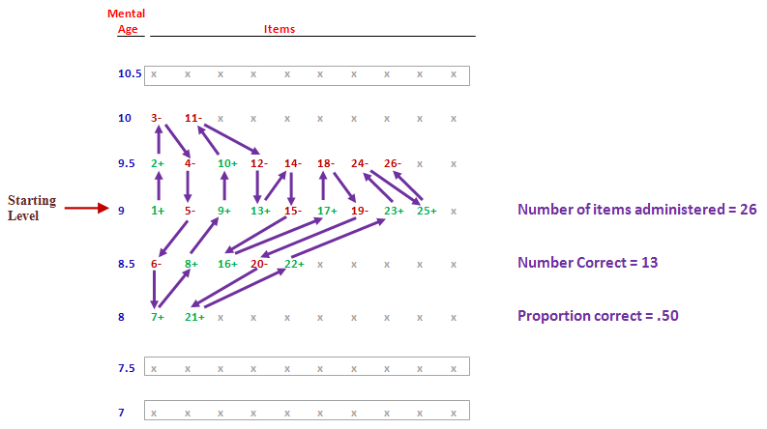
How CAT Works (Binet’s Test)

Slide 26
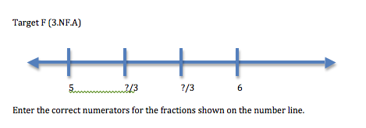
Creating a Range of Difficulty
To which grade level does this item align? Why?
How could you make an item like the one shown below easier? Harder?

Slide 27
Using the vertical coherence of the standards to support the adaptive nature of the test
DRAFT

Slide 28
Viewing Sample Items & Tasks
Preliminary Sample Items
http://sampleitems.smarterbalanced.org/itempreview/sbac/
Full Practice Tests Available
http://sbac.portal.airast.org/practice-test/

Slide 29
Focus on Reasoning

Slide 30
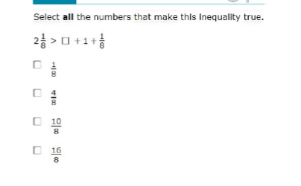
What is reasoning in mathematics?
How could a student use reasoning to do this problem?
How could a student solve this procedurally?
Benefits of either or both approaches?

Slide 31
“Reasoning is the lifeblood of mathematics.”
Hung-Hsi Wu

Slide 32
The Language of Coherence at the Cluster Level
4.NF.B Build fractions from unit fractions by applying and extending previous understandings of operations on whole numbers.
10 > ___ + 7
Entering a smaller number will give a smaller sum

Slide 33
Claim 3: Communicating Reasoning
Students can clearly and precisely construct viable arguments to support their own reasoning and to critique the reasoning of others.

Slide 34
Targets for Claim 3
Target A: Test propositions or conjectures with specific examples. (DOK 2).
Target B: Construct, autonomously, chains of reasoning that will justify or refute propositions or conjectures. (DOK 3, 4).
Target C: State logical assumptions being used. (DOK 2, 3)
Target D: Use the technique of breaking an argument into cases. (DOK 2, 3)
Target E: Distinguish correct logic or reasoning from that which is flawed and—if there is a flaw in the argument—explain what it is. (DOK 2, 3, 4)
Target F: Base arguments on concrete referents such as objects, drawings, diagrams, and actions. (DOK 2, 3)
Target G: At later grades, determine conditions under which an argument does and does not apply. (DOK 3, 4)

Slide 35
Basic Structure of All Tasks (Cont.):
Response Types:
Multiple-Choice with single correct response (MC)
Multiple Choice, multiple correct response (MS)*
Matching Tables T/F and Y/N variations (MI)*
Hot Text (HT)
Equation/Numeric (EQ)
Drag and Drop, Hot Spot
Graphing (GI)
Text (Performance tasks only)
* No more than six choices in MS and MI items.

Slide 36
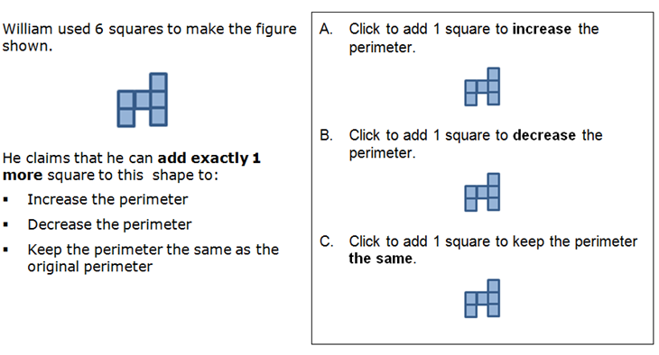
Grade 3 Example

Slide 37
Grade 4 Example

Slide 38
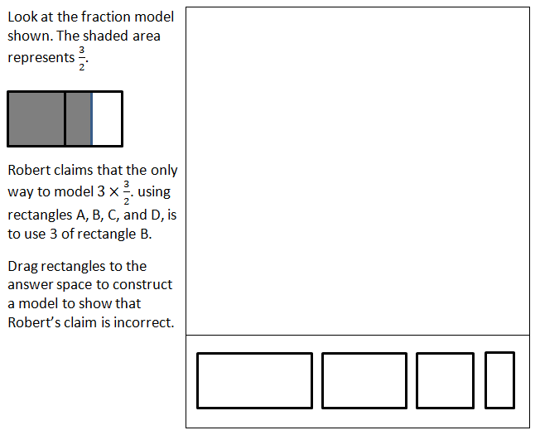
Grade 5 Example
A
B
C
D

Slide 39
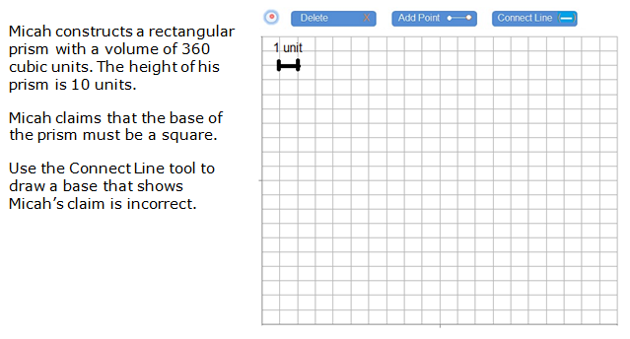
Grade 6 Example
Rubric: (1 point) The student constructs a rectangle that shows Micah’s claim is incorrect (e.g., 4 x 9, 3 x 12, or 2 x 18).

Slide 40
Grade 8 Example
Rubric: (1 point) The student selects the flawed work
(i.e., $90/0.9 = $100 and highlights “the bats are on sale for 10% off).

Slide 41
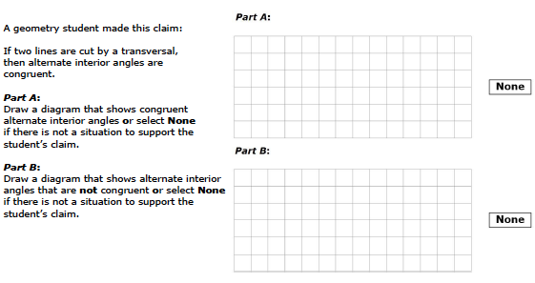
HS Example

Slide 42
Rubrics: What is it exactly that we want students to do?

Slide 43
Scoring Rubrics
The rubric must be aligned to the item’s purpose (or its targeted construct), with attention given to the coherence of the standards.
Some decisions are still needed about non-targeted constructs to attend to coherence (e.g., how to treat major or minor calculation errors in items targeting students’ reasoning).

Slide 44
Grade 3 & Grade 7: Example items from part of a performance task
Solve the problem.
What are the important attributes of the problem? What is its purpose?
Based on its purpose and expected student responses, how many points should it be worth?
Create a scoring rubric outlining how you will award credit at each score point that you’ve identified.

Slide 45
Applying and Refining Item Level Rubrics
Examine the student work with the rubric you just developed.
Are there any papers that are hard to score? What are they? Why are they harder to score?
Do the “hard to score” cases seem like anomalies or something that you could anticipate from several students?
Is the current score point distribution still okay? If not, how will you change it and why?
Are there any clarifications you can make to the rubric to help scorers classify papers better? How will these increase reliability?
Did you find any student responses that misinterpreted the problem in some way? Would you make any changes to the problem to help clarify?

Slide 46
Rubric Refinements
Current Rubric for Grade 3:
(2 points) Student agrees with Tom and shows:
the total number of pounds for Thursday and Friday (223) is greater than the total number of pounds collected Monday through Wednesday (182).
OR the number of pounds for Monday and Tuesday (37 + 55) is less than the number of pounds for Thursday (133) since the same amount was collected Wednesday and Friday.
OR another plausible explanation.
(1 point)
Student may provide a partially correct response (e.g., added totals from Thursday and Friday and Monday through Wednesday correctly), but fails to address the comparison between the totals and Tom’s claim.
OR Student may provide a clear comparison and addresses Tom’s claim, but the response includes a calculation error.

Slide 47
Rubric Refinements
Current Rubric for Grade 7:
(2 points)
Student response identifies a reasonable range for a household of 2, considering the water wasted should be about 10% of the normal water usage (e.g., 16 to 20 gallons of water per day)
AND Student supports their response with correct mathematics.
(1 point)
Student makes a computation error, but shows understanding of how to find the percent of a number.
OR Student forgets to double the range in the end (8-10 gallons), or does not double the range correctly.
OR Student provides a correct range, but used incorrect mathematics or an incoherent or incomplete explanation.
OR Student does not supply a range of values, but a value that falls within the range of 16-20.

Slide 48
Why might an initial scoring rubric change after field testing?
Discussions about whether the rubric supports the targeted construct of the item are easier to have with sample student work
To add language that may increase scoring reliability (e.g., calling out specific examples that are frequently seen at a particular score point)
There was more or less variability than anticipated in student responses
Requires change to the number of points the item is worth

Slide 49
Find Out More
Smarter Balanced can be found online at:
SmarterBalanced.org
Contact Information:
info@smarterbalanced.org

