Slide 1
Engaging students in quality mathematical argumentation
Day 2: Math Bridging Practices Summer Workshop
Tuesday, June 24, 2014

Slide 2
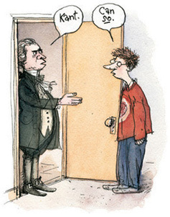
Goal – Argumentation Day 2
We’ve talked some about … What counts as a valid argument?
Tasks and resources: What types of tasks and other resources prompt or support student argumentation?
We will also consider … What does productive argumentation look like in the classroom?

Slide 3
Why is justification (mathematical argumentation) so important?
For teaching
By eliciting reasoning, you gain insight into students’ thinking – can better address misconceptions and scaffold their learning
For learning
By reasoning, students learn and develop knowledge (conceptual, linked knowledge, not memorized facts)
Equity issue – provide students access
In the end, it’s more efficient (retention; it’s not ‘you know it or you don’t’)
For assessing
To support a classroom culture where students can know
Reasoning is empowering; merely restating or memorizing information is disempowering and not engaging; reasoning is mathematics
Many students can reason very well, even when they have weaker computational skills

Slide 4
Tasks and Questions
What’s so important about Tasks and Questions??

Slide 5
What will happen next…

Slide 6
Of course, it’s not a one-to-one correspondence…

Slide 7
Task/Resource Sorting Activity
Review of tasks and resources
Guiding question:
If a student does what is asked of him or her by the task, or uses the resource to guide his or her work (with reasonable interpretation), will s/he engage constructing viable arguments and/or critiquing the reasoning of others?

Slide 8
Task/Resource Sorting Activity
Three categories:
Likely to support/engage in cva and cro
Potentially will support/engage…
Unlikely to support/engage…

Slide 9
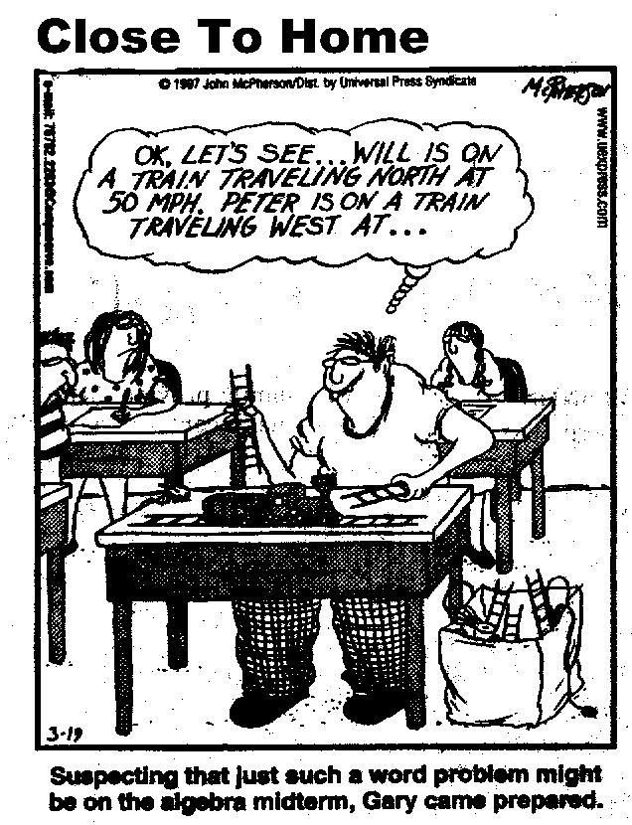
Sample 1
Train A leaves the station traveling due east at 90 mph at 9am. Train B leaves the station traveling due west at 70 mph at 10am. …

Slide 10
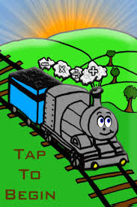
Sample 1
Train A leaves the station traveling due east at 90 mph at 9am. Train B leaves the station traveling due west at 70 mph at 10am. How far apart are the trains at noon?
Train A leaves the station traveling due east at 90 mph at 9am. Train B leaves the station traveling due west at 70 mph at 10am. How far apart are the trains at noon? Show your work.
Train A leaves the station traveling due east at 90 mph at 9am. Train B leaves the station traveling due west at 70 mph at 10am. How far apart are the trains at noon? Explain how you know.

Slide 11
Sample 2
Writing in math
Student Journal Prompt:
Josie thinks that the quadratic equation x² + 4x + 6 has no roots because you cannot factor x² + 4x + 6.
You’re not so sure. Check Josie’s claim and decide for yourself.

Slide 12
Your task
Think: Review the tasks/resources on the Handout - Private Think Time for ~5 minutes. There’s a set of categories with descriptors you can use for reference as well. These are meant to guide; not be complete rules.
Pairs-Share: with a partner at your table, review the tasks/resources. Take turns being the first to offer your thoughts on the task or resource. Person with the closest birthday should go first and be prepared to share group’s thinking. (~10 mins)
Full Group Discussion
Table # | Focal task
1 | A & D
2 | B & E
3 | C & A
4 | D & B
5 | E & C
6 | A & D
7 | B & E
8 | C

Slide 13
INSERT SLIDES OF EACH TASK/RESOURCE

Slide 14
We understand… What are our take-aways?
Implications for when you design tasks or resources?
Implications for your work with students?
What was clarified? Lingering questions?

Slide 15
Video – 7th grade math class
Argumentation in action
Fractions

Slide 16
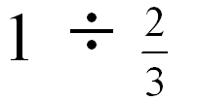
The Prompt
On first glance, how would you rate the cognitive challenge of this task?

Slide 17
The Prompt
CH: “Without doing a rule that you know, like, see if you can make sense of why, what one divided by two-thirds is.”

Slide 18
Argumentation in action
Arguments/justifications unfold as part of the math class.
Cathy Humphrey’s video – 15 mins
From book Connecting Mathematical ideas: Middle School Video Cases to Supporting Teaching and Learning (Boaler & Humphreys, 2005). Heineman Press.

Slide 19
Prior to the Video
The teacher talked to her students about her goals for the class—that is, to learn what they understood about division, not just what they could do.
7th-grade class. Some know “the rule” and others don’t. Students drawn from “upper” 50% of students.
For each problem, she asked the students to do two things:
Decide without paper or pencil what they think the answer is
Try to explain why their answer makes sense
Already discussed 1/(1/3), so she thought this would be straightforward.
Notes:
When during the year?

Slide 20
While Watching
What is the claim being discussed?
What are the arguments that students are making? (Try to mark each argument on your transcript.)
What is the teacher doing to support (or hinder) students’ engagement with argumentation?
Watch for “talk moves” or other pedagogical moves
What are the students doing that support (or hinder) argumentation?
Let’s watch...

