Slide 1
Goals for today
Bridging Math Practices
Math – Day 3
June 24, 2014
Understand what we mean by algebraic reasoning.
Recognize how different algebraic expressions connect to the problem at hand.
Analyze and evaluate understandings and/or misunderstandings on students’ approaches to the hexagon task.
Increase our understanding of the use of strip diagrams to solve different types of problems.

Slide 2
Algebra and Algebraic Reasoning
“To think algebraically, one must be able to understand patters, relations, and functions; represent and analyze mathematical situations and structures using algebraic symbols; use mathematical models to represent and understand quantitative relationships; and analyze change in various contexts.”
(Navigating through Algebra in Grades 3-5, NCTM, 2001)
“Algebra and algebraic reasoning remain at the core of the high school mathematics curriculum. Algebra’s dominance in the school curriculum is related to the importance of algebra in more advanced areas of mathematics, the usefulness of algebraic reasoning in all walks of life, and the role of algebra as a tool for the mathematical modeling required in many technological and scientific fields.”
(Focus in High School Mathematics: Reasoning and Sense Making, 2010, p. 1)

Slide 3
Habits of Mind in Reasoning and Sense Making in Algebra
Analyzing a problem, for example:
  Defining relevant variables and conditions;
  Seeking patterns and relationships;
  Looking for hidden structure.
Implementing a strategy, for example:
  Making purposeful use of procedures;
  Monitoring progress toward a solution.
Reflecting on a solution to a problem, e.g.:
  Interpreting a solution;
  Considering the reasonableness of a solution;
  Generalizing a solution to a broader class of problems;
  Looking for connections to other problems.
Focus in High School Mathematics: Reasoning and Sense Making, 2010

Slide 4
Activity 1: Revisiting the Hexagon Task
What is the perimeter of the 25th figure?
Write a formula for the perimeter of the n-th figure.
Analyze Student’s work

Slide 5
Ratio: Two Perspectives
A Composed unit/Batch
Fixed numbers of parts
Example: For every 7 female project participants in this room there is 1 male project participant.
Two quantities are in a ratio of A to B if for every A units present of the first quantity there are B units present of the second quantity.
Example: Alvaro’s favorite trail mix requires 1 parts of raisins, 4 parts granola, and 5 parts of M&M peanuts a bag/bowl.
Two quantities are in a ratio of A to B if we divide the first quantity into A equal parts, then the second quantity consist of B equal parts of the same size.

Slide 6
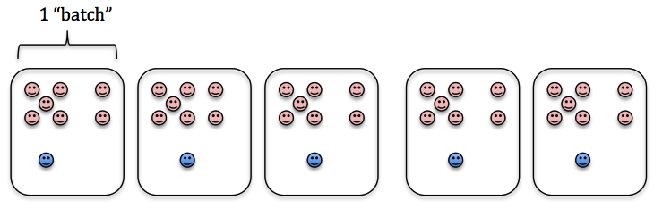
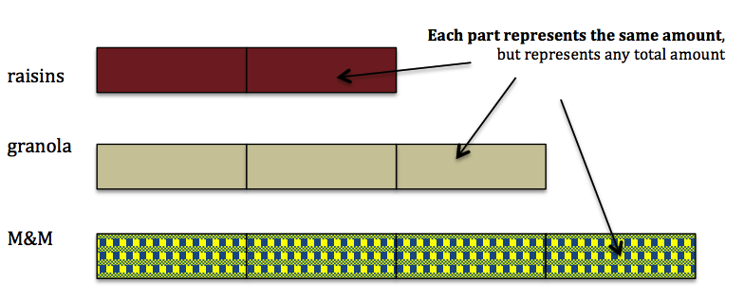
Ratio: Two Perspectives
A Composed unit/Batch
Fixed numbers of parts
Example: For every 7 female project participants in this room there is 1 male project participant.
Example: Alvaro’s favorite trail mix requires 2 parts of raisins, 4 parts granola, and 5 parts of M&M peanuts in each bowl.

Slide 7

Looking Back at Strip Diagrams
Warm-Up Example:
  The exchange rate of US Dollars and Euros is $4 for €3. If a bottle of wine is €21, how much is the bottle in US Dollars?

Slide 8
Activity 2: Problem solving with Strip Diagrams
We will work on this in two groups
One group stays here
  2nd- 5th grade teachers and math coaches
Another group in Room 101
  6th grade – high school teachers

Slide 9
Guiding questions for reflection…
What did we learn today?
  Something old, new, borrowed?
More specifically
  What does it take to reason algebraically?
  Any important results?
  Take away from using strip diagrams on different problems
Questions you still have

