Slide 1
Bridging Math Practices Summer Workshop
Wednesday, June 25, 2014
Day 3

Slide 2
Day 3 AGENDA
Introductions
Front matter
Team Teach – Talk Frame Practice
The Hexagon Task
Argumentation
Lunch
Math – proportional → algebraic
CRD time
Protocol
Looking toward August…
Notes:
The Hexagon Task - algebraic and proportional reasoning; modeling talk frame; focus on publicizing
Argumentation – pattern process vs pattern result reasoning; warrants for choices of method…

Slide 3
The Name Game!
How many names do you know??
Prize if you know all names by August 19…

Slide 4
Paul & the Website
http://bridges.education.uconn.edu

Slide 5
Links

Slide 6
Links
Mike’s students - which is larger? How do you know?
1) 5/6 O 13/14 2) 3/8 O 4/5

Slide 7
3 Construct viable arguments and critique the reasoning of others.
Mathematically proficient students understand and use stated assumptions, definitions, and previously established results in constructing arguments. They make conjectures and build a logical progression of statements to explore the truth of their conjectures. They are able to analyze situations by breaking them into cases, and can recognize and use counterexamples. They justify their conclusions, communicate them to others, and respond to the arguments of others.
… Elementary students can construct arguments using concrete referents such as objects, drawings, diagrams, and actions. Such arguments can make sense and be correct, even though they are not generalized or made formal until later grades. Later, students learn to determine domains to which an argument applies. Students at all grades can listen or read the arguments of others, decide whether they make sense, and ask useful questions to clarify or improve the arguments.

Slide 8
Links
Progression: argumentation - Reasoning of Angel, Micah, Roland, and “algebraist”
Progression – proportional reasoning - Lamon text
Turnonccmath.net
Learning progression documents http://ime.math.arizona.edu/progressions/

Slide 9
Talk Frame Mini-lesson
Think
Today with your team you will …
Teach the mini-lesson to another team
Participate as another team teaches you their mini-lesson
Reflect on the usefulness of the talk frame
We Understand

Slide 10
Think
As you teach & learn today, keep in the back of your mind:
What can the talk frame do to support student reasoning?
Talk Idea
Talk Idea
Talk Idea
We Understand
We understand…

Slide 11
Talk Frame Teaching Logisitics
Materials are in assigned rooms (talk frame icons, chart paper, markers, masking tape, handouts (if requested), & other requested items)
Assign a timekeeper to make sure both groups get sufficient teaching time (~20 min. each)
Teams | Room
A & B | 144
C & D | 144
E & F | 142
G & H | 140C
H & I | 101
Please return here by _____

Slide 12
Reflection on the Talk Frame
Think
Based on your experiences this week:
What can the talk frame do to support student reasoning?
We Understand

Slide 13
10 min BREAK

Slide 14
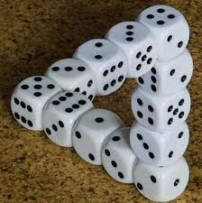
Problem Solving and Pedagogy!

Slide 15
Doing Problem Solving Tasks Together –Purposes
Provide a common math-teaching-and-learning experience for reflection and discussion
Opportunity to discuss tasks and task implementation
Exposure to/discussion of some teaching strategies
Opportunities to see how others think
To learn more math (connections); engage in productive struggle
For fun! ☺

Slide 16
One model: A pedagogy of mathematical reasoning
New question(s)
Generate ideas
Elicit and
Publicize ideas
Press on and develop ideas collaboratively
Solidify and/or refine new meanings
Two routines:
Talk Frame
Conjectures Routine

Slide 17
Doing Problem Solving Tasks Together
Ground Rules
You have the right to share your thinking, the right to be listened to; you have an obligation to explain to others
Person with the next birthday is your “Point Guard.” Only that person may raise his or her hand to ask a Group Question.
Check Point. Call me or Mary over. All must be able to explain your answers to A & B!

Slide 18
Problem Solving - Structure
Please clear table tops for work space
Hexagons are available
THINK: Private Think Time (5 mins)
SHARE: Sharing with table (15 mins)
** CHECK POINT**
Talk Frame: DISCUSSION: Connecting ideas, coming to new understandings (10 – 15 mins)
If this is not an authentic problem for you, please let me know. I have an extension.
Notes:
Start with 3 minutes of private think time
Partner work: 5 minutes
Whole-class discussion using the Talk Frame (10-12 mins)

Slide 19
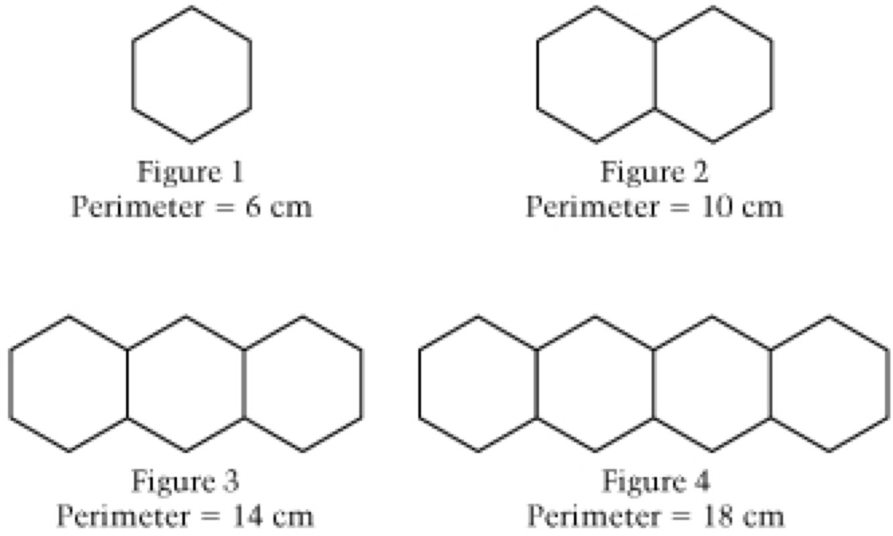
THE HEXAGON TASK
Each figure in the pattern below is made of hexagons that measure 1 centimeter on each side.
Draw Figure 5. Find the perimeter of Figure 5.
If the pattern of adding one hexagon to each figure is continued, what will be the perimeter of the 25th figure in the pattern? Justify your answer.

Slide 20
Think

Slide 21
Possible think questions
How are ____ and ____ connected?
How do ___ and ____ see this hexagon figure differently?
Where is the ________ sides in _____’s formula?
If ____ were to look at Figure 1000, what would s/he do?
Why does _____ need to ______?

Slide 22
Each figure in the pattern below is made of hexagons that measure 1 centimeter on each side.
If the pattern of adding one hexagon to each figure is continued, what will be the perimeter of the 25th figure in the pattern? Justify your answer.
Extension: How can you find the perimeter of any figure? (A figure with n hexagons?)

Slide 24
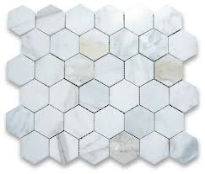
Hexagon Task Debrief
How were ideas made public? What supported the sharing of ideas/publicizing of ideas?
What kind of work did the class have to do to make sense of other’s ideas and reasoning?
When were you engaged in constructing viable arguments?
When were you engaged in critiquing the reasoning of others?

Slide 25
One model: A pedagogy of mathematical reasoning
New question(s)
Generate ideas
Elicit and
Publicize ideas
Press on and develop ideas collaboratively
Solidify and/or refine new meanings
Two routines:
Talk Frame
Conjectures Routine

Slide 26
Some Resources
NCTM – prototype – Digital Library of Practice
http://www.nctm.org/profdev/library/default.aspx?id=34507
A Framework for Analyzing Geometric Pattern Tasks Math Teaching in the Middle School – Friel & Markworth (resources)
Beyond Presenting Good Problems: How a Japanese Teacher Implements and Mathematics Task – Smith – in NCTM 66th Yearbook (resources)

Slide 27
Quick Stretch!

Slide 28
A-SSE.A.2: Use the structure of an expression to identify ways to rewrite it.
A-SSE.A.3: Choose and produce an equivalent form of an expression to reveal and explain properties of the quantity represented by the expression.
Notes:
Leading towards
A-REI.1 Explain each step in solving a simple equation as following
from the equality of numbers asserted at the previous step,
starting from the assumption that the original equation has a solution.
Construct a viable argument to justify a solution method.

Slide 29
A- REI: Reasoning with Equations and Inequalities.
-Understand solving equations as a process of reasoning and explain the reasoning

