Slide 1
MCB 5472
Computer Methods in Molecular Evolution
Spring 2014
Dr. J. Peter Gogarten jpgogarten@gmail.com
Dr. Jonathan Klassen jonathan.Klassen@uconn.edu
Email is good; please include “MCB 5472” in title

Slide 2
Outline
Pre-exam
Course syllabus (Klassen)
Student projects (Gogarten)
Intro to Unix & Perl (Klassen)
Exercises

Slide 3
Course Website
http://mcb5472.clas.uconn.edu
All assignments and lectures will be posted here
Comments are enabled, use these before emailing Jonathan and Peter directly
Answering and discussing comments is encouraged, and can count towards your participation grade

Slide 4
Student Projects
Should be related to your interests !!!
Keep it simple -- this is a class project not a PhD thesis
Examples for possible projects:

Slide 5
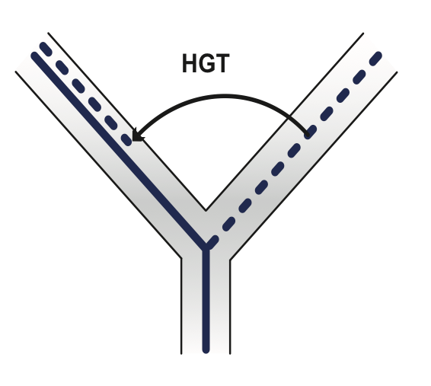
Evolution of a gene family
When in the evolution of the interferon gene family (or whatever you are interested in) did gene duplications occur?
Can one discriminate between gene conversion and multiple parallel transfers?
Were the “gene duplications” additive transfers between close relatives?
Which of the resulting subfamilies (if any) have acquired a new function?
What is the phylogenetic distribution of this subfamily? (Would you expect members of this subfamily to be present in insects, fish, chicken, fungi, archaea?)
Can you detect episodes of positive selection or of relaxed purifying selection?
Is there anything that would suggest gene conversion events?
The “ to-do-list” would include:
gather data (note for some of the questions mentioned above you’ll need aa and nucleotide sequences),
align sequences
build phylogenies
analyze sequences
assess reliability of branches
INTERPRET WHAT YOU GOT!

Slide 6
Example: Can one detect a distinct divergence peak in the divergence between paralogs in putatively chimeric genomes?
Genome fusions are the latest rage in evolutionary biology:
For example:
Koonin EV, Mushegian AR, Galperin MY, Walker DR. Comparison of archaeal and bacterial genomes: computer analysis of protein sequences predicts novel functions and suggests a chimeric origin for the archaea.
Mol Microbiol. 1997 Aug;25(4):619-37.
The Eukaryotes are a chimera of at least an archaeal like host cell and a bacterium that evolved into a mitochondrium (+ in some cases a cyanobacterium that evolved into a plastid)
The Haloarchaea contain many bacterial genes
The Thermotogales contain many archaeal genes
Most plants and many fungi (likely including bakers yeast) are aneupolyploids
In most of these instances it is not clear that the transfer (or duplication) really occurred in a single massive event, or if the transfers (duplications) occurred on a gene by gene basis.
(in yeast the type of genes that were duplicated suggest distinct selection pressures, see Benner et al http://www.sciencemag.org/content/296/5569/864.full )

Slide 7
Example: Chimera? continued
In case of a chimera formed in a single historic event one would expect
Two distinct types of phylogenetic affinity.
E.g.: Genes in Thermotoga maritima should either group with the sistergroup of the bacterial partner, or with the sistergroup of the archaeal donor.
B) An ancient genome duplication or chimera formation should be revealed by peaks in the divergence of paralogs.

Slide 8
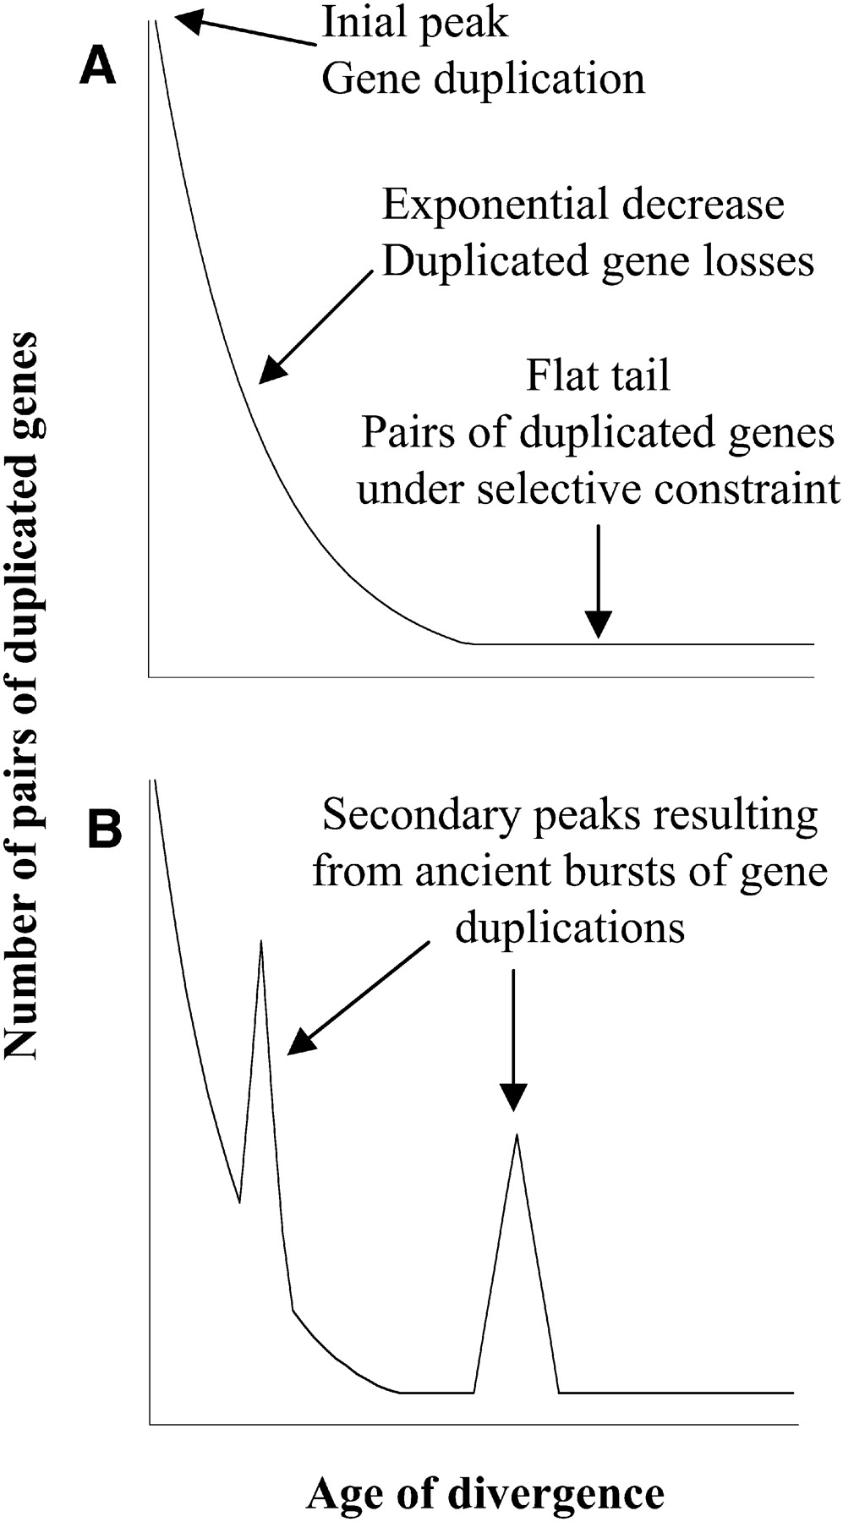

Theoretical Age Distributions of Pairs of Duplicated Genes in a Genome
Blanc, G., et al. Plant Cell 2004;16:1667-1678
Copyright ©2004 American Society of Plant Biologists

Slide 9
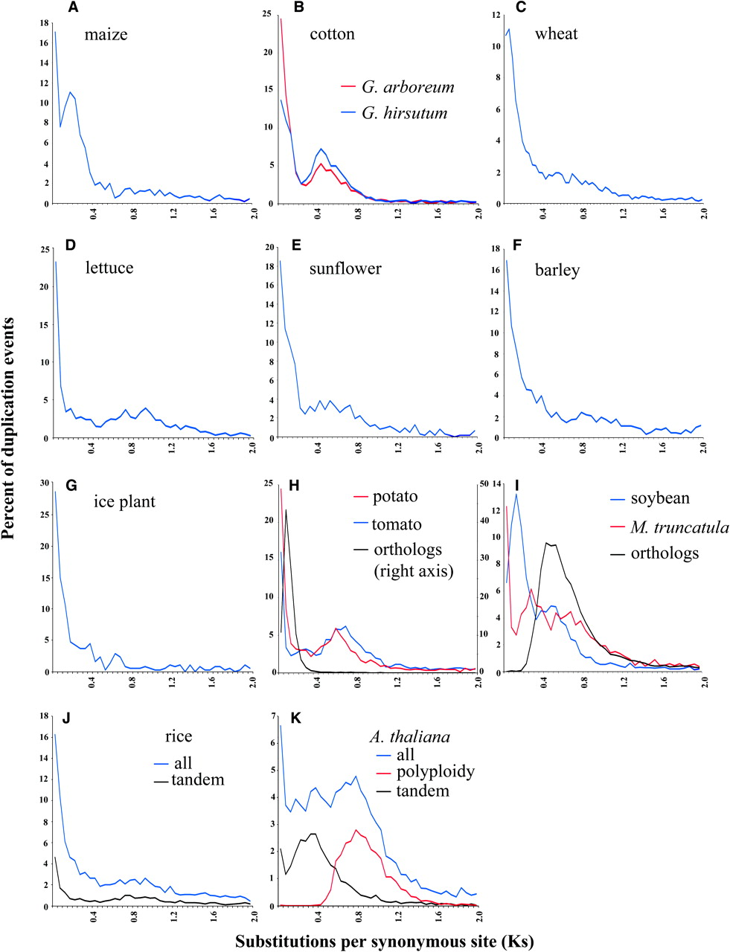
Distributions of the Fraction of Duplication Events as a Function of Their Levels of Synonymous Substitution for 14 Model Plant Species
Blanc, G., et al. Plant Cell 2004;16:1667-1678
Copyright ©2004 American Society of Plant Biologists

Slide 10
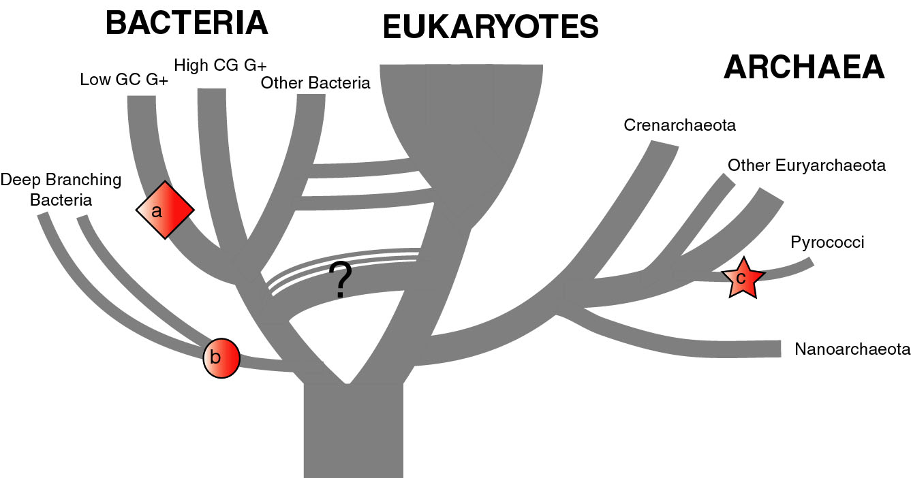
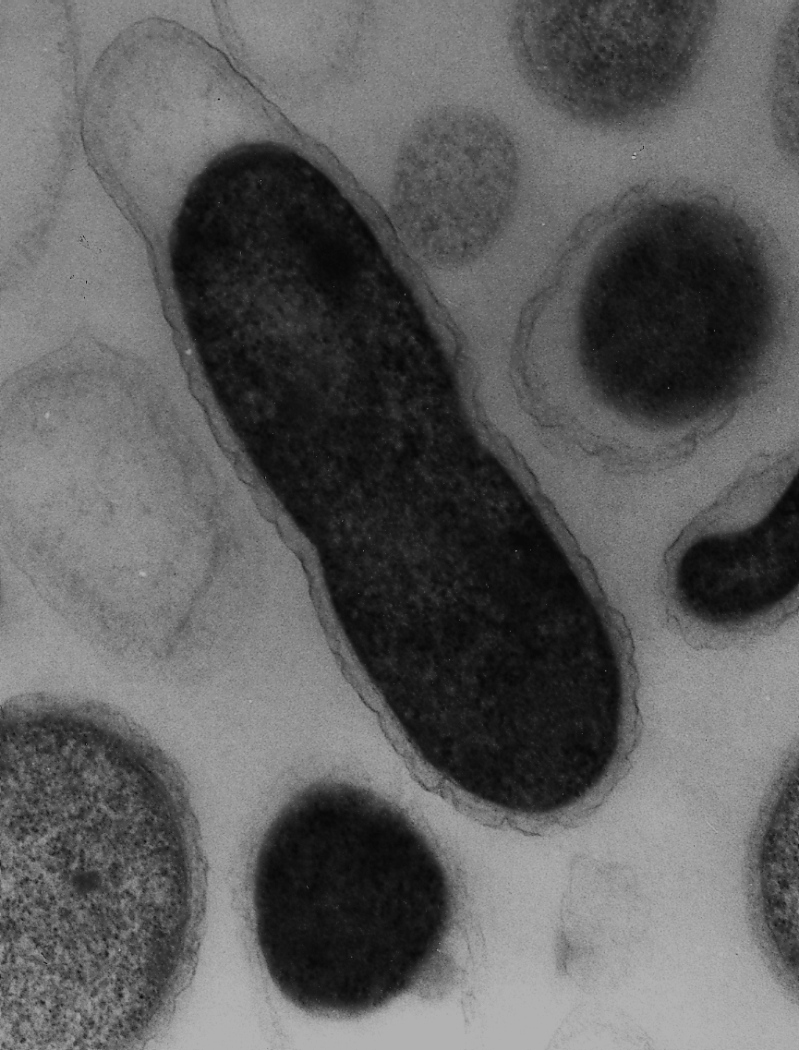
The Phylogenetic Position of Thermotoga
(a) Most genome based approaches
(b) according to 16S & other ribosomal markers
(c) according to phylogenetically discordant genes
Zhaxybayeva O, Fournier G, Lapierre P, Swithers K, Nesbø C, Gogarten JP, Doolittle WF, Noll KM: Phylogenetic position of Thermotogales revisited: conflicting signals and evidence for thermophilic ancestral proteome, PNAS 3/24/2009
Gophna U, Doolittle WF & Charlebois RL:
Weighted genome trees: refinements and applications. J. Bacteriol. (2005)
Gogarten JP & Townsend JP: Horizontal gene transfer, genome innovation, and evolution Nature Reviews in Microbiology 3(9) 679-687(2005)

Slide 11
Progressive gene gain in the Thermotogales
Bacillus/Clostridium
Other
Archaea
Aquificae
Thermotoga specific
The acquisition of archaeal and clostridial genes appears to be an ongoing process.

Slide 12

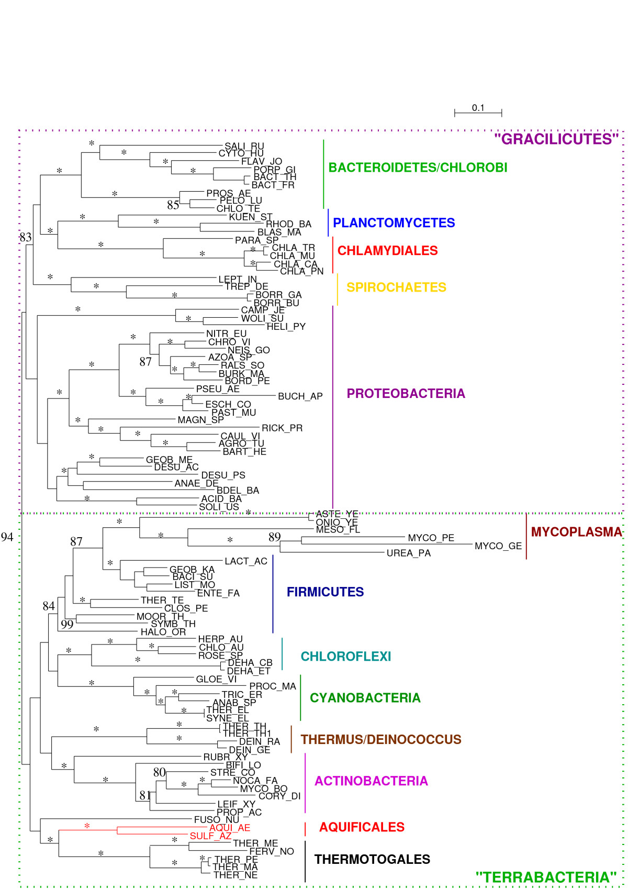
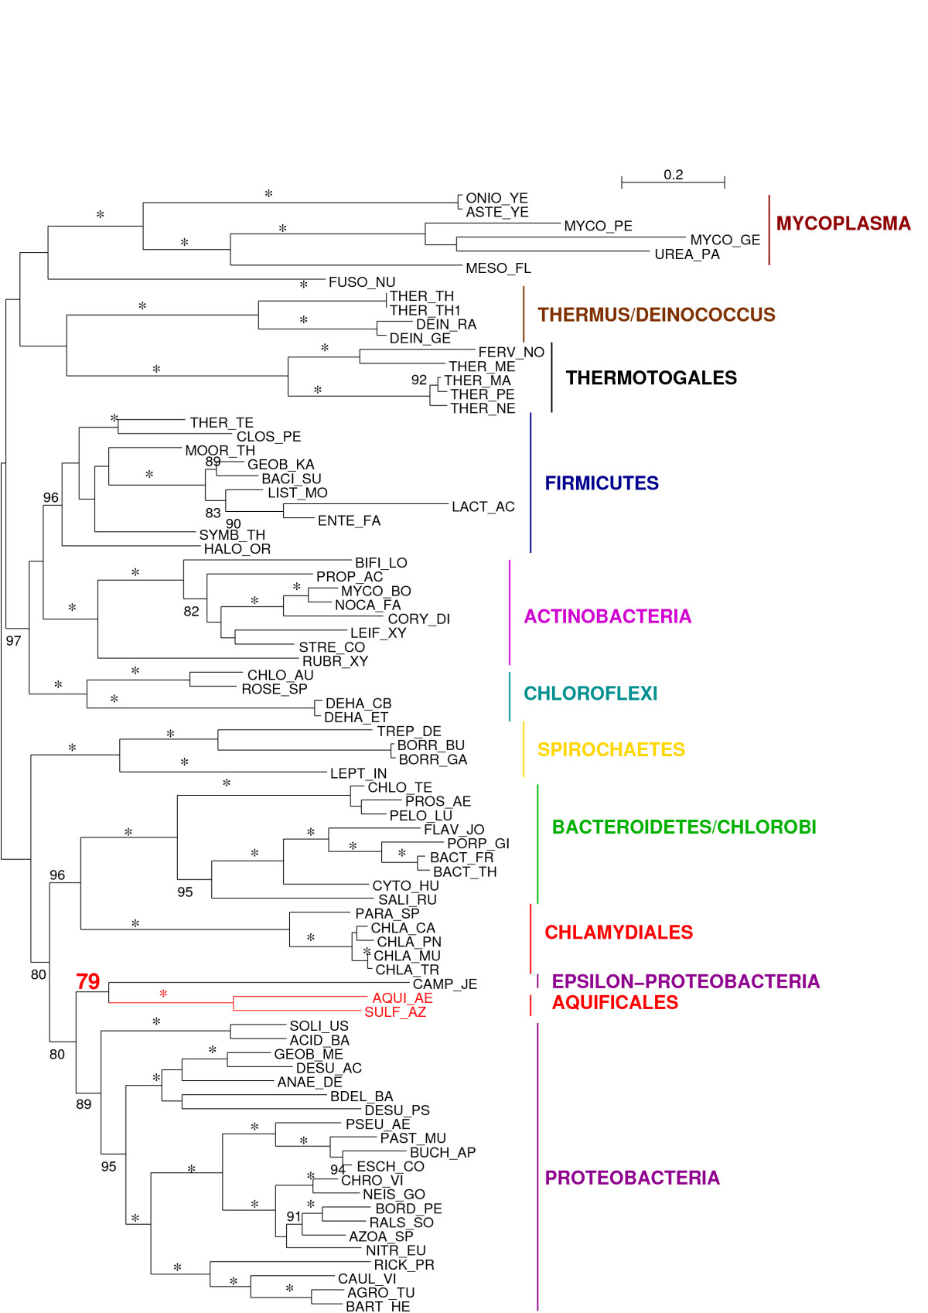
Slow sites, recoded
rplL-rpoB-rpoC phylogeny

Slide 13
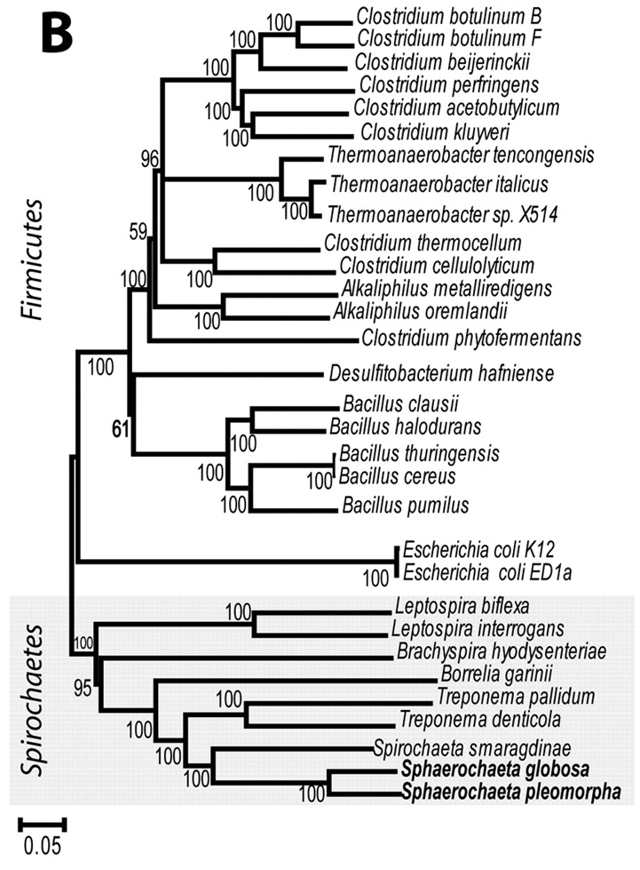
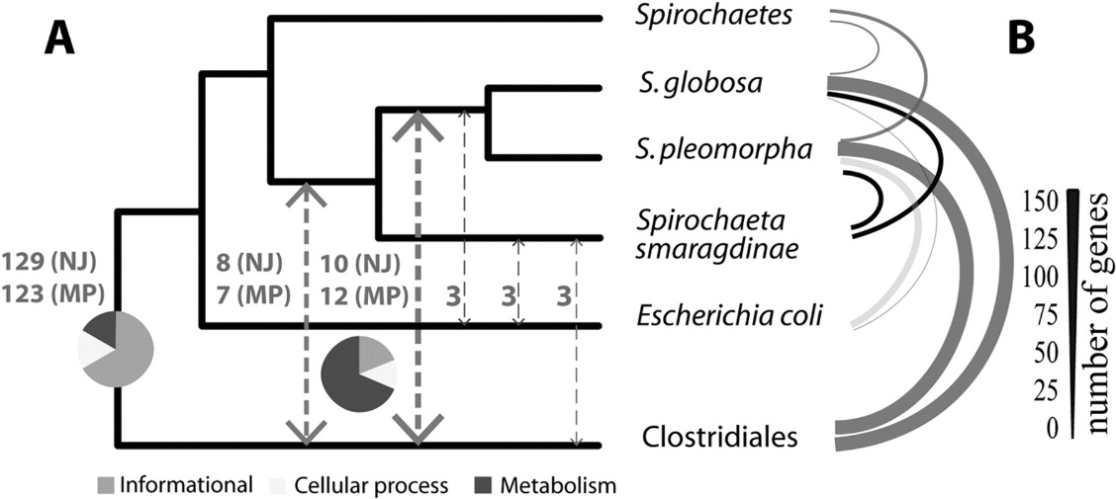

“The Sphaerochaeta genomes are highly enriched in fermentation and carbohydrate metabolism genes relative to other spirochetes, indicating a fermentative lifestyle. Remarkably, most of the enriched genes appear to have been acquired from non spirochetes, particularly clostridia, in several massive horizontal gene transfer events (>40% of the total number of genes in each genome).”
43 single-copy informational gene sequences
the values next to the arrows indicate the numbers of genes exchanged (out of a total of 178 genes examined).

Slide 14
Chimera Example, continued
The “ to-do-list” would include:
Formulate the question you want to address
Download and analyze the required genomes
Run blastall (this might take a couple of hours)
Analyze the results in an Excel spreadsheet
Selected some genes (e.g., the ones that are most archaeal), assemble gene families and reconstruct their phylogenies.
INTERPRET YOUR RESULTS! What does it all mean?

Slide 15
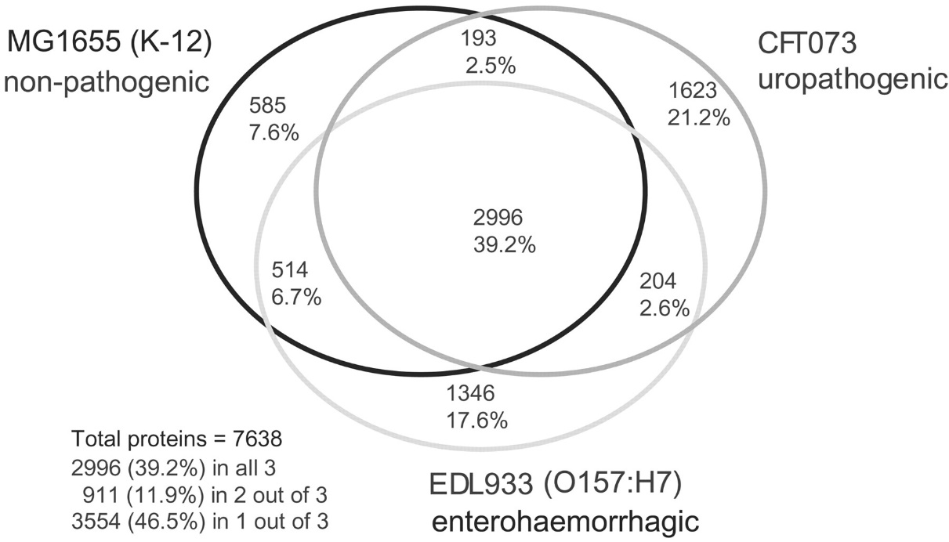

Example: Open or Closed Pan Genomes
Strain-specific
Dispensable
Welch et al, 2002
core
Edwards-Venn cogwheel
A.W.F. Edwards 1998
Dispensable
+
+
Pan-genome
+

Slide 16
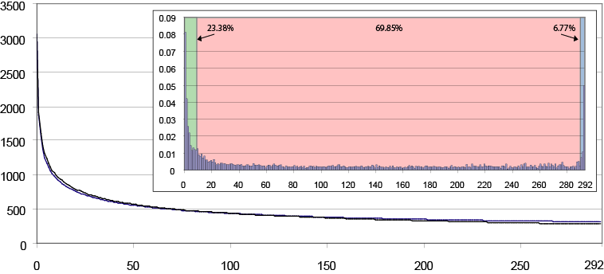
Gene frequency in a typical genome
Pick a random gene from any of the 293 genomes
Search in how many genomes this gene is present
Sampling of 15,000 genes
(Accessory pool)
(Character genes)
(Extended Core)
F(x) = sum [ A_{n}*exp^{(Kn*x)}]

Slide 17
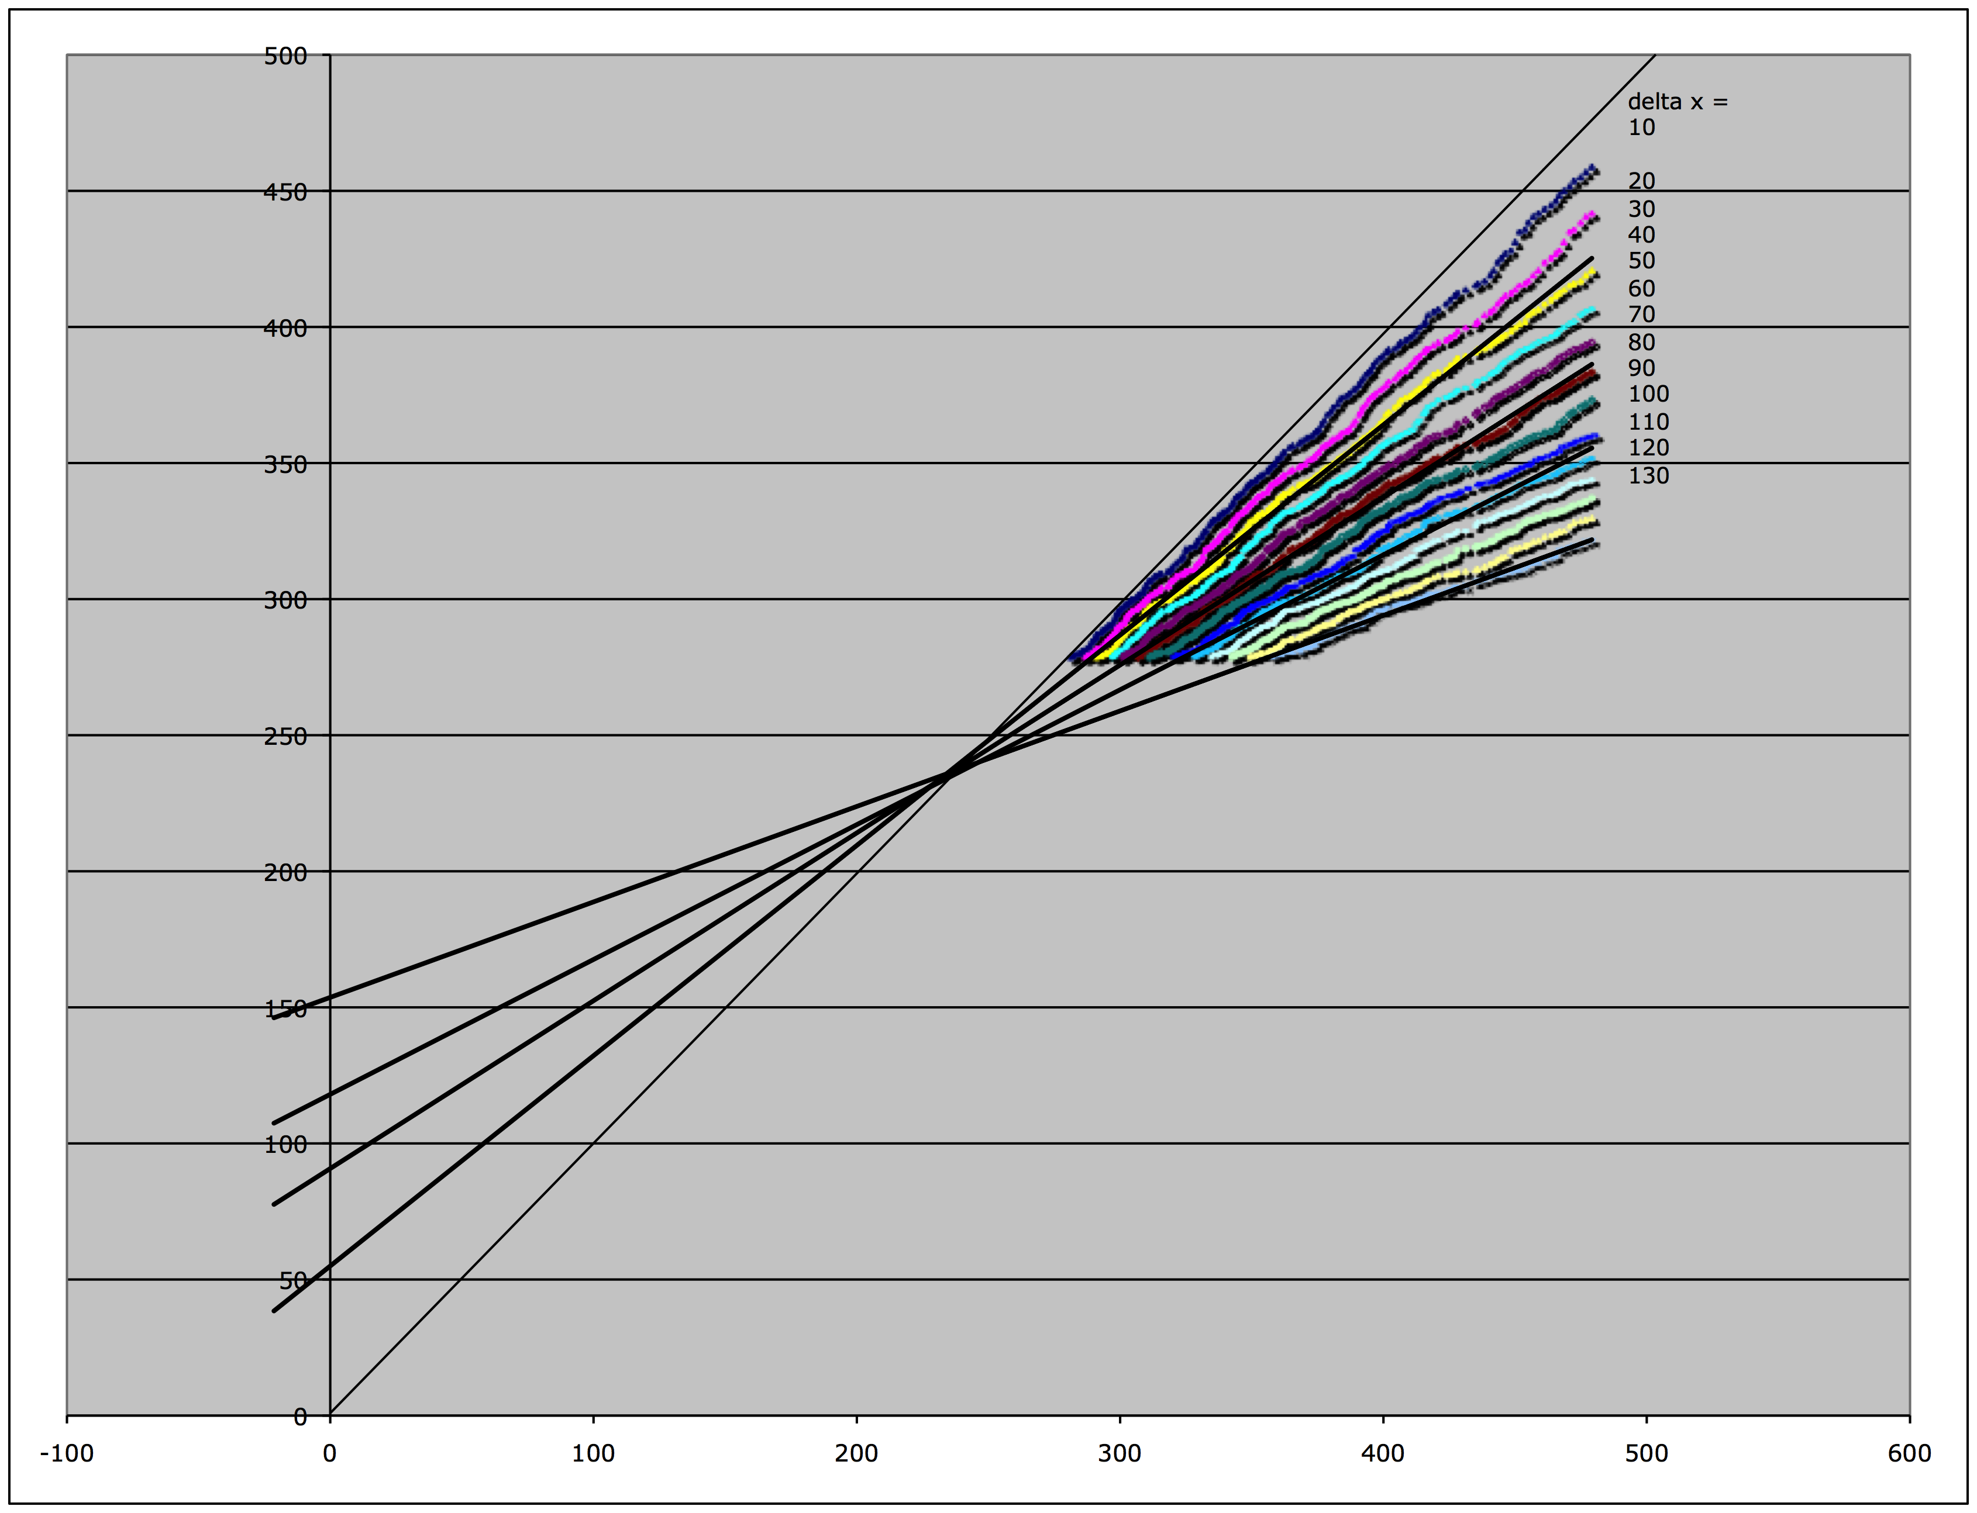
Kézdy-Swinbourne Plot
If f(x)=K+A • exp(-k•x), then
f(x+∆x)=K+A • exp(-k•(x+∆x)).
Through elimination of A:
f(x+∆x)=exp(-k • ∆x) • f(x) + K’
And for x→∞,
f(x)→K, f(x+∆x)→K
Novel genes after looking in x + ∆x genomes
~230 novel genes per genome
Novel genes after looking in x genomes
only values with x ≥ 80 genomes were included
Even after comparing to a very large (infinite) number of bacterial genomes, on average, each new genome will contain about 230 genes that do not have a homolog in the other genomes.

Slide 18
How does the size of the pan-genome differ for different group of organisms?
For highly sampled organisms (such as E. coli) is the pan-genome open, or can one observe saturation at very high levels of sampling?
Can one observe saturation for the bacterial pan-genome?
The BBC bioinformatics facility maintains pan-genome collections for bacteria and archaea at the 90% and 95% 16S rRNA identity cut-off

Slide 19
Example: Screen for accessory genes in collections of mostly incomplete genome sequences.
Sequencing genomes has become cheap, but many of the sequenced genomes are not closed. (Examples at UConn: Halorubrum and Aeromonas genomes.)
Mapping read/contigs onto a closed reference genome, screen for genes absent in the reference genome
In case of larger contigs, determine the location of the accessory genes
Determine function these accessory genes.
Where did these genes originate?

Slide 20
Example: How are molecular parasites distributed over the tree/net of life?
Build position specific scoring matrices (PSI-BLAST) or Profiles for Hidden Markov Models (HMMER) for proteins that characterize (molecular) parasites (virus coat proteins, transposase, or integrase genes)
Using the same collection of pan-genomes for groups with 5 and 10% 16S rRNA divergence, determine how many matches are in each of these group pan-genomes.
Use other genome collections, including draft genomes as targets.

Slide 21
MCB 5742 Assignment #1:
Introduction to the terminal and Perl
January 22, 2014
Jonathan Klassen
jonathan.klassen@uconn.edu
(please put “MCB 5472” in your email title)

Slide 22
Outline
Introduction to UNIX
Logging on to the Biotechnology Center Cluster
Beginning with Perl

Slide 23
Introduction to UNIX
Nearly all bioinformatics software runs on UNIX and its derivatives (e.g., LINUX and Mac OS)
Very little bioinformatics software runs on Windows
Bioinformatics is very strongly tied to the open-source software movement
  Lots of help available on-line
  Most programs are free
  Windows is not very open-source friendly

Slide 24
Windows users:
Option 1: Do all of your work connected to the Biotechnology Cluster server. Download sshclient (ftp://ftp.uconn.edu/restricted/ssh/)
Option 1: Install LINUX to run in parallel with Windows (e.g., Biolinux http://nebc.nerc.ac.uk/tools/bio-linux)

Slide 25
Unix and Perl Primer for Biologists
The designated text for this course is “Unix and Perl Primer for Biologists”, which can be found here: http://korflab.ucdavis.edu/Unix_and_Perl/unix_and_perl_v3.1.1.pdf
(Or on the website)

Slide 26
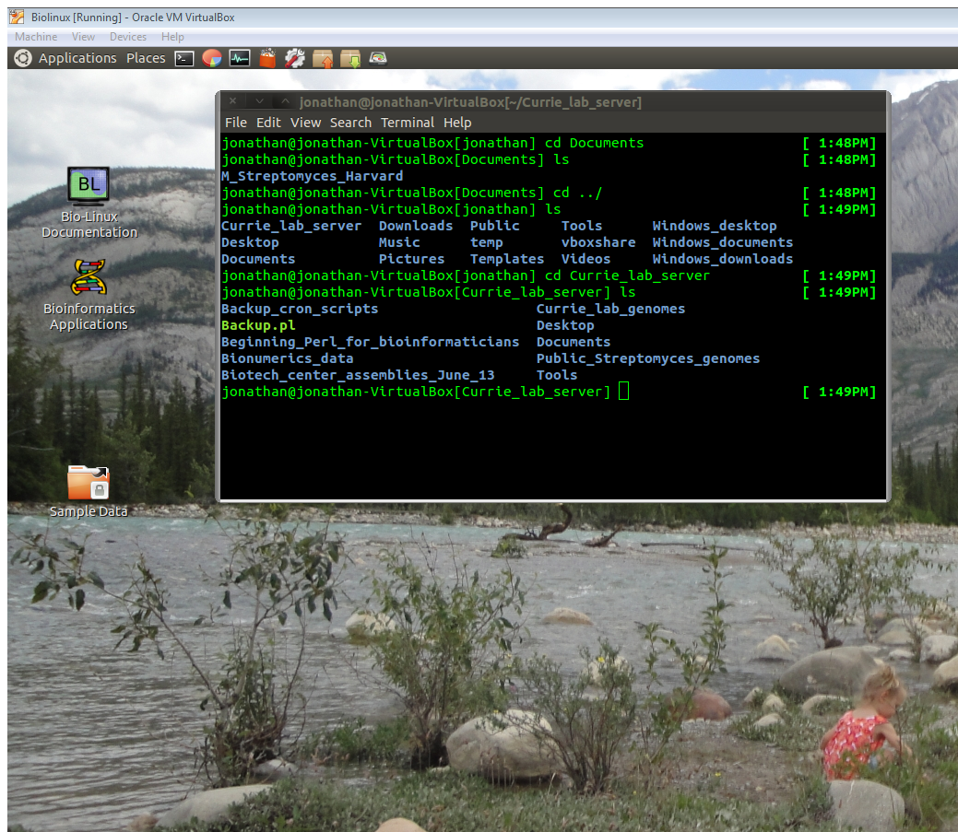
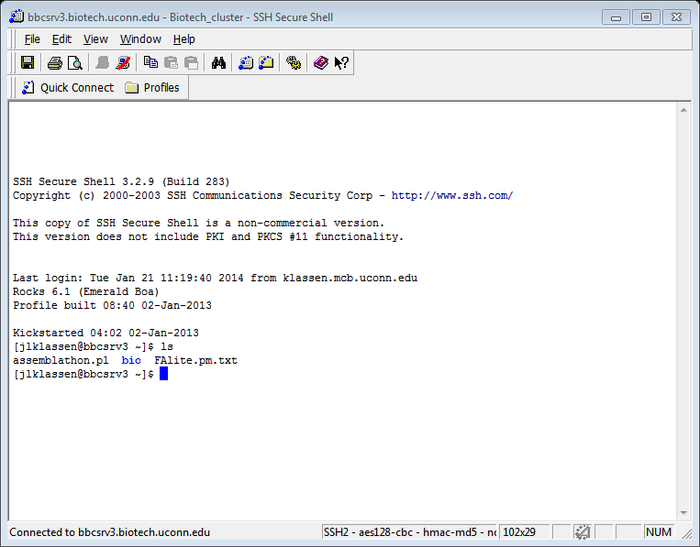
Terminal
The terminal is the primary way to do computational biology
Mac: Utilities/Applications/
Terminal
Linux: Applications/Accessories/
Terminal
Windows: sshclient

Slide 27
Terminal commands
Using the terminal requires learning a series of commands that you will learn in the first exercise (Korf text U1-U28)
These mainly involve doing various things to files
These commands are extremely powerful once you learn them.

Slide 28
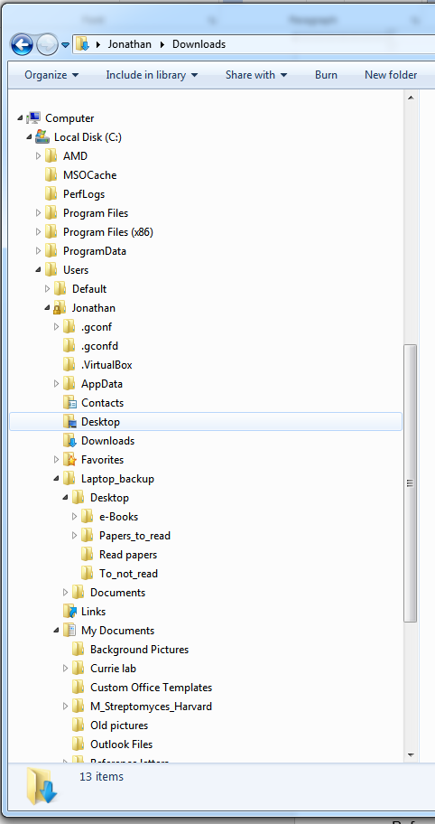
Directory trees
All computer files are organized hierarchically
Each folder has an address
/Users/Jonathan/
Laptop_backup/Destop/
e-Books

Slide 29
Navigation commands
ls – list directory contents
cd – change directory
  cd Documents (move up to directory “Documents”)
  cd /Users/jlklassen/Documents (the same)
  cd Documents/stuff (move up 2 directories)
  cd /Users/jlklassen/Documents/stuff (the same)
  cd ../ (move down 1 directory)
  cd ../Desktop (move down 1 then up 1)
  cd /Users/jlklassen/Desktop (the same)
  cd ~/Desktop (the same)

Slide 30
More navigation commands
cp – copy documents & directories
  cp stuff.stuff Desktop/ (make a copy in Desktop/)
  cp stuff.stuff more_stuff.stuff (make a copy here)
mv – move documents & directories
  mv Documents Desktop/ (move Documents into Desktop/)
  mv Documents Desktop (rename Documents as Desktop)
rm – delete documents (BE CAREFUL)
  rm to_delete.stuff (delete)
mkdir – make a new directory
  mkdir New_dir (make new directory here)
  mkdir Documents/New_dir (make new directory in New_dir)
rmdir – remove a directory
  rmdir Old_dir (delete)

Slide 31
The Biotechnology Center cluster
Your computer is good enough for basic tasks
However, many tasks require more horsepower
We connect to more powerful computers remotely using “ssh”
Mac OS and Linux: follow directions in your email
Windows: use sshclient

Slide 32
Working on the Cluster
The cluster works by queuing all the jobs to be run and sending them to a free “node” as they become available.
ssh’ing onto the server starts you all on the same “head node”
  DO NOT EXECUTE PROGRAMS HERE
For simple scripts, type “qlogin” and then run your scripts as normal
For more involved jobs use the qsub system – see http://bbcsrv3.biotech.uconn.edu/wiki/index.php/Qsub

Slide 33
Text editors
Mac OS: textwrangler
Linux: gedit
Windows: download gedit https://wiki.gnome.org/Apps/Gedit
Cluster: nano or vi
It is often easiest to write your script using a graphical text editor, move it to the cluster and then make only minor edits using nano or vi.

Slide 34
Some Unix tips
Do not use spaces in your filenames
Do not use a word processor instead of a text editor
“*” is a wildcard character and is exceeding useful to match more than one thing
  mv *.pl Documents/
  (move everything ending in “.pl” into the folder “Documents”)
  mv *.p*l Documents/
  (move everthing ending in “.p”+something or nothing+”l”, i.e., both stuff.pl and stuff.perl would get moved)

Slide 35
More Unix tips
Use “>” to redirect output from the screen into a file
perl script.pl > outfile.out
Use “|” to redirect output into another program
perl script.pl | wc
Use “&” to run program in the background
perl script.pl&
Use “nohup” to run the program after you exit the terminal
nohup perl script.pl& > nohup.out
File extensions can be whatever you want them to be, although conventions do exist (e.g., .pl)
  This is a good way of keeping track what files contain

Slide 36
Perl
Perl is a programing language that is great for scripting, i.e., tying programs together and reformatting their input and output
By convention, perl scripts end with “.pl”
Execute method #1:
perl script.pl
Execute method #2:
chmod u+x script.pl
./script.pl

Slide 37
Perl rule #1
For normal scripts, the first line of every script must be:
#!/usr/bin/perl
For the cluster, however, this line must be:
#!/bin/env/perl
This tells the computer where to find the perl software itself

Slide 38
Perl rule #2
Add comments to your code, otherwise neither me nor you will have any idea what it means the next time we look at it!
Comments are everything that follows “#”, except for the #!/bin/env/perl line
e.g., # this is a comment
e.g., print “something”; # this part is a comment

Slide 39
Perl rule #3
Every line of code ends with a “;” character
If you add an “enter” to your code, perl will keep reading your code until it reaches the next “;”

Slide 40
A command - print
The print command…prints things!
  By default to the screen
Text to be printed must be in single or double quotation marks
print “This is text”;
print ‘This is text’;

Slide 41
Interpolation
Perl has fancy characters built into it
  “\t” means print a tab character
  “\n” means print a new line character (enter)
Double quotation marks tell perl to treat these as single characters
print “This\tis a tab”;
(outputs “This is a tab”)
Single quotation mark tell perl to treat these characters literally
print ‘This\tis not a tab’;
(outputs “This\tisnot a tab”)

Slide 42
Strings
Strings are most basic type of variable in perl
  Think of them as words
All string variable names start with a “$”,
e.g., $string
Assign a string variable using “=“
  $string = “text”;
  print $string; outputs “text”
  $string = 42;
  print $string; outputs “42”
  $string = “text \t text”;
  print $string; outputs “text text”
  i.e., interpolates

Slide 43
Math operators
Perl can do all simple mathematical operations
$add = 1 + 2;
$subtract = 2 – 1;
$multiply = 2 * 2;
$divide = 5 / 3;
note: floating point numbers
$exponent = 2 ** 2;
$modulo = 3 % 2; # i.e., remainder

Slide 44
Comparison operators
Greater than: >
Less than: <
Greater than or equal: >=
Less than or equal: <=
Equal (numeric): ==
Not equal (numeric): !=
Equal (string): eq
Not equal (string): ne

Slide 45
Conditional statements
A common task is to evaluate if something is true using if, elseif and else.
  Note curly brackets denoting blocks do not need semicolons
  if ($number < 4){
  print “$number is less than 4”;
  }
  elseif ($number == 4){
  print “$number is equal to 4”;
  }
  else {
  print “$number is greater than 4”;
  }

Slide 46
Conditional statements 2
  Comparing strings:
  if ($desert eq “chocolate”){
  print “Don’t share $desert”;
  }
  elseif ($desert ne “tapioca”){
  print “Share $desert”;
  }
  else {
  print “Pass on $desert”;
  }

Slide 47
Opening an input file
Use the open command
  Specify a name for that file in the script, by convention in block capital letters
  List file name in quotes
open (INFILE, “infile.in”);
  “infile.in” is now recognized by perl as “INFILE”
Pro tip: tell your script to exit if it cannot open in input file
open (INFILE, “infile.in”) or die “Cannot open infile.in”;
  die tells the program to exit and print out a message why it died

Slide 48
Opening an output file
Use the same open command, but with one important difference:
open (OUTFILE1, “>outfile1.out”) or
die “Can’t open outfile1.out”;
  One “>” will overwrite outfile1.out if it already exists
open (OUTFILE2, “>>outfile2.out”) or
die “Can’t open outfile2.out”;
  Two “>>”s will append new output to the and of outfile2.out

Slide 49
Reading through your file
A simple way to read an input file is using while loop combined with a special input operator
while ($line = <INFILE>){
print $line;
}
  In words:
    Read INFILE line by line
    Assign each line to the string $line
    Print that line ($line) to the screen
    Stop when you run out of lines

Slide 50
Printing to an output file
Make sure an output file was opened first!
Use the print command:
print OUTFILE $line;
print $line to the OUTFILE
print $line;
prints $line to the screen
Your output file stays open until you close it
close OUTFILE;

Slide 51
Assignment #1:
View on the course website: http://mcb5472.clas.uconn.edu
Complete each task, and email the output, scripts, and input files to Jonathan (jonathan.klassen@uconn.edu; include “MCB 5472” in title)

