Slide 1
MCB 5472 Lecture #1 – NCBI and public data
Jan 27/14

Slide 2
Pretest question #1
Define “Evolution by Natural Selection” in one or two sentences
Variation exists in a population
Variation is inherited
Individuals reproduce more than the environment can support, therefore competition occurs
Differential reproduction is driven by hereditable variation allowing more efficient resource use

Slide 3
Pretest question #2
Can two sequences that are aligned reasonably well over their whole lengths be 66% homologous?
Sequences either are or are not homologous.
Homologous sequences can vary in their similarity

Slide 4
NCBI
www.ncbi.nlm.nih.gov
National Center for Biotechnology Information
Run by the US National Institute of Health National Library of Medicine
Since 1988 has been the designated US repository for data relating to biological research
Also runs its own research program in computational biology

Slide 6
Comprised of 42 databases containing together >900 million records
NCBI Resource Coordinators Nucl. Acids Res. 2014 42: D7-D17

Slide 7
GenBank
Central database for nucleotide sequences
Synced daily with alternative independent databases
European Nucleotide Archive (ENA)
DNA Data Bank of Japan (DDBJ)
Linked to other NCBI resources via Entrez system

Slide 8
GenBank sequence types
WGS (whole genome sequencing)
TSA (transcriptome shotgun assembly)
12 standard nucleotide types
Split by taxon + ENV for environmental sequences
PAT (patent sequences)
6 high-throughput types
EST (expressed sequence tag)
GSS (genome survey sequence)
HTC (high-throughput cDNA)
HTG (high-throughput genomic)
STS (sequence tagged sites)

Slide 9
NCBI raw nucleotide data
SRA – Sequence Read Archive: raw next-generation sequencing data, typically underpins a GenBank genome assembly
Trace Archive: raw Sanger sequencing data

Slide 10
Benson et al. Nucl. Acids Res. 2014 42: D32-D37

Slide 11
RefSeq
RefSeq is a curated collection of annotated sequences
Typically, raw nucleotide sequences come from GenBank
Annotations are typically from NCBI, but sometimes from collaborations with the broader community
Some quality restrictions for RefSeq annotating GenBank data

Slide 12
Discuss
What makes a database? Why use a database, e.g., vs. a spreadsheet
GenBank is a repository, but RefSeq is not. Why is this significant?

Slide 13
Discuss
3. What data types of genomic data are there?
4. How are these data types related

Slide 14
.gbk files
NCBI’s standard format of annotating nucleotide sequences

Slide 15
Accession: NCBI’s identifier for
this sequence record
Version: NCBI’s identifier for
this sequence record version
GI: NCBI’s identifier for
this unique document
These features are the only ones that are “stable”, i.e., absolute identifiers

Slide 16
Locus: A name for this
stretch of DNA
Length of DNA
Molecule type
GenBank division
Date of last modification

Slide 17
Dblink: other NCBI databases related to this record
Source: the organism from which this sequence was determined
Organism: Taxonomic breakdown for the SOURCE organism, according to NCBI’s Taxonomy DB

Slide 18
Dblink: other NCBI databases related to this record
Source: the organism from which this sequence was determined
Organism: Taxonomic breakdown for the SOURCE organism, according to NCBI’s Taxonomy DB
Reference: reference(s) relating to the sequence
Origin: The nucleotide sequence
“//”: always marks the end of the file

Slide 19
“source”: annotations of the entire sequence
Range of the sequence on the molecule
/organism, /strain, /sub_strain: taxonomic information
/mol_type: type of molecule sequenced
/db_xref: other NCBI database ID
/product: what the gene feature makes, typically descriptive
An annotated gene feature
Range of the feature on the “source” sequence

Slide 20
LOCUS NT_077402 257719 bp DNA linear CON 13-AUG-2013
DEFINITION Homo sapiens chromosome 1 genomic contig, GRCh37.p13 Primary
Assembly.
ACCESSION NT_077402 GPS_000125215 NT_077911
VERSION NT_077402.2 GI:224514618
DBLINK BioProject: PRJNA168
Assembly: GCF_000001405.25
KEYWORDS RefSeq.
SOURCE Homo sapiens (human)
ORGANISM Homo sapiens
Eukaryota; Metazoa; Chordata; Craniata; Vertebrata; Euteleostomi;
Mammalia; Eutheria; Euarchontoglires; Primates; Haplorrhini;
Catarrhini; Hominidae; Homo.
REFERENCE 1 (bases 1 to 257719)
AUTHORS Gregory,S.G., Barlow,K.F., McLay,K.E., Kaul,R., Swarbreck,D.,
Dunham,A., Scott,C.E., Howe,K.L., Woodfine,K., Spencer,C.C.,
Jones,M.C., Gillson,C., Searle,S., Zhou,Y., Kokocinski,F.,
McDonald,L., Evans,R., Phillips,K., Atkinson,A., Cooper,R.,
Jones,C., Hall,R.E., Andrews,T.D., Lloyd,C., Ainscough,R.,
Almeida,J.P., Ambrose,K.D., Anderson,F., Andrew,R.W., Ashwell,R.I.,
Aubin,K., Babbage,A.K., Bagguley,C.L., Bailey,J., Beasley,H.,
Bethel,G., Bird,C.P., Bray-Allen,S., Brown,J.Y., Brown,A.J.,
Buckley,D., Burton,J., Bye,J., Carder,C., Chapman,J.C., Clark,S.Y.,
Clarke,G., Clee,C., Cobley,V., Collier,R.E., Corby,N.,
Coville,G.J., Davies,J., Deadman,R., Dunn,M., Earthrowl,M.,
Ellington,A.G., Errington,H., Frankish,A., Frankland,J., French,L.,
Garner,P., Garnett,J., Gay,L., Ghori,M.R., Gibson,R., Gilby,L.M.,
Gillett,W., Glithero,R.J., Grafham,D.V., Griffiths,C.,
Griffiths-Jones,S., Grocock,R., Hammond,S., Harrison,E.S., Hart,E.,
Haugen,E., Heath,P.D., Holmes,S., Holt,K., Howden,P.J., Hunt,A.R.,
Hunt,S.E., Hunter,G., Isherwood,J., James,R., Johnson,C.,
Johnson,D., Joy,A., Kay,M., Kershaw,J.K., Kibukawa,M.,
Kimberley,A.M., King,A., Knights,A.J., Lad,H., Laird,G., Lawlor,S.,
Leongamornlert,D.A., Lloyd,D.M., Loveland,J., Lovell,J., Lush,M.J.,
Lyne,R., Martin,S., Mashreghi-Mohammadi,M., Matthews,L.,
Matthews,N.S., McLaren,S., Milne,S., Mistry,S., Moore,M.J.,
Nickerson,T., O'Dell,C.N., Oliver,K., Palmeiri,A., Palmer,S.A.,
Parker,A., Patel,D., Pearce,A.V., Peck,A.I., Pelan,S., Phelps,K.,
Phillimore,B.J., Plumb,R., Rajan,J., Raymond,C., Rouse,G.,
Saenphimmachak,C., Sehra,H.K., Sheridan,E., Shownkeen,R., Sims,S.,
A scaffold from the human genome project

Slide 21
Skuce,C.D., Smith,M., Steward,C., Subramanian,S., Sycamore,N.,
Tracey,A., Tromans,A., Van Helmond,Z., Wall,M., Wallis,J.M.,
White,S., Whitehead,S.L., Wilkinson,J.E., Willey,D.L., Williams,H.,
Wilming,L., Wray,P.W., Wu,Z., Coulson,A., Vaudin,M., Sulston,J.E.,
Durbin,R., Hubbard,T., Wooster,R., Dunham,I., Carter,N.P.,
McVean,G., Ross,M.T., Harrow,J., Olson,M.V., Beck,S., Rogers,J.,
Bentley,D.R., Banerjee,R., Bryant,S.P., Burford,D.C., Burrill,W.D.,
Clegg,S.M., Dhami,P., Dovey,O., Faulkner,L.M., Gribble,S.M.,
Langford,C.F., Pandian,R.D., Porter,K.M. and Prigmore,E.
TITLE The DNA sequence and biological annotation of human chromosome 1
JOURNAL Nature 441 (7091), 315-321 (2006)
PUBMED 16710414
REMARK Erratum:[Nature. 2006 Oct 26;443(7114):1013. Banerjee, R [added];
Bryant, SP [added]; Burford, DC [added]; Burrill, WDH [added];
Clegg, SM [added]; Dhami, P [added]; Dovey, O [added]; Faulkner, LM
[added]; Gribble, SM [added]; Langford, CF [added]; Pandian, RD
[added]; Porter, KM [added]; Prigmore, E [added]]
REFERENCE 2 (bases 1 to 257719)
CONSRTM International Human Genome Sequencing Consortium
TITLE Finishing the euchromatic sequence of the human genome
JOURNAL Nature 431 (7011), 931-945 (2004)
PUBMED 15496913
REFERENCE 3 (bases 1 to 257719)
AUTHORS Lander,E.S., Linton,L.M., Birren,B., Nusbaum,C., Zody,M.C.,
Baldwin,J., Devon,K., Dewar,K., Doyle,M., FitzHugh,W., Funke,R.,
Gage,D., Harris,K., Heaford,A., Howland,J., Kann,L., Lehoczky,J.,
LeVine,R., McEwan,P., McKernan,K., Meldrim,J., Mesirov,J.P.,
Miranda,C., Morris,W., Naylor,J., Raymond,C., Rosetti,M.,
Santos,R., Sheridan,A., Sougnez,C., Stange-Thomann,N.,
Stojanovic,N., Subramanian,A., Wyman,D., Rogers,J., Sulston,J.,
Ainscough,R., Beck,S., Bentley,D., Burton,J., Clee,C., Carter,N.,
Coulson,A., Deadman,R., Deloukas,P., Dunham,A., Dunham,I.,
Durbin,R., French,L., Grafham,D., Gregory,S., Hubbard,T.,
Humphray,S., Hunt,A., Jones,M., Lloyd,C., McMurray,A., Matthews,L.,
Mercer,S., Milne,S., Mullikin,J.C., Mungall,A., Plumb,R., Ross,M.,
Shownkeen,R., Sims,S., Waterston,R.H., Wilson,R.K., Hillier,L.W.,
McPherson,J.D., Marra,M.A., Mardis,E.R., Fulton,L.A.,
Chinwalla,A.T., Pepin,K.H., Gish,W.R., Chissoe,S.L., Wendl,M.C.,
Delehaunty,K.D., Miner,T.L., Delehaunty,A., Kramer,J.B., Cook,L.L.,
Fulton,R.S., Johnson,D.L., Minx,P.J., Clifton,S.W., Hawkins,T.,
The human genome project had a few authors!

Slide 22
Branscomb,E., Predki,P., Richardson,P., Wenning,S., Slezak,T.,
Doggett,N., Cheng,J.F., Olsen,A., Lucas,S., Elkin,C.,
Uberbacher,E., Frazier,M., Gibbs,R.A., Muzny,D.M., Scherer,S.E.,
Bouck,J.B., Sodergren,E.J., Worley,K.C., Rives,C.M., Gorrell,J.H.,
Metzker,M.L., Naylor,S.L., Kucherlapati,R.S., Nelson,D.L.,
Weinstock,G.M., Sakaki,Y., Fujiyama,A., Hattori,M., Yada,T.,
Toyoda,A., Itoh,T., Kawagoe,C., Watanabe,H., Totoki,Y., Taylor,T.,
Weissenbach,J., Heilig,R., Saurin,W., Artiguenave,F., Brottier,P.,
Bruls,T., Pelletier,E., Robert,C., Wincker,P., Smith,D.R.,
Doucette-Stamm,L., Rubenfield,M., Weinstock,K., Lee,H.M.,
Dubois,J., Rosenthal,A., Platzer,M., Nyakatura,G., Taudien,S.,
Rump,A., Yang,H., Yu,J., Wang,J., Huang,G., Gu,J., Hood,L.,
Rowen,L., Madan,A., Qin,S., Davis,R.W., Federspiel,N.A.,
Abola,A.P., Proctor,M.J., Myers,R.M., Schmutz,J., Dickson,M.,
Grimwood,J., Cox,D.R., Olson,M.V., Kaul,R., Raymond,C., Shimizu,N.,
Kawasaki,K., Minoshima,S., Evans,G.A., Athanasiou,M., Schultz,R.,
Roe,B.A., Chen,F., Pan,H., Ramser,J., Lehrach,H., Reinhardt,R.,
McCombie,W.R., de la Bastide,M., Dedhia,N., Blocker,H.,
Hornischer,K., Nordsiek,G., Agarwala,R., Aravind,L., Bailey,J.A.,
Bateman,A., Batzoglou,S., Birney,E., Bork,P., Brown,D.G.,
Burge,C.B., Cerutti,L., Chen,H.C., Church,D., Clamp,M.,
Copley,R.R., Doerks,T., Eddy,S.R., Eichler,E.E., Furey,T.S.,
Galagan,J., Gilbert,J.G., Harmon,C., Hayashizaki,Y., Haussler,D.,
Hermjakob,H., Hokamp,K., Jang,W., Johnson,L.S., Jones,T.A.,
Kasif,S., Kaspryzk,A., Kennedy,S., Kent,W.J., Kitts,P.,
Koonin,E.V., Korf,I., Kulp,D., Lancet,D., Lowe,T.M., McLysaght,A.,
Mikkelsen,T., Moran,J.V., Mulder,N., Pollara,V.J., Ponting,C.P.,
Schuler,G., Schultz,J., Slater,G., Smit,A.F., Stupka,E.,
Szustakowski,J., Thierry-Mieg,D., Thierry-Mieg,J., Wagner,L.,
Wallis,J., Wheeler,R., Williams,A., Wolf,Y.I., Wolfe,K.H.,
Yang,S.P., Yeh,R.F., Collins,F., Guyer,M.S., Peterson,J.,
Felsenfeld,A., Wetterstrand,K.A., Patrinos,A., Morgan,M.J., de
Jong,P., Catanese,J.J., Osoegawa,K., Shizuya,H., Choi,S. and
Chen,Y.J.
CONSRTM International Human Genome Sequencing Consortium
TITLE Initial sequencing and analysis of the human genome
JOURNAL Nature 409 (6822), 860-921 (2001)
PUBMED 11237011
REMARK Erratum:[Nature 2001 Aug 2;412(6846):565]

Slide 23
COMMENT REFSEQ INFORMATION: The reference sequence is identical to
GL000001.1.
On or before Jun 10, 2009 this sequence version replaced
gi:29794400, gi:29794392.
Assembly Name: GRCh37.p13 Primary Assembly
The DNA sequence is composed of genomic sequence, primarily
finished clones that were sequenced as part of the Human Genome
Project. PCR products and WGS shotgun sequence have been added
where necessary to fill gaps or correct errors. All such additions
are manually curated by GRC staff. For more information see:
http://genomereference.org.
##Genome-Annotation-Data-START##
Annotation Provider :: NCBI
Annotation Status :: Full annotation
Annotation Version :: Homo sapiens Annotation Release 105
Annotation Pipeline :: NCBI eukaryotic genome annotation
pipeline
Annotation Software Version :: 5.1
Annotation Method :: Best-placed RefSeq; Gnomon
Features Annotated :: Gene; mRNA; CDS; ncRNA
##Genome-Annotation-Data-END##
FEATURES Location/Qualifiers
source 1..257719
/organism="Homo sapiens"
/mol_type="genomic DNA"
/db_xref="taxon:9606"
/chromosome="1"
Annotation information
division-specific methods
Source field (sequence overview)

Slide 24
gene 1874..4409
/gene="DDX11L1"
/note="DEAD/H (Asp-Glu-Ala-Asp/His) box helicase 11 like
1; Derived by automated computational analysis using gene
prediction method: BestRefSeq."
/pseudo
/db_xref="GeneID:100287102"
/db_xref="HGNC:37102"
misc_RNA join(1874..2227,2613..2721,3221..4409)
/gene="DDX11L1"
/product="DEAD/H (Asp-Glu-Ala-Asp/His) box helicase 11
like 1"
/note="Derived by automated computational analysis using
gene prediction method: BestRefSeq."
/pseudo
/transcript_id="NR_046018.2"
/db_xref="GI:389886562"
/db_xref="GeneID:100287102"
/db_xref="HGNC:37102"
gene complement(<4362..19370)
/gene="WASH7P"
/gene_synonym="FAM39F; WASH5P"
/note="WAS protein family homolog 7 pseudogene; Derived by
automated computational analysis using gene prediction
method: BestRefSeq."
/pseudo
/db_xref="GeneID:653635"
/db_xref="HGNC:38034"
misc_RNA complement(join(<4362..4829,4970..5038,5796..5947,
6607..6765,6858..7055,7233..7368,7606..7742,7915..8061,
8268..8366,14738..14891,19321..19370))
/gene="WASH7P"
/gene_synonym="FAM39F; WASH5P"
/product="WAS protein family homolog 7 pseudogene"
/note="Derived by automated computational analysis using
gene prediction method: BestRefSeq."
/pseudo
/transcript_id="NR_024540.1"
/db_xref="GI:215277009"
/db_xref="GeneID:653635"
A couple of pseudogenes
Note strand information,
splice junctions

Slide 25
STS 4596..4719
/standard_name="G54113"
/db_xref="UniSTS:109350"
gene 20366..20503
/gene="MIR1302-2"
/gene_synonym="hsa-mir-1302-2; MIRN1302-2"
/note="microRNA 1302-2; Derived by automated computational
analysis using gene prediction method: BestRefSeq."
/db_xref="GeneID:100302278"
/db_xref="HGNC:35294"
/db_xref="miRBase:MI0006363"
precursor_RNA 20366..20503
/gene="MIR1302-2"
/gene_synonym="hsa-mir-1302-2; MIRN1302-2"
/product="microRNA 1302-2"
/note="Derived by automated computational analysis using
gene prediction method: BestRefSeq."
/transcript_id="NR_036051.1"
/db_xref="GI:301173067"
/db_xref="GeneID:100302278"
/db_xref="HGNC:35294"
/db_xref="miRBase:MI0006363"
ncRNA 20438..20458
/gene="MIR1302-2"
/gene_synonym="hsa-mir-1302-2; MIRN1302-2"
/ncRNA_class="miRNA"
/product="hsa-miR-1302"
/note="Derived by automated computational analysis using
gene prediction method: BestRefSeq."
/db_xref="miRBase:MIMAT0005890"
/db_xref="GeneID:100302278"
/db_xref="HGNC:35294"
/db_xref="miRBase:MI0006363"
Sequence tagged site
ncRNA gene that
undergoes
processing

Slide 26
gene 59091..60008
/gene="OR4F5"
/note="olfactory receptor, family 4, subfamily F, member
5; Derived by automated computational analysis using gene
prediction method: BestRefSeq."
/db_xref="GeneID:79501"
/db_xref="HGNC:14825"
/db_xref="HPRD:14974"
mRNA 59091..60008
/gene="OR4F5"
/product="olfactory receptor, family 4, subfamily F,
member 5"
/note="Derived by automated computational analysis using
gene prediction method: BestRefSeq."
/transcript_id="NM_001005484.1"
/db_xref="GI:53828739"
/db_xref="GeneID:79501"
/db_xref="HGNC:14825"
/db_xref="HPRD:14974"
CDS 59091..60008
/gene="OR4F5"
/note="Derived by automated computational analysis using
gene prediction method: BestRefSeq."
/codon_start=1
/product="olfactory receptor 4F5"
/protein_id="NP_001005484.1"
/db_xref="GI:53828740"
/db_xref="CCDS:CCDS30547.1"
/db_xref="GeneID:79501"
/db_xref="HGNC:14825"
/db_xref="HPRD:14974"
/translation="MVTEFIFLGLSDSQELQTFLFMLFFVFYGGIVFGNLLIVITVVS
DSHLHSPMYFLLANLSLIDLSLSSVTAPKMITDFFSQRKVISFKGCLVQIFLLHFFGG
SEMVILIAMGFDRYIAICKPLHYTTIMCGNACVGIMAVTWGIGFLHSVSQLAFAVHLL
FCGPNEVDSFYCDLPRVIKLACTDTYRLDIMVIANSGVLTVCSFVLLIISYTIILMTI
QHRPLDKSSKALSTLTAHITVVLLFFGPCVFIYAWPFPIKSLDKFLAVFYSVITPLLN
PIIYTLRNKDMKTAIRQLRKWDAHSSVKF"
A protein-coding gene
Note translation

Slide 27
gene complement(132447..164392)
/gene="LOC100996442"
/note="Derived by automated computational analysis using
gene prediction method: Gnomon."
/db_xref="GeneID:100996442"
misc_RNA complement(join(132447..133011,145767..145831,
154263..154791,155884..155942,158100..158165,
163753..164392))
/gene="LOC100996442"
/product="uncharacterized LOC100996442, transcript variant
X2"
/note="Derived by automated computational analysis using
gene prediction method: Gnomon. Supporting evidence
includes similarity to: 1 EST, and 88% coverage of the
annotated genomic feature by RNAseq alignments, including
3 samples with support for all annotated introns"
/transcript_id="XR_246629.1"
/db_xref="GI:530360230"
/db_xref="GeneID:100996442"
misc_RNA complement(join(148340..148674,154263..154791,
155884..155942,158100..158165,163753..164392))
/gene="LOC100996442"
/product="uncharacterized LOC100996442, transcript variant
X1"
/note="Derived by automated computational analysis using
gene prediction method: Gnomon. Supporting evidence
includes similarity to: 4 ESTs, and 86% coverage of the
annotated genomic feature by RNAseq alignments, including
4 samples with support for all annotated introns"
/transcript_id="XR_159064.3"
/db_xref="GI:530360229"
/db_xref="GeneID:100996442"
A gene with 2 splice varients

Slide 28
assembly_gap 167418..217417
/estimated_length=50000
/gap_type="within scaffold"
/linkage_evidence="unspecified"
gene complement(217770..218778)
/gene="RPL23AP21"
/gene_synonym="RPL23A_1_1"
/note="ribosomal protein L23a pseudogene 21; Derived by
automated computational analysis using gene prediction
method: Curated Genomic."
/pseudo
/db_xref="GeneID:728481"
/db_xref="HGNC:35827"
CONTIG join(complement(AP006221.1:36117..36731),AL627309.15:103..166904,
gap(50000),AP006222.1:1..40302)
//
Gap in the sequence
Another pseudogene
Note that instead of the nucleotide sequences there is instead a reference to several sequences joined together and a gap
Reflects that the “completed genome” is anything but!

Slide 29
NCBI genomes: Bioprojects
Allow multiple related data to be linked together

Slide 30
NCBI genomes: Assembly

Slide 31
NCBI genomes
Frankly, this is a bit of a mess on the website
Often, records are not in their complete form, i.e., instead consisting of links to subordinate data types, e.g., assembly->nucleotide->protein
But sometimes these are from GenBank, other times from Refseq
Genbank, Refseq, Entrez data structures to not overlap in a simple manner
If you want to download genomic data, this is not the way to do it!

Slide 32
NCBI FTP portal
ftp://ftp.ncbi.nlm.nih.gov/
Allows access both from the web and from Terminal (using the program ftp)
Includes all of NCBI’s data structures as separate database folders

Slide 36
.fna: chromosome nucleotides
.ffn: genes
.faa: proteins
.gbk: annotated chromosomes
.gbs: scaffolds
.gff: all annotations
.ptt: protein annotations
.rnt: RNA annotations (not mRNA)

Slide 37
gff (Genome Feature Format)
A compact tabular annotation format, especially common for larger eukaryotic genomes
Does not include sequences
An input file type for many genomics programs (particularly sequence viewers)

Slide 38
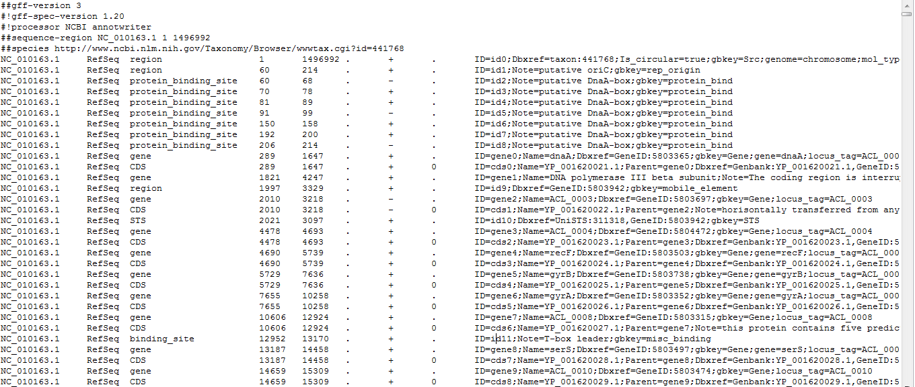
Columns:
1: Seq ID
2: Source
3: Type
4: Start
5: End
6: Score
7: Strand
8: Phase
9: Attribues (itself subdivided)

Slide 39
NCBI FTP portal
Fungi have a similar download structure as bacteria
Other Eukaryotic genomes unfortunately do not have a standard format in this folder, meaning you have to dig through the Refseq and Genbank folders
Genome reports have helpful tables linking all this information together: ftp://ftp.ncbi.nlm.nih.gov/genomes/GENOME_REPORTS/
Unfortunately, @$*%# NCBI did not make them tab-delimited so you can’t easily use them in Excel, or even Perl!

Slide 40
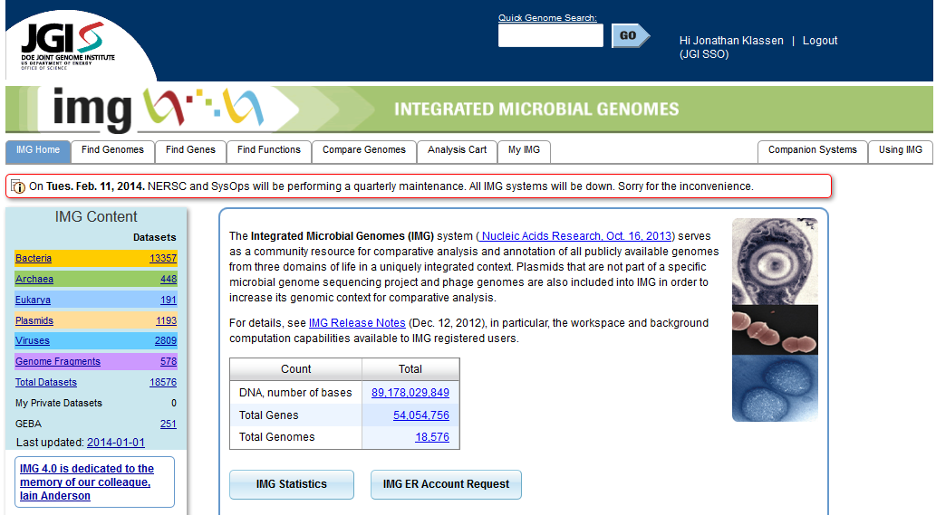
IMG: Integrated Microbial Genomes http://img.jgi.doe.gov/

Slide 41
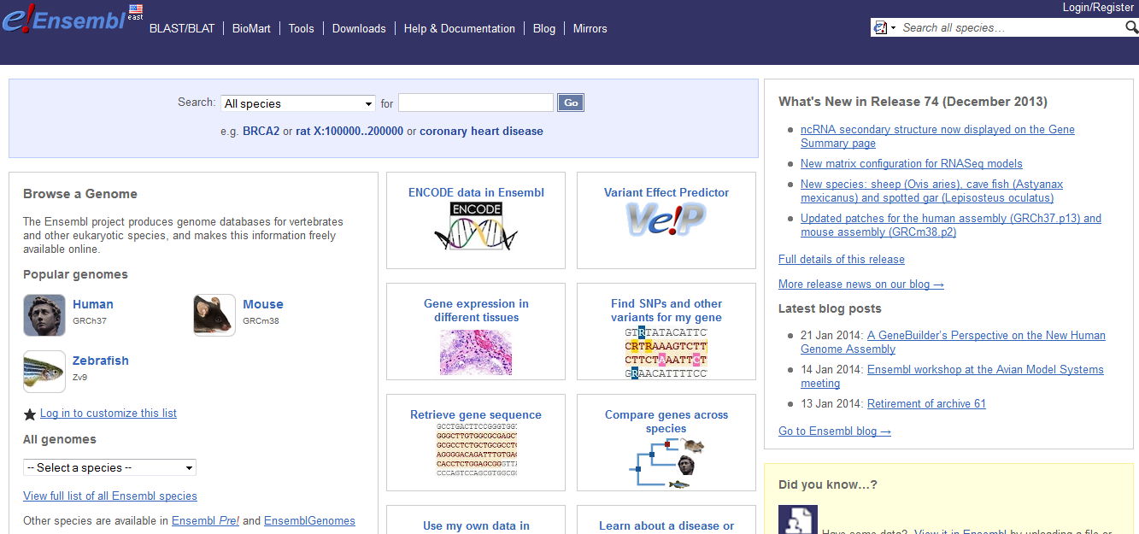
Ensembl: www.ensembl.org

Slide 42
Next: Dr. Jill Wegrzyn, Biotechnology Center Cluster
Reminder: Assignments due Wed before class
Note: I will not be very available to answer questions Tues evening
This Wed: Introduction to Perl part 2

