Slide 1
MCB 5472 Lecture 2 Feb 3/14
GenBank continued
Primer: Genome sequencing and assembly

Slide 2
Genbank
Founded in 1982 at the Los Alamos National Laboratory
Initially managed at Stanford in conjunction with the BIOSCI/Bionet news groups
1989-92 transition to the NCBI on the east coast
One precursor was Margaret Dayhoff’s Atlas of Protein Sequence and Structure
In 1987 genbank fit onto a few 360 KB floppy disks.
Genbank uses a flat file database format (see http://en.wikipedia.org/wiki/Flat_file_database)
NCBI does not use a relational databank (as in Oracle, peoplesoft)
NCBI stores data in ASN.1 format (http://en.wikipedia.org/wiki/Abstract_Syntax_Notation_One), which allows to hardwire crosslinks to other data bases, and makes retrieval of related information fast.
NCBI’s sample record (http://www.ncbi.nlm.nih.gov/Sitemap/samplerecord.html) contains links to most the fields used in the gbk flatfile.
In the genbank records at NCBI the links connect to the features (i.e. the pubmed record, or the encoded protein sequence) --- not easy to work with.
611860050

Slide 3
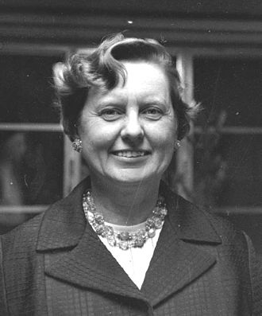
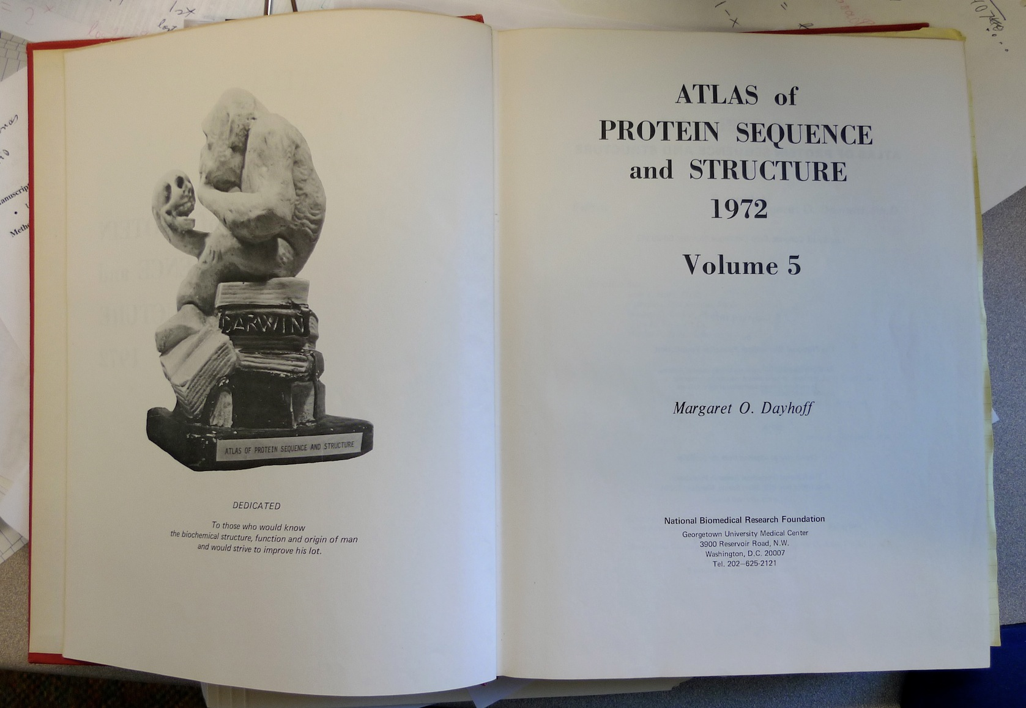
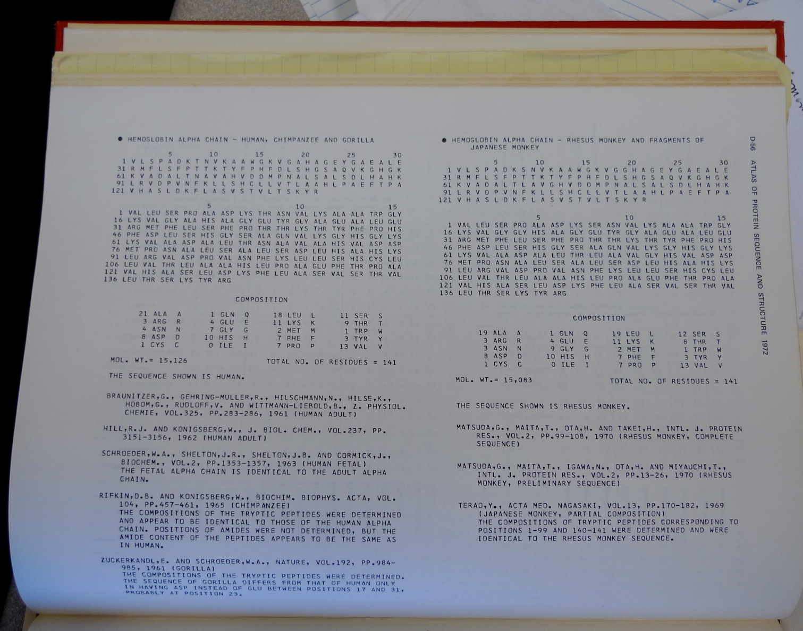
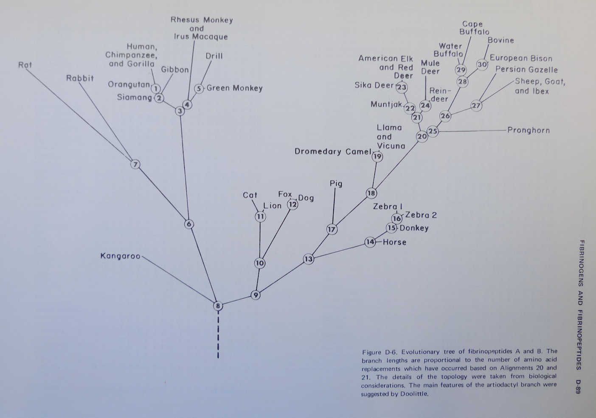
Dr. Margaret Belle (Oakley) Dayhoff March 11, 1925 – February 5, 1983
Among other things, we owe her the first nucleotide and protein data bank, the PAM substitution matrix, and the single letter amino acid code. (Image from wikipedia)

Slide 4
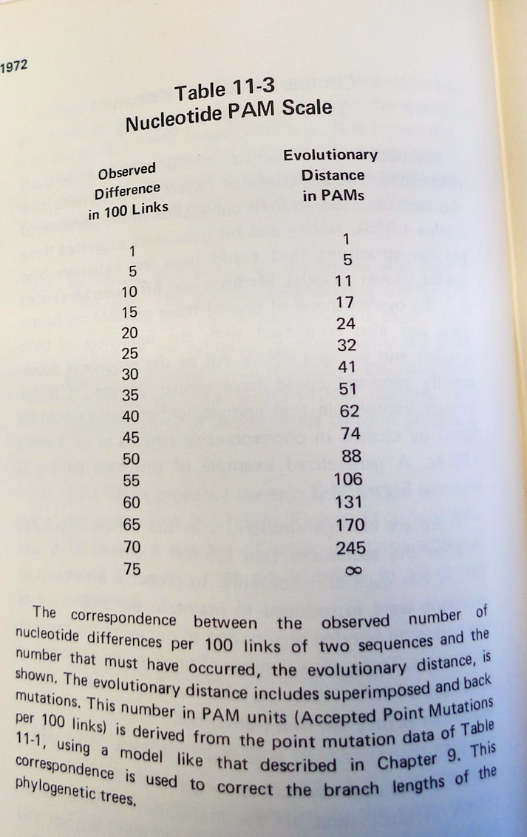
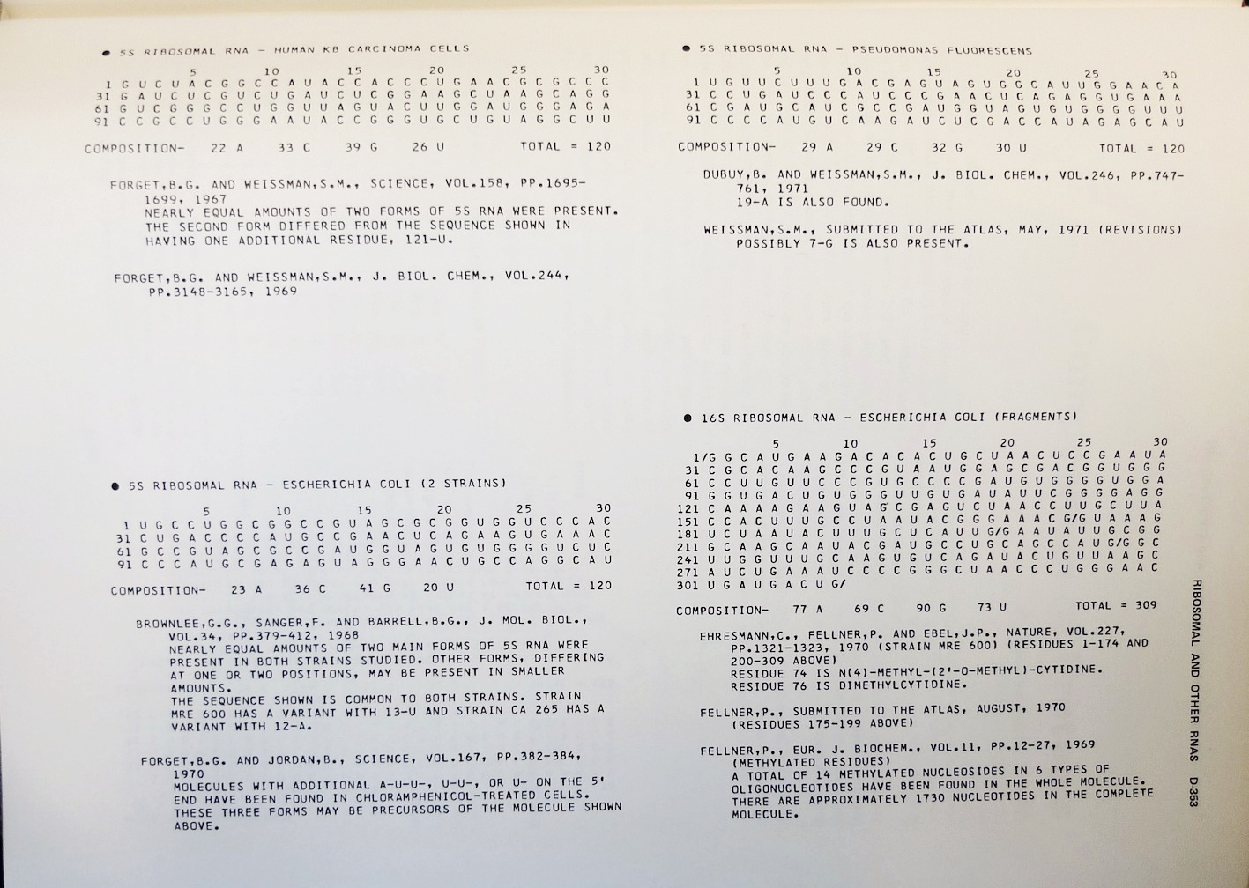
Atlas of Protein Sequences 1972 (cont)
The Atlas also contained RNA sequences, and PAM matrix for nucleotides

Slide 5
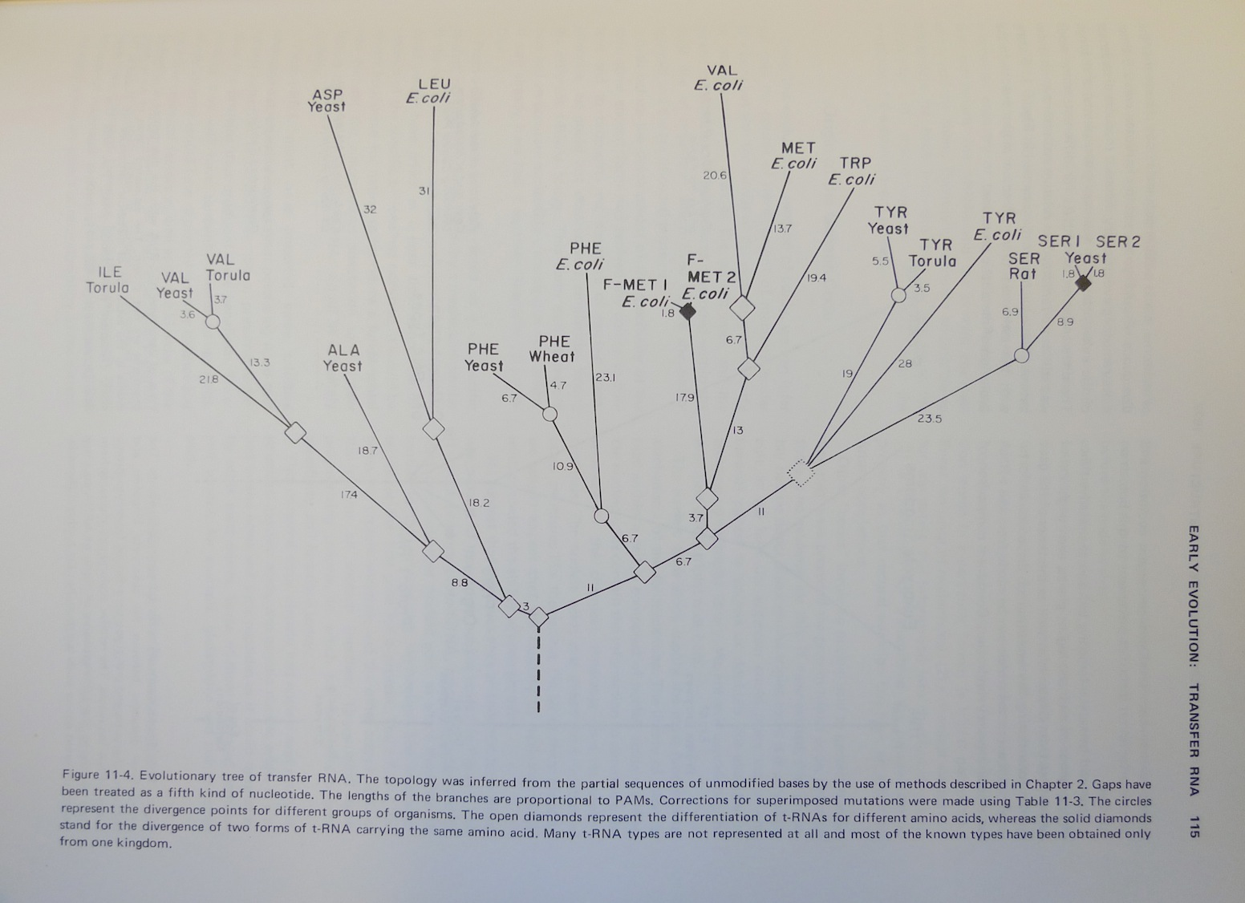
Atlas of Protein Sequences 1972 (cont)
Contained phylogenetic reconstructions that went back in time to far before the Last Unversal Common Ancestor (LUCA) aka the cenancestor of all living cellular organisms alive today.
tRNA phylogeny

Slide 6
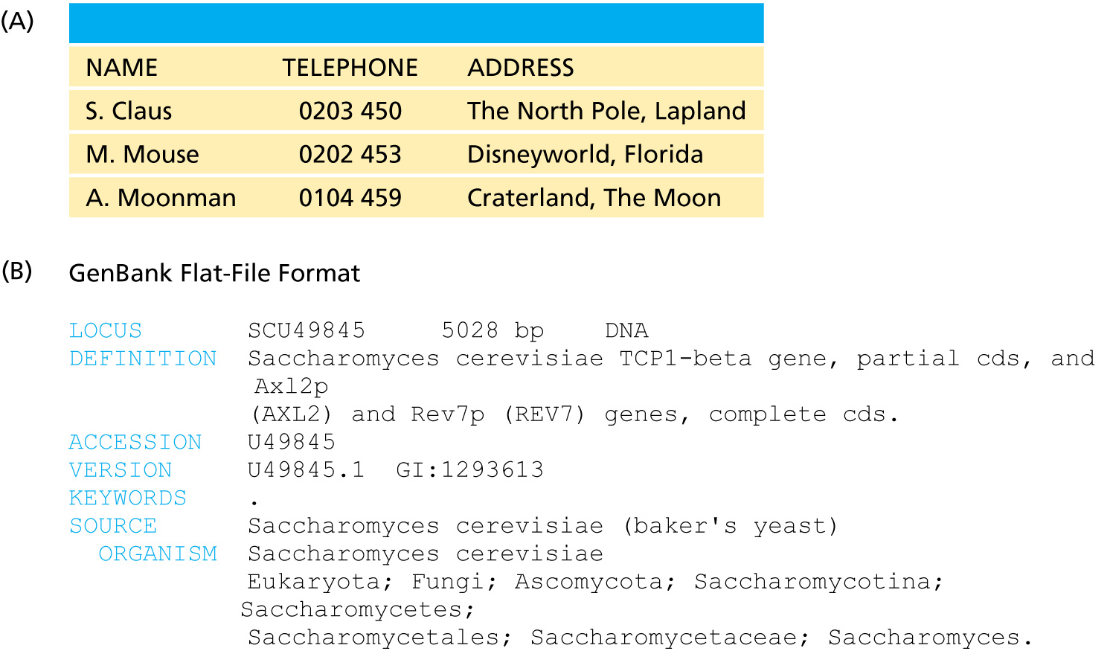
Relational vs flat-file

Slide 7
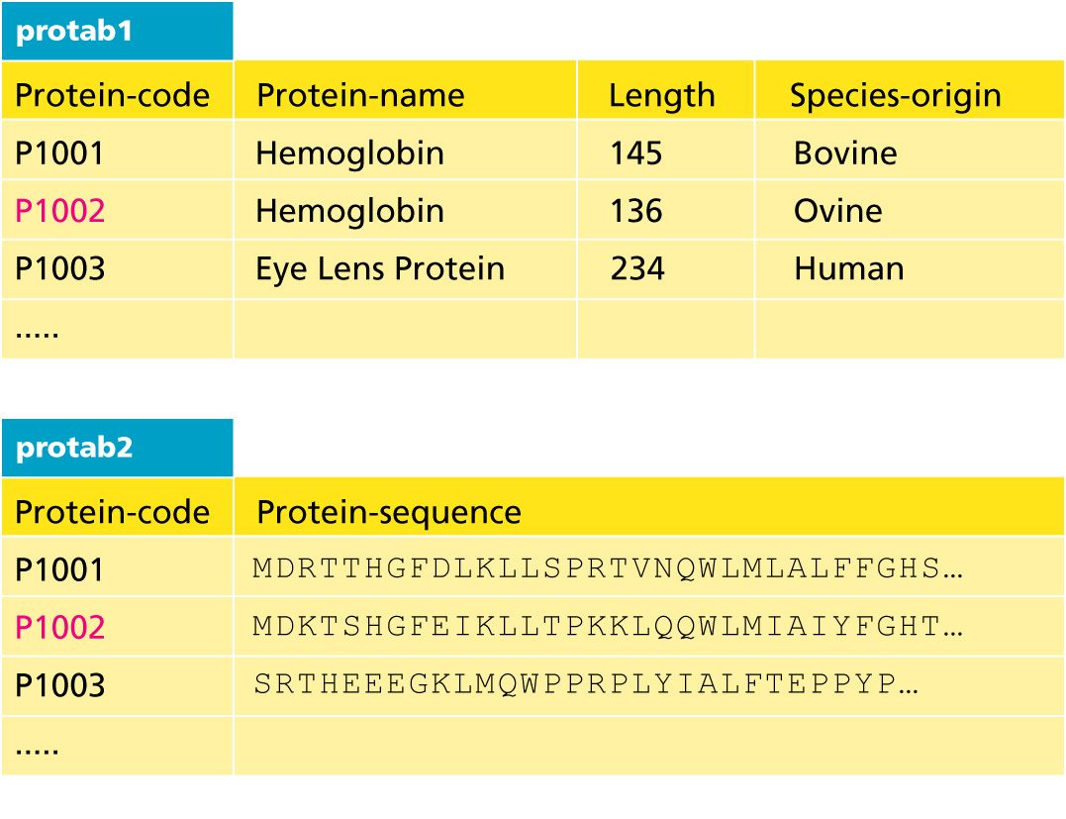
data tables
SQL can be used to connect/join and search tables
Example: GI numbers -> sequence and GI numbers to taxonomic information

Slide 8
Taxonomy at the NCBI
The taxonomy browser at NCBI is well maintained and useful, despite sometimes using strange labels (domains are labeled as superkingdoms)
The taxonomic categories are linked to available sequences (genomes, proteins, nucleotide)
The FTP site at the NCBI is a taxonomic wasteland: the archaeal genomes are stored in the folder labeled Bacteria.

Slide 9
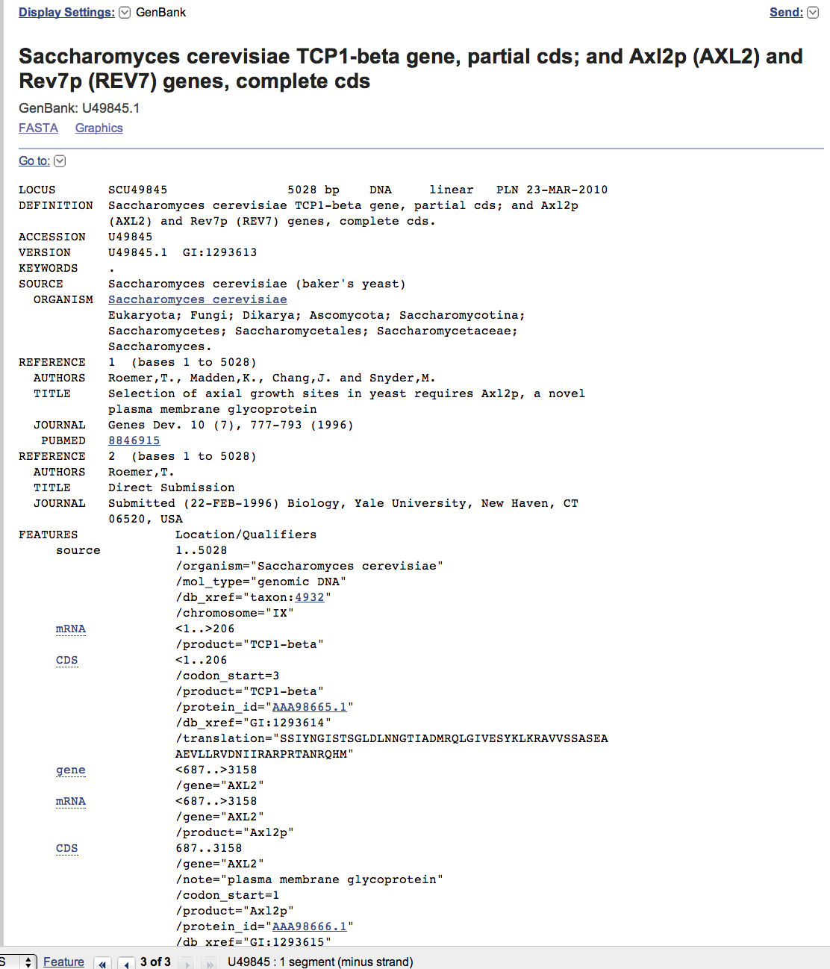
To obtain a CDS from a gene at NCBI
Click on the CDS you are interested in

Slide 10
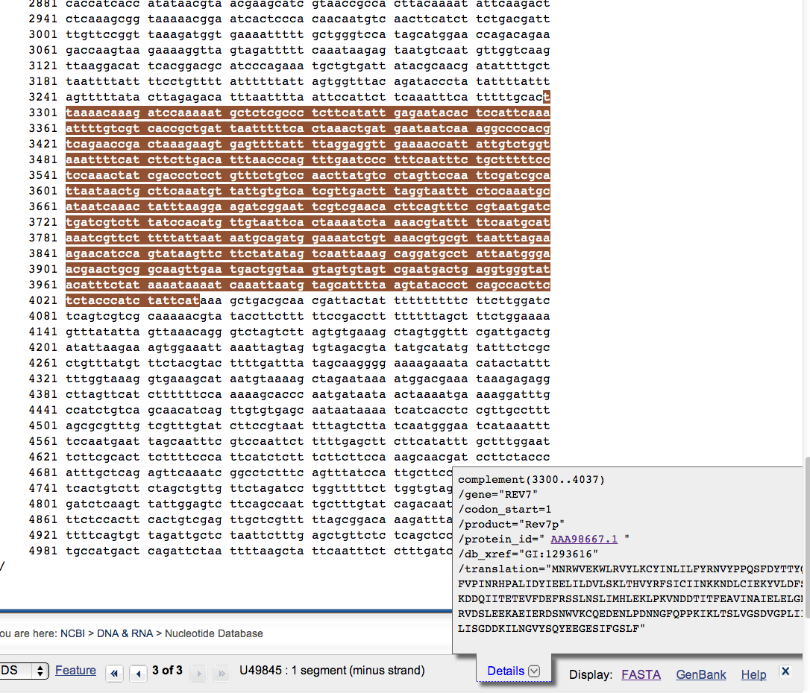
To obtain a CDS from a gene at NCBI
Keep in mind for later!
Click on the FASTA link

Slide 11
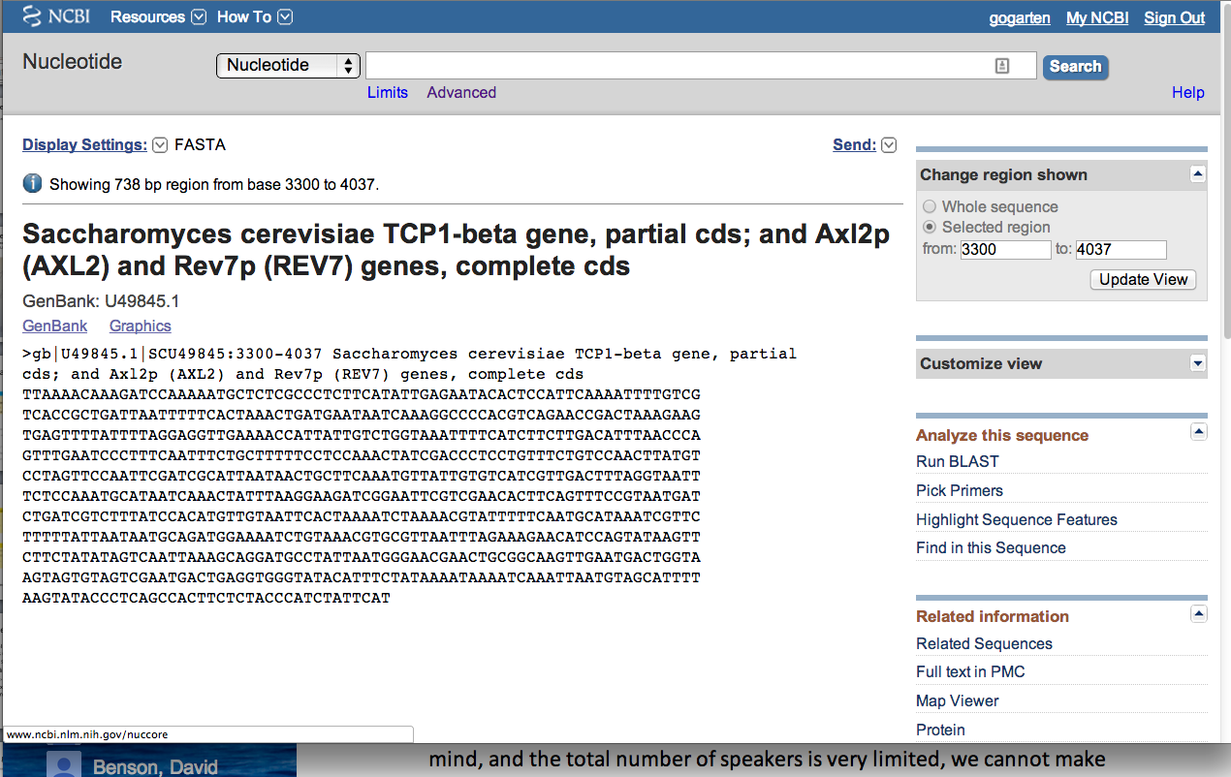
To obtain a CDS from a gene at NCBI
Note that the header indicates that this is only part of the genbank entry, the rest of the annotation line is for the original entry

Slide 12
To obtain a CDS from a gene at NCBI
Note that the sequence is from the non-coding strand, to get the complement click here

Slide 13
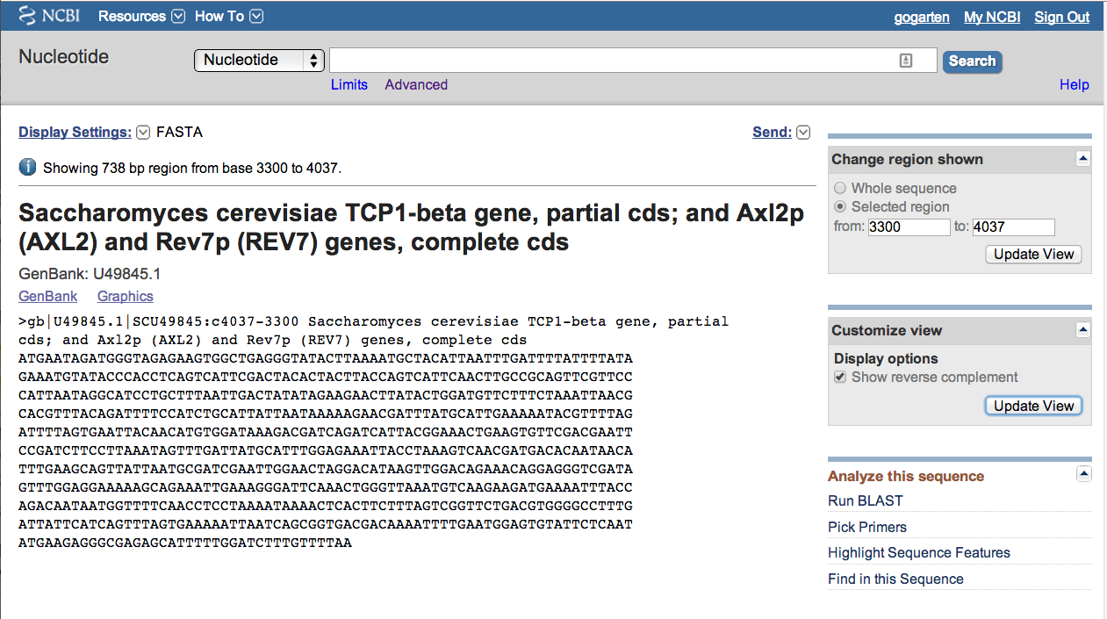
To obtain a CDS from a gene at NCBI
Place check mark here
And update view

Slide 14
gff (Genome Feature Format)
A compact tabular annotation format, especially common for larger eukaryotic genomes
Does not include sequences
An input file type for many genomics programs (particularly sequence viewers)

Slide 15
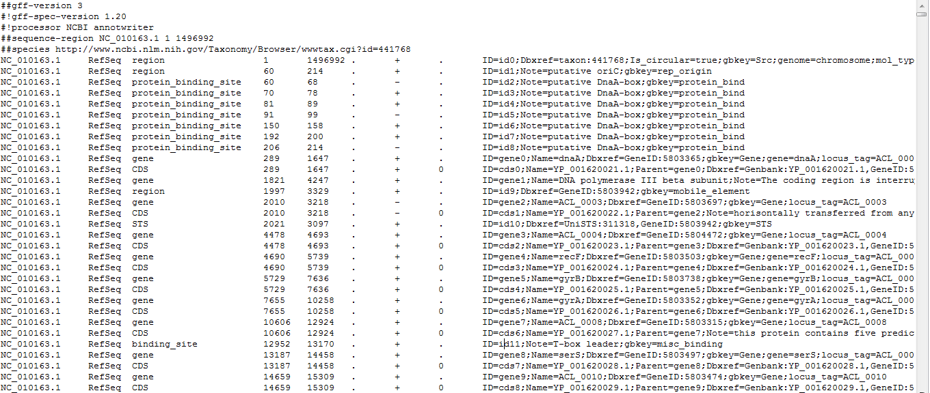
Columns:
1: Seq ID
2: Source
3: Type
4: Start
5: End
6: Score
7: Strand
8: Phase
9: Attributes (itself subdivided)

Slide 16
Genome sequencing and assembly: a primer
Analyses are only as good as their input data…

Slide 17
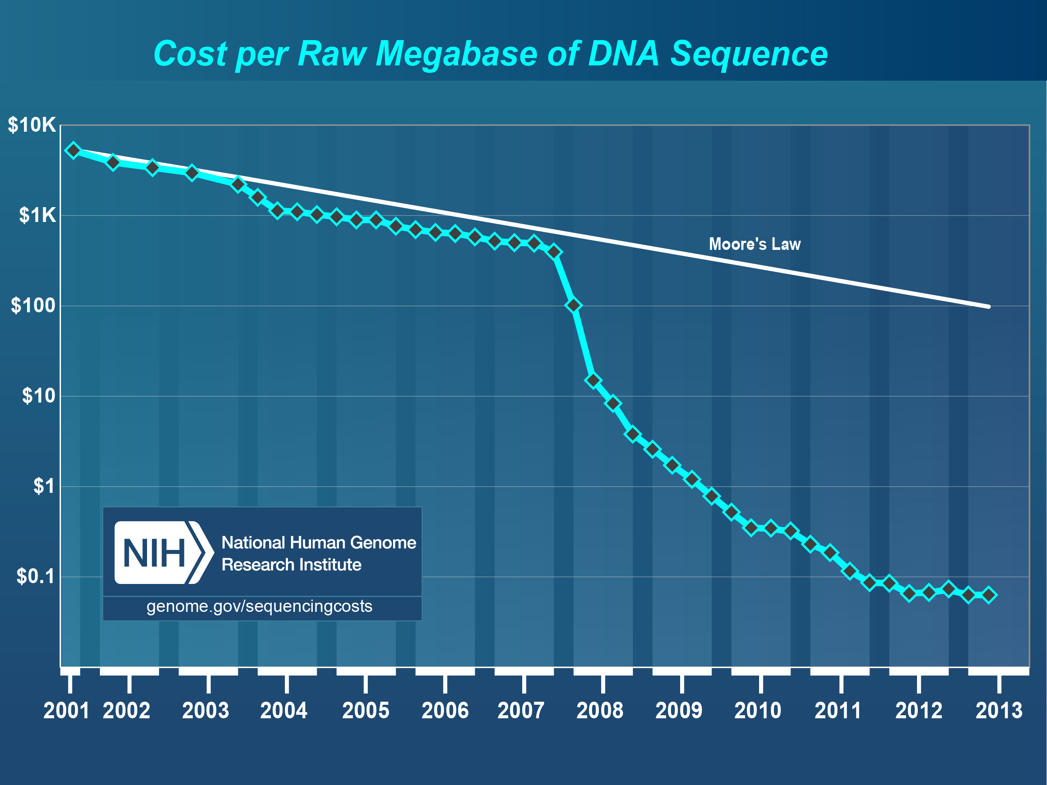

Slide 18
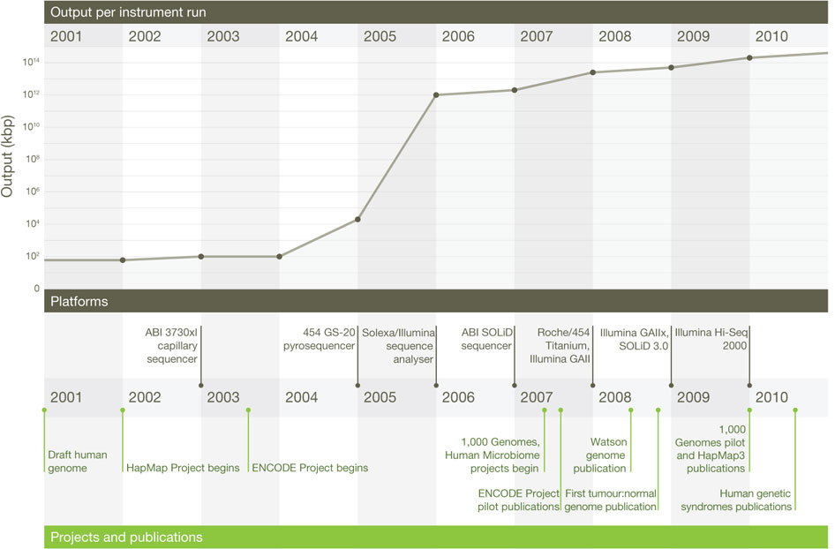
Changes in instrument capacity over the past decade, and the
timing of major sequencing projects
ER Mardis. Nature 470, 198-203 (2011) doi:10.1038/nature09796

Slide 19
15GB; 2x300bp; ~$100K; ~1d
120GB; 2x150bp; ~$250K; ~1d
1TB; 2x125bp; ~$740K; 6d
18TB; 2x150bp; $10M; 6d
http://www.illumina.com/systems.ilmn

Slide 20
Why it matters
How a genome was sequenced matters for molecular evolution studies
Different sequencing methods have different error profiles
Different sequencing methods require different assembly methods, each with different biases and error profiles

Slide 21
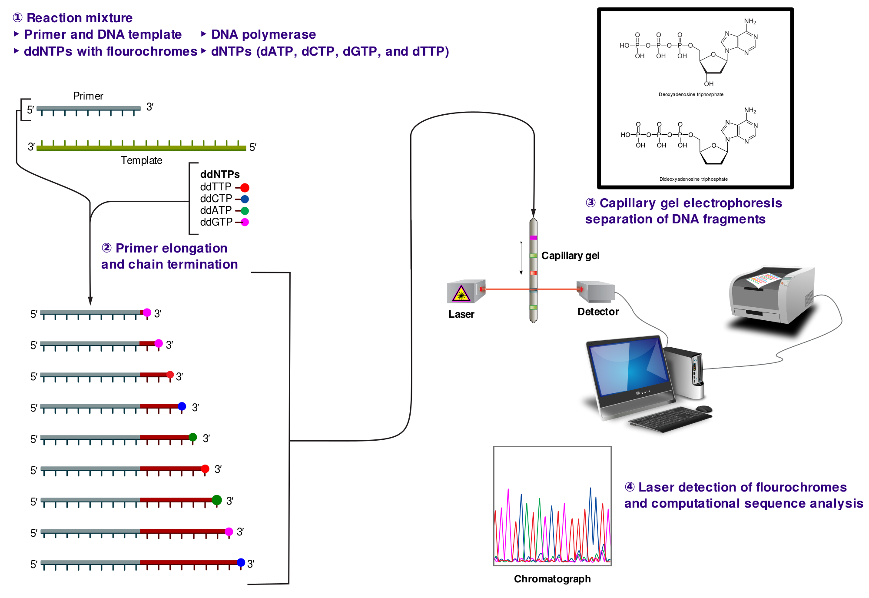
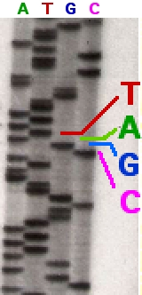
Sanger sequencing
http://en.wikipedia.org/wiki/File:Sanger-sequencing.svg
http://en.wikipedia.org/wiki/File:Sequencing.jpg

Slide 22
Sanger sequencing
High quality, especially because often manually examined
Low throughput, high cost
Read lengths 900-1000bp
Still gold standard method for DNA sequencing (and most common!)

Slide 23
454 sequencing
Introduced in 2005
Moderate throughput, cost
Up to ~700bp read lengths
Homopolymer errors problematic
e.g., “AAAAA” vs “AAAA”
Mardis (2008) Ann. Rev. Genom. Hum. Genet. 9:387-402

Slide 24
Overlap/layout/consensus genome assembly
Compare all reads to each other to find those that overlap
Create overlap graph arranging reads according to their overlaps
Find unique path through the graph
Assemble overlapping reads by aligning the reads and deriving consensus

Slide 25
Overlap/layout/consensus genome assembly
Nodes: reads
Edges: alignments
Only one unique path
Leverage alignment probabilities
http://gcat.davidson.edu/phast/index.html

Slide 26
Overlap/layout/consensus genome assembly
Requires all-vs-all comparison of reads
becomes computationally intensive as the number of reads increases
Developed and applied for Sanger and 454 sequencing

Slide 27
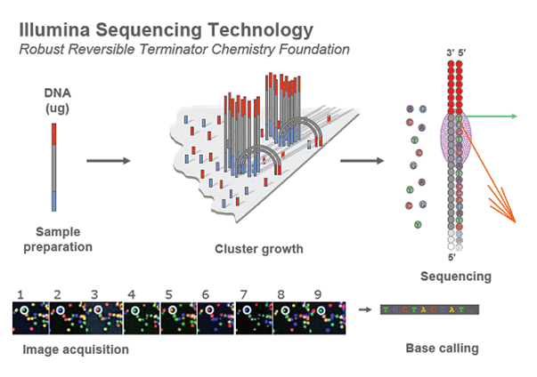
Illumina sequencing
Introduced 2006
Short reads
High throughput
Substitutions are main error
http://openwetware.org/images/7/76/BMC_IlluminaFlowcell.png

Slide 28
De Bruijn graph assembly
Instead of comparing all reads with each other, split reads up into kmers
i.e., subsets of each read of a given length
k=4
TGGC, GGCA
GCAT, CATT, ATTG, TTGC, TGCA, GCAA
TGCA, GCAA, CAAT
CAAT, AATT
ATTT, TTTG, TTGA, TGAC
http://gcat.davidson.edu/phast/index.html

Slide 29
De Bruijn graph assembly
Draw a graph of kmer overlap
Find unique path through graph
̶ Leverage
kmers next
to each
other
in reads
http://gcat.davidson.edu/phast/index.html

Slide 30
De Bruijn graph assembly
Doesn’t need all-vs-all comparison so is much faster
Can handle large numbers of reads, e.g., as generated by Illumina technology
Graph is much more complicated, RAM intensive
More sensitive to errors

Slide 31
Other technologies
SOLiD: different technology but similar data to Illumina, i.e., short reads, high throughput
Ion Torrent: different technology but similar data to 454, i.e., moderately long reads, moderate throughput, homopolymer errors

Slide 32
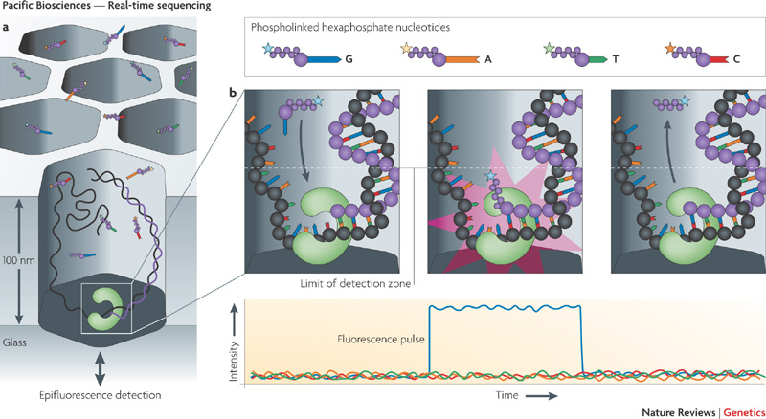
PacBio sequencing
Metzker (2010) Nat. Rev. Genet. 11: 31-46

Slide 33
PacBio sequencing
Single molecule (no PCR needed)
Long reads (up to 30KB)
Can read modified bases
High error rate (~12%), mostly substitutions
Can overcome using high coverage
Assembly via overlap/layout/consensus methods

Slide 34
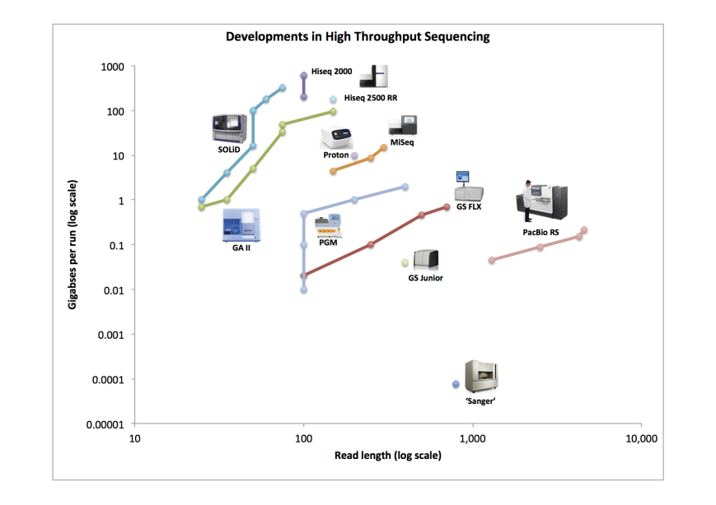
Trade off between read length & throughput
Lex Nederbragt (2013): developments in NGS. figshare. http://dx.doi.org/10.6084/m9.figshare.100940.

Slide 35
Why is read length important?
Consider a genomic repeat
Each repeat is larger than the read length
Where should reads inside the repeat be placed?
OR: who do you chose between loops in the De Bruijjn graph?
http://gcat.davidson.edu/phast/index.html

Slide 36
Define: contig
A contig is a stretch of DNA without any gaps
The result of sequencing read assembly

Slide 37
How do assemblers respond to repeats that they can’t resolve?
Break the graph into multiple contigs
Some reads are never included in draft genomes
Lowers genome quality
http://gcat.davidson.edu/phast/index.html

Slide 38
Does it matter? Are real genomes too complex to assemble using short reads?
Experiments using simulated reads from model genomes

Slide 39
Bacteriophage λ & E. coli
Phage $λ$
E. coli
As read lengths increase, more of the genome becomes unique
Reads from real genomes (solid lines) do not become completely unique
Dashed is random reads for same sized genome
Whiteford, N. et al. (2005) Nuc. Acids Res. 33, e171

Slide 40
E. coli
Each line is % contigs > that size in bp
E. coli genome is ~4.6 Mbp
Still far from complete assembly at 200bp
Assembly largely in gene-sized fragments
Whiteford, N. et al. (2005) Nuc. Acids Res. 33, e171

Slide 41
C. elegans
Still unassembled at 100bp
Whiteford, N. et al. (2005) Nuc. Acids Res. 33, e171

Slide 42
C. elegans
C. elegans genome size: ~100 Mb
Still far from complete at 200 bp
Gene sized fragments reasonable (note genes have introns and so are larger)
Whiteford, N. et al. (2005) Nuc. Acids Res. 33, e171

Slide 43
Human chromosome 1
Dashed: chr 1
Solid: whole genome
Still many 125bp reads that can’t be uniquely mapped
Whiteford, N. et al. (2005) Nuc. Acids Res. 33, e171

Slide 44
Human chromosome 1
Chr 1 is 249 Mb
Still far from complete assembly at 125 bp
Gene-sized fragments still possible, but getting harder
% genome in contigs > listed size
Whiteford, N. et al. (2005) Nuc. Acids Res. 33, e171

Slide 45
Problem
Recall: Sanger sequencing has long read lengths, but is low-throughput and expensive
Illumina etc. has short read lengths but is high-throughput and cheap
Lots of low quality genomes therefore have appeared
Short-read Illumina etc.
Low coverage Sanger

Slide 46
One result: gene fragmentation
Number & % gene fragments
Correlation with assembly quality (N50)
Klassen & Currie (2012) BMC Genomics 13:14

Slide 47
Definition: N50
Order contigs from longest to shortest
Sum lengths of all contigs
N50 is contig size where you reach 50% of the total assembly size
Other analogous measures, N80 etc.

Slide 48
Gene fragmentation
Can cause your gene to be missed
Confounds gene content analyses
Some genes counted as duplicates
Some genes falsely annotated

Slide 49
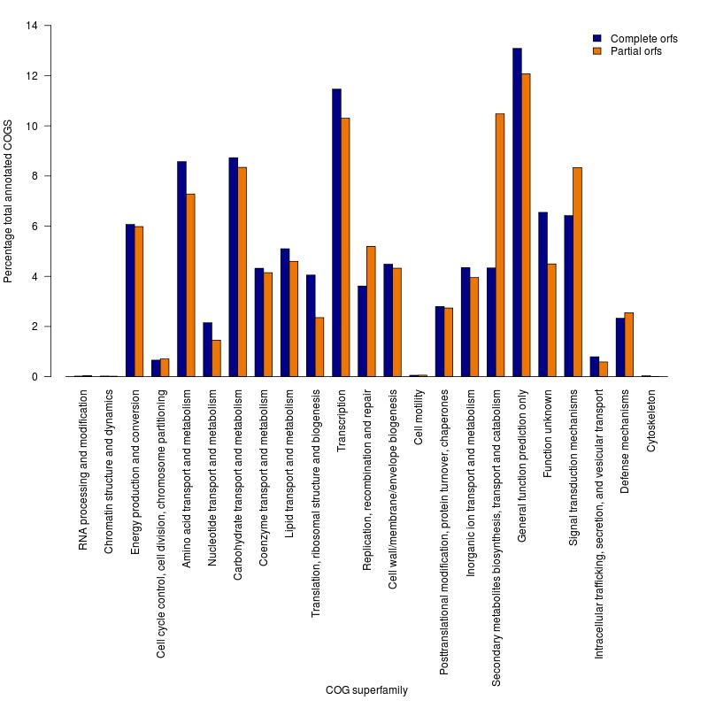
Gene fragmentation affects different genes differently
Klassen and Currie, BMC Genomics (2012) 13: 14

Slide 50
One solution: increase read length
Increasing read length is a focus of several sequencing platforms (PacBio, MiSeq)
These especially (but not exclusively) target bacterial genomes where they are most effective
Not all technologies do this: less applicable for counting applications (e.g., RNAseq) and resequencing

Slide 51
Definition: scaffold
Scaffolds are a series of contigs connected by gaps
i.e., an assembly of contigs
Often the gaps are of known length

Slide 52
Scaffold increase genome quality
Allow some contigs to be merged
Often gaps are small limiting information loss for a genomic region
Allow gross genome structure to be better revealed
Gene fragmentation still exists because contigs are still broken

Slide 53
Mate pair libraries
Illumina method:
Biotinylate fragment
Circularize
Fragment, ligate sequencing adaptors
4 & 5. Sequence from both ends
6. Reconstruct original fragment computationally
Berglund et al. 2011 Invest. Genet. 2:23

Slide 54
Paired libraries
Provide sequence from 2 chromosomal regions
Paired-end: ~300bp apart
Same principle as mate-pair but fancy PCR instead of ligation (cheaper libraries)
Mate-pairs: at least 3kb, often 8kb, 20kb, 40kb
Larger libraries span larger repeats, but can be tricky to make
Costly, lower throughput

Slide 55
Paired libraries
In de novo genome assembly, nearly all read assemblers only use read pairing information AFTER contig assembly during scaffolding
This is starting to change as algorithms mature
Read pairings are often used during read mapping to a reference genome

Slide 56
Resequencing
If you have a high-quality reference genome already, it is often efficient to map sequencing reads to that genome instead of assembling it de novo
Computationally more tractable (restricted search space)
Common for epidemiology, population-level studies
Caveat: you only get what you look for!

Slide 57
Other scaffolding methods
Optical maps: create restriction maps of chromosome, link to genome sequences
Requires reasonable genome assembly to start with
Genetic linkage maps: more classical experimental method of estimating gene location, can be linked to genome sequences

Slide 58
Outlook for sequencing
Two themes:
Illumina increasing throughput, often short reads
Most important for resequencing, counting applications, clinical application
PacBio is recently taking over the de novo assembly niche
Watch for Oxford Nanopore in this space soon

Slide 59
Discuss:
What are some different errors encountered during DNA sequencing?
What effect do they have on molecular evolution studies?
What can be done to mitigate them?

