Slide 1
MCB 5472 Lecture #5: Gene Prediction and Annotation February 24, 2014

Slide 2
Note on the assignment
Depending on your settings PSI-BLAST can take a while to run
Do not leave this until the last minute!
Recall from Assignment Lecture #1: nohup can allow you to leave a job running on the cluster
E.g., nohup [task] & > nohup.out

Slide 3
Do you have a DNA sequence…
Limited utility by itself
Annotations describe what the DNA does
Structural: what features are present on the DNA?
Functional: what do those features do?

Slide 4
How to annotate: 2 methods
From first principles:
Experimental data in the literature
Algorithmic rules
From orthology / homology to previously annotated sequences

Slide 5
Annotation accuracy
Manual annotation from experimental data in the literature is highly accurate
Although not all experiments are unequivocal
Annotations using algorithms can be quite accurate
Depends on the complexity of the problem the algorithm is trying to solve
Annotations based on orthology relies on the assumption that function is conserved
Depends on how rigorously orthologs are defined
Depends on functions not changing over time

Slide 6
Gene annotation
Gene and protein annotation is typically algorithmic
Genes and proteins have specific features that algorithms use to define them
Algorithms for bacteria and archaea work quite well, eukaryotes more difficult because of additional complexity, e.g., splicing

Slide 7
Prokaryote gene finding
Glimmer, GeneMark: Markov Models
Genes modeled based on differences between coding and non-coding regions
E.g., typically start with ATG, end with stop codon
E.g., ORF overlap
E.g., ribosome binding regions
Often have difficulty to decide which strand is coding.
Prodigal: summed likelihood of finding individual gene features
Can be challenged by %GC bias
Better performance by training on known genome annotations

Slide 8
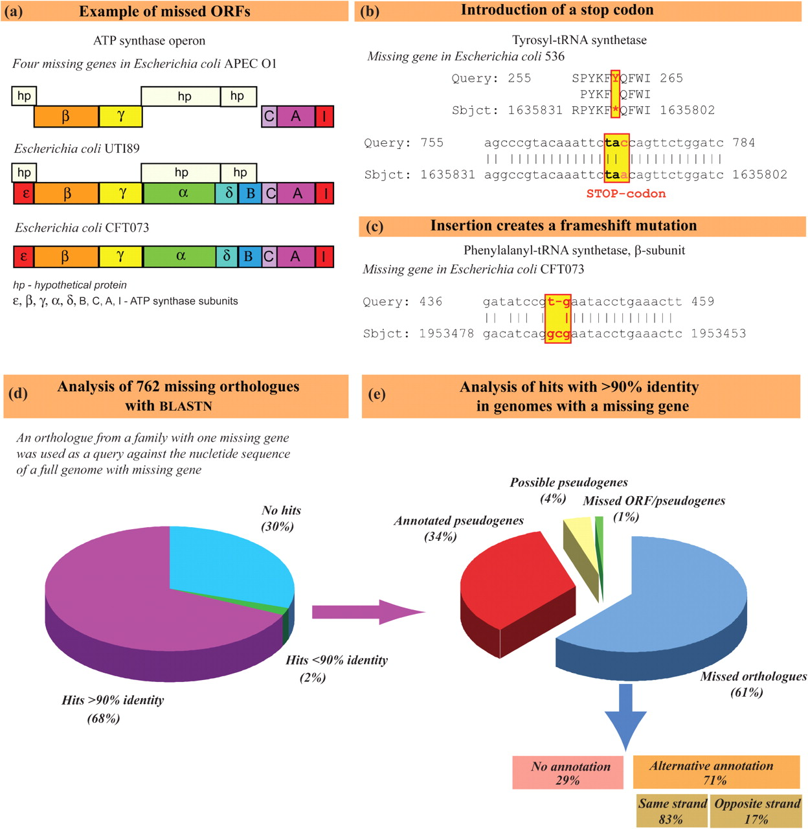
Fig. 1. Analysis of ORFs missing in one out of 30 completely annotated Escherichia genomes.
Poptsova M S , and Gogarten J P Microbiology 2010;156:1909-1917
SGM
Notes:
Analysis of ORFs missing in one out of 30 completely annotated Escherichia genomes. (a) An example of several consecutive ORFs that were not recognized in one genome, even though the complete, uninterrupted ORFs are present. The operon is correctly annotated in the other genomes; however, in E. coli UTI89 additional hypothetical proteins are identified as being encoded on the complementary strand, and in APEC O1 only these hypothetical proteins are identified as ORFs at the expense of the ATP synthase subunit ORFs. (b, c) Examples of substitutions in the nucleotide sequence that led to stop codons (b) or frameshifts (c). Given the importance of the encoded proteins, it seems likely that in some of these instances the mutations are not real but reflect sequencing errors. (d) Distribution of missing genes with respect to blastn searches using the correctly annotated ORF from one of the other genomes as query. (e) Distribution of error types for those missing ORFs that had a match with more than 90 % sequence identity in the genome for which the ORF was missing in the annotation.

Slide 9
Remember: genes are not transcripts!
5’ mRNA analysis in Helicobacter pylori shows much greater transcript diversity than evident from simple gene annotations
Most NCBI annotations equate genes with transcripts
Sharma et al. 2010 Nature 464:250-255

Slide 10
Eukaryotic gene finding
E.g., Augustus, GeneMark-ES
ab initio methods work less well compared to prokaryotic genes
More complicated transcripts (e.g., splice variants)
Less information at promoter (e.g., Prodigal uses Shine-Delgarno sequences; -35 and -10 regions vs. single TATA box)
NCBI annotations more clearly separate genes (includes pseudogenes), mRNA (typically spliced) & protein (spliced like mRNA)

Slide 11
Adding information to gene annotations
Combine multiple prediction methods
For prokaryotes, typically longest transcript chosen
For eukaryotes, typically all splice variants kept
Search for homologous genes in related taxa
True genes will be evolutionarily conserved
Annotation errors can be propagated
Annotations do not specify the evidence supporting them
Integrate RNAseq
Augustus can incorporate into its predictions directly
Rare for prokaryotes
Requires genes be expressed and detectable

Slide 12
Metagenomes and single-cell genomes
Assemblies are typically much more fragmented than those of cultured microbes
Requires dedicated gene prediction methods
Training information often missing/obscured
Gene fragments obscure genomic features used for gene prediction

Slide 13
Non-coding RNAs
Some HMM-based software
RNAMMER (ribosomal RNAs)
tRNAscan-SE (tRNAs)
Rfam: database of non-coding RNA families
Curated sequence alignments taking into account secondary structures
Infernal: software for searching DNA sequence databases using structured RNA molecule profiles
Takes RNA secondary structure into account via “covariance models”
Sister project to Pfam (see later)

Slide 14
Functional annotations

Slide 15
Manual annotation
Low-throughput
High accuracy

Slide 16
SwissProt
Started 1986 at the Swiss Institute for Bioinformatics, later developed at the European Bioinformatics Institute
Goal: providing reliable protein sequences having a high level of annotation
Directly curated from literature information
Contrast to NCBI: a sequence repository with some automated annotation pipelines
Current version (2014_02): 542,503 sequences annotated from 22,6190 references

Slide 17
UniProt
Ultimately manual annotation couldn’t keep up, parallel TrEMBL database created using automated annotation
UniProtKB stores combined SwissProt/TrEMBL databases, incorporates Protein Information Resource (PIR), built on M. Dayhoff’s atlas
Syncs with EMBL/DDBJ/GenBank nucleotide databases
Hosts several protein annotation schemes
ExPASy – major proteomics analysis resource
www.uniprot.org

Slide 18
Manual annotations linked to references

Slide 19
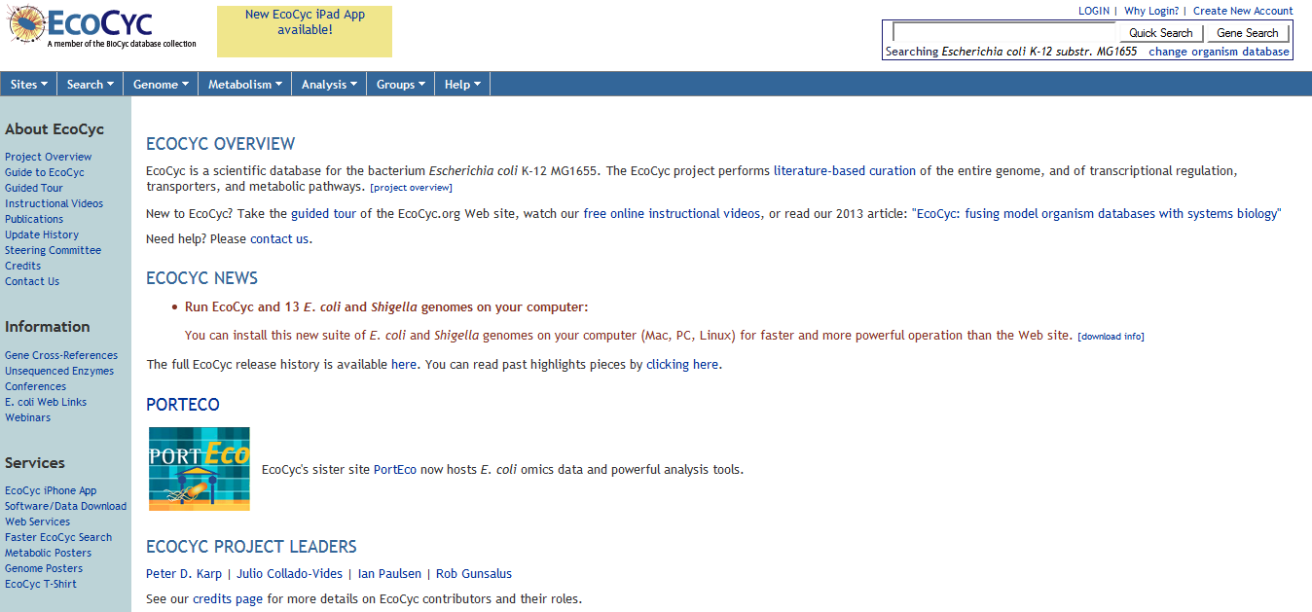
Ecocyc – an example manually edited model organism database
http://ecocyc.org/

Slide 20
Ontologies
Manual annotations originally used free-text labels, not standardized
Problem: free text is difficult for computers to make use of
Ontologies: knowledge representation using standardized terms and interrelationships
Amenable to computation

Slide 21
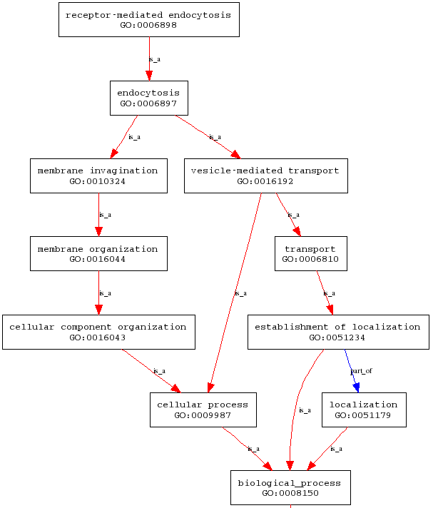
E.g., GO
Controlled vocabulary
Defined relationships
“Directed acyclic graph”
Links are directional
No individually circular paths
http://lopasgen677s09.weebly.com/gene-ontology.html

Slide 22
Gene Ontology (GO)
http://www.geneontology.org/
Consortium that defines standardized terms and relationships
Centered on model organism databases
E.g., human, mouse, Drosophila, E.coli
Most curation derived from these sources, but do extend more broadly
Linked and mapped to many other resources
Used by many computational analysis tools

Slide 23
GO domains
GO is divided into three domains, encompassing three separate functional properties
Biological process: what it does
Molecular function: how it does it
Cellular component: where it does it

Slide 24
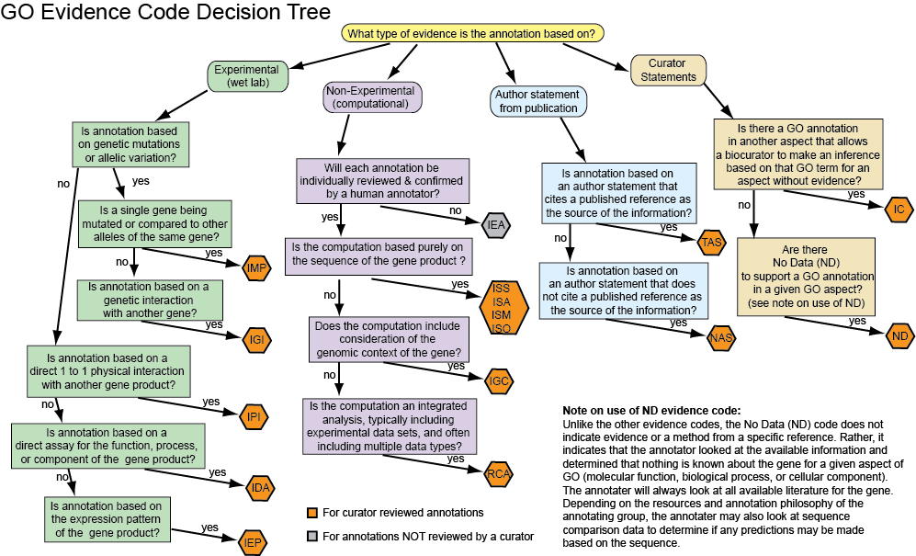
GO evidence codes
GO uniquely has an ontology to describe the evidence supporting annotations
http://www.geneontology.org/GO.evidence.tree.shtml

Slide 25
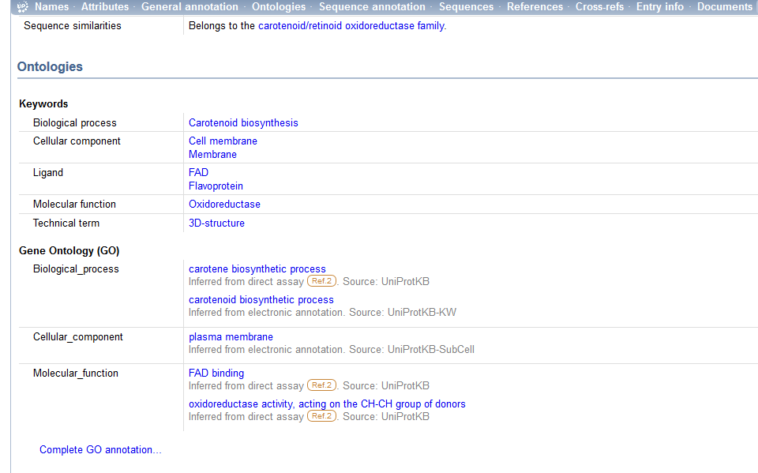
GO on UniProt

Slide 26
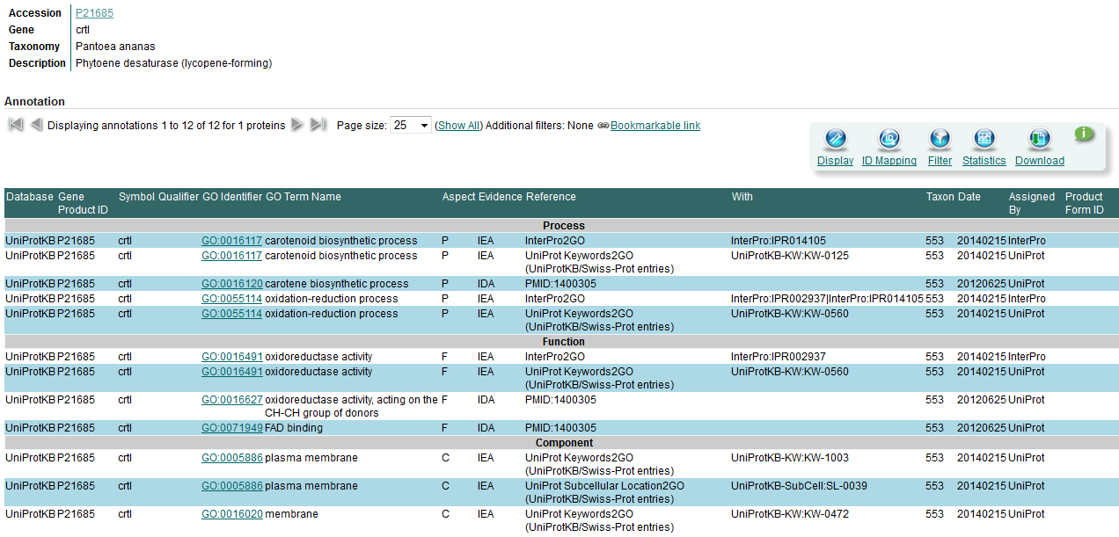
GO on UniProt
Some GO annotations added manually
Some mapped to other term databases

Slide 27
Annotation families
There are many different types of protein annotations, often with different foci and methods
Hand vs. automatically generated
Entire vs partial proteins

Slide 28
Pfam
http://pfam.sanger.ac.uk/
Originally constructed in the late 1990’s for annotation of the C. elegans genome
Developed & maintained by the Sanger Institute and S. Eddy (now Howard Hughes)
Purpose: to overcome the % alignment problem inherit to BLAST
i.e., BLAST hits may not reflect homology over the entire query and/or reference sequence
Currently (v27.0) 14,831 manually curated protein domain families

Slide 29
Pfam
Pfam-A: manually selected and aligned alignments and HMMs of protein domains
v27.0: 14,831 families
At least 1 domain in 80% of proteins in UniProt
Figure is still scaling with database sizes
Represents 58% of total sequence in UniProt
Pfam-B: automatically-generated families for domains not in Pfam-A
Mostly families with only a few members

Slide 30
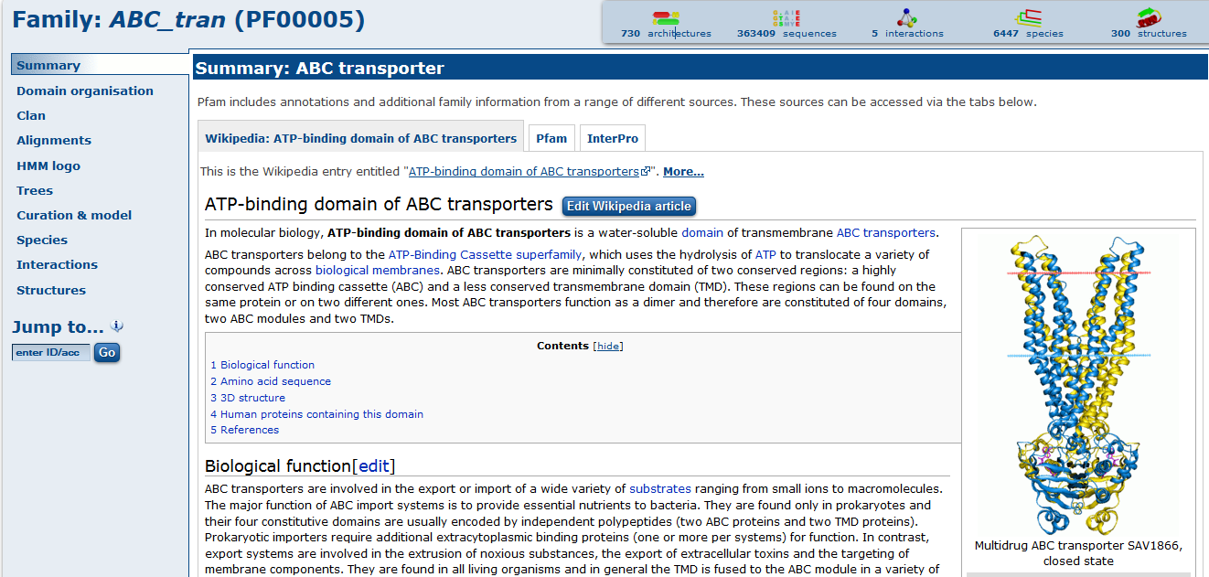
Pfam example

Slide 31
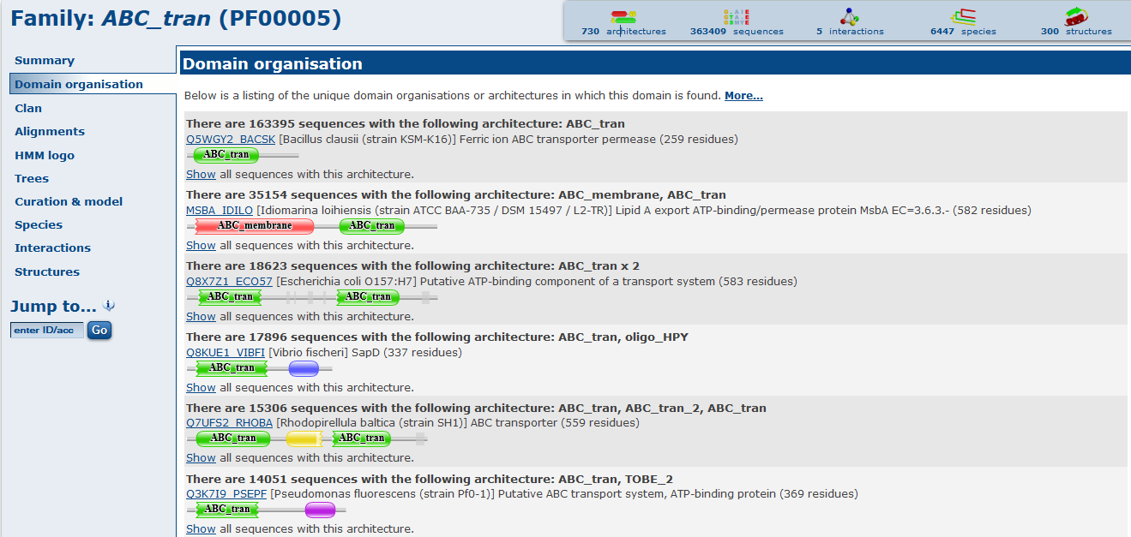
Pfam example

Slide 32
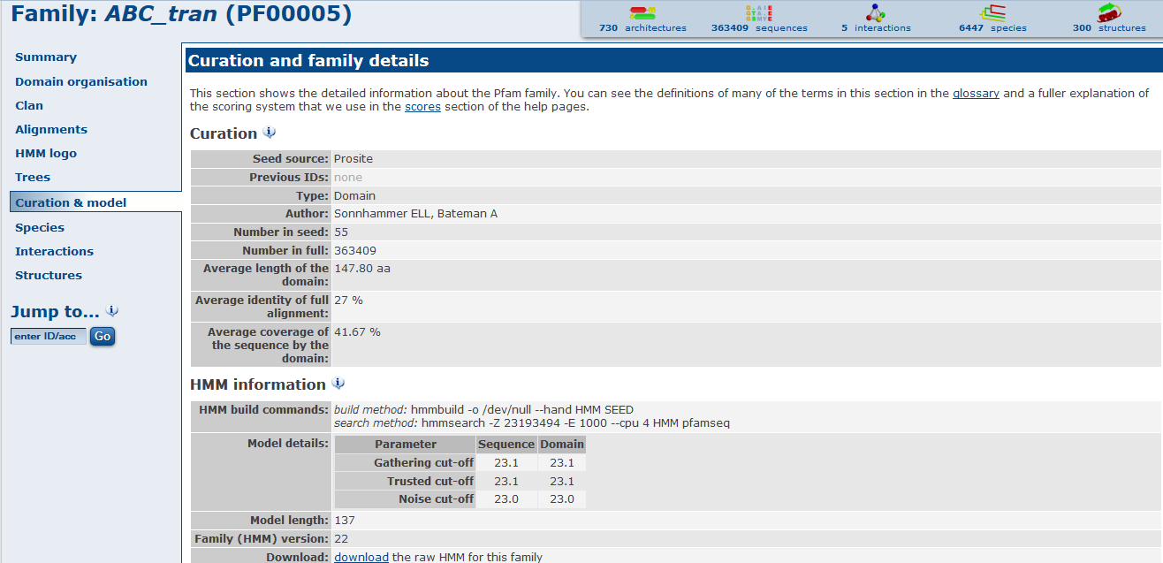
Pfam example

Slide 33
Clusters of Orthologus Groups (COG)
One of the earliest attempts to define protein families by orthology (Tatusov et al 1997 Science)
Used BLAST between proteins from multiple genomes to define triangles, i.e., triplets where each is a best match to the others
Kristensen et al. 2010 Bioinformatics 26:1481-1487

Slide 34
COG triangles
Allows single-direction best hits
Start with central triangle and add edges whenever possible
Causes paralogs to be linked
Allows distant & fast evolving homologs to be linked through intermediates
Sold lines: RBHs
Dotted lines: single direction
Tatusov et al 1997 Science 278: 631-637

Slide 35
COGs
Bacterial COGs not updated often (last 2003)
COGs more recently defined for other groups:
KOGs (eukaryotes)
arCOGs (archaea)
POGs (phages)
Each COG family has a free-text annotation
4873 families total
Grouped into 24 superfamilies
COGs can belong to >1 superfamilies

Slide 36
eggNOG
‘evolutionary genealogy of genes: Non-supervised Orthologous Groups’
Constructed & maintained by EMBL (Peer Bork)
Attempt to extend and update COG/KOG database annotations without requiring manual annotations (which do not scale)

Slide 37
eggNOG: method
Use BLAST/fasta/Smith-Watterman alignments to find best matches
Represent in-paralogs by single sequences
Map sequences to COG/KOGs
Triangle cluster non-matching sequences
Add single RBH hits to clusters
Automatically split multi-domain proteins
Derive annotations by consensus within groups derived from multiple annotation sources

Slide 38
eggNOG:
http://eggnog.embl.de/version_4.0.beta/
107 different annotation levels
1.7 million ortholog groups
7.7 million proteins
Probably the currently most comprehensive ortholog database
Can use to construct PSSMs/HMMs

Slide 39
Interpro
Classifies proteins according to a combination of multiple protein motifs
Multiple sources synthesized into single Interpro classification system
Four broad annotation types: Family, Domains, Repeats, Sites
Interpro terms mapped to GO
InterProScan – resource to annotate proteins using all member databases
HMM and regular expression-based classifications

Slide 41
Interpro: member databases
Pfam (domains, curated; Sanger)
PROSITE (diagnostic motifs; SIB)
HAMAP (homologs, curated; SIB)
PRINTS (conserved motifs; U. Manchester)
ProDom (domains, automatic via PSI-BLAST; PRABI Villerubanne)
SMART (domains and architectures esp. signaling, curated; EMBL)
TIGRFAMs (homologs, curated; JCVI)
PIRSF (homologs & domains, ; Georgetown)
SUPERFAMILY (structures, curated, U Bristol)
CATH-Gene3D (homologs, mapped to structures, automatic via Markov clustering; University College London)
PANTHER (functional homologs, curated, USC)

Slide 42
Conserved Domains Database (CDD)
Protein classification database maintained by NCBI
CDD database based on domains curated by NCBI using structural alignments
Also includes external resources: Pfam, SMART, COG, PRK, TIGRFAM
Downloadable PSSMs for each CDD family for querying via RPS-BLAST

Slide 43
CD-Search

Slide 45
Are functions actually conserved?
All of the protein annotation methods that we have discussed assume the hypothesis that function is evolutionarily conserved
But we know that this can be confounded by duplication/loss and xenology
Can be addressed by better methods of determining orthology
Not typically accommodated by annotation databases
Even orthologous functions can drift and/or be promiscuous

Slide 46
Are functions actually conserved?
Compare curated GO annotations of orthologs and paralogs
Corrected for annotation biases
Functions of orthologs more similar than paralogs, but not perfectly
Altenhoff et al. (2012) PLoS Comput. Biol. 8:e1002514

Slide 47
Are functions actually conserved?
Same for 13 species instead of just 2
Paralogy potentially a greater confounder
Differences in GO annotation completeness
Altenhoff et al. (2012) PLoS Comput. Biol. 8:e1002514

Slide 48
Are functions actually conserved?
Define function as expression similarity between same human and mice tissues
Same trend: ortholog function more conserved than paralogs, not absolute
Chen & Zhange (2012) PLoS Comput. Biol. 8:e1002784

Slide 49
Are functions actually conserved?
Yes, but not perfectly even for highly conserved sequences
Likely depends on definition of “function”
Annotated functions are likely quite broad in most cases

Slide 50
Protein database vs. pathways and reactions
Protein databases are based on homology
Hypothesis that function is conserved
Reaction databases classify function without reference to homology
Function can be due to evolutionary convergence
GO is an example of this we have already seen
Reaction and pathway annotations are therefore closer to function but further from underlying evolutionary mechanism

Slide 51
Enyzme Commission
One of the oldest functional annotation schemes, arising out of biochemistry
Four part numerical nomenclature having increasing specificity
EC 3: hydrolases
EC 3.4: hydrolases acting on peptide bonds
EC 3.4.11: hydrolases cleaving amino-terminal amino acids from a peptide
EC 3.4.11.4: hydrolases cleaving amino-terminal amino acids from a tripeptide
Database updates are infrequent

Slide 52
Kyoto Encyclopedia of Genes and Genomes (KEGG)
Manually edited pathway database
Orthologs defined in other genomes
Reactions combined into metabolic maps
Pathways are typically quite general
Individual proteins can be freely queried via web
Individual genomes can be annotated via KAAS server
Underlying database NO LONGER FREE

Slide 53
KEGG example

Slide 55
http://www.genome.jp/kegg/kaas/

Slide 56
Biocyc
Collection of curated metabolic pathways
Typically smaller modules compared to KEGG
www.biocyc.org

Slide 57
Metacyc example

Slide 58
Metacyc example

Slide 59
Metacyc example

Slide 60
Uniprot cross-references Interpro, metacyc

Slide 61
Annotation process
Use web to find information about particular proteins
Use individual tools separately on your genome
Allows most customization, proofchecking
Standard for eukaryotic genomes
Use automatic prediction servers
Common for prokaryotes
E.g., NCBI, IMG (JGI), RAST, Megan, MAGE
Each vary slightly in algorithm, user engagement and proofchecking, visualization
Transfer homology from previously-annotated sequences
Can propagate incorrect annotations
Can limit coverage

