Slide 1
MCB 5472 Lecture #6: Sequence alignment March 27, 2014

Slide 2
Sequence alignment
As you have seen, sequence alignment is key to nearly all experiments in molecular evolution
Thus far we have discussed local alignment as implemented in BLAST
Global alignment:
Aligns sequences over their entire length
Assumes that sequences for alignment are homologous

Slide 3
Recall from BLAST lecture:
Sequence alignment is scored:
According to a substitution matrix
Some substitutions are more likely than others
Using affine gaps
Gap opening and extension are considered separately
Reflects biological reality that
Alignment score is the sum of substitution and gaps scores

Slide 4
Pairwise alignments

Slide 5
Needleman-Wunsch
Needleman and Wunsch (1970) J. Mol. Biol. 48:443-453
The first algorithm to computer the optimum alignment between two sequences using dynamic programming
i.e., examines many possible solutions and picks the best
Implemented as EMBOSS needle program
Global alignments: assumes sequences should be aligned over their entire lengths

Slide 6
Needleman-Wunsch
Works by scoring alignments sequentially and evaluating scoring for each alignment position based on previous scores
Gaps in one position may force an unlikely substitution later on
Calculating these scores represents a dynamic programming sub-problem; computationally efficient
Evaluates all possibilities but also maps the best option
Guarantees finding the best path according to the parameters used

Slide 7
Smith-Waterman
Smith and Waterman (1981) J. Mol. Biol. 147:195-197
Local alignment version of Needleman-Wunsch
Guaranteed to find the statistically best local alignment
BLAST only evaluates a subset of alignment possibilities
Implimented in FASTA search program

Slide 8
Multiple sequence alignment

Slide 9
Multiple sequence alignment
Extending similar dynamic programming approaches to calculate all possible sequence alignments quickly becomes impossible
Various tools therefore use different heuristic approaches to align multiple sequences
Different specializations and/or motivations
Different computational efficiency

Slide 10
ClustalW
One of the first widely used multiple sequence alignment programs
Thompson et al. (1994) Nuc. Acids Res. 22: 4673-4680
Larkin et al. (2007) Bioinformatics 23:2947-2948
ClustalX: Widely used version with a graphical interface

Slide 12
ClustalW
Step #1a: Align all pairs of sequences separately
Current default: count kmers conserved between sequences
Can also be global alignments (original defaults)
Step #1b: Calculate distance matrix from pairwise comparisons
Step #2: Cluster distance matrix using neighbor-joining or UPGMA algorithms to create a “guide tree”
Step #3: Midpoint root tree and weight branches by sequence similarity

Slide 13
ClustalW guide trees
Guide trees are no substitute for full phylogenetic analysis!!!
Not based on multiple sequence alignment
Are only a rough approximation of the true relationships between sequences
Even though they can be produced by ClustalW they should not be used for detailed analysis!

Slide 14
ClustalW
Step #4: Progressive alignment
Starting from most similar sequences on guide tree, align each to each other
Uses full dynamic programming alignment methods (cf. N-W) including substitution and gap penalties
Gap opening parameters vary based on sequence position to favor alignment to preexisting gaps
Any gaps introduced are maintained during subsequent alignment iterations

Slide 15
Progressive alignment example
M Q T I F
M Q T I F
L H - I W
M Q T I F
L H - I W
L Q S - W
L - S - F
L H I W
L Q S W
L Q S W
L - S F
L S F
Gaps introduced earlier are propagated into later alignments
Edgar (2004) BMC Bioinformatics 5:133

Slide 16
ClustalW
Step #1
Step #2
Step #3
Step #4
Thompson et al. (1994) Nuc. Acids Res. 22:4673-4680

Slide 17
Thompson et al. (1994) Nuc. Acids Res. 22:4673-4680

Slide 18
ClustalW
No guarantee of optimal alignment
Early errors propagated to more divergent sequences
This is true of all multiple sequence programs
Reasonably accurate when all sequences are ~ <40% identical
Scales reasonably well to a few thousand sequences
Easy to run!
Has been superseded by better programs

Slide 19
ClustalW command line
Easy! Type “clustalw” and follow along

Slide 20
MUSCLE
Edgar (2004) Nuc. Acids Res. 32:1792-1797
Edgar (2004) BMC Bioinformatics 5:133
Designed to improve speed and accuracy over older multiple sequence alignment programs like clustalw
Now a preferred alignment method, especially for high-throughput studies

Slide 21
MUSCLE
Stage #1: create draft progressive alignment
Step #1-1: calculate distance between genomes using kmers, create distance matrix
Step #1-2: cluster distance matrix into guide tree using UPGMA algorithm
Step #1-3: conduct progressive multiple sequence alignment
Accuracy sacrificed for speed at this step
So far, same as clustalw but faster and less accurate

Slide 22
MUSCLE
Stage #2: refine progressive alignment
Most inaccuracy in Stage #1 due to using kmer distances to create guide tree
Step #2-1: re-create distance matrix using Kimura distances (more accurate, need input multiple sequence alignment)
Step #2-2: cluster distance matrix using UPGMA
Step #2-3: recalculate progressive alignment, omitting alignments that stayed the same from Step #1-3
Result: more accurate alignment than Stage #1

Slide 23
MUSCLE
Stage #3: Alignment refinement
Step #3-1: moving from root to tip in the tree from step #2-2, remove that node and spit the alignment into two subalignments
Step #3-2: compute alignment profiles for each subalignment
Step #3-3: re-align profiles to each other
Step #3-4: determine if new alignment has a better score than the previous one, if so keep new one and goto step #3-1 using the next node in the tree
Stop when scores stop improving

Slide 24
Profile alignment
Can yield better gap placement by removing biases from original pairwise alignments
Edgar (2004) BMC Bioinformatics 5:133

Slide 25
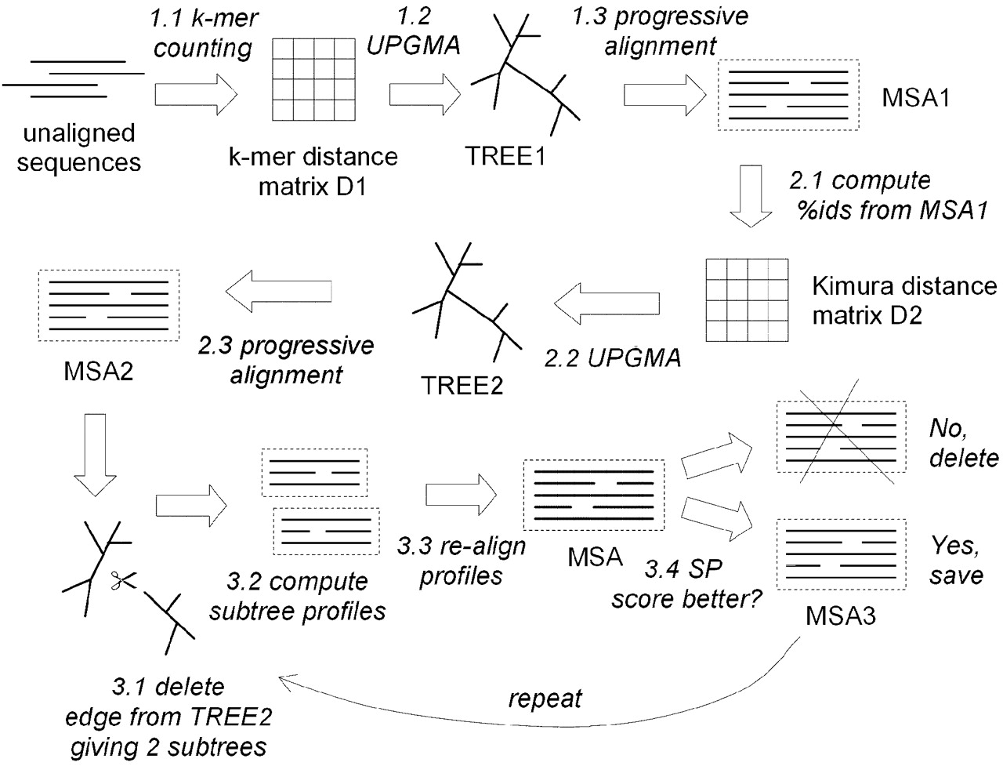
MUSCLE
Edgar (2004) Nuc. Acids Res. 32:1792-1797

Slide 26
MAFFT
Katoh et al. (2002) Nucl. Acids Res. 30:3059-3066
Katoh & Standley (2013) Mol. Biol. Evol. 30:772-780
Similar to MUSCLE, designed to improve speed and accuracy of multiple sequence alignment vs. clustalw

Slide 27
MAFFT
Instead of progressive alignments, MAFFT uses a “fast Fourier transform”
Creates local alignment blocks based on physico-chemical properties of amino acids (esp. volume & polarity)
Very fast!
Does not require calculating alignments exhaustively, rather how blocks link together
Statistical framework the same for pairwise and multiple alignments

Slide 28
MAFFT
Scoring system dramatically simplified relative to clustalw (uses complicated heuristic normalizations)
Contains an optional iterative refinement method (similar to MUSCLE)
Newer versions contain robust profile alignment methods (i.e., aligning alignments)
Speedup and accuracy similar to MUSCLE

Slide 29
PRANK
Loytynoja and Goldman (2008) Science 320:1632-1635
Motivation: alignment programs typically group gaps together
Gaps represent insertion/deletion (indel) evolutionary events
Result: multiple evolutionary events are grouped together

Slide 30
clustalw
clustalw SIV gp120 protein alignment
Reconstruction of indels implies 8 independent deletions
(unlikely)
Loytynoja and Goldman (2008) Science 320:1632-1635

Slide 31
PRANK
Progressive alignments using substitution matrices sequentially evaluates alignments on a column-by-column basis
Individual columns by themselves lack sufficient information to accurately reflect evolution of the entire sequence
PRANK evaluates gap conservation during alignment refinement to decide if the gap should be used during subsequent alignment steps

Slide 32
PRANK of same SIV gp120
Loytynoja and Goldman (2008) Science 320:1632-1635

Slide 33
PRANK
Better models of indel events
Sequence alignments are not artificially compressed (i.e., shorter than true alignments)
Computational cost

Slide 34
SATé
Liu et al. (2012) Syst. Biol. 61:90-106
Liu et al. (2009) Science 324:1561-1564
Something different: performs alignment and tree estimation simultaneously

Slide 35
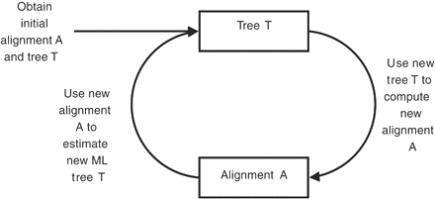
SATé
Multiple iterations creating new trees and alignments each time
Trees constructed using Multiple Likelihood methods (v. robust)
ML trees function as “guide” trees for subsequent iterations
Liu et al. (2009) Science 324:1561-1564

Slide 36
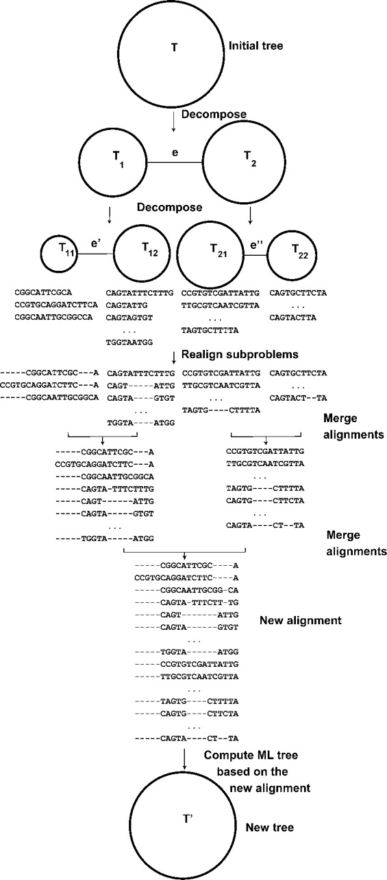
SATé
Alignments subdivided along longest tree branch each iteration
Many splits having increasing phylogenetic resolution
Alignments merged into master alignment
Tree recalculated
Liu et al. (2012) Syst. Biol. 61:90-106

Slide 37
Which alignment method is best?
Head-to-head analyses rarely cover all possibilities
Depends on the expected output
E.g., comparison to reference alignment
E.g., effect on tree construction
E.g., effect on identifying site-specific selection
Trade-offs: speed vs accuracy

Slide 38
Which alignment method is best?
Alignment score compared
to known reference
Compute time
Thompson et al. (2011) PLoS One 6:e18093

Slide 39
Which alignment method is best?
Loytynoja and Goldman (2008)
Science 320:1632-1635

Slide 40
Different algorithms can give different results
PCoA plot of trees constructed using different alignment algorithms
Blackburne and Whelan (2013) Mol. Biol. Evol. 30:642-653

Slide 41
Different algorithms can give different results
Correlation of sites identified as under selection using different sequence alignment algorithms
Blackburne and Whelan (2013) Mol. Biol. Evol. 30:642-653

Slide 42
Note: nucleotides vs. proteins
Recall: proteins are more conserved compared to nucleotides
Sequence alignment is therefore more robust using protein sequences
Gaps in nucleotide alignments should reflect codon structures

Slide 43
Note: nucleotides vs. proteins
Software exists to convert between protein and nucleotide sequences for alignment
PAL2NAL http://www.bork.embl.de/pal2nal/ Suyama et al. (2006) Nucl. Acids Res. 34:W609-W612
MEGA6: GUI version http://www.megasoftware.net/ Tamura et al. (2013) Mol. Biol. Evol. 30:2725-2729
Doesn’t scale fantastically compared to terminal but user-friendly

Slide 44
Sequence masking
Another way to deal with poor alignments is to remove regions thought to be inaccurate before further analysis
Lose information, but optimize sensitivity/specificity tradeoff
Common for phylogenetic applications
Gaps are often used during phylogenetic reconstruction, so are better to remove if not actually informative
Not entirely without controversy

Slide 45
Gblocks
Talavera and Castresana (2007) Syst. Biol. 56: 564-577
http://molevol.cmima.csic.es/castresana/Gblocks.html
Identifies blocks of sequences aligned with high confidence
E.g., few gaps, few columns lacking sequence conservation, confidently-aligned flanking regions

Slide 46
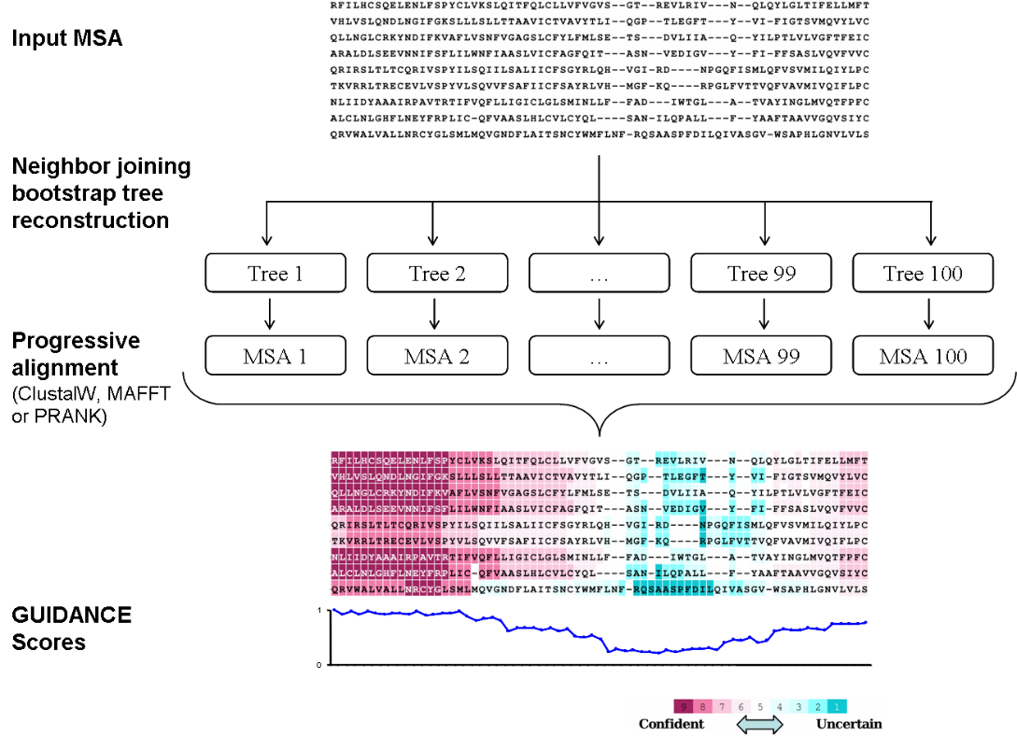
GUIDANCE
Penn et al. (2010) Nucl. Acids Res. 38:W23-W28
http://guidance.tau.ac.il/overview.html
Create alignment guide trees based on alignment columns
Score compared to master alignment

Slide 47
Summary:
Choice of multiple sequence alignment program will affect downstream analyses
Different trade-offs to approach
No substitute for manual inspection and correcting alignments when the resulting phylogeny really, really matters!-

