Slide 1
MCB5472 Computer methods in molecular evolution
Lecture 3/22/2014

Slide 2
Review of Alignments

Slide 3
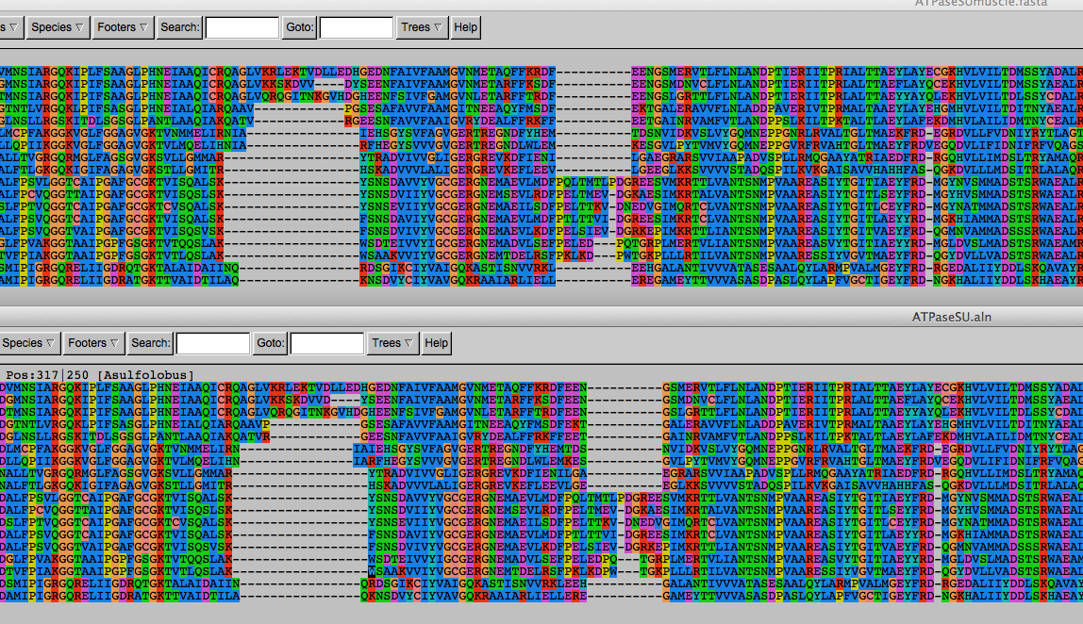
ATPase dataset
Alignment
clustal
vs
muscle
Conserved parts are aligned reproducibly

Slide 4
ATPase dataset
Alignment
clustal
vs
muscle
The alignment of the less conserved parts is questionable.
Using the progressive alignment approach on these sequences can cause problems in downstream analyses.

Slide 5
ATPase dataset
Alignment
PRANK
vs
muscle

Slide 6
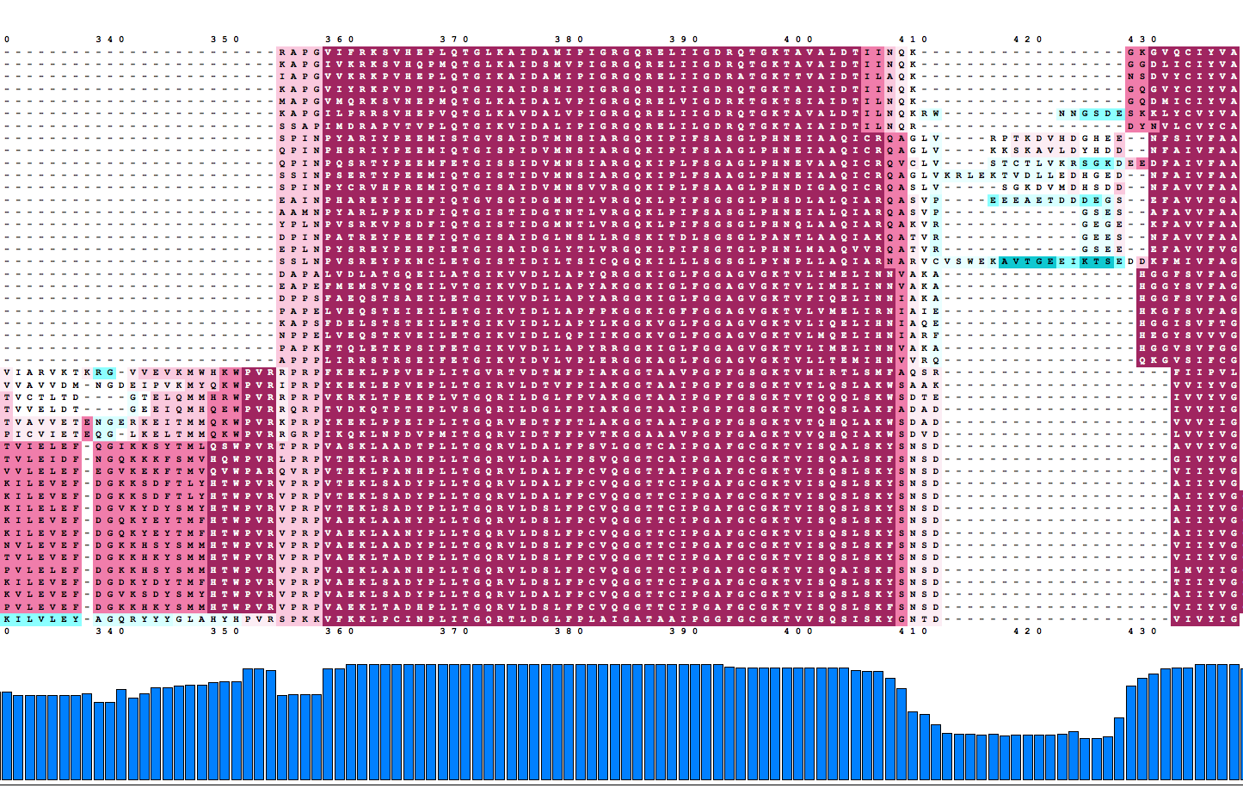
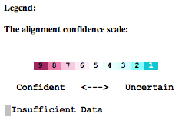
ATPase dataset
Reliably aligned positions determined with guidance

Slide 7
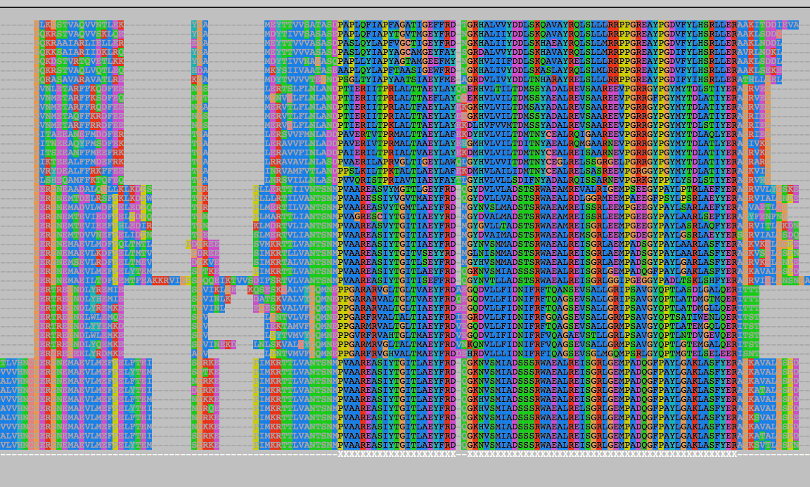
ATPase dataset
Reliably aligned columns determined with GBLOCKS

Slide 8
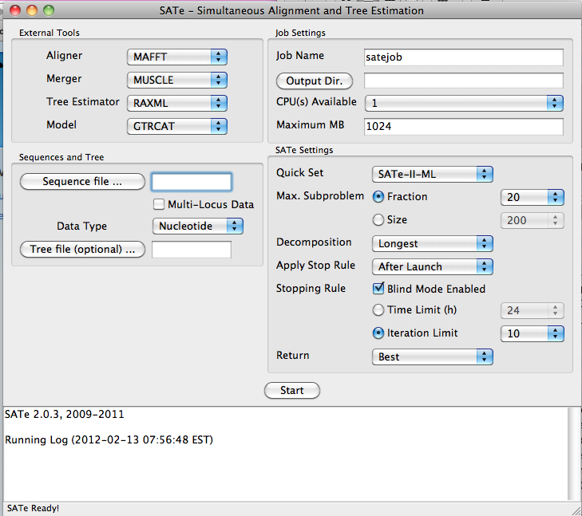
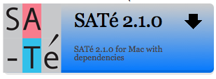
SATé Simultaneous Alignment and Tree Estimation
http://phylo.bio.ku.edu/software/sate/sate.html
GUI works well on iMacs, uses only local processors, BUT a machine with two
6 core intel processors counts having 24 processors due to “multithreading”.

Slide 9
Discussion
What is the effect of throwing out sites that are not reliably aligned?
What can one do to avoid phylogenetic reconstruction artifacts due to progressive alignment of non-homologous sites?
(consider guide trees and gaps)

Slide 10
What’s in a tree?
Trees form molecular data are usually calculated as unrooted trees (at least they should be - if they are not this is usually a mistake).
To root a tree you either can assume a
molecular clock (substitutions occur at a constant rate, again this assumption is usually not warranted and needs to be tested),
or you can use an outgroup (i.e. something that you know forms the deepest branch).
For example, to root a phylogeny of birds, you could use the homologous characters from a reptile as outgroup; to find the root in a tree depicting the relations between different human mitochondria, you could use the mitochondria from chimpanzees or from Neanderthals as an outgroup; to root a phylogeny of alpha hemoglobins you could use a beta hemoglobin sequence, or a myoglobin sequence as outgroup, to root the tree of life, you could use ancient paralogs, such as in the ATP synthases.
or you can use polarized characters.
Trees have a branching pattern (also called the topology), and branch lengths.
Often the branch lengths are ignored in depicting trees (these trees often are referred to as cladograms - note that cladograms should be considered rooted).
You can swap branches attached to a node, and in an unrooted you can depict the tree as rooted in any branch you like without changing the tree.

Slide 11
Terminology for Trees
(Leaves, OTUs), (Branches, splits, bipartitions), Nodes
In a rooted tree: clades (for unrooted trees sometimes the term clann is used)
Mono-, Para-, polyphyletic groups, cladists and a natural taxonomy
The term cladogram refers to a strictly bifurcating diagram, where each clade is defined by a common ancestor that only gives rise to members of this clade. I.e., a clade is monophyletic (derived from one ancestor) as opposed to polyphyletic (derived from many ancestors). (Note: you do need to know where the root is!)
A clade is recognized and defined by shared derived characters (= synapomorphies). Shared primitive characters (= sympleisiomorphies, alternative spelling is symplesiomorphies) do not define a clade, but a paraphyletic group. Characters that evolved twice independently are known as Homoplasies. They define polyphyletic groups (see in class example drawing ala Hennig).
To use these any terms ((aside from homoplasy) you need to have polarized characters; for most molecular characters you don't know which state is primitive and which is derived (exceptions:....).
See the wikipedia entries for Willi Hennig , cladistics, and monophyly – see holophyly and the link to Ashlock’s paper for a divergent view.

Slide 12
Terminology
Related terms: autapomorphy = a derived character that is only present in one group; an autapomorphic character does not tell us anything about the relationship of the group that has this character ot other groups.
homoplasy = a derived character that was derived twice independently (convergent evolution). Note that the characters in question might still be homologous (e.g. a position in a sequence alignment, frontlimbs turned into wings in birds and bats).
paraphyletic = a taxonomic group that is defined by a common ancestor, however, the common ancestor of this group also has decendants that do not belong to this taxonomic group. Many systematists despise paraphyletic groups (and consider them to be polyphyletic). Examples for paraphyletic groups are reptiles and protists. Many consider the archaea to be paraphyletic as well.
holophyletic = same as above, but the common ancestor gave rise only to members of the group.

Slide 13
C C C c c
B B b b b
A a a a a
I
II
III
IV
V
D -> d
C -> c
B -> b
A -> a

Slide 14
C C C c c
B B b b b
A a a a a
I
II
III
IV
V
D -> d
Shared derived characters (aka synapomorphies) define monophyletic groups
C -> c
B -> b
A -> a

Slide 15
D D D D d
C C C c c
B B b b b
I
II
III
IV
V
D -> d
C -> c
Shared primitive characters (aka symplesiomorphies) define paraphyletic groups
B -> b
A -> a

Slide 16
D D D D d
C C C c c
B B b b b
A a a a a
I
II
III
IV
V
D -> d
Characters that are not shared, even if they are derived (as the autapomorphy d), do not provide phylogenetic information.
C -> c
B -> b
A -> a

Slide 17
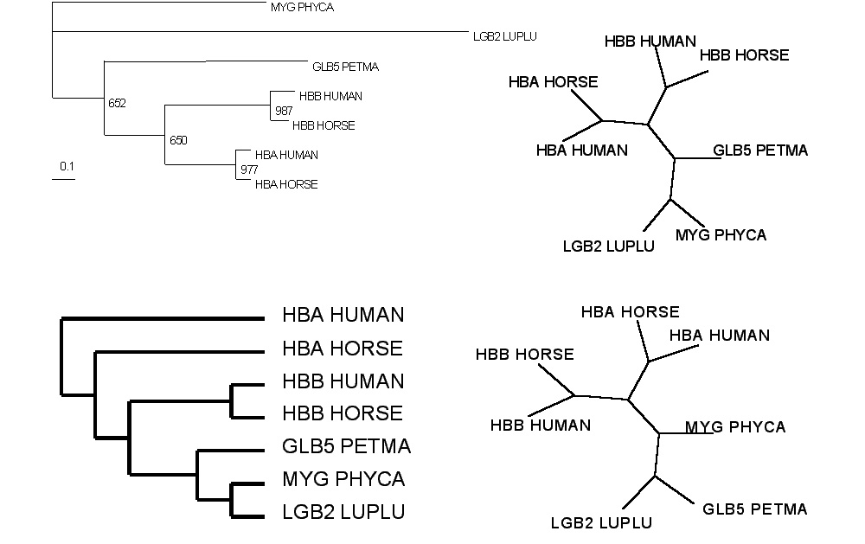
Test:Which of these trees is different?
More tests here

Slide 18
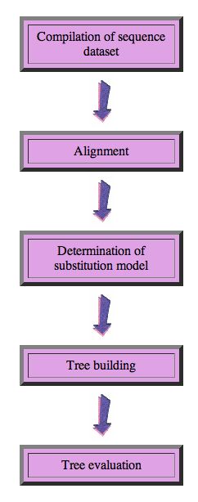
Steps in phylogenetic analysis
Phylogenetic analysis is the inference of evolutionary relationships between genes or organisms.
Phylogenetics tries to answer the question “How did groups of organisms come into existence?”
Those relationships are usually represented by tree-like diagrams.
Note: the equation of biological evolution with a tree like process has limited validity at best.

Slide 19
Phylogenetic reconstruction - How
Distance analyses
calculate pairwise distances
(different distance measures, correction for multiple hits, correction for codon bias)
make distance matrix (table of pairwise corrected distances)
calculate tree from distance matrix
i) using optimality criterion
(e.g.: smallest error between distance matrix
and distances in tree, or use
ii) algorithmic approaches (UPGMA or neighbor joining)
See wikipedia entry on Neighbor joining for a good illustration on how NJ works. See here < http://www.southampton.ac.uk/~re1u06/teaching/upgma/ > for a worked example of UPGMA

Slide 20
Phylogenetic reconstruction - How
Parsimony analyses (see wikipedia entry for Parsimony)
find that tree that explains sequence data with minimum number of substitutions
(tree includes hypothesis of sequence at each of the nodes)
Maximum Likelihood analyses
given a model for sequence evolution, find the tree that has the highest probability under this model.
This approach can also be used to successively refine the model.
Bayesian statistics
use ML analyses to calculate posterior probabilities for trees, clades and evolutionary parameters. Especially MCMC approaches have become very popular in the last year, because they allow to estimate evolutionary parameters (e.g., which site in a virus protein is under positive selection), without assuming that one actually knows the "true" phylogeny.

Slide 21
Else:
spectral analyses, like evolutionary parsimony, look only at patterns of substitutions,
Another way to categorize methods of phylogenetic reconstruction is to ask if they are using
an optimality criterion (e.g.: smallest error between distance matrix and distances in tree, least number of steps, highest probability), or
algorithmic approaches (UPGMA or neighbor joining)
Packages and programs available: PHYLIP, phyml, MrBayes, Tree-Puzzle, PAUP*, clustalw, raxml, PhyloGenie, HyPhy

Slide 22
Bootstrap ?
See here http://gogarten.uconn.edu/mcb3421_2011/bs.html andhere http://en.wikipedia.org/wiki/Bootstrapping_(statistics)
Non-parametric bootstrap: bootstrap samples are generated through sampling with replacement
Parametric bootstrap (not frequently used, should be used more often) samples are created through simulation of sequence evolution (with parameters estimated through ml). Good for testing hypotheses! (Examples?)

Slide 23
Boostrap Support Values for Embedded Quartets vs. Bipartitions:
Performance evaluation using sequence simulations and phylogenetic reconstructions

Slide 24
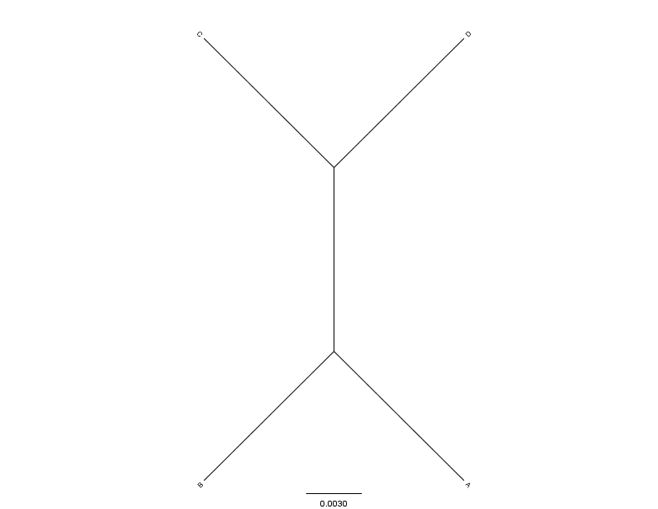
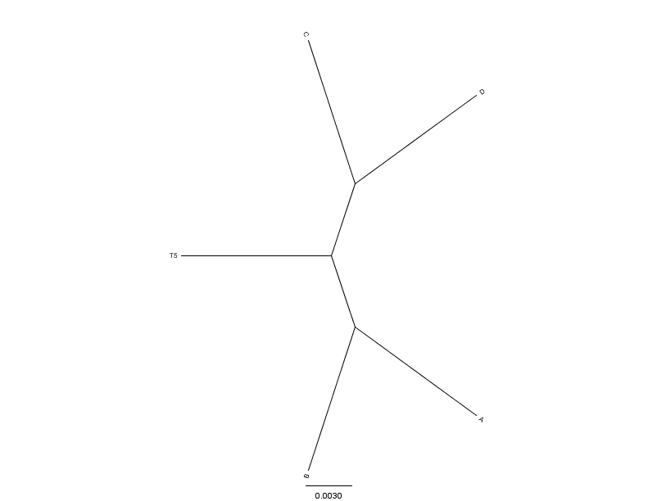
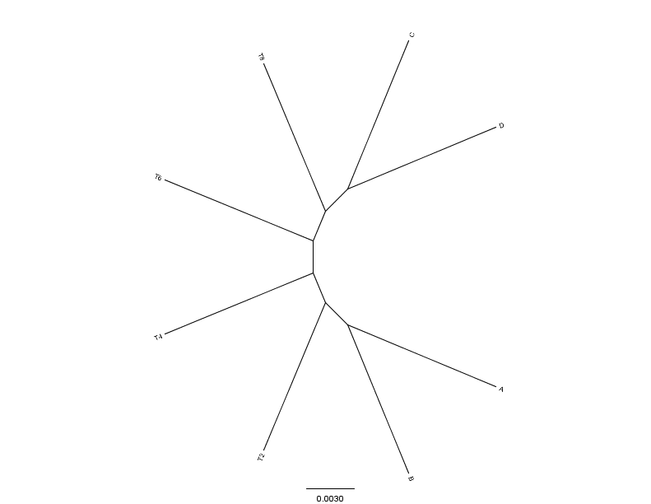
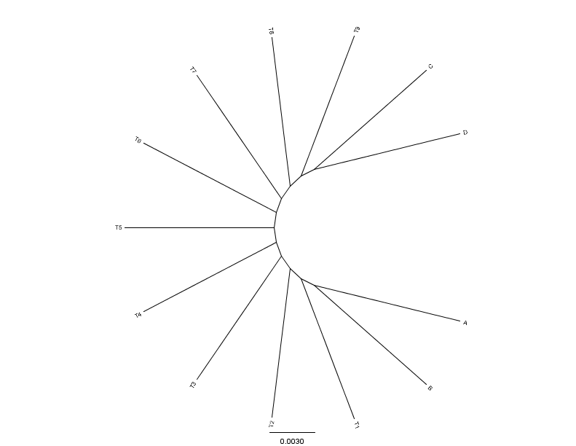
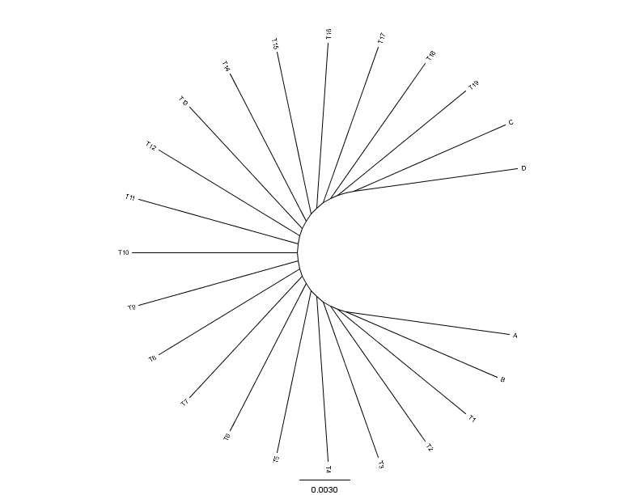
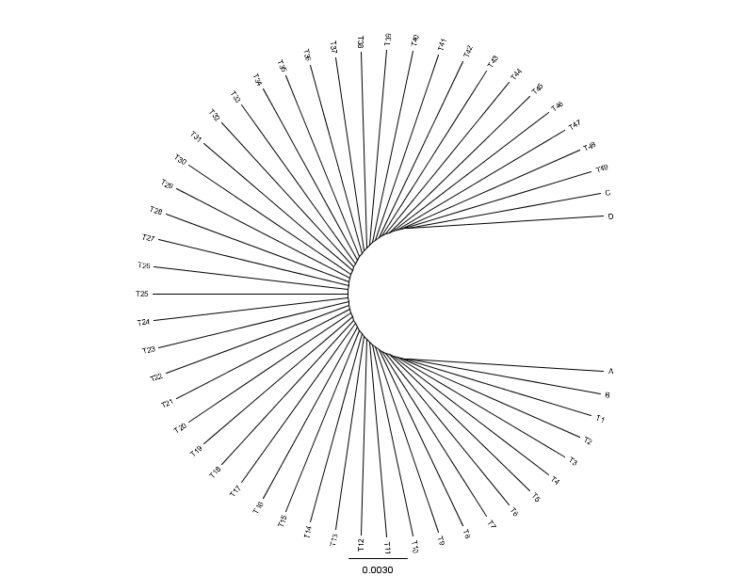
0.01
0.01
N=4(0)
N=5(1)
N=8(4)
0.01
0.01
0.01
N=13(9)
N=23(19)
N=53(49)

Slide 25
Methodology :
Input tree
Seq-Gen
Aligned Simulated AA Sequences (200,500 and 1000 AA)
WAG, Cat=4
Alpha=1
Seqboot
100 Bootstraps
ML Tree Calculation FastTree, WAG, Cat=4
Repeat
100 times
Extract Highest Bootstrap support separating AB><CD
Consense
Extract Bipartitions
For each individual
tree
Count How many trees embedded quartet AB><CD is supported

Slide 26
Results :
Maximum Bootstrap Support value for any Bipartition separating (AB) and (CD)
Maximum Bootstrap Support value for embedded Quartet (AB),(CD)

Slide 27
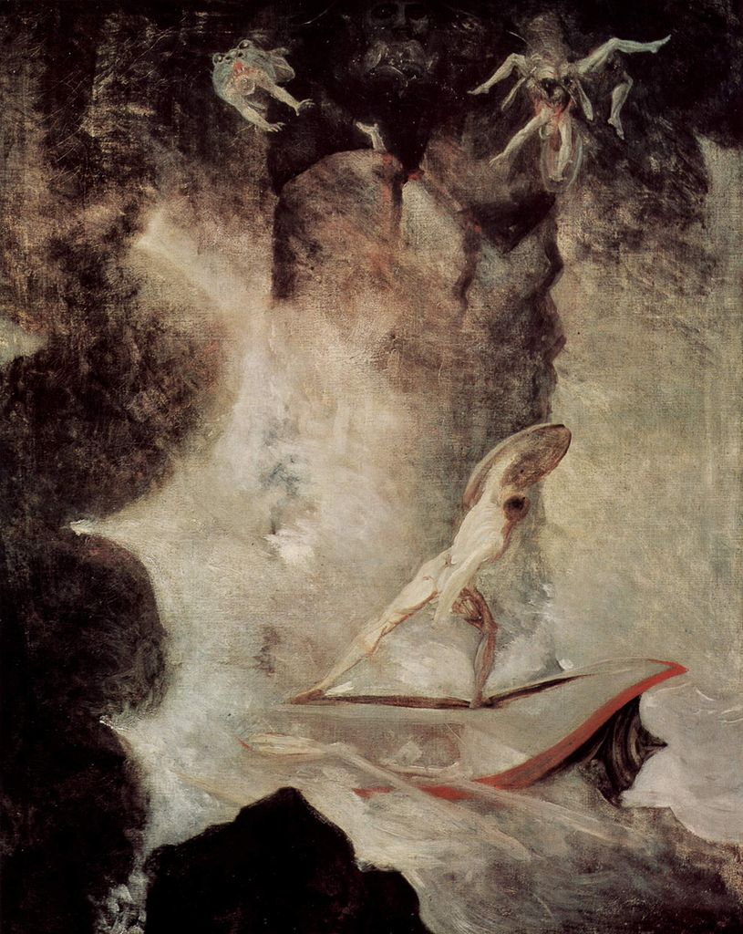
Johann Heinrich Füssli
Odysseus vor Scilla und Charybdis
From: http://en.wikipedia.org/wiki/File:Johann_Heinrich_F%C3%BCssli_054.jpg

Slide 28
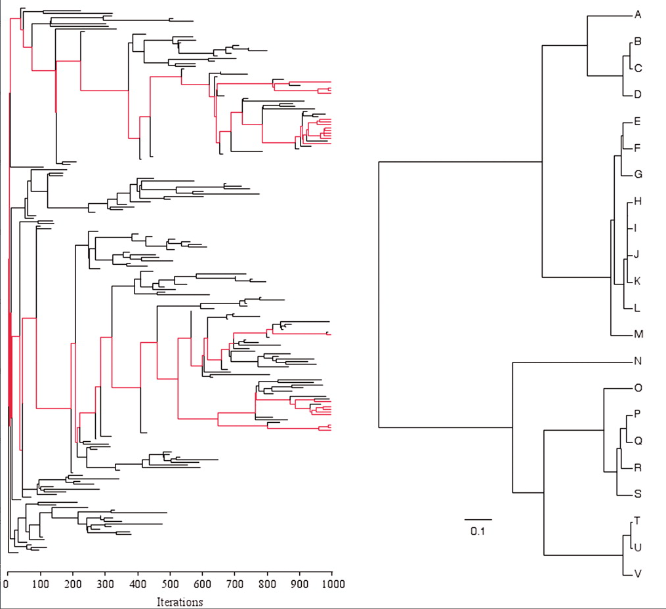
Genome simulation with EvolSimulator.
Lapierre P et al. Brief Bioinform 2012;bib.bbs050
© The Author 2012. Published by Oxford University Press. For Permissions, please email: journals.permissions@oup.com

Slide 29
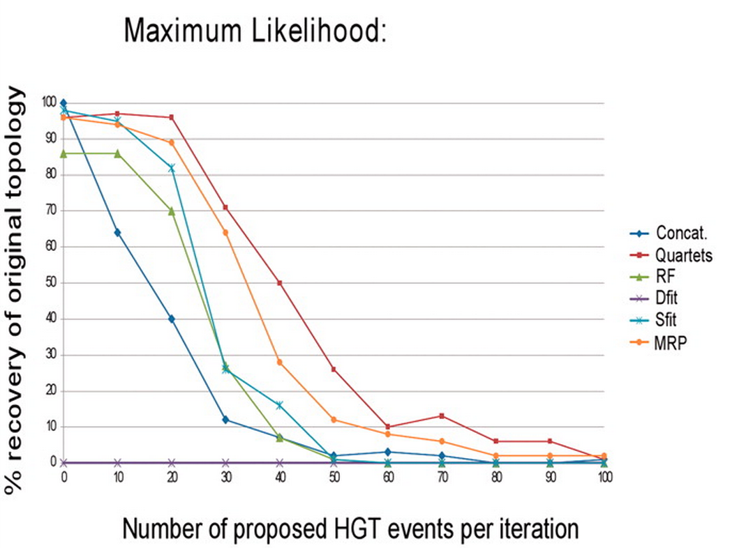
The impact of HGT on phylogenomic reconstruction methods
Lapierre P et al. Brief Bioinform 2012;bib.bbs050
© The Author 2012. Published by Oxford University Press. For Permissions, please email: journals.permissions@oup.com

Slide 30
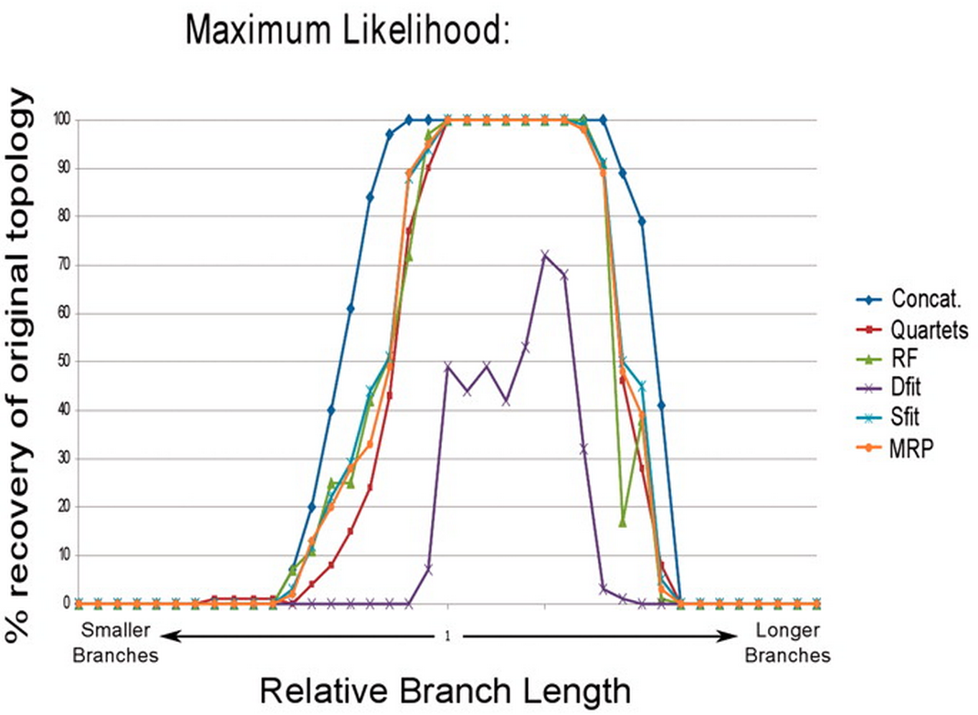
Percent recovery of original tree topology with increased and decreased substitution rates.
Lapierre P et al. Brief Bioinform 2012;bib.bbs050
© The Author 2012. Published by Oxford University Press. For Permissions, please email: journals.permissions@oup.com

Slide 31
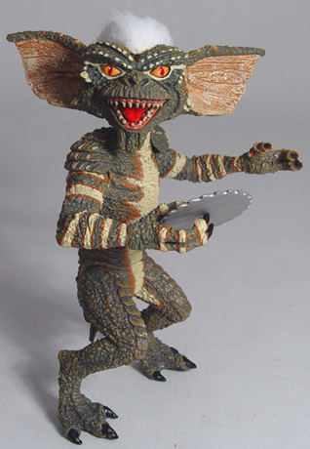
Elliot Sober’s Gremlins
Observation: Loud noise in the attic
?
Hypothesis: gremlins in the attic playing bowling
Likelihood = P(noise|gremlins in the attic)
P(gremlins in the attic|noise)
?
?

Slide 32
Assignments for next week Monday:
Write a script that prints out a hash sorted on the keys in alphabetical order.
How can you remove an entry in a hash (key and value)?
Write a program that it uses hashes to calculates mono-, di-, tri-, and quartet-nucleotide frequencies in a genome.
Turn your project outline into a step by step to-do list / pseudocode

Slide 33
assignments continued
Assume that you have the following non-aligned multiple sequence files in a directory: A.fa : vacuolar/archaeal ATPase catalytic subunits ; B.fa : vacuolar/archaeal ATPase non-catalytic subunits; alpha.fa : F-ATPases non-catalytic subunits, beta.fa : F-ATPases catalytic subunits, F.fa : ATPase involved in the assembly of the bacterial flagella.
Write a perl script that executes muscle or clustalw2 and
aligns the sequences within each file
successively calculates profile alignments between all aligned sequences.

