Slide 1
MCB5472 Student Presentations
Lecture 4/28/2014

Slide 2
Signup sheet for presentations
https://docs.google.com/spreadsheet/ccc?key=0AjJsMXOC-NEVdEhuenJ3bFEwdUJRUno1alg0aVlvcEE&usp=sharing

Slide 3
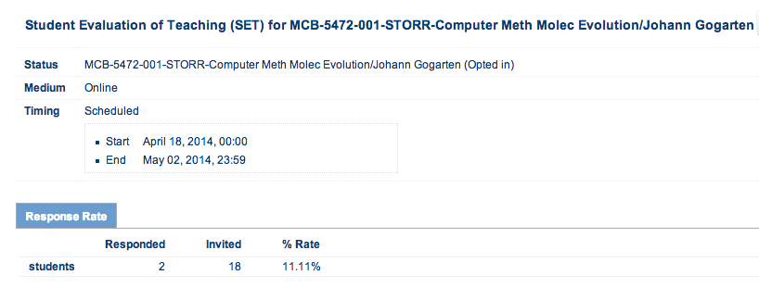
As of 11 am on 4/28

Slide 4
