Slide 1
MCB5472 Computer methods in molecular evolution
Lecture 4/14/2014

Slide 2
MCrobot demo?
http://hydrodictyon.eeb.uconn.edu/people/plewis/software.php

Slide 3
OldAssignment
Given a multiple fasta sequence file*, write a script that for each sequence extract the gi number and the species name, and then rewrites the file so that the annotation line starts with the gi number, followed by the species/strain name, followed by a space. (The gi number and the species name should not be separated by or contain any spaces – replace them by _. This is useful, because many programs will recognize the number and name as handle for the sequence (e.g., clustalw2 and phyml)
Assume that the annotation line follows the NCBI convention and begins with the > followed by the gi number, and ends with the species and strain designation given in [] Example: >gi|229240723|ref|ZP_04365119.1| primary replicative DNA helicase; intein [Cellulomonas flavigena DSM 20109]
*An example multiple sequence file in the unofficial NCBI formatted annotation line is here.

Slide 4
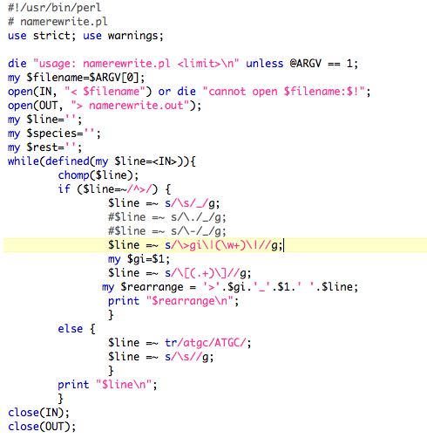
More elegant

Slide 5
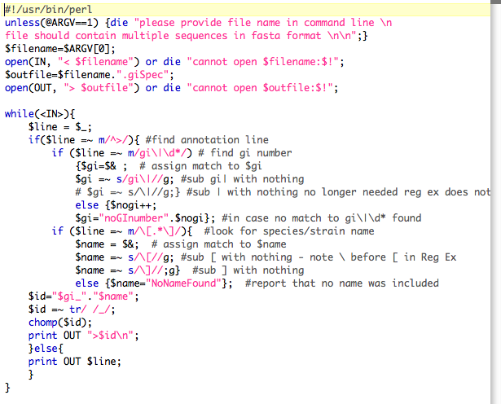
less elegant
See P17 for info on $&

Slide 6
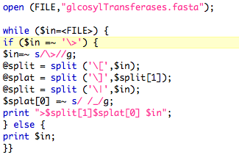
More brute force

Slide 7
HGT as a force a creative force
New biochemical pathways
Oxygen producing PS Acetoclasitc Methanognesis (here) (cause of the Permian extinctions? here )
New substrates, new weapons, new resistance genes, breaks up linkage in case of selective sweeps.
Discussion:
Selfish genes versus altruism. (Evolutionary stable strategies).
Group selection? (plasmid sharing in Agrobacteria after plant transformation)
Under which conditions is it useful for an organism to sacrifice itself (e.g. GTAs), so that other members of the population reap a benefit? -> social parasites
Evolution of the holobiont? (sushi wrapper digesting intestinal symbionts)
Is selection really acting on the holobiont?

Slide 8
selection versus drift
The larger the population the longer it takes for an allele to become fixed.
Note: Even though an allele conveys a strong selective advantage of 10%, the allele has a rather large chance to go extinct.
Note#2: Fixation is faster under selection than under drift.

Slide 9
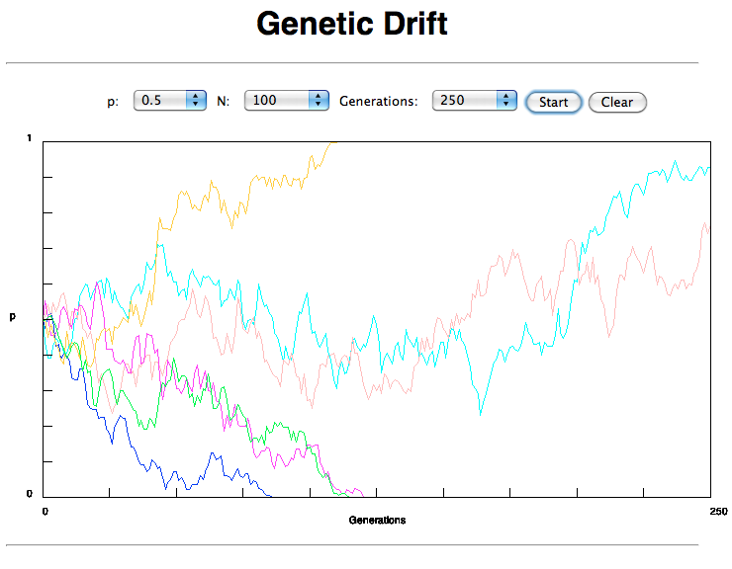
If one waits long enough, one of two alleles with equal fitness will be
fixed

Slide 10
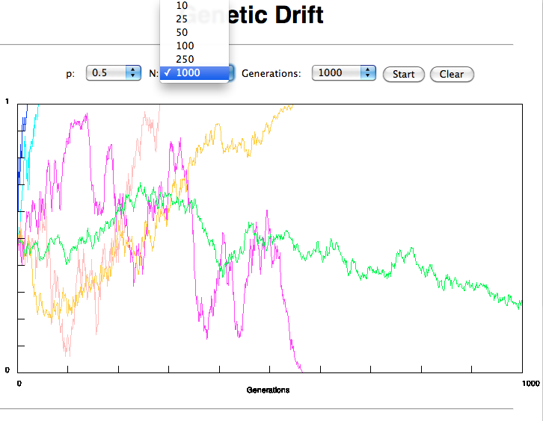
Time till fixation depends on population size

Slide 11
s=0
Probability of fixation, P, is equal to frequency of allele in population. Mutation rate (per gene/per unit of time) = u ;
freq. with which allele is generated in diploid population size N =u*2N
Probability of fixation for each allele = 1/(2N)
Substitution rate =
frequency with which new alleles are generated * Probability of fixation= u*2N *1/(2N) = u = Mutation rate
Therefore: If f s=0, the substitution rate is independent of population size, and equal to the mutation rate !!!! (NOTE: Mutation unequal Substitution! ) This is the reason that there is hope that the molecular clock might sometimes work.
Fixation time due to drift alone:
t_{av}=4*N_{e} generations (N_{e}=effective population size; For n discrete generations N_{e}= n/(1/N₁+1/N₂+…..1/N_{n})

Slide 12
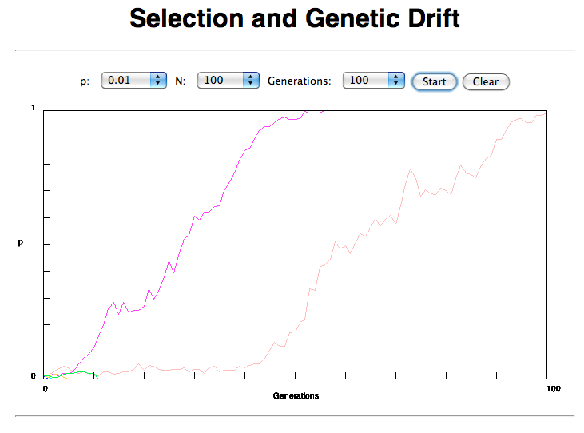
Notes:
faster than drift alone! compare slide 5.

Slide 13
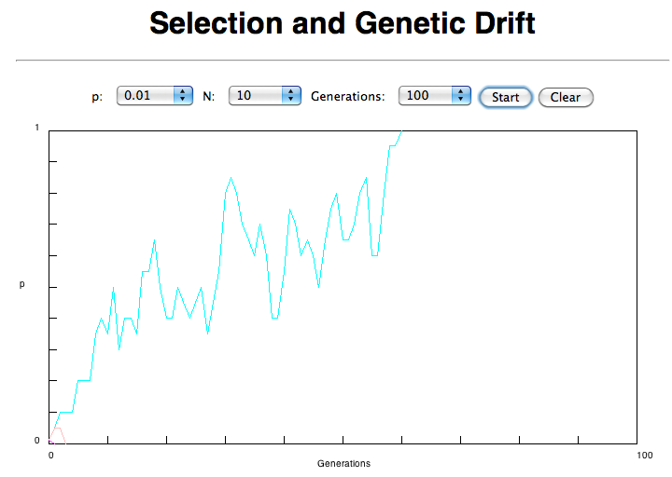

Slide 14
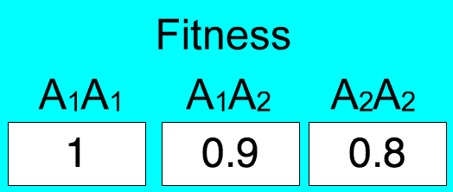
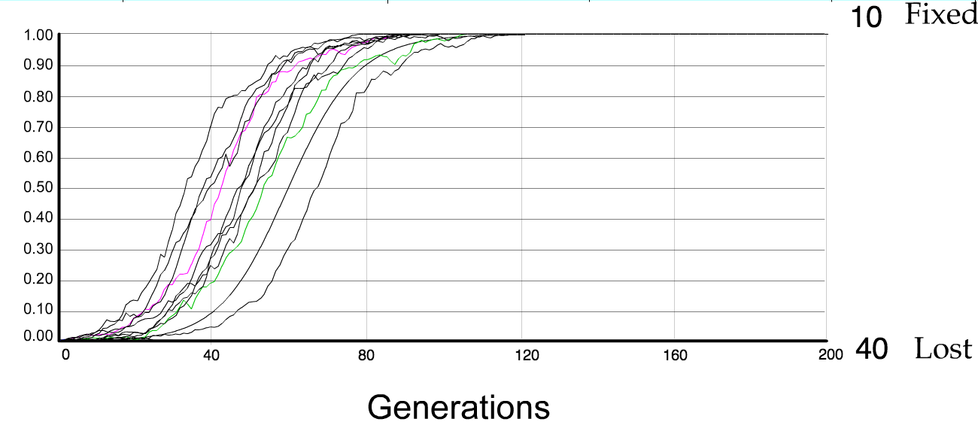
N=50 s=0.1
50 replicates

Slide 15
s>0
Time till fixation on average:
t_{av}= (2/s) ln (2N) generations (also true for mutations with negative “s”)
E.g.: N=10⁶,
s=0: average time to fixation: 4*10⁶ generations s=0.01: average time to fixation: 2900 generations
N=10⁴,
s=0: average time to fixation: 40.000 generations s=0.01: average time to fixation: 1.900 generations
substitution rate of mutation under positive selection is larger than the rate with which neutral mutations are fixed.
This is easily detected in case of diversifying selection.

Slide 16
Random Genetic Drift
Selection
100
advantageous
Allele frequency
disadvantageous
0
Modified from from www.tcd.ie/Genetics/staff/Aoife/GE3026/GE3026_1+2.ppt

Slide 17
Positive selection (s>0)
A new allele (mutant) confers some increase in the fitness of the organism
Selection acts to favour this allele
Also called adaptive selection or Darwinian selection.
NOTE: Fitness = ability to survive and reproduce
Modified from from www.tcd.ie/Genetics/staff/Aoife/GE3026/GE3026_1+2.ppt

Slide 18
Advantageous allele
Herbicide resistance gene in nightshade plant
Modified from from www.tcd.ie/Genetics/staff/Aoife/GE3026/GE3026_1+2.ppt

Slide 19
Negative selection (s<0)
A new allele (mutant) confers some decrease in the fitness of the organism
Selection acts to remove this allele
Also called purifying selection
Modified from from www.tcd.ie/Genetics/staff/Aoife/GE3026/GE3026_1+2.ppt

Slide 20
Neutral mutations
Neither advantageous nor disadvantageous
Invisible to selection (no selection)
Frequency subject to ‘drift’ in the population
Random drift – random changes in small populations

Slide 21
Types of Mutation-Substitution
Replacement of one nucleotide by another
Synonymous (Doesn’t change amino acid)
Rate sometimes indicated by Ks
Rate sometimes indicated by d_{s}
Non-Synonymous (Changes Amino Acid)
Rate sometimes indicated by Ka
Rate sometimes indicated by d_{n}
(this and the following 4 slides are from mentor.lscf.ucsb.edu/course/ spring/eemb102/lecture/Lecture7.ppt)

Slide 22
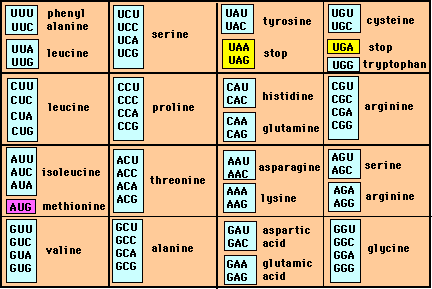
Genetic Code – Note degeneracy of 1st vs 2nd vs 3rd position sites

Slide 23
Genetic Code
Four-fold degenerate site – Any substitution is synonymous
From: mentor.lscf.ucsb.edu/course/spring/eemb102/lecture/Lecture7.ppt

Slide 24
Genetic Code
Two-fold degenerate site – Some substitutions synonymous, some
non-synonymous
From: mentor.lscf.ucsb.edu/course/spring/eemb102/lecture/Lecture7.ppt

Slide 25
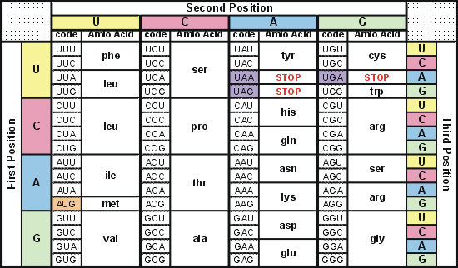
Degeneracy of 1st vs 2nd vs 3rd position sites results in 25.5% synonymous changes and 74.5% non synonymous changes (Yang&Nielsen,1998).
Genetic Code
Notes:
An inspection of the genetic code table suggests most changes at the first position are nonsynonymous, all changes at the second codon position are nonsynonymous and only some changes at the third position are synonymous. As a result we do not expect to see equal proportions of synonymous and nonsynonymous mutations even if there is no selection at protein level. Indeed, if mutations from any one nucleotide to any other occur at the same rate , we expect 25.5% of mutations to be synonymous and 74.5% mutations to be nonsynonymous.

Slide 26
Measuring Selection on Genes
Null hypothesis = neutral evolution
Under neutral evolution, synonymous changes should accumulate at a rate equal to mutation rate
Under neutral evolution, amino acid substitutions should also accumulate at a rate equal to the mutation rate
From: mentor.lscf.ucsb.edu/course/spring/eemb102/lecture/Lecture7.ppt

Slide 27
Counting #s/#a
Ser Ser Ser Ser Ser
Species1 TGA TGC TGT TGT TGT
Ser Ser Ser Ser Ala
Species2 TGT TGT TGT TGT GGT
#s = 2 sites
#a = 1 site
#a/#s=0.5
To assess selection pressures one needs to calculate the rates (Ka, Ks), i.e. the occurring substitutions as a fraction of the possible syn. and nonsyn. substitutions.
Things get more complicated, if one wants to take transition transversion ratios and codon bias into account. See chapter 4 in Nei and Kumar, Molecular Evolution and Phylogenetics.
Modified from: mentor.lscf.ucsb.edu/course/spring/eemb102/lecture/Lecture7.ppt

Slide 28
Testing for selection using dN/dS ratio
dN/dS ratio (aka Ka/Ks or ω (omega) ratio) where
dN = number of non-synonymous substitutions / number of possible non-synonymous substitutions
dS =number of synonymous substitutions / number of possible non-synonymous substitutions
dN/dS >1 positive, Darwinian selection
dN/dS =1 neutral evolution
dN/dS <1 negative, purifying selection
Notes:
The synonymous and non-synonymous rates dN and dS are defined as the numbers of synonymous and nonsynonymous substitutions per site. The ratio of the two rates omega=dN/dS then measures selective pressure at the protein level. If selection level has no effect on fitness, nonsynonymous mutations will be fixed at the same rate as synonymous mutations so that dN=dS and omega=1. If nonsynonymous mutations are deleterious purifying selection will reduce their fixation rate so that dN<dS and omega<1. If nonsynonymous mutations are favored by Darwinian selection, they will be fixed at a higher rate than synonymous mutations resulting in dN>dS and omega>1.

Slide 29
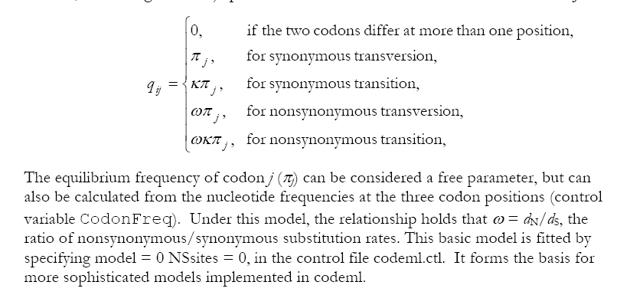
PAML (codeml) the basic model

Slide 30
dambe
Three programs worked well for me to align nucleotide sequences based on the amino acid alignment,
One is DAMBE (works well for windows). This is a handy program for a lot of things, including reading a lot of different formats, calculating phylogenies, it even runs codeml (from PAML) for you.
The procedure is not straight forward, but is well described on the help pages. After installing DAMBE go to HELP -> general HELP -> sequences -> align nucleotide sequences based on …->
If you follow the instructions to the letter, it works fine.
DAMBE also calculates Ka and Ks distances from codon based aligned sequences.
Alternatives are
tranalign from the EMBOSS package, and
Seaview (see below)

Slide 31
dambe (cont)

Slide 32
Codon based alignments in Seaview
Load nucleotide sequences (no gaps in sequences, sequence starts with nucleotide corresponding to 1st codon position)
Select view as proteins

Slide 33
Codon based alignments in Seaview
With the protein sequences displayed, align sequences
Select view as nucleotides

Slide 34
PAML (codeml) the basic model

Slide 35
sites versus branches
You can determine omega for the whole dataset; however, usually not all sites in a sequence are under selection all the time.
PAML (and other programs) allow to either determine omega for each site over the whole tree, ,
or determine omega for each branch for the whole sequence,
.
It would be great to do both, i.e., conclude codon 176 in the vacuolar ATPases was under positive selection during the evolution of modern humans – alas, a single site does not provide much statistics ….

Slide 36
Sites model(s)
work great have been shown to work great in few instances.
The most celebrated case is the influenza virus HA gene.
A talk by Walter Fitch (slides and sound) on the evolution of this molecule is here .
This article by Yang et al, 2000 gives more background on ml aproaches to measure omega. The dataset used by Yang et al is here: flu_data.paup .

Slide 37
sites model in MrBayes
The MrBayes block in a nexus file might look something like this:
begin mrbayes; set autoclose=yes; lset nst=2 rates=gamma nucmodel=codon omegavar=Ny98; mcmcp samplefreq=500 printfreq=500; mcmc ngen=500000; sump burnin=50; sumt burnin=50;
end;

Slide 38
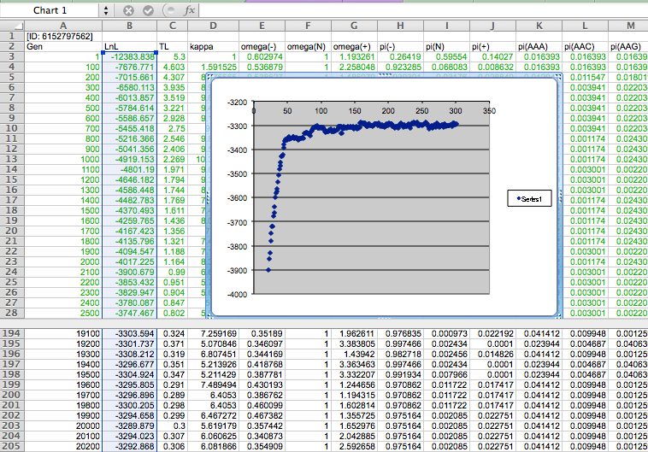

Slide 39
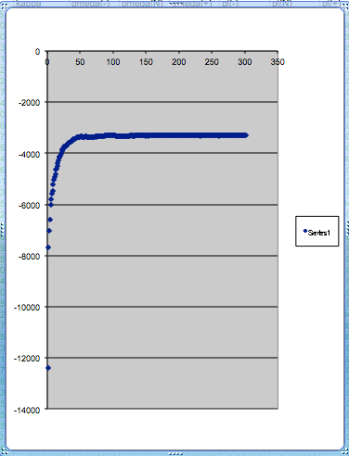
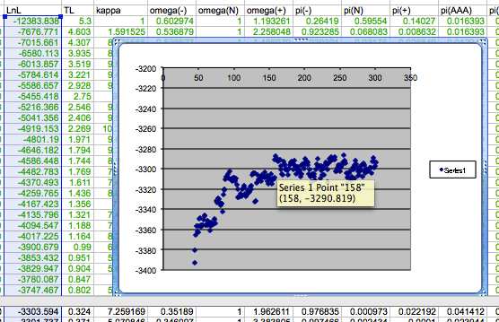
plot LogL to determine which samples to ignore
the same after rescaling the y-axis

Slide 40
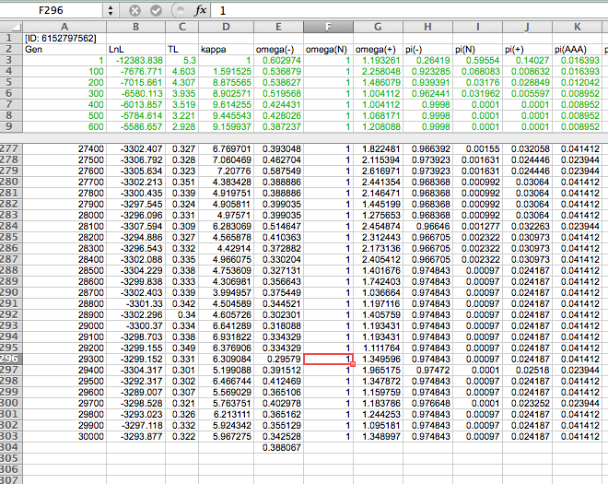

Slide 41
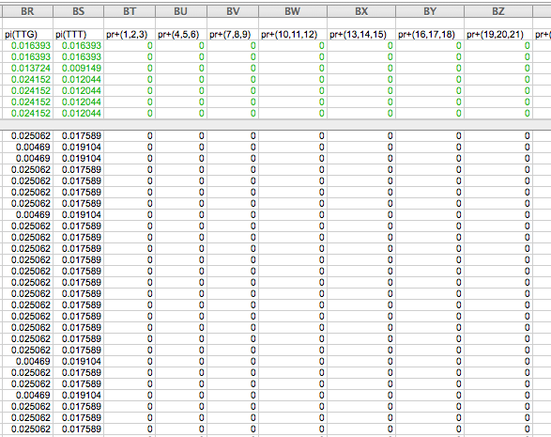

Slide 42
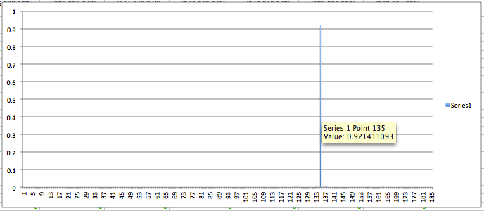
for each codon calculate the the average probability
copy paste formula
plot row
enter formula

Slide 43
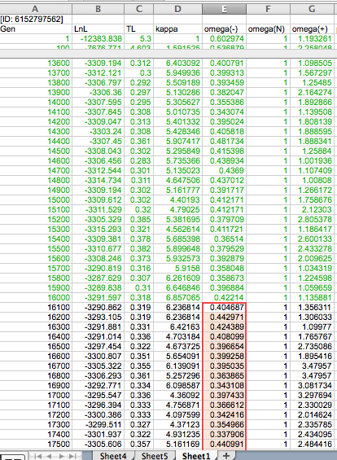
To determine credibility interval for a parameter (here omega<1):
Select values for the parameter, sampled after the burning.
Copy paste to a new spreadsheet,

Slide 44
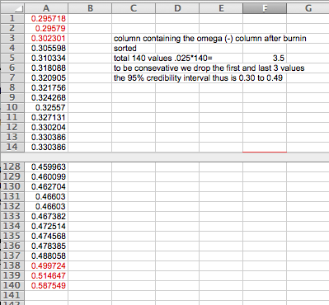
Sort values according to size,
Discard top and bottom 2.5%
Remainder gives 95% credibility interval.

Slide 45
Slides on codeml are at http://abacus.gene.ucl.ac.uk/ziheng/data/pamlDEMO.pdf
http://m.docente.unife.it/silvia.fuselli/dispense-corsi/EM_Lezione%208.pdf

Slide 46
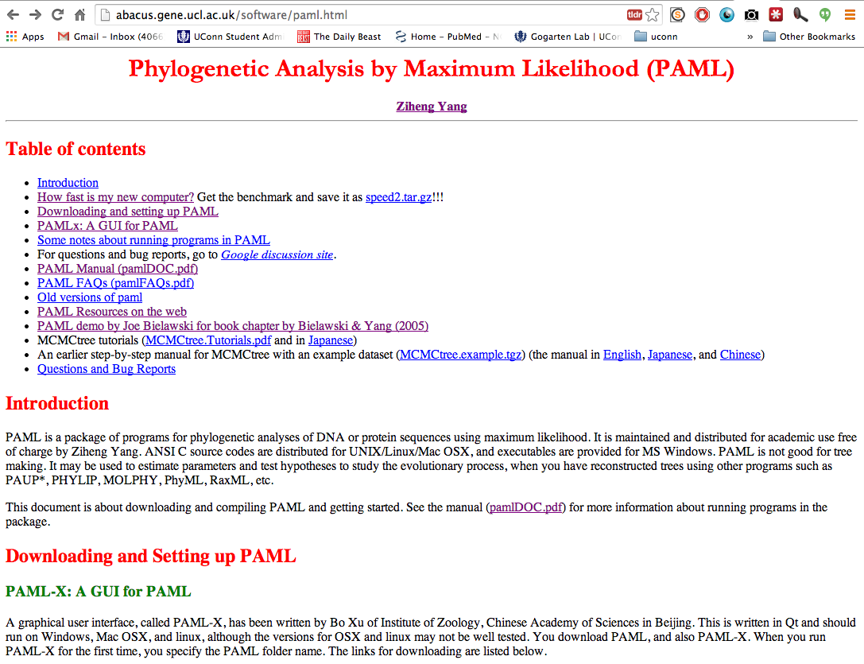

Slide 47
From:
http://abacus.gene.ucl.ac.uk/ziheng/data/pamlDEMO.pdf

Slide 48
PAML – codeml – sites model
the paml package contains several distinct programs for nucleotides (baseml) protein coding sequences and amino acid sequences (codeml) and to simulate sequences evolution.
The input file needs to be in phylip format.
By default it assumes a sequential format (e.g. here).
If the sequences are interleaved, you need to add an “I” to the first line, as in these example headers:
6 467 I gi|1613157 ---------- MSDNDTIVAQ ATPPGRGGVG ILRISGFKAR EVAETVLGKL gi|2212798 ---------- MSTTDTIVAQ ATPPGRGGVG ILRVSGRAAS EVAHAVLGKL gi|1564003 MALIQSCSGN TMTTDTIVAQ ATAPGRGGVG IIRVSGPLAA HVAQTVTGRT gi|1560076 ---------M QAATETIVAI ATAQGRGGVG IVRVSGPLAG QMAVAVSGRQ gi|2123365 -----MN--- -ALPSTIVAI ATAAGTGGIG IVRLSGPQSV QIAAALGIAG gi|1583936 -----MSQRS TKMGDTIAAI ATASGAAGIG IIRLSGSLIK TIATGLGMTT PKPRYADYLP FKDADGSVLD QGIALWFPGP NSFTGEDVLE LQGHGGPVIL PKPRYADYLP FKDVDGSTLD QGIALYFPGP NSFTGEDVLE LQGHGGPVIL LRPRYAEYLP FTDEDGQQLD QGIALFFPNP HSFTGEDVLE LQGHGGPVVM LKARHAHYGP FLDAGGQVID EGLSLYFPGP NSFTGEDVLE LQGHGGPVVL LQSRHARYAR FRDAQGEVID DGIAVWFPAP HSFTGEEVVE LQGHGSPVLL LRPRYAHYTR FLDVQDEVID DGLALWFPAP HSFTGEDVLE LQGHGSPLLL
5 855 I
human
goat-cow
rabbit
rat
marsupial
1
GTG CTG TCT CCT GCC GAC AAG ACC AAC GTC AAG GCC GCC TGG GGC AAG GTT GGC GCG CAC
... ... ... G.C ... ... ... T.. ..T ... ... ... ... ... ... ... ... ... .GC A..
... ... ... ..C ..T ... ... ... ... A.. ... A.T ... ... .AA ... A.C ... AGC ...
... ..C ... G.A .AT ... ..A ... ... A.. ... AA. TG. ... ..G ... A.. ..T .GC ..T
... ..C ..G GA. ..T ... ... ..T C.. ..G ..A ... AT. ... ..T ... ..G ..A .GC ...
61
GCT GGC GAG TAT GGT GCG GAG GCC CTG GAG AGG ATG TTC CTG TCC TTC CCC ACC ACC AAG
... ..A .CT ... ..C ..A ... ..T ... ... ... ... ... ... AG. ... ... ... ... ...
.G. ... ... ... ..C ..C ... ... G.. ... ... ... ... T.. GG. ... ... ... ... ...
.G. ..T ..A ... ..C .A. ... ... ..A C.. ... ... ... GCT G.. ... ... ... ... ...
..C ..T .CC ..C .CA ..T ..A ..T ..T .CC ..A .CC ... ..C ... ... ... ..T ... ..A

Slide 49
PAML – codeml – sites model (cont.)
the program is invoked by typing codeml followed by the name of a control file that tells the program what to do (or it uses codeml.ctl by default).
paml can be used to find the maximum likelihood tree, however, the program is rather slow. Phyml is a better choice to find the tree, which then can be used as a user tree.
An example for a codeml.ctl file is codeml.hv1.sites.ctl
This file directs codeml to run three different models:
one with an omega fixed at 1, a second where each site can be either have an omega between 0 and 1, or an omega of 1, and third a model that uses three omegas as described before for MrBayes.
The output is written into a file called Hv1.sites.codeml_out (as directed by the control file).
Point out log likelihoods and estimated parameter line (kappa and omegas)
Additional useful information is in the rst file generated by the codeml
Discuss overall result.

Slide 50
PAML – codeml – branch model
For the same dataset to estimate the dN/dS ratios for individual
branches, you could use this file codeml.hv1.branches.ctl as control file.
The output is written, as directed by the control file, into a file called Hv1.branch.codeml_out
A good way to check for episodes with plenty of non-synonymous substitutions is to compare the dn and ds trees.
Bottom line: one needs plenty of sequences to detect positive selection.

Slide 51
PAML – codeml – branch model
dS -tree
dN -tree

Slide 52
From:
http://abacus.gene.ucl.ac.uk/ziheng/data/pamlDEMO.pdf

Slide 54
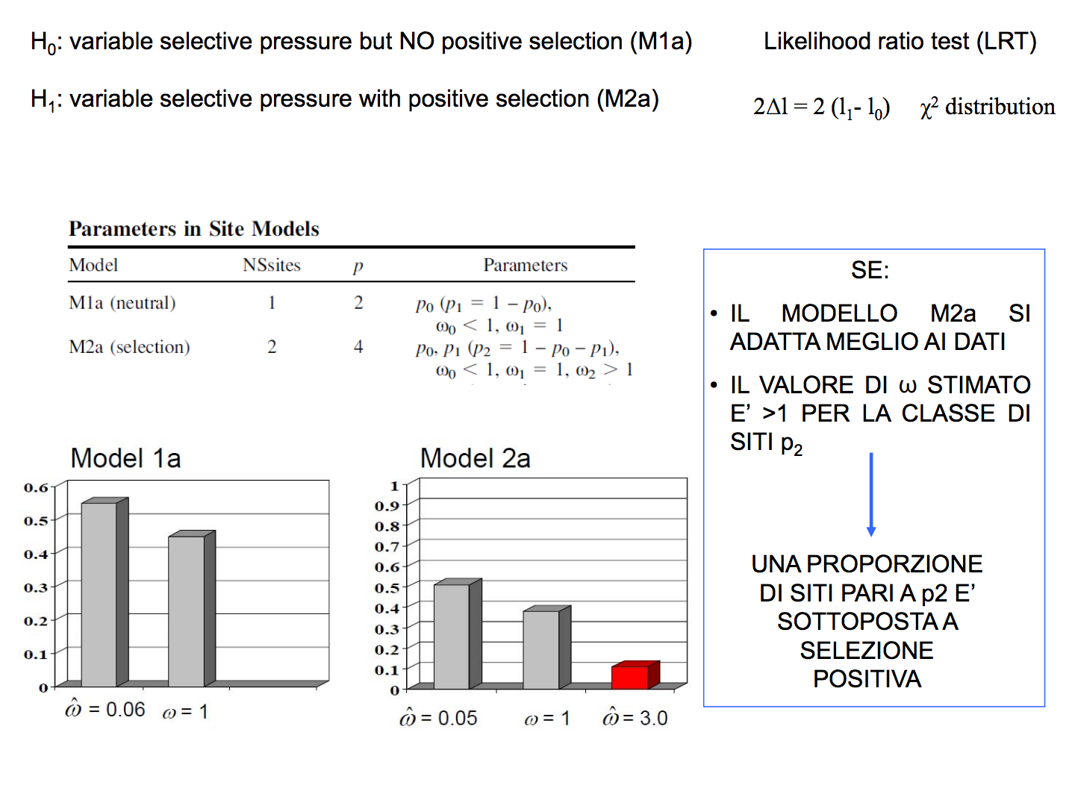
From: http://m.docente.unife.it/silvia.fuselli/dispense-corsi/EM_Lezione%208.pdf

Slide 55
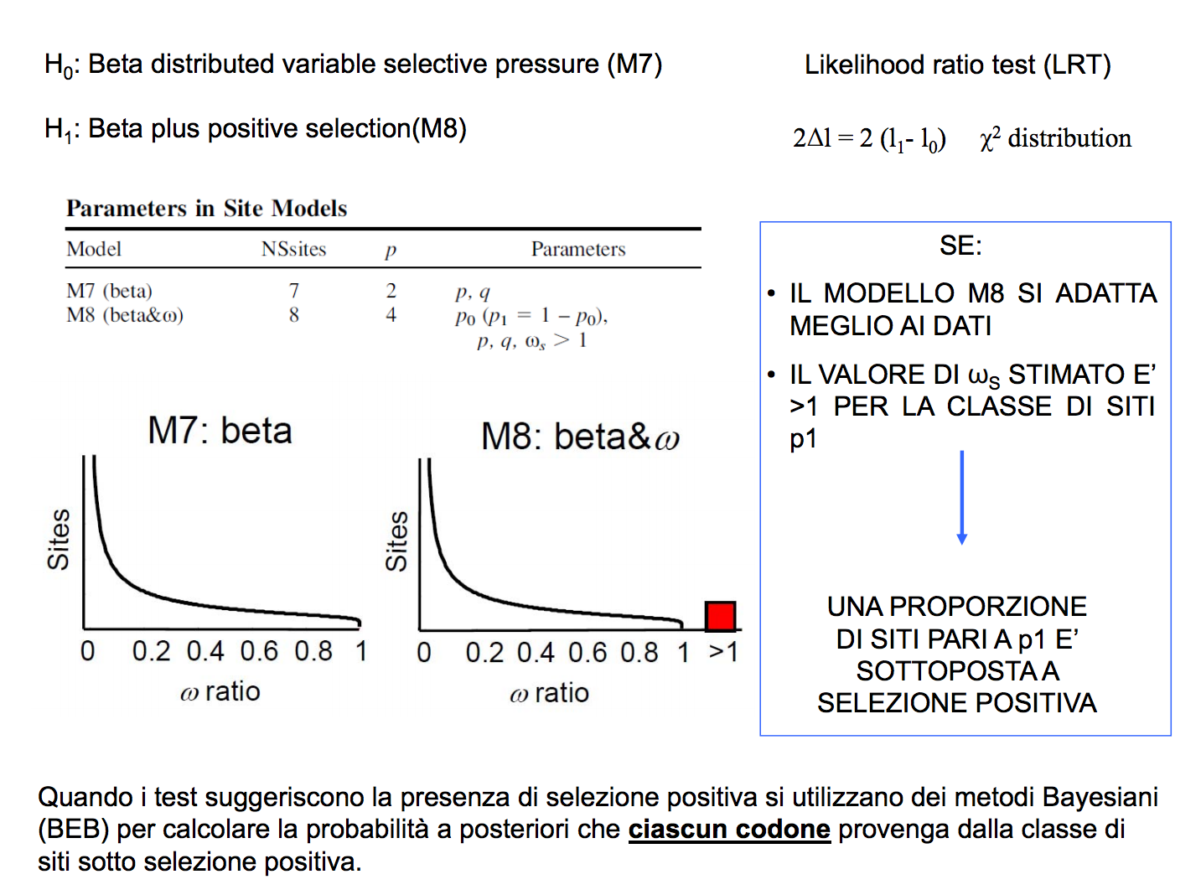
From: http://m.docente.unife.it/silvia.fuselli/dispense-corsi/EM_Lezione%208.pdf

Slide 56
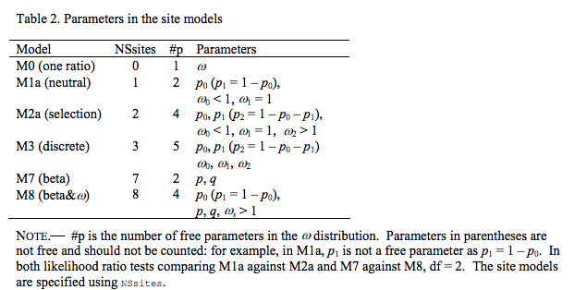
From: PAML manual

Slide 57
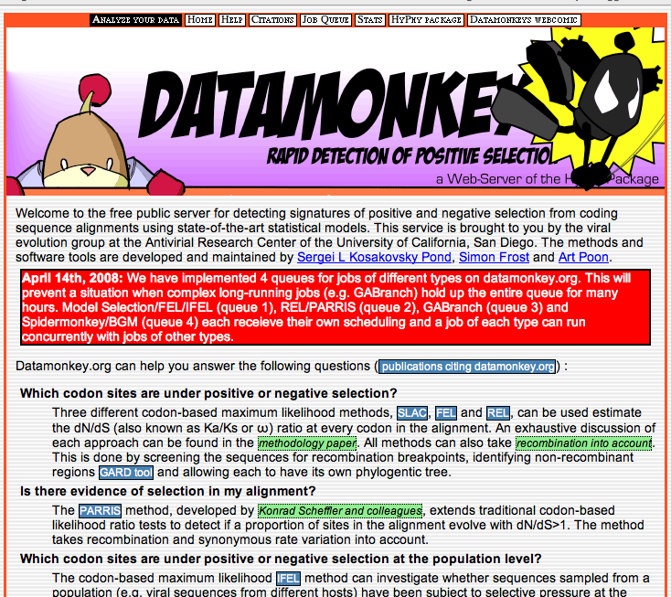
Hy-Phy - Hypothesis Testing using Phylogenies.
Using Batchfiles or GUI
Information at http://www.hyphy.org/
Selected analyses also can be performed online at
http://www.datamonkey.org/

Slide 58
hy-phy
Results of an anaylsis using the SLAC approach

Slide 59
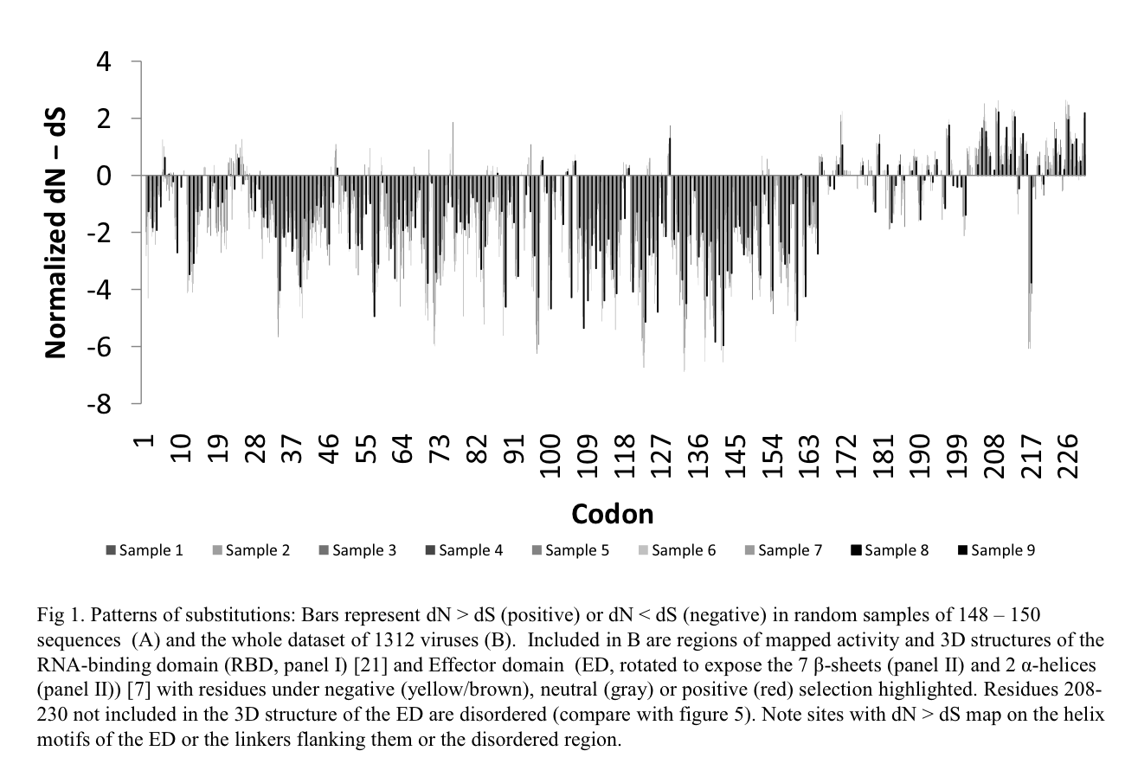

Slide 60
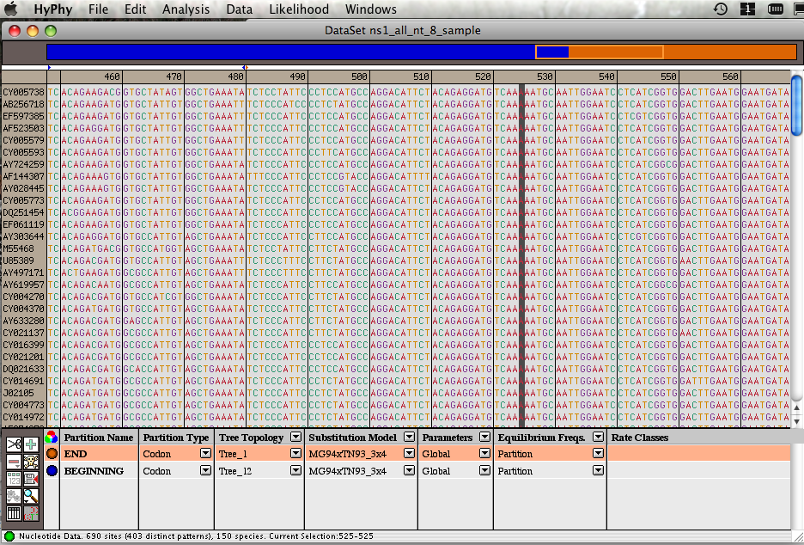
Example testing for dN/dS in two partitions of the data -- John’s dataset
Set up two partitions, define model for each, optimize likelihood

Slide 61
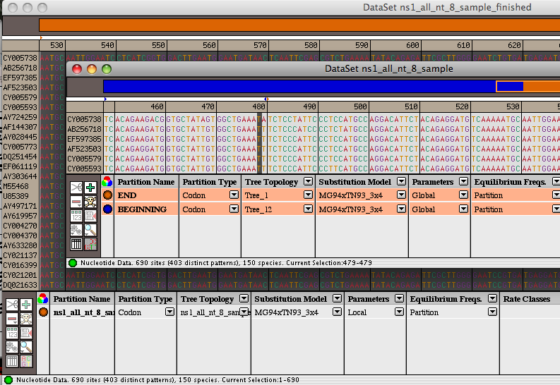
Example testing for dN/dS in two partitions of the data -- John’s dataset
Alternatively, especially if the the two models are not nested, one can set up two different windows with the same dataset:
Model 1
Model 2

Slide 62
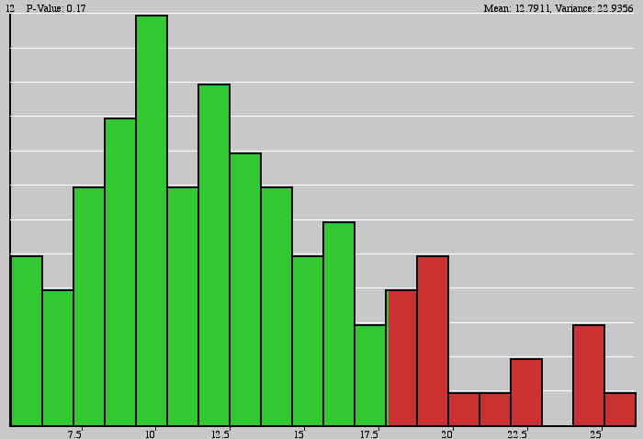
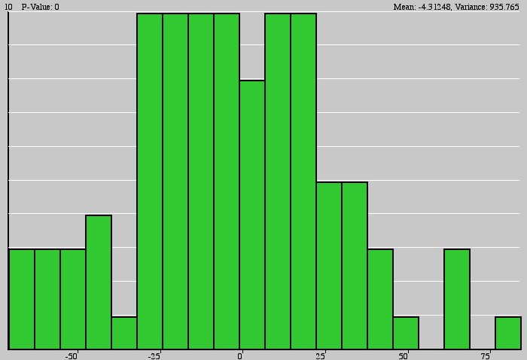
Example testing for dN/dS in two partitions of the data -- John’s dataset
Simulation under model 2, evaluation under model 1, calculate LR
Compare real LR to distribution from simulated LR values. The result might look something like this or this

Slide 63
Purifying selection in GTA genes
dN/dS <1 for GTA genes has been used to infer selection for function
GTA genes
Lang AS, Zhaxybayeva O, Beatty JT. Nat Rev Microbiol. 2012 Jun 11;10(7):472-82
Lang, A.S. & Beatty, J.T. Trends in Microbiology , Vol.15, No.2 , 2006
Notes:
The ratio of non-synonymous-to-synonymous (dN/dS, or ω) codon substitution rates can be used as an indication of the selective pressure acting on a protein-coding gene. If a gene (or gene segment) is under purifying selection, non-synonymous mutations (that is, mutations resulting in a change of the encoded amino acid) will be selected against, resulting in ω < 1. In neutrally evolving proteins, synonymous and non-synonymous mutations will be fixed at approximately the same rate, resulting in ω = 1. Because different regions of a protein-coding gene may be under different selective constraints, codons can be divided into two categories: those with ω < 1 (yellow; the estimated ω is indicated on the bar) and those with ω fixed to 1 (green); the estimated proportion of codons in each category is given on the horizontal axis.

Slide 64
Purifying selection in E.coli ORFans
dN-dS < 0 for some ORFan E. coli clusters seems to suggest they are functional genes.
Gene groups | Number | dN-dS>0 | dN-dS<0 | dN-dS=0
E. coli ORFan clusters | 3773 | 944 (25%) | 1953 (52%) | 876 (23%)
Clusters of E.coli sequences found in Salmonella sp., Citrobacter sp. | 610 | 104 (17%) | 423(69%) | 83 (14%)
Clusters of E.coli sequences found in some Enterobacteriaceae only | 373 | 8 (2%) | 365 (98%) | 0 (0%)
Adapted after Yu, G. and Stoltzfus, A. Genome Biol Evol (2012) Vol. 4 1176-1187

Slide 65
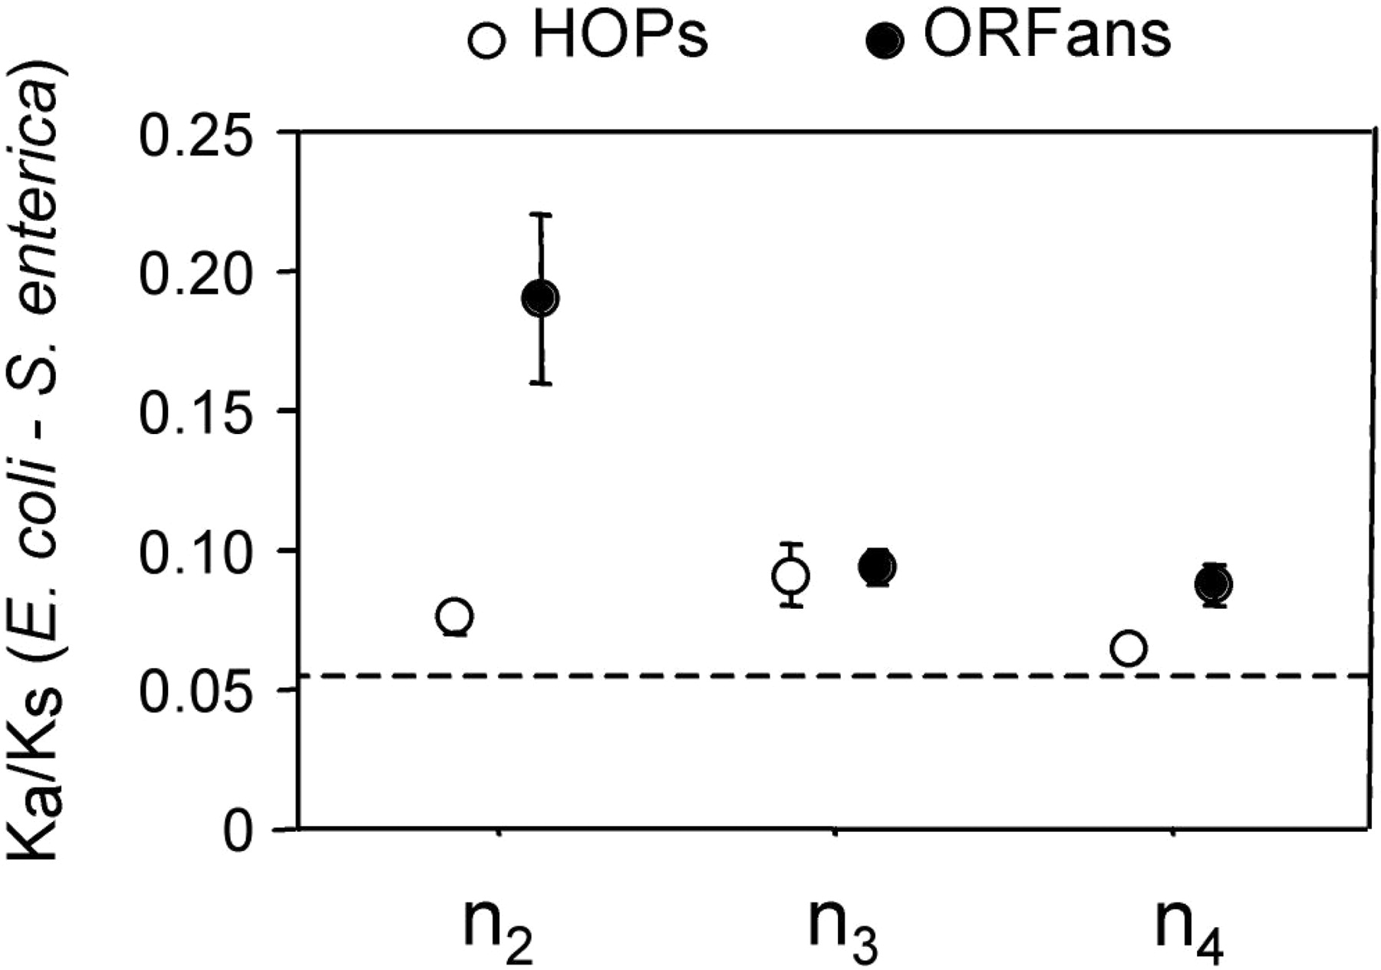
Vincent Daubin and Howard Ochman: Bacterial Genomes as New Gene Homes: The Genealogy of ORFans in E. coli. Genome Research 14:1036-1042, 2004
The ratio of non-synonymous to synonymous substitutions for genes found only in the E.coli - Salmonella clade is lower than 1, but larger than for more widely distributed genes.
Increasing phylogenetic depth
Fig. 3 from Vincent Daubin and Howard Ochman, Genome Research 14:1036-1042, 2004

Slide 66
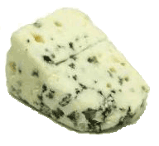
Trunk-of-my-car analogy: Hardly anything in there is the is the result of providing a selective advantage. Some items are removed quickly (purifying selection), some are useful under some conditions, but most things do not alter the fitness.
Could some of the inferred purifying selection be due to the acquisition of novel detrimental characteristics (e.g., protein toxicity, HOPELESS MONSTERS)?

Slide 67
Other ways to detect positive selection
Selective sweeps -> fewer alleles present in population
(see contributions from archaic Humans for example) Repeated episodes of positive selection -> high dN

Slide 68
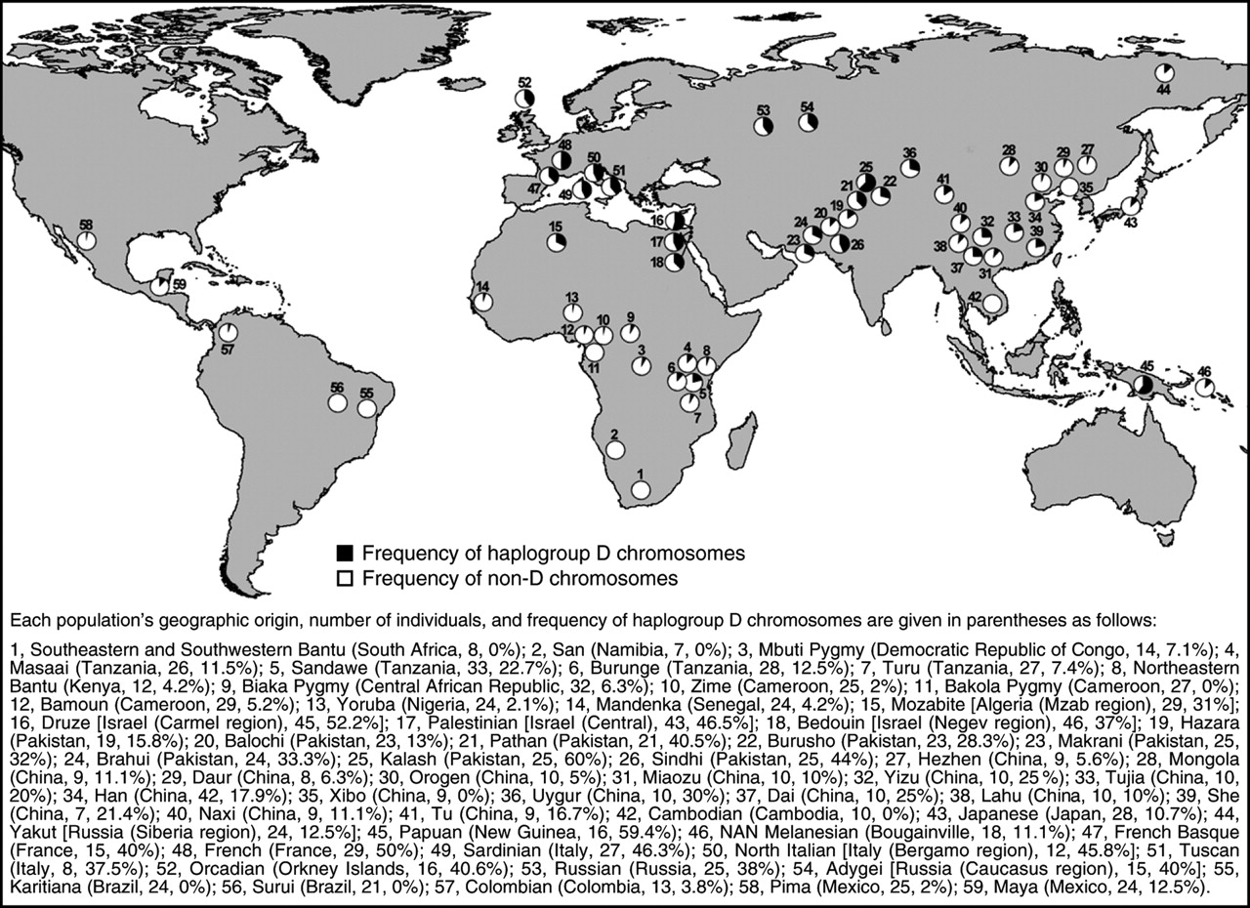
Variant arose about 5800 years ago

Slide 69
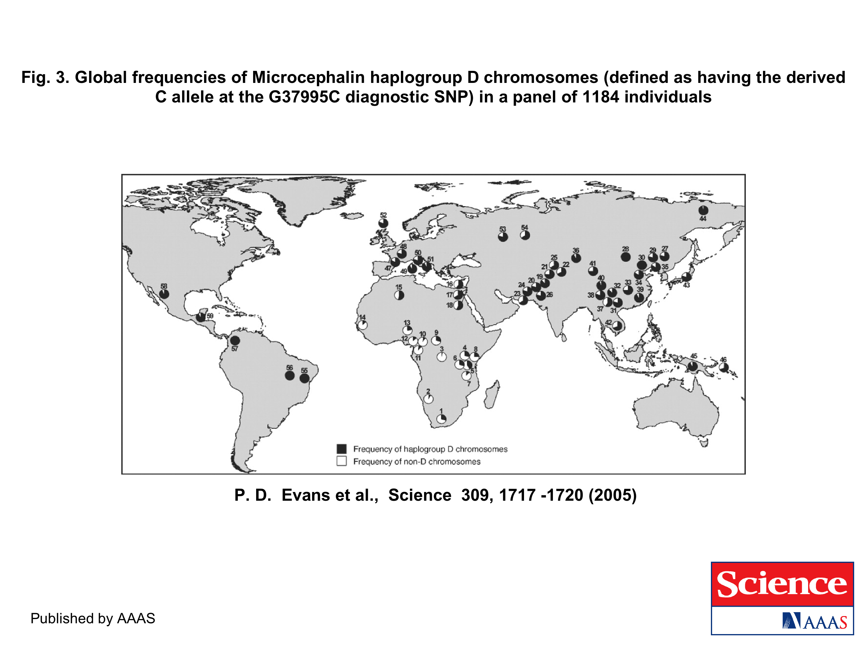
The age of haplogroup D was found to be ~37,000 years

Slide 70
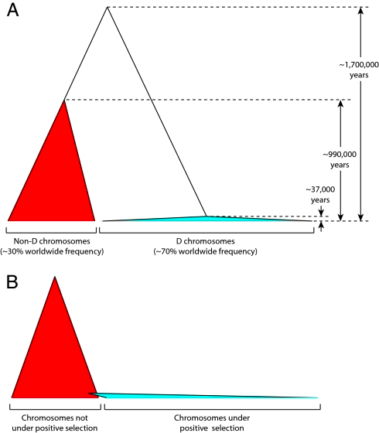
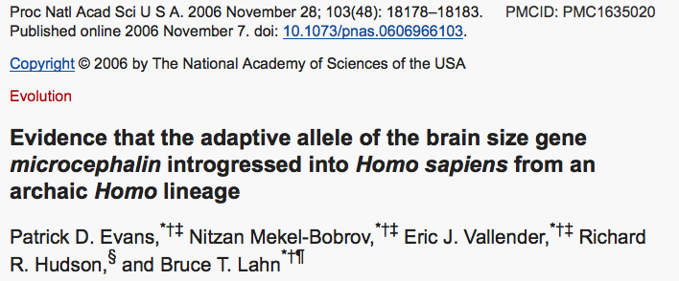

Slide 71
From: http://www.nytimes.com/2012/01/31/science/gains-in-dna-are-speeding-research-into-human-origins.html?_r=1

Slide 72
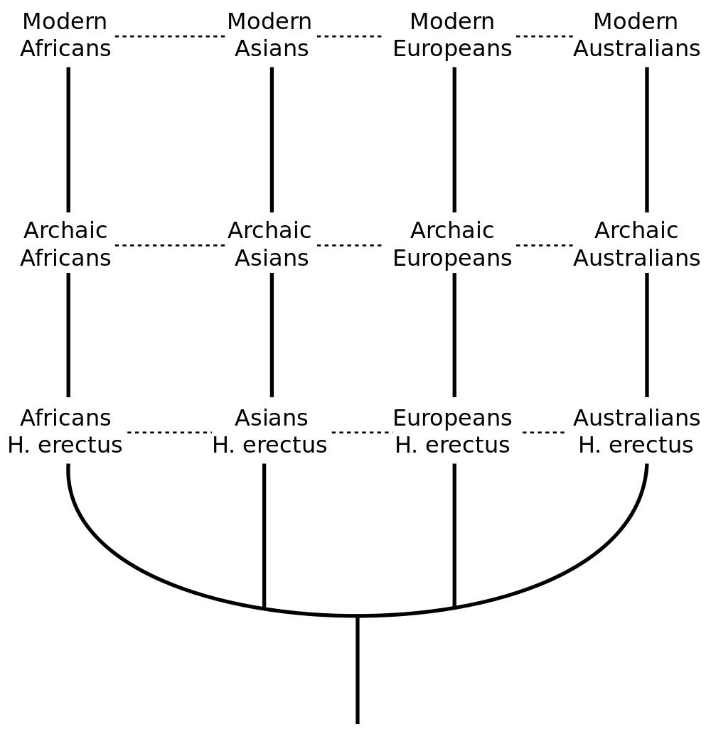
The multiregional hypothesis
From http://en.wikipedia.org/wiki/Multiregional_Evolution

Slide 73
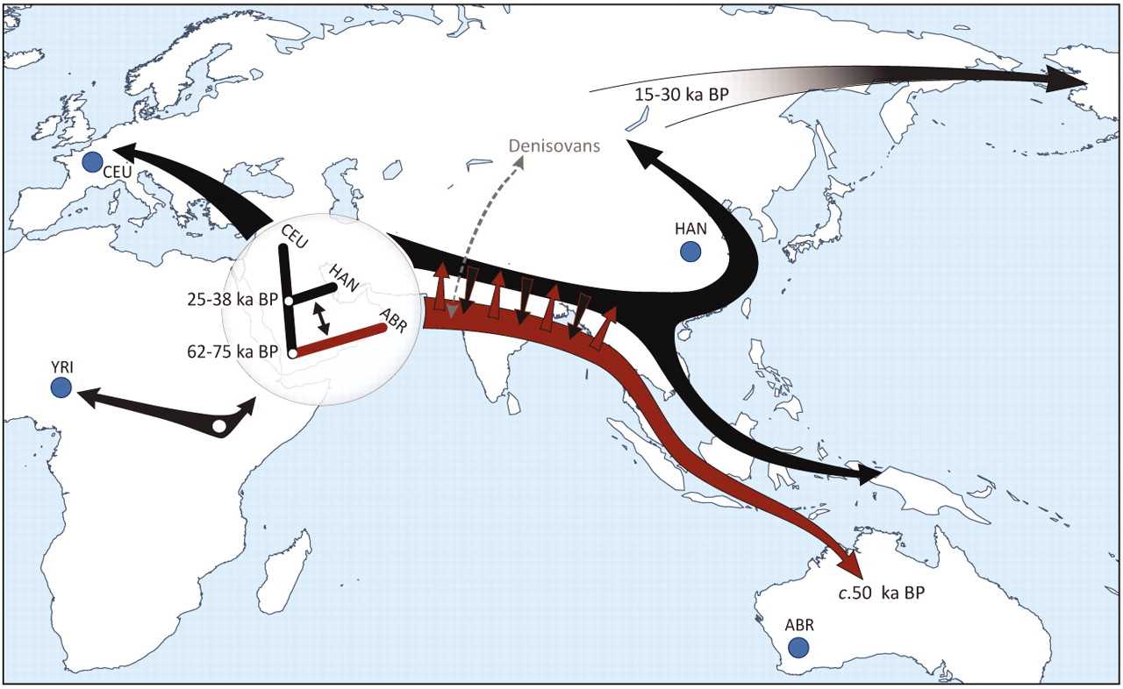

Slide 74
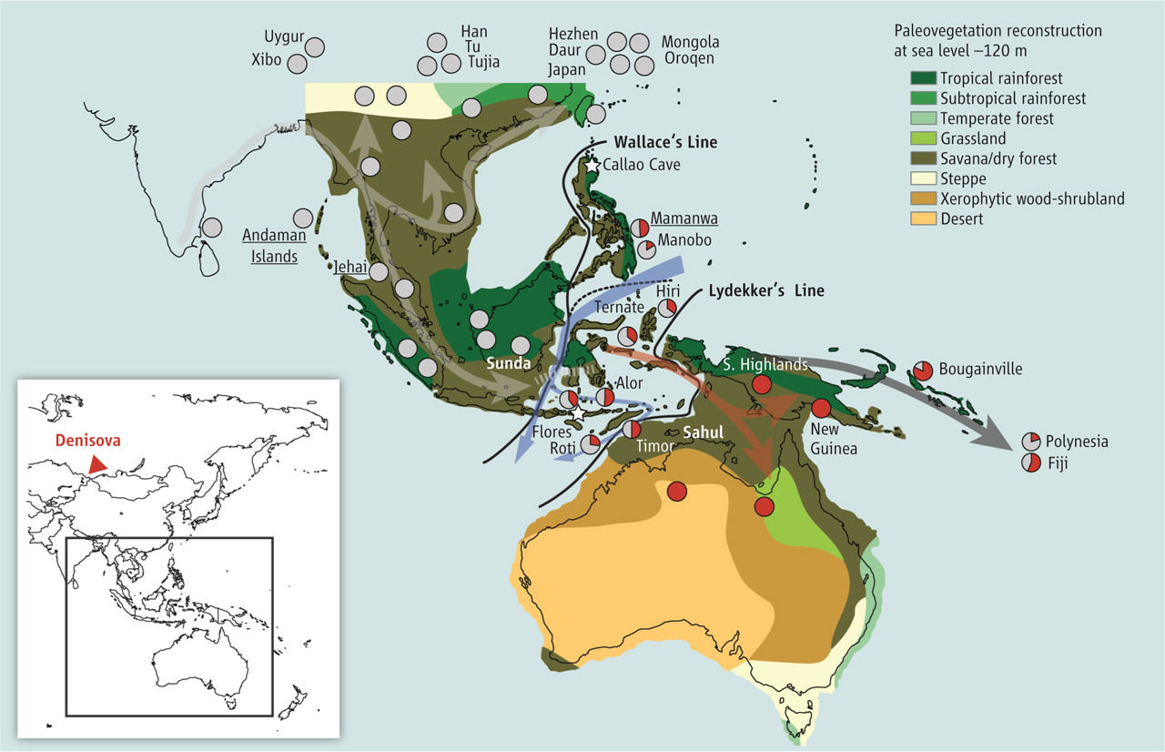
Did the Denisovans Cross Wallace's Line?
Science 18 October 2013:
vol. 342 no. 6156 321-323
Ancient migrations.
The proportions of Denisovan DNA in modern human populations are shown as red in pie charts, relative to New Guinea and Australian Aborigines (3). Wallace's Line (8) is formed by the powerful Indonesian flow-through current (blue arrows) and marks the limit of the Sunda shelf and Eurasian placental mammals.

Slide 75
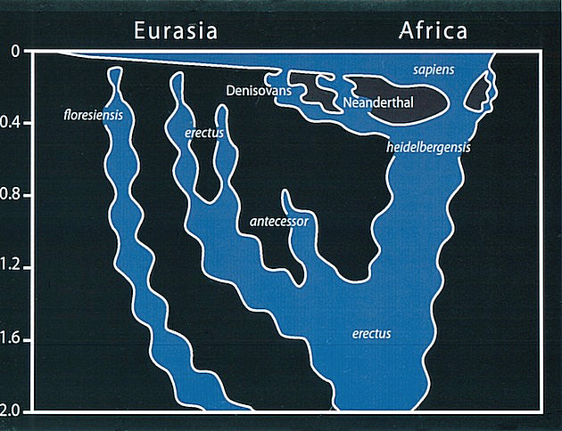
Archaic human admixture with modern Homo sapiens
From: http://en.wikipedia.org/wiki/Archaic_human_admixture_with_modern_Homo_sapiens

Slide 76
For more discussion on archaic and early humans see:
http://en.wikipedia.org/wiki/Denisova_hominin
http://www.nytimes.com/2012/01/31/science/gains-in-dna-are-speeding-research-into-human-origins.html
http://www.sciencedirect.com/science/article/pii/S0002929711003958
http://www.abc.net.au/science/articles/2012/08/31/3580500.htm
http://www.sciencemag.org/content/334/6052/94.full
http://www.sciencemag.org/content/334/6052/94/F2.expansion.html
http://haplogroup-a.com/Ancient-Root-AJHG2013.pdf

