Slide 1
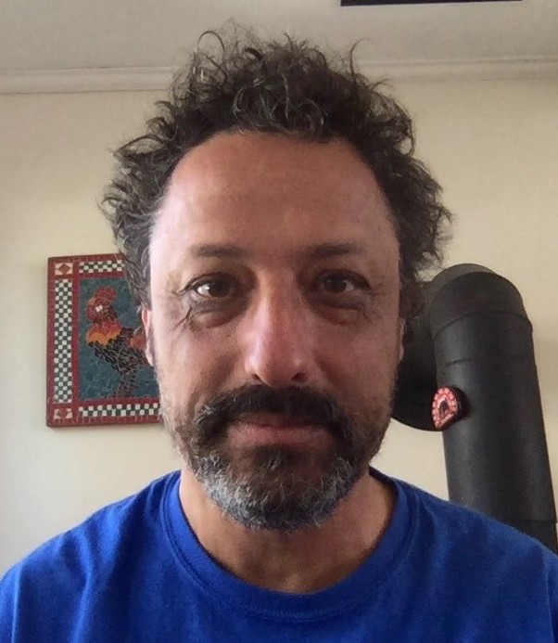
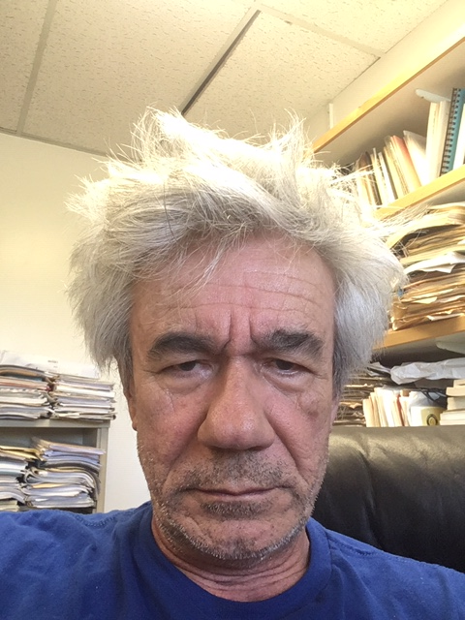

Radiative products for the PACE era
Emmanuel Boss (Umaine) & Robert Frouin (UCSD-SIO)
Objective: Provide legacy radiative products + novel radiative products that are useful, state-of-the-art, validated and with known uncertainties on a pixel-by-pixel basis.
Useful ← based on inputs from likely users.
Notes:
Robert Frouin, my Colleague and I, are excited to be part of the PACE team.
Our focus is on generating radiative product for PACE at each pixel.
These include legacy products as well as novel one.
Our aim is for them to be useful - that is based on the needs of the community, state-of-the-art, validated and with known uncertanities.

Slide 2
Deliverables:
Level 2 & 3 E_{d}(λ), E₀(λ) & A_{s}(λ) at z=0⁺ and z= 0- from 400-700nm every 5nm at satellite passage and daily-integrated.
Band integrated PAR (400-700) and UVA(340-400) flux.
Sub-surface radiative quantities or k-functions to compute them.
Associated pixel-by-pixel uncertainties.
Notes:
The deliverables of our project are algorithms to obtain:
Ocean albedo and Planar and scalar irradiance at both just above and just below the ocean's surface as well as at additional specific levels below the surface.
Spectral resolution is 5nm spanning from 400 to 700nm.
Band integrated PAR (400-700) and UVA (340-400) fluxes of interest to biogeochemical processes such as primary productivity and photochemistry.
The sub-surface light fields could be provided as such or via appropriate k-functions.
All these products will be validated and will have associated pixel-by-pixel uncertainties.

Slide 3
Methods (radiative quantities):
1. Surface radiation products
Variables:
-Daily-averaged downward plane and scalar irradiance just above and below the surface and surface albedo in the 5 nm spectral bands of the OCI from 340 to 700 nm.
-Integrated values over the PAR spectral range (400-700 nm), and UVA-I (340-400nm) fluxes.
Resolution/Coverage:
-Original spatial resolution (1 km) in instrument projection at Level 2.
-4 km resolution on Plate Carrée and equal-area grids at Level 3 (compatible with other Level 3 OCI products and radiation products from other missions).
-Global geographic coverage over ice-free ocean and inland water bodies everyday of year.

Slide 4
2. Algorithms
Plane Irradiance:
-Budget approach, i.e. solar flux penetrating the surface, E_{d}(0⁻), is obtained by subtracting from the flux arriving at TOA (known), the flux reflected to space by the atmosphere/surface system (estimated from the OCI measurements), accounting for atmospheric transmission (modeled).
-No need to distinguish clear and cloudy regions within a pixel.
-Assumptions: Plane-parallel atmosphere, clear atmosphere positioned above cloud layer
E_{d}(0⁻) = E_{clear}(1 – A)(1-S_{a}A)⁻¹ ; E_{d}(0⁺) = E_{clear}(1 – A)(1 - A_{s})⁻¹(1-S_{a}A)⁻¹; E_{clear} = E_{TOA}cos(θ_{s})T_{d} T_{g}
<E_{d} > = (1/24) ∫_{t} cos(θ_{s}(t) E_{d}(A’(t))dt
A’(t) = 1- [1 -A(t) + A_{s}(t)] [1 - N(t)A_{c}(τ_{c}(t))] /[(1 - N(t_{sat})A_{c}(τ_{c}(t_{sat}))] - A_{s}(t), N and τ_{c} from hourly MERRA-2 data.
-0⁻ irradiance estimated more directly, but 0⁺ irradiance easier to evaluate.

Slide 5
Scalar irradiance:
-24h-averaged scalar quantities can obtained from a reduced set of parameters, the most important ones being the location and date which control the day length and mean Sun zenith angle, then the influence of the clouds which is between null (clear sky) and maximum (100% cloud cover), and finally the wind speed.
-Method is based on look-up tables of clear sky and overcast situations and the derived cloud factor from the OCI observations, i.e., the ratio of the actual flux and the clear sky flux, either above or below surface.
-For example, to estimate the spectral scalar irradiance just below the surface at λ_{i}, <E_{o}(λ_{i}, 0⁻)>, from the spectral plane flux just above the surface at λ_{i}, <E_{d}(λ_{i}, 0⁺)>, we have:
<CF(λ_{i})>^{obs} = <E_{d}(λ_{i}, 0⁺)>^{obs}/<E_{d-clear}(λ_{i}, 0⁺)>^{obs}
<CF_{overcast}(λ_{i})>^{lut} = <E_{d-overcast}(λ_{ι}, 0⁺)>^{lut}/<E_{d-clear}(λ_{i}, 0⁺)>^{lut}
S1 =[<E_{o-clear}(λ_{i}, 0⁺)>^{lut} - <E_{o-overcast}(λ_{i}, 0⁺)>^{lut}]/[1 - <CF_{overcast}(λ_{ι})>^{lut}]
<E_{o}(λ_{i}, 0⁻)> = S1[<CF(λ_{i})>^{obs} - <CF_{overcast}(λ_{i})>^{lut}] + <E_{o-overcast}(λ_{i}, 0⁺)>^{lut}

Slide 6
Estimation of scalar PAR irradiance just below surface
+
Figure 1: Left: Simulations of 24-h averaged ratio of scalar PAR irradiance below the surface and plane PAR irradiance above surface as a function of latitude for clear-sky (solid lines) and totally overcast situations (dashed lines, cloud optical thickness = 50, constant along the day) and for wind speeds of 0, 7, and 15 ms⁻¹ as a function of latitude. The date is 21st of June. Right: Estimated scalar PAR irradiance below the surface from plane PAR irradiance above surface for all the days of 2011 and 3 wind speeds. The color of the symbols denotes the cloud factor. Units are mol ph m⁻² day⁻¹.

Slide 7
3. Uncertainty Assignment
-Algorithm component of the total uncertainty budget, which is expected to dominate, will be estimated as a function of clear sky daily mean values and cloud factors by simulating for a wide range of situations the satellite measurements and the corresponding daily values.
-Several years of MERRA-2 hourly input data (aerosols, clouds) will be used. The large number of data points will allow adequate sampling of atmospheric variability (many variations of daytime nebulosity, for all latitudes).
-Complete per-pixel uncertainty budget includes uncertainties associated with measurement noise and radiometric calibration, which may require estimating the sensitivity of daily fluxes to input reflectance and covariance in the various spectral bands. Approach will be to apply procedure above to noisy OCI simulations.

Slide 8
Uncertainty on daily mean plane PAR irradiance above surface
Figure 2: Uncertainty on daily mean plane PAR irradiance above surface (estimated - actual) from simulations for the period 2003-2012 using 1-hourly resolved MERRA-2 input data. For each day, a set of TOA spectral reflectance data is simulated for observation at 10:30 local time and several viewing geometries (nadir and 20° view zenith with relative azimuth of 0, 90 and 180°, with sun glint avoidance). (Left): 2D plot of the uncertainty bias as a function of the clear sky daily mean plane PAR irradiance above surface (x axis) and cloud factor (y axis), along with 1D (marginal) distribution. (Right): Same as left but for the uncertainty standard deviation.

Slide 9
4. Evaluation
Theoretical:
-Simulations of the OCI signal and corresponding above/below surface fluxes performed with the GPU-accelerated SMART-G Monte Carlo code.
-Differences between daily mean fluxes computed by SMART-G and by the proposed algorithms will be quantified for various configurations. This will provide a measure of expected uncertainty in the OCI daily-mean flux estimates. The results may help to adjust the algorithms.
-SMART-G code will be run with MERRA-2 data to generate look-up tables of clear sky and overcast situations to estimate scalar fluxes from plane fluxes and of uncertainties (bias, standard deviation) as a function of clear sky values and cloud factor.
Experimental:
-Systematic, long-term measurements for above surface products from existing platforms, including CCE-1 and CCE-2 buoys (Western Pacific), BOUSSOLE buoy (Mediterranean Sea), and AERONET-OC sites.
-Appropriate sensors for PAR, UV fluxes, and spectral irradiance will be installed on AERONET-OC platforms, processed, and distributed as part of AERONET flux network.

Slide 10
Methods (propagation below the surface):
Variables: extending daily radiation products to depth: k_{0,} k_{d ,} k_{PAR ,} k_{UVA}
Legacy empirical products :k_{d}(490) & k_{d}(PAR).
User-requested products: e.g Z_{eu} & Z_{PAR}=0.415, and MLD median PAR.
New spectral products: k₀(λ), k_{d}(λ) to N levels (alternatively E_{x}(z_{N})).
Computation of k_{0,d}(PAR, UVA), from propagating spectral light at depth.
Explore using PACE-based IOPs + Hydrolight, [Chl] and empirical approaches which take stratification into account (Xing et al., in review).
Resolution/Coverage:
-Original spatial resolution (1 km) in instrument projection at Level 2.
-4 km resolution on Plate Carrée and equal-area grids at Level 3 (compatible with other Level 3 OCI products and radiation products from other missions).
-Global geographic coverage over ice-free ocean and inland water bodies everyday of year.
Notes:
Propagation of light fields to depth will be for daily radiation products and involve legacy products as well as new ones.
Legacy products include the planar attenuation at 490nm and PAR near the surface.
The novel products will be derived in consultation with users and could include
PAR products such as euphotic depth or a specific isolume depth or median light levels in the ML.
Radiative fields at given depths or, alternatively, the associated k functions.
The methods to obtain them will be based on a variety of approaches spanning spanning from empirical approaches to those based on radiative transfer computations using IOPs retreived with PACE. An example of the empirical approach is a recent study we have conducted (in review for RSE) where we used a profiling-floats-based radiometry dataset to build an algorithm to compute planar radiometric quantities for PAR and E(490) at any depth given surface observations.
The resolution and coverage of these products could be the same as the surface radiative products (based on users needs).

Slide 11
Uncertainties:
Uncertainties in subsurface light-fields will be computed based on the method used. For example, if the diffuse attenuation will be computed from surface IOPs retrieved from PACE, the uncertainties in the IOPs together with with those due to the assumptions of the RT computations (e.g., the choice of the VSF) will be propagated through.
To verify our approach to obtain subsurface light field and their uncertainties, we will conduct comparisons with field measurements of instantaneous and daily averaged radiometric quantities at depth under similar conditions where satellite data are obtained (even if at other time of the day cloudy conditions may prevail).
Notes:
Uncertainties in subsurface light field will be computed based on the method used to compute them. For example, if IOPs from PACE are used to compute attenuation functions then their uncertainties (expected to provided with this product) will be propagated. Additional uncertainties, such as those from RT computations will be propagated as well.
To verify our approach for subsurface radiative quantities as well as their uncertainties we will compare them to field measurements.

Slide 12
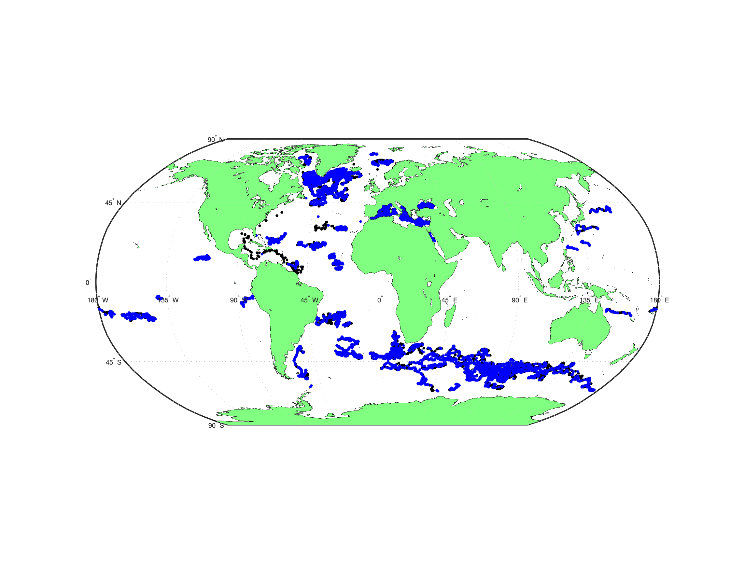
Evaluation (detection/removal of bias):
BGC-Argo data set (PAR+3λ), particularly vertical structure (> 16K QCed profiles).
MOBY (near surface, Hyperspectral), BOUSSOLE.
Optical datasets in SeaBASS and PANGAEA.
Moorings (OOI, OceanSITES), particularly for daily data.
Include remote sensing when available (surface to depth).
Notes:
To determine the best approach to compute subsurface light field and its uncertainties we will use field data
to:
1. derive and evaluate empirical approaches (e.g. Xing et al., in review).
2. evaluate semi-analytical approaches.
Datasets we have access to are:
BGC-Argo: currently has more than 16K QCed profiles of radiometry providing the depth distribution of Ed at three wavelengths + PAR
MOBY and BOUSSOLE: These two sites used for vicarious calibration collect near surface radiometry at discreet depth, an hyperspectraly at MOBY.
Moorings (OceanSITES and OOI): hourly data through out the day.
Databases such as SeaBASS and PANGAEA
If you are aware of more data, please let us know. In particular, we are not aware of scalar irradiance datasets available other than for PAR.

Slide 13
Performance metrics:
Plan do use standard metrics.
Acceptable ranges are known from observations and theory (e.g. clear day and clearest waters).
Spatial domain: global (optically deep).
Mask optically shallow waters (e.g. based on depth databases and anomalous reflectances).
Highest relative uncertainties under clouds and at high latitudes near the time of polar night.
Notes:
We plan to use standard metrics such as absolute and relative bias, RMSD, RRMSD etc'.
The values of radiative quantities are constrained physically as well as empirically and their acceptable ranges are known.
The spatial domain of our product is the global optically deep ocean.
We will develop a mask for optically shallow waters.
We expect the largest uncertainties to be in partially cloudy conditions as well as at high latitudes near polar night.

Slide 14
Timeline:
Task | Y1 Q1 | Y1 Q2 | Y1 Q3 | Y1 Q4 | Y2 Q1 | Y2 Q2 | Y2 Q3 | Y2 Q4 | Y3 Q1 | Y3 Q2 | Y3 Q3 | Y3 Q4
Consult users | x | x | x | x
RT calculations | x | x | x | x
Assembling field data | x | x | x | x
Formulation and testing |  |  | x | x | x | x | x
Evaluation with field data |  |  |  |  |  | x | x | x | x | x
Hand off to GSFC |  |  |  |  |  |  |  | x | x | x | x
Publications |  |  |  |  |  |  |  |  | x | x | x | x
Notes:
Our tentative timeline is as follows:
We will consult users (early adopters) to ensure the products we will deliver are fit for purpose.
Year one will also be used to assemble datasets of measured light fields and perform ratidative-transfer calculations.
We will build and test algorithms in years one and two and evaluate them with data starting in year two.
Finally we will interface with the Goddard team to implement the algorithms at the latest by the middle of the second year and write the associated protocols and manuscripts.

Slide 15
Thank you!
Questions?
Comments?
Suggestions?
Potential for collaboration?
rfrouin@ucsd.edu
emmanuel.boss@maine.edu
Notes:
Thank you for your attention.
If you have any questions or comments, please send them to us.
Ditto if you have any suggestions regarding datasets and relevant papers you think we should be aware of.
Finally, if you see a way by which our projects can collaborate, please tell us.
We look forward for a productive fun-filled time on the PACE Science Team!

