Slide 1
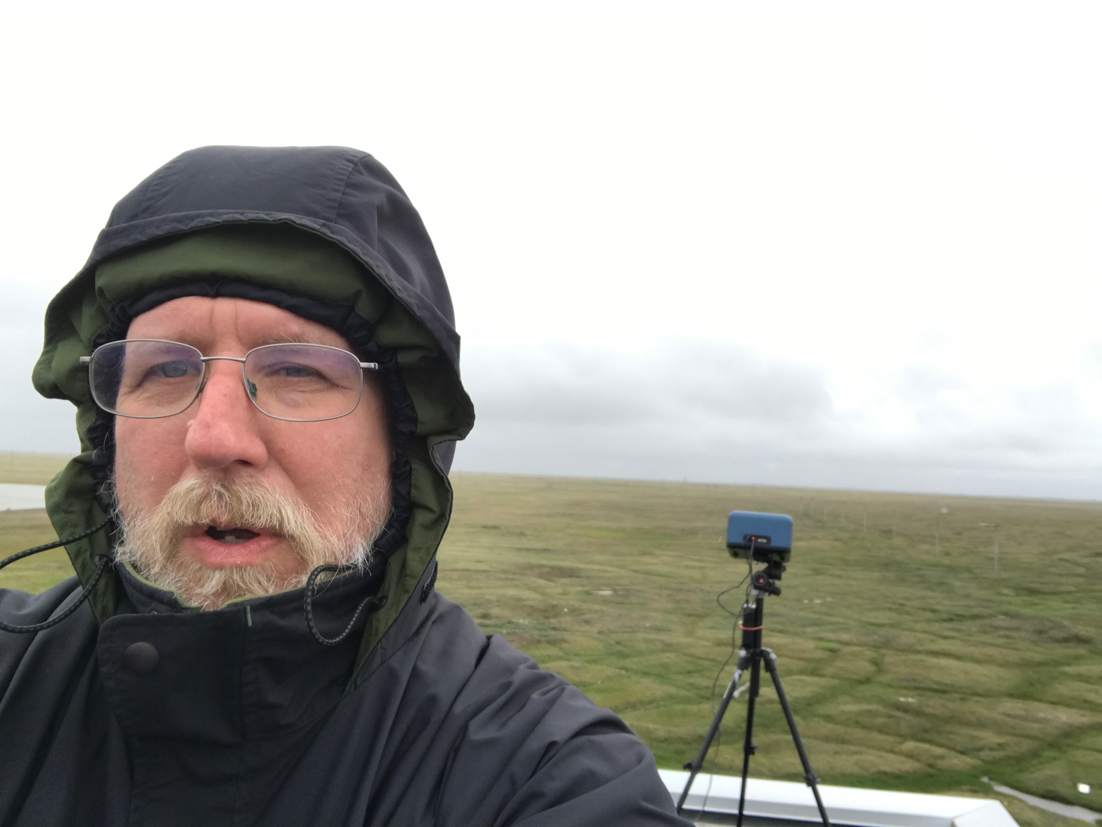

Terrestrial Ecology Products from PACE
Team: K. Fred Huemmrich
Joint Center for Earth System Technology
University of Maryland Baltimore County
Biospheric Sciences Laboratory
Code 618
NASA Goddard Space Flight Center
Greenbelt, MD 20771

Slide 2
Terrestrial Ecology Products from PACE
Project Objectives:
To advocate for the use of PACE observations for analysis of terrestrial ecosystems
PACE, with its frequently collected continuous high spectral resolution imagery and global coverage from OCI, provides an opportunity to describe dynamics of key terrestrial vegetation biochemical and functional characteristics.
PACE spectral reflectance may also identify vegetation functional type coverage, related to biodiversity and which further constrains physiological responses.
Taken together, PACE measurements can describe factors determining plant productivity, stress responses, and resource allocations, providing new insights into global patterns of the function of terrestrial ecosystems and their response to environmental conditions.
My role in the PACE SAT is advisory, there are no PACE terrestrial products being developed at this time

Slide 3
Terrestrial Ecology Products from PACE
Potential PACE OCI terrestrial ecology products could include:
Leaf Pigment Contents
  - Chlorophylls, carotenoids, and anthocyanins; related to plant condition, stress responses, and productivity
Photochemical Reflectance Index (PRI) and Chlorophyll-Carotenoid Index (CCI)
  - Describes photoprotection through xanthophyll cycle and longer-term changes in ratio of chlorophyll and carotenoid pigment pools
Leaf Water Content
  - Describes plant water status
Leaf Mass per Area (LMA)
  - An indicator of plant growth strategies for allocation of nutrients
Maximum rate of RuBP carboxylation (Vcmax)
  - Describes vegetation photosynthetic capacity
Gross Primary Productivity (GPP)
  - Provides a direct independent estimate of productivity from spectral data
Plant Functional Type Cover Fractions
  - Related to biodiversity and provides constraints on physiological responses
Global mapping of any of these variables would represent an important advancement for terrestrial ecology

Slide 4
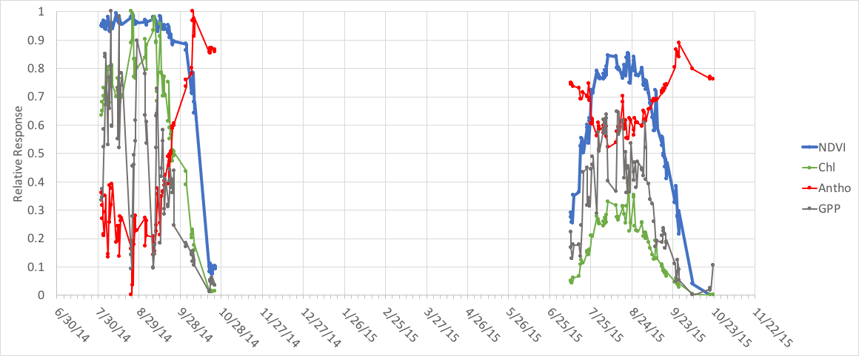
Seasonal Change in Leaf Pigment Contents
NDVI (Normalized Difference Vegetation Index), a frequently used vegetation index, is sensitive to changes in green leaf area, but does not fully describe seasonal activity in plants
PACE’s frequent observations and spectral bands can track seasonal vegetation biochemical changes related to plant productivity and stress responses
Midday observations of a cornfield in Beltsville, MD over two different years from the automated FUSION sensor suite. Gross primary productivity (GPP) measured from flux tower in same field.
NDVI seasonal pattern differs from those of Chlorophyll and Anthocyanin indices
- Second year is more stressed than the first
  - Less Chlorophyll, more Anthocyanin
- NDVI does not track GPP as well as chlorophyll content

Slide 5
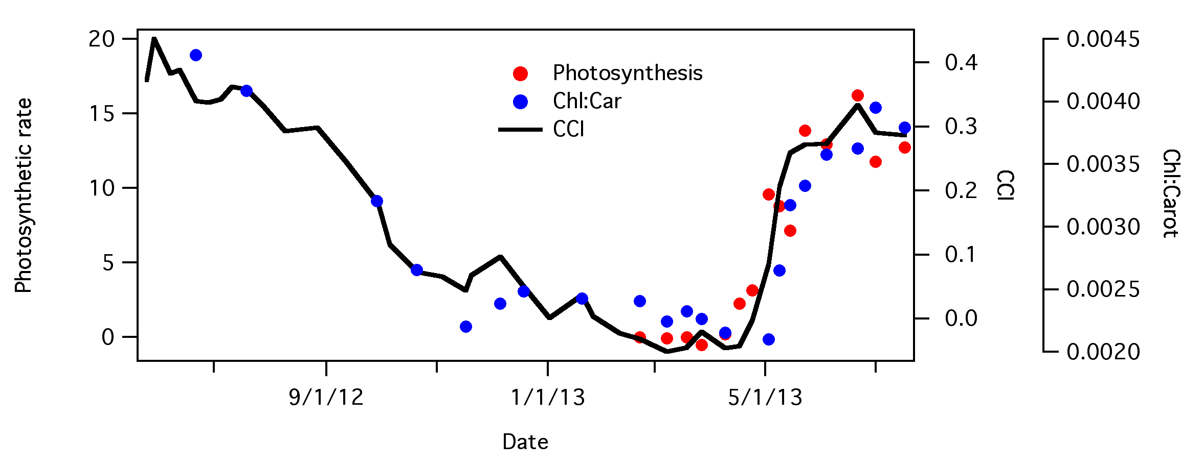
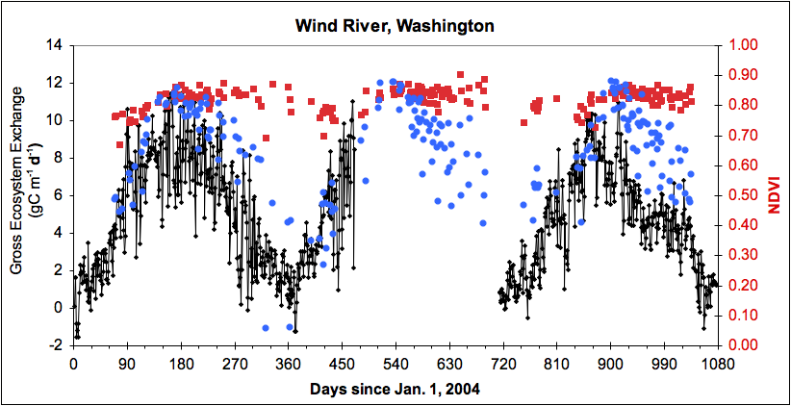
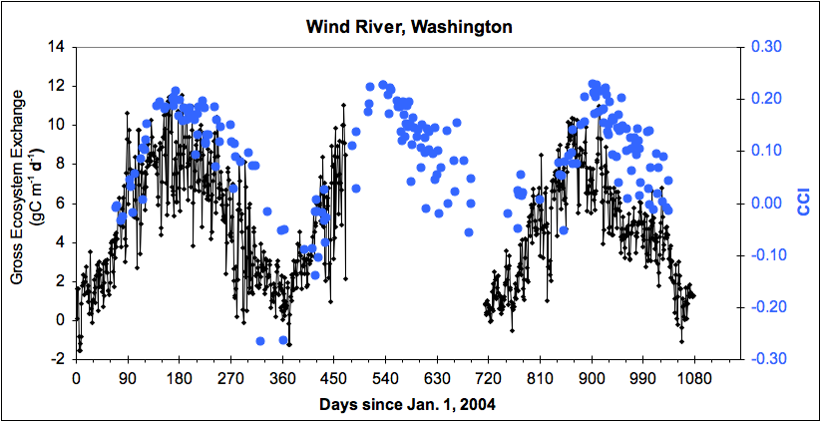
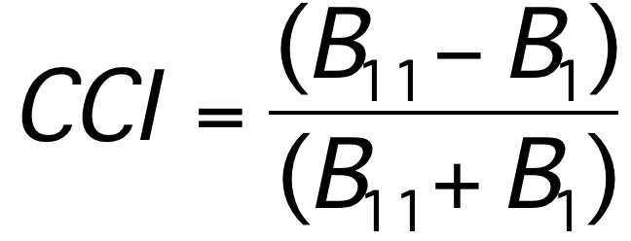
Seasonal Change in Evergreen Conifers
NDVI does poorly describing seasonal change in evergreens
New spectral indices can track vegetation biochemical changes related to plant productivity, PACE can continue this time series
Leaf-level response
The Chlorophyll-Carotenoid Index (CCI) combines MODIS Ocean and Land bands (band 11 at 531 nm and band 1, a broad red band)
Time trends for Pinus contorta needles exposed to a boreal climate through winter and photosynthetic activation in the spring
  Points show photosynthesis (red) and ratio of chlorophyll:carotenoid pigment amounts (blue)
  Black line - CCI
Canopy-level response
Wong and Gamon 2015
Time trends for Douglas fir forest
  Points show NDVI (red) and CCI (blue) from MODIS MAIAC surface reflectance
  Black line - daily gross ecosystem production from flux tower
VIIRS, the operational MODIS follow-on does not have a 531 nm band, PACE is required to continue this work
Gamon et al. 2016

Slide 6
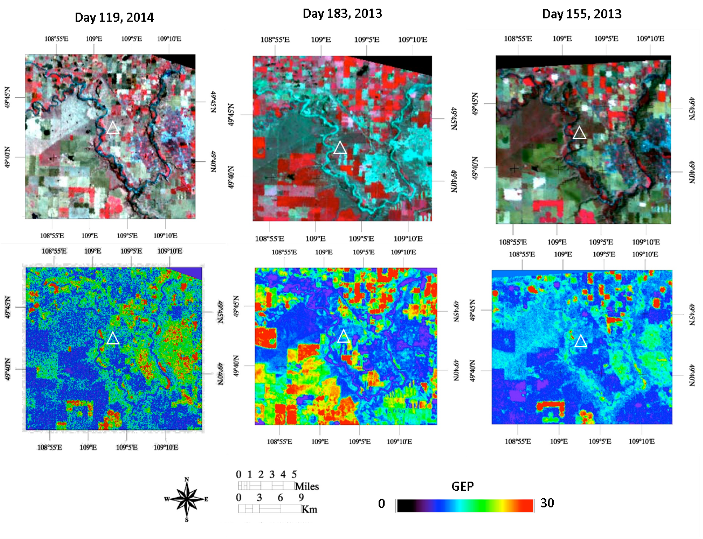
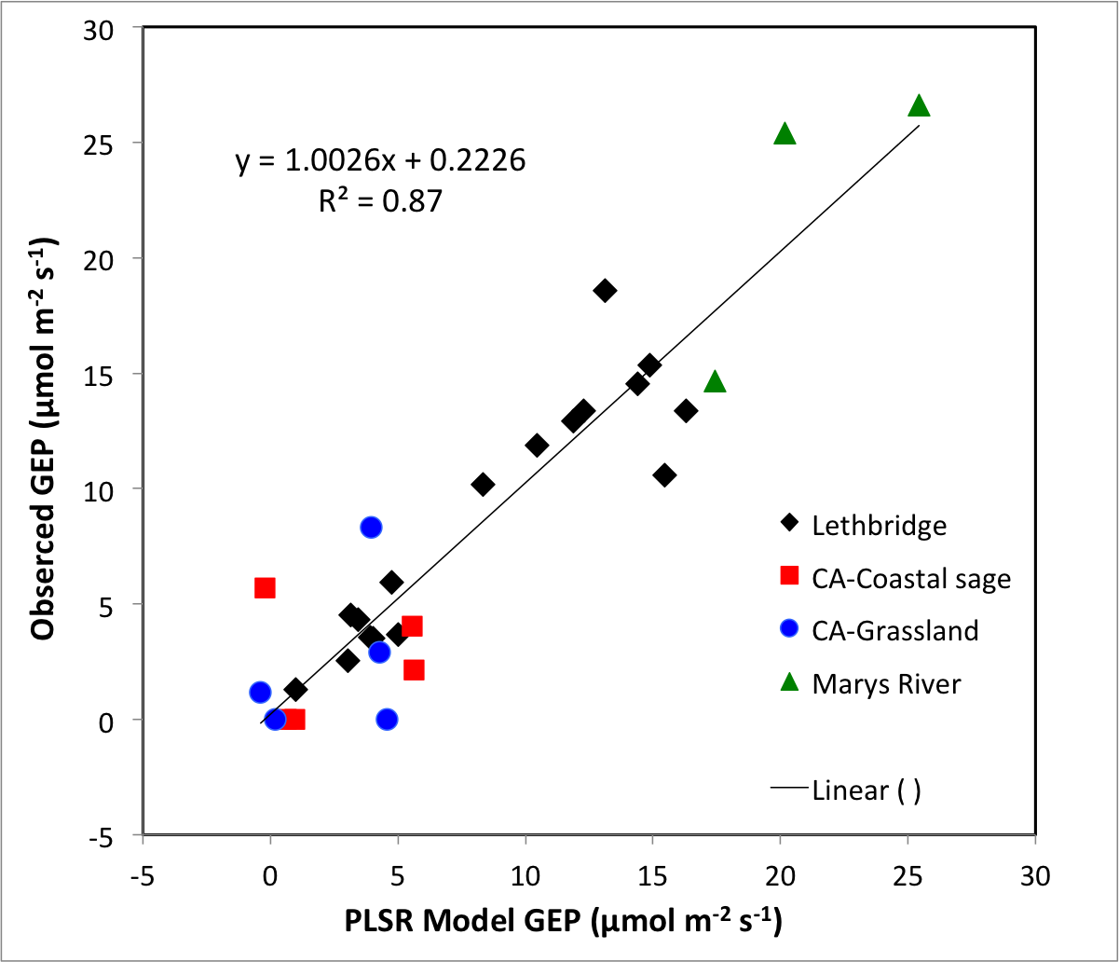
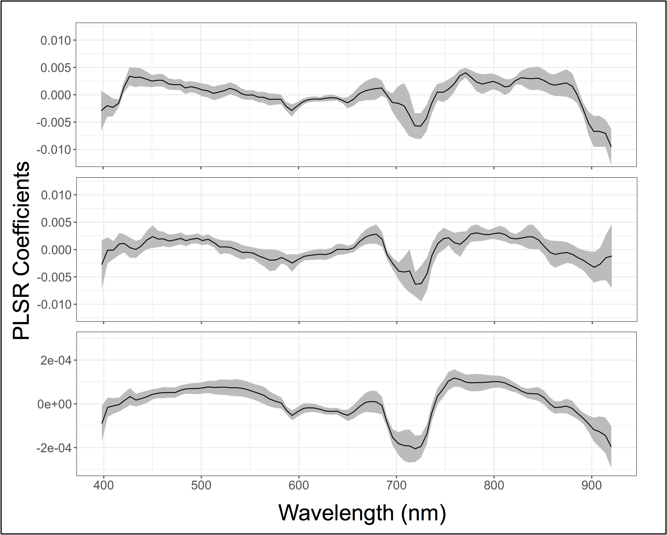
Estimating Ecosystem Gross Primary Production from Hyperspectral Reflectance
Spring
Day 119,
2014
The spectral information from PACE will be able to describe terrestrial ecosystem productivity
In this example, spectral imagery from HICO (Hyperspectral Imager for the Coastal Ocean) were used to map spatial patterns of ecosystem gross primary productivity
  -Algorithm used Partial Least Squares Regression applied to all the useable spectral bands to describe GPP across a variety of different vegetation types and through the growing season
Summer
Day 183,
2013
Autumn
Day 255,
2013
GPP
(µmol m⁻² s⁻¹)
Gross Primary Production for Crop/grassland near Lethbridge, AB from HICO Imagery at 100 m resolution
Huemmrich et al. 2016

Slide 7
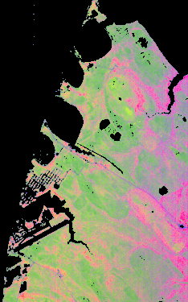
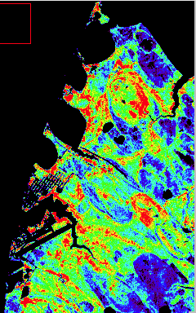
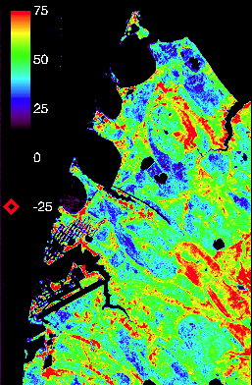
Describing Coverage of Vegetation Functional Types
Biodiversity
Integrated PACE products can address questions of terrestrial ecosystem diversity, biochemistry, and function
Biochemistry
Ecosystem
Function
This example shows an area of tundra where multiple types of information were derived from spectral information as would be available from PACE OCI
Plant type distribution affects animal species distributions, e.g. caribou, and ecosystem response to climate change and thawing permafrost
Biochemistry responds to environmental conditions, e.g. soil nutrients, water availability
Ecosystem function shows the spatial patterns in productivity over an area considered a single vegetation type in models
N
1 km
Tundra plant type cover fractions
R-Vascular Plants
G-Moss
B-Lichen
Chlorophyll Index
Hyperion image of tundra near Utqiagvik (Barrow), AK, USA, July 20, 2009
Huemmrich et al. JSTARS 2013
Photosynthetic light use efficiency (mol C mol⁻¹ absorbed quanta X 1000)
Notes:
Note work has shown ability to determine coverage of C3 vs C4 prairie plants, important for determining photosynthetic rates

Slide 8
PACE and SBG
Observing priorities for the Surface Biology and Geology (SBG) mission are:
  Terrestrial vegetation physiology, functional traits, and health
  Inland and coastal aquatic ecosystems physiology, functional traits, and health
  Snow and ice accumulation, melting, and albedo
  Active surface changes (eruptions, landslides, evolving landscapes, hazard risks)
  Effects of changing land use on surface energy, water, momentum, and C fluxes
  Managing agriculture, natural habitats, water use/quality, and urban development
The SPG spectrometer will cover from 350 to 2500 nm at 10 nm or less and GSD of 30-45 m
Presently, SBG is evaluating different architecture concepts
  Although the SBG architecture has not yet been defined, I do not expect SBG to have the temporal resolution of PACE
  There can be synergies between the frequent PACE observations and the higher spatial resolution of SBG

Slide 9
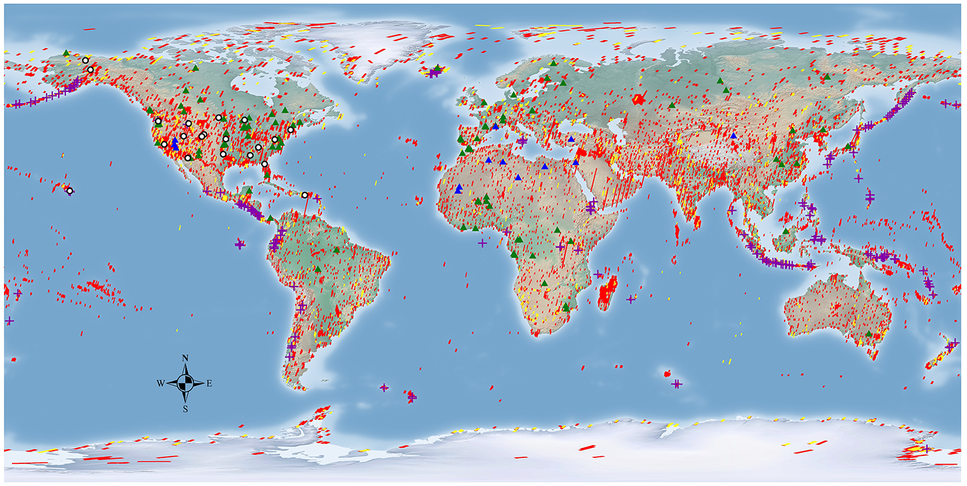
PACE and SBG
SBG is working on a processing pipeline for correcting existing imaging spectrometer data (Hyperion and AVIRIS) to surface reflectance
Also, developing tools to simulate SBG-like data
Data from these projects may be leveraged for PACE algorithm development and testing
PACE with its earlier launch date can test out some potential SBG products
Hyperion Image Collection

Slide 10
Data Requirements
The terrestrial products require atmospherically corrected OCI surface reflectances
These will be produced by Alexei Lyapustin - MAIAC Processing of OCI Over Land: High Resolution Aerosol Retrievals and Atmospheric Correction
  Prototype testing from this project will process TROPOMI data to surface reflectance.
    - The spectral region covered by TROPOMI could be used to calculate indices sensitive to terrestrial leaf chlorophyll content as a test example of a PACE terrestrial product
  The existing MODIS MAIAC surface reflectance product provides both Land and Ocean bands over land, making possible studies of indices such as CCI

Slide 11
Conclusions
PACE’s frequent observations of high quality spectral reflectance are excellent for examining terrestrial ecosystem dynamics (seasonal change along with the ability to detect the effects of transients, such as periods of drought) – extending our understanding of ecosystem processes beyond existing approaches
PACE surface reflectance over land is a requirement for the creation of terrestrial products, the MAIAC PACE OCI project will be producing them
Activities supporting SBG may be leveraged to help in the development of PACE terrestrial products
  - PACE with its earlier launch date can test out some potential SBG products

