Slide 1


HyperStrata
Hyperspectral retrieval of stratification in aquatic systems
Daniel Odermatt Eawag
Alexander Damm University of Zurich
Camille Minaudo EPFL
Abolfazl Irani Rahaghi Eawag

Slide 2
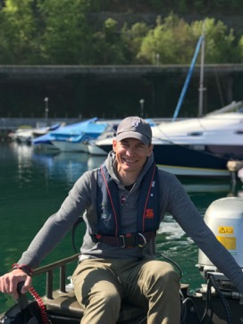
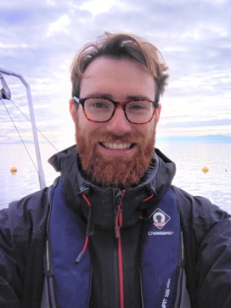
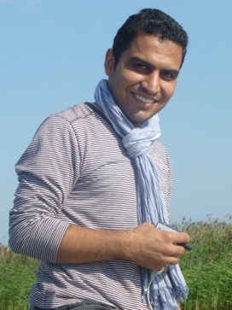
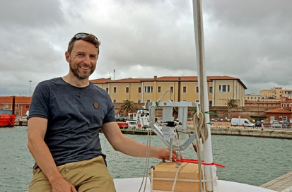
Team
Alexander Damm
Hyperspectral remote sensing
Professor tenure track
University of Zurich, RSWS
Camille Minaudo
IOP measurements
Postdoctoral researcher
EPFL-ENAC Aquatic Physics
Abolfazl Irani Rahaghi
Project scientist
Postdoctoral researcher
Eawag dept. Surface Waters

Slide 3
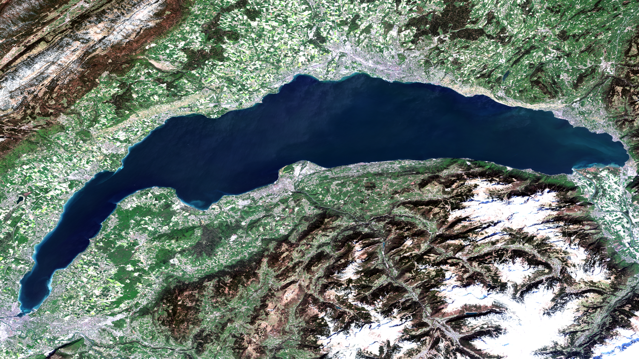
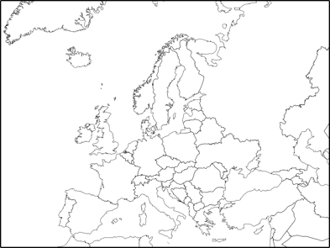
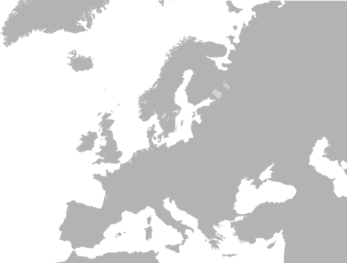
Lake Geneva spring bloom, 2020-04-14 (S-2A)

Slide 4
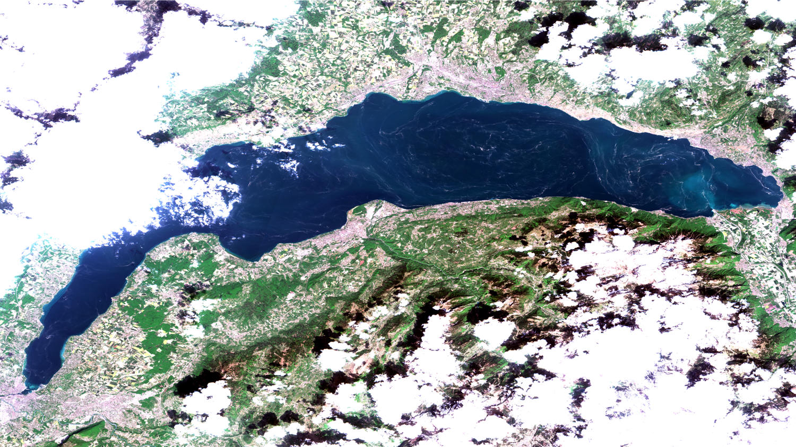
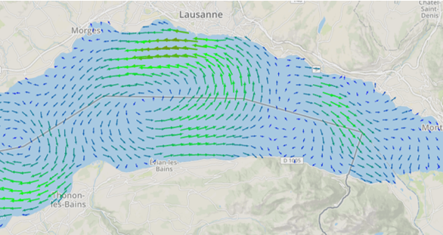
Floating pollen, 2020-04-24 (S-2A)

Slide 5
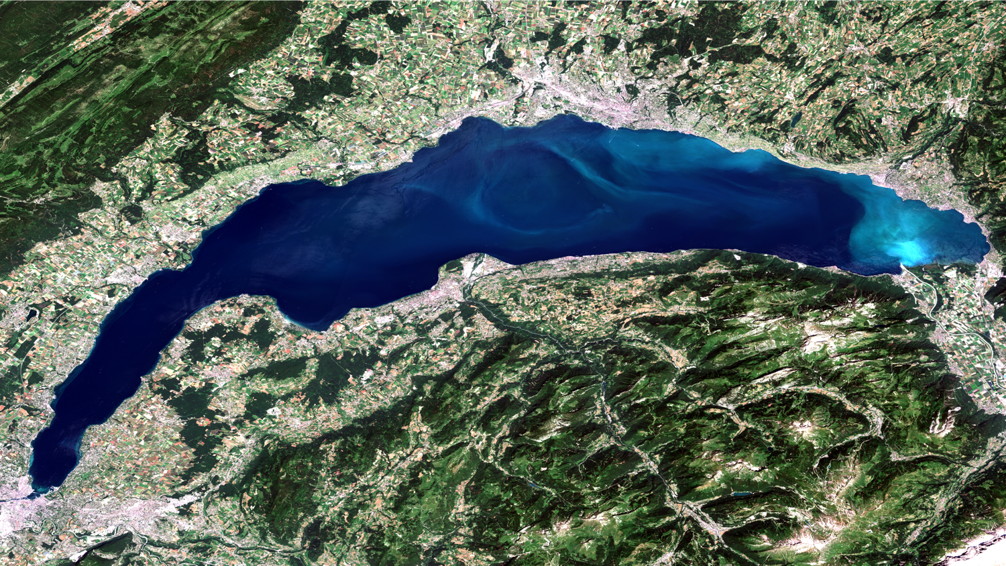
Calcite precipitation, 2019-06-29 (S-2A)
LéXPLORE
SHL2

Slide 6
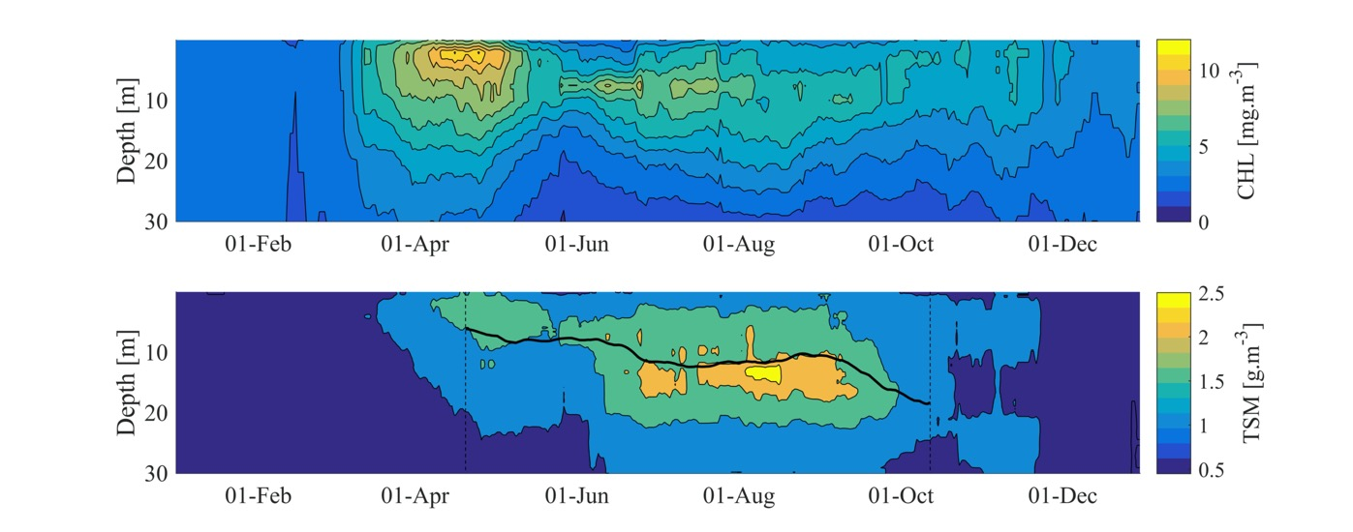
Mean stratification at lake center, 2002-2015

Slide 7
Objectives
Improvement of freshwater remote sensing retrieval methods by taking into account the vertical variation of water quality parameters
Characterizing the physical and biogeochemical processes underlying the vertical variation of water quality parameters
Investigating the links between physical stratification, biogeochemical stratification and optical remote sensing signals using hydrodynamic simulations, high-resolution vertical water profiles and hyperspectral airborne (and later on PACE) imagery
Develop, test, and release a python plugin for SNAP that implements the developed algorithm for use with PACE data

Slide 8
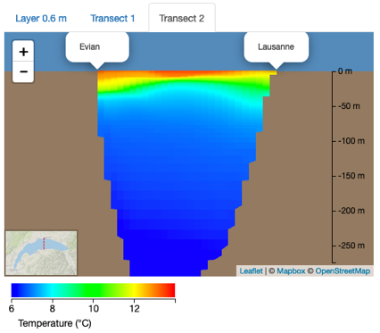
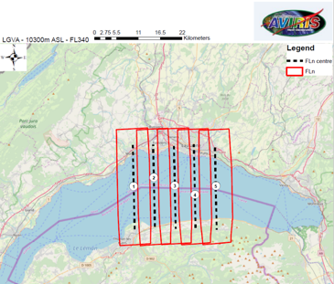
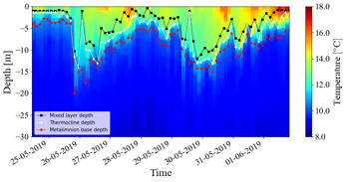
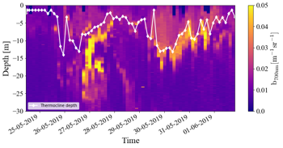
Overall project logic
Link optical to physical stratification using automated profiler measurements
Expand optical stratification in the horizontal domain using a Delft3D hydrodynamic model
Develop a constrained inversion technique for AVIRIS NG data

Slide 9
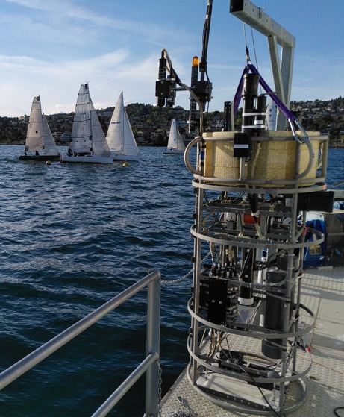
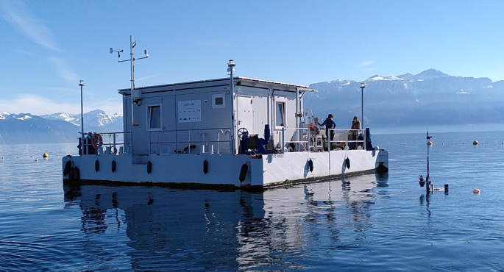
LéXPLORE and Wetlabs Thetis profiler
1/cm sampling every 3 hours
ACS: absorption, attenuation
ECO triplets: backscatter (440, 532, 630, 700nm) and fluorescence (CHL, CDOM)
Satlantic HOCR: E_{d}, L_{u}
SeaBird SBE: CTD and O₂

Slide 10
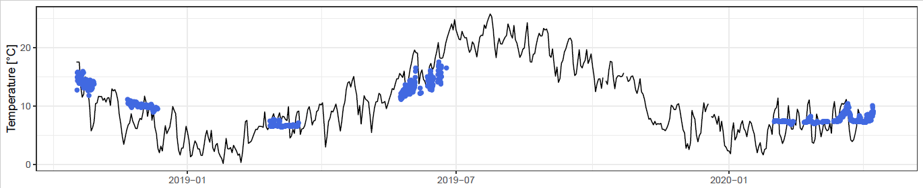
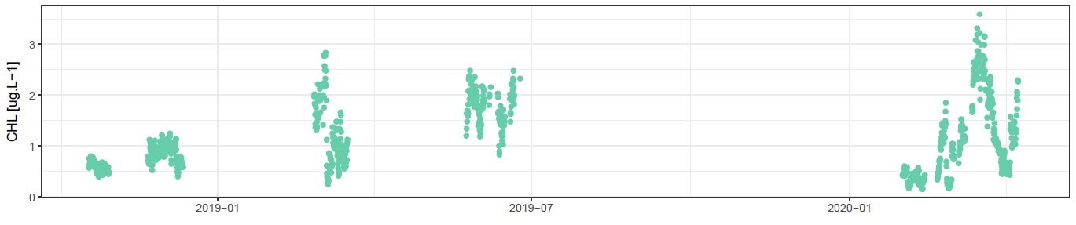
1000 bio-optical profiles since October 2018
T°C air
T°C lake (mixed layer)
CHL lake (mixed layer)

Slide 11
Start of the spring bloom, March/April 2020
spectral attenuation slope
676 nm absorption peak height

Slide 12
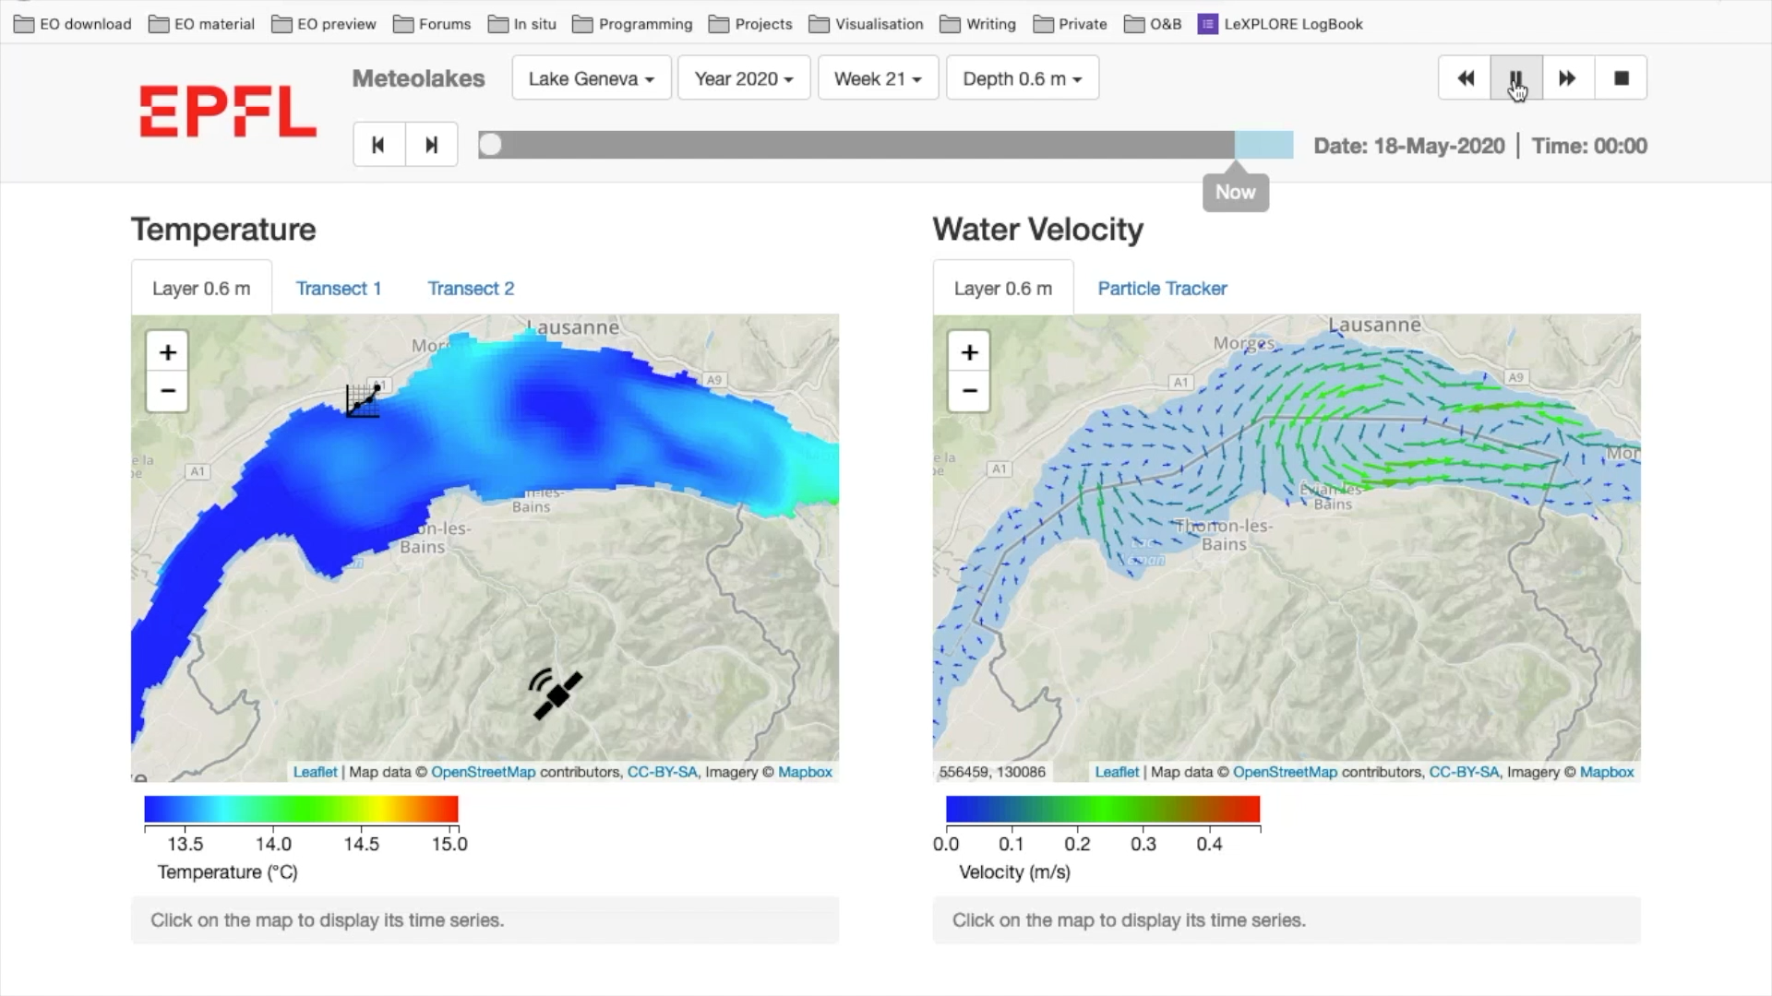
Meteolakes hydrodynamic model (Delft3D)

Slide 13
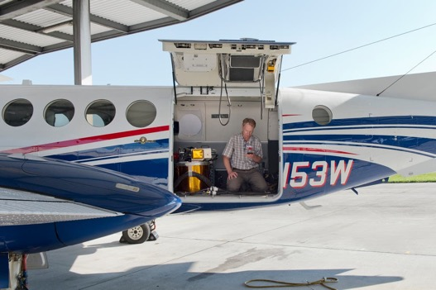
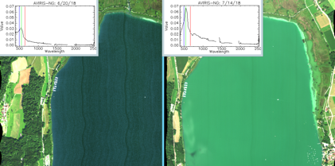
OCI-analogous data
Cooperation agreements by NASA and Univ. Zurich on hyperspectral sensor use (AVIRIS NG) and development (CWIS-II)
2018 AVIRIS data provided by JRC, 2020 visit postponed to 2021
Lake Geneva was also tasked for acquisition by the Italian PRISMA hyperspectral satellite

Slide 14
Methods and fieldwork summary
IOP calibration:
Optical closure with Thetis AOP
TSM, CDOM
a_{pig}, a_{det}
AVIRIS pre-processing:
Atmospheric correction review (e.g. Isofit, ATCOR)
Preventing inappropriate assumptions on R_{w}(vis)
AVIRIS ground truth:
2nd set of AOP/IOP devices
Fast-track sampling with CTD/fluorescence probe
Hydrodynamic model:
Further development in parallel project (datalakes)

Slide 15
Deliverables
AVIRIS NG processing chain
AVIRIS NG R_{w} products
A model that approximates optical from physical stratification
A model that relates vertically non-uniform IOP to R_{w}
A retrieval algorithm implemented as SNAP-Python plugin

Slide 16
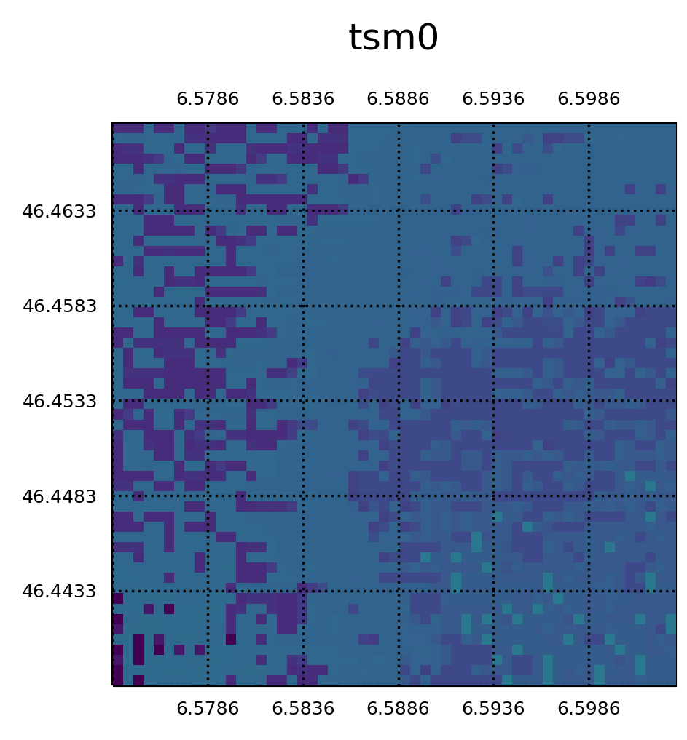
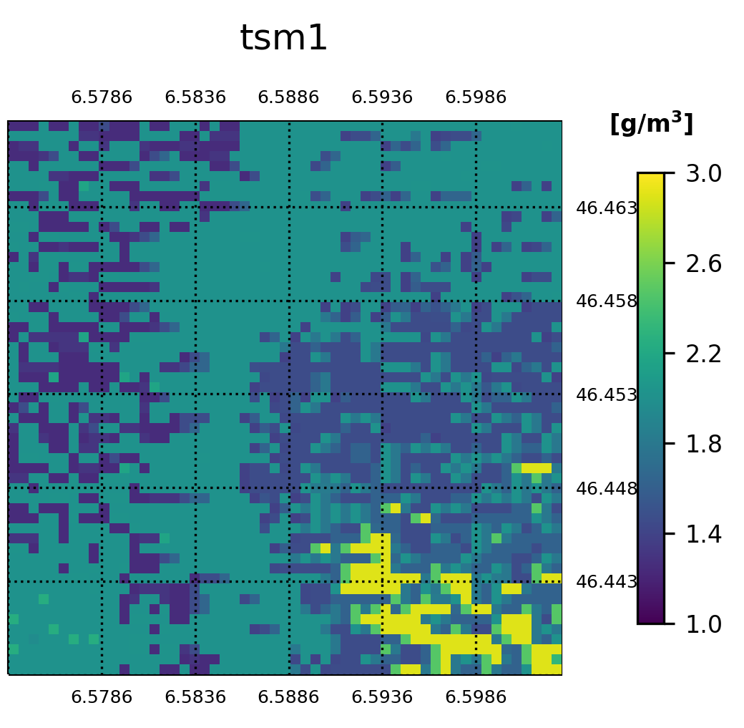

Performance assessment: Is this even working?
Downhill-Simplex retrieval result for a 60 m resampled Sentinel-2A 3x3 km subset around SHL2 on 2016-08-23,
using a constrained layer boundary depth at z=8 m and chl=1.79 mg/m³ at all depths for optimization.

Slide 17
Performance and uncertainty assessment
Qualitative assessment will be sufficient for main concerns -
  are the layer boundary depths reasonable?
  are the vertical gradients reasonable?
For in-depth assessment we will adopt the performance metrics proposed by Seegers et al. (2018)
The spatial domain of applicability is theoretically large, given that most lakes worldwide are oligotrophic- or mesotrophic. Most remote sensing studies focus however on eutrophic lakes, where vertical non-uniformities are negligible
Our retrieval algorithm will probably require automated IOP profiles, a hydrodynamic model or comparable a priori knowledge as input in order to manage ill-posed spectral signals

Slide 18
Final remarks
This isn’t a very popular research topic yet, we appreciate all suggestions all opinions
We’re happy to help as PACE-SAT European branch where needed

