Slide 1
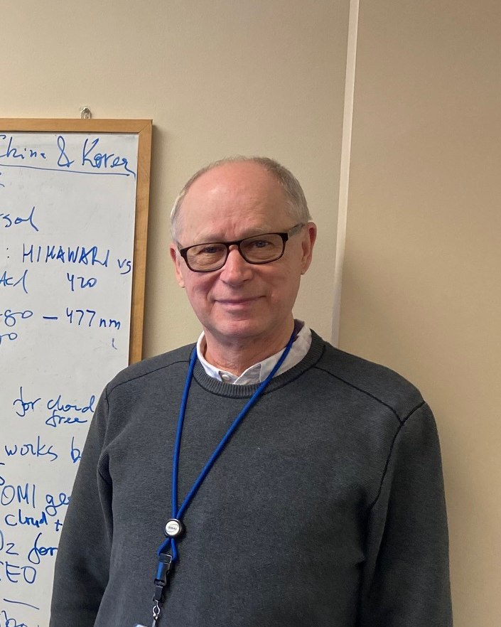
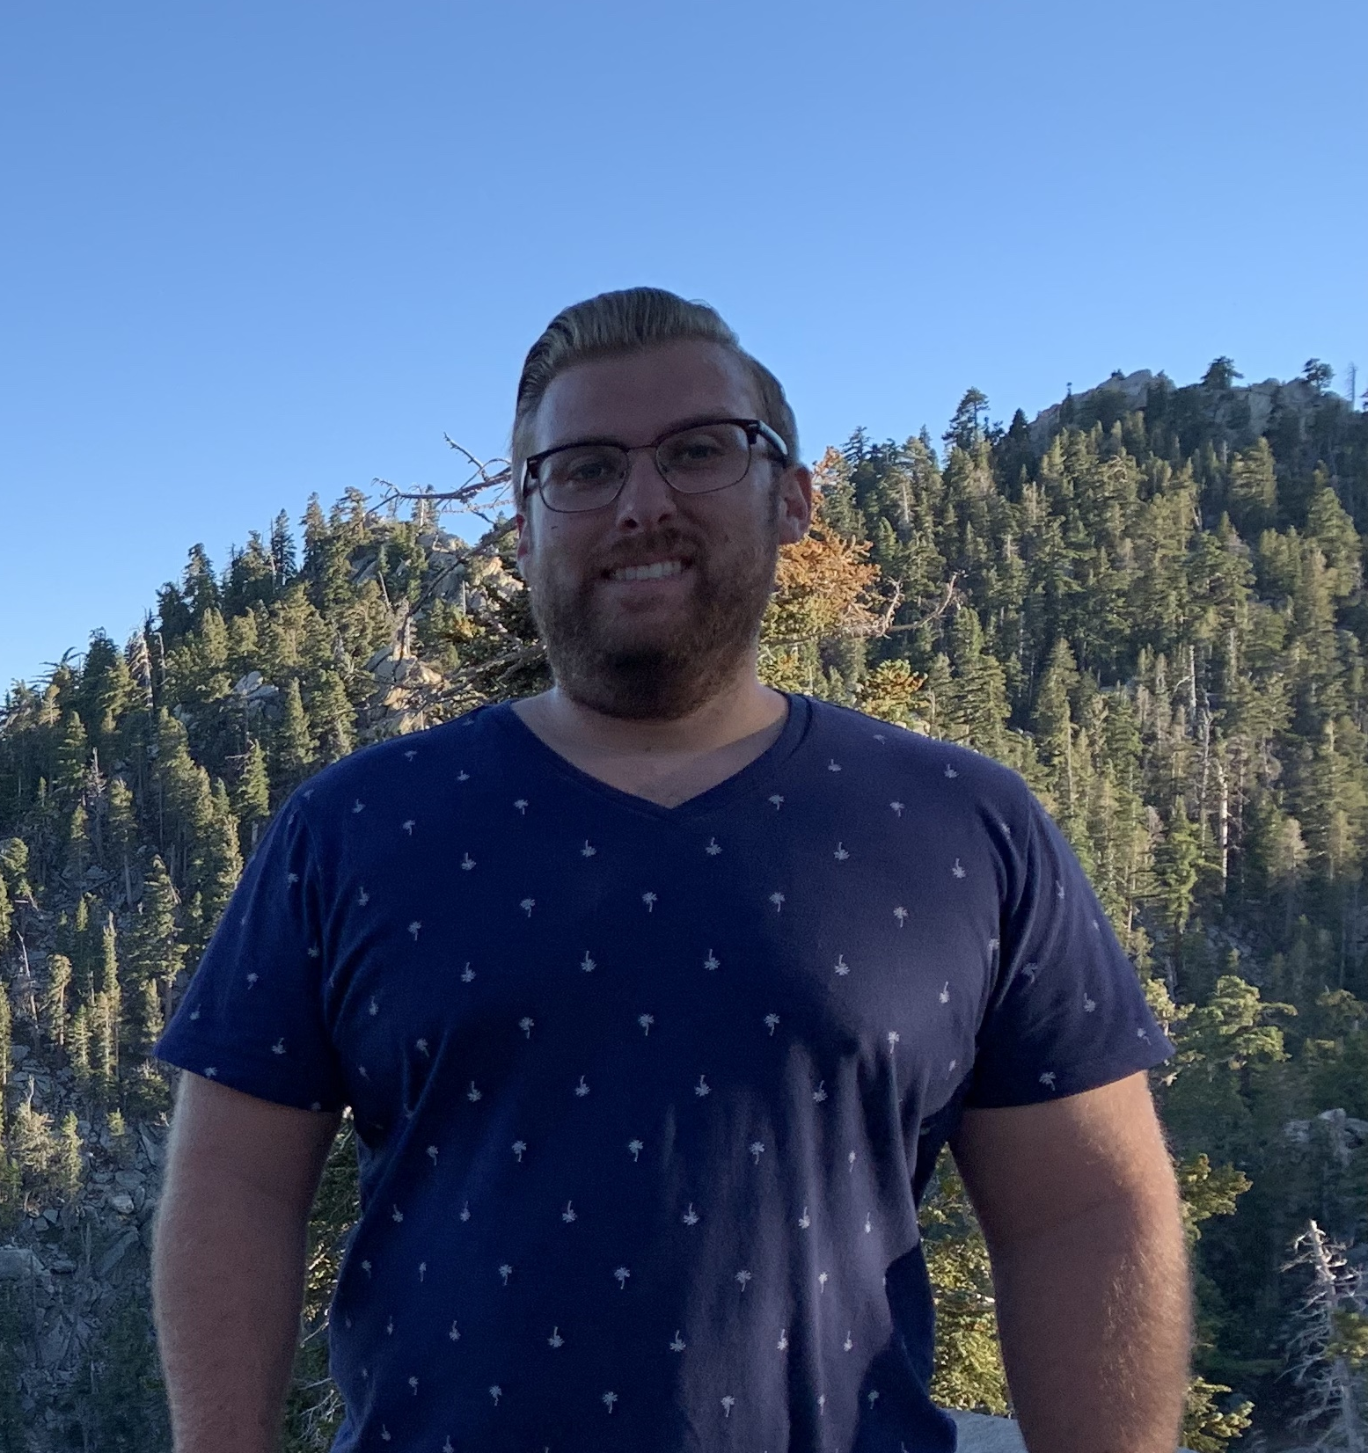
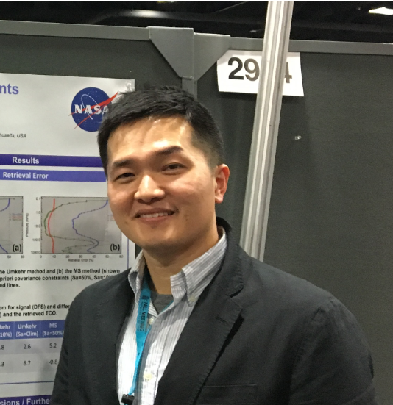
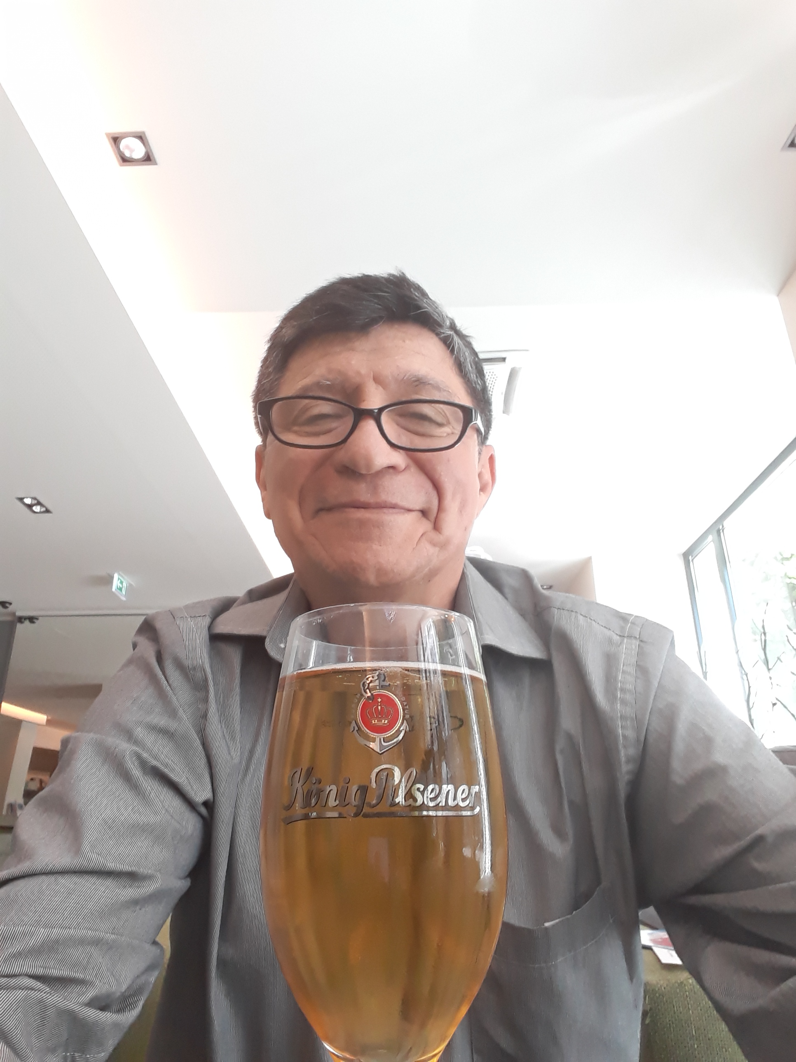
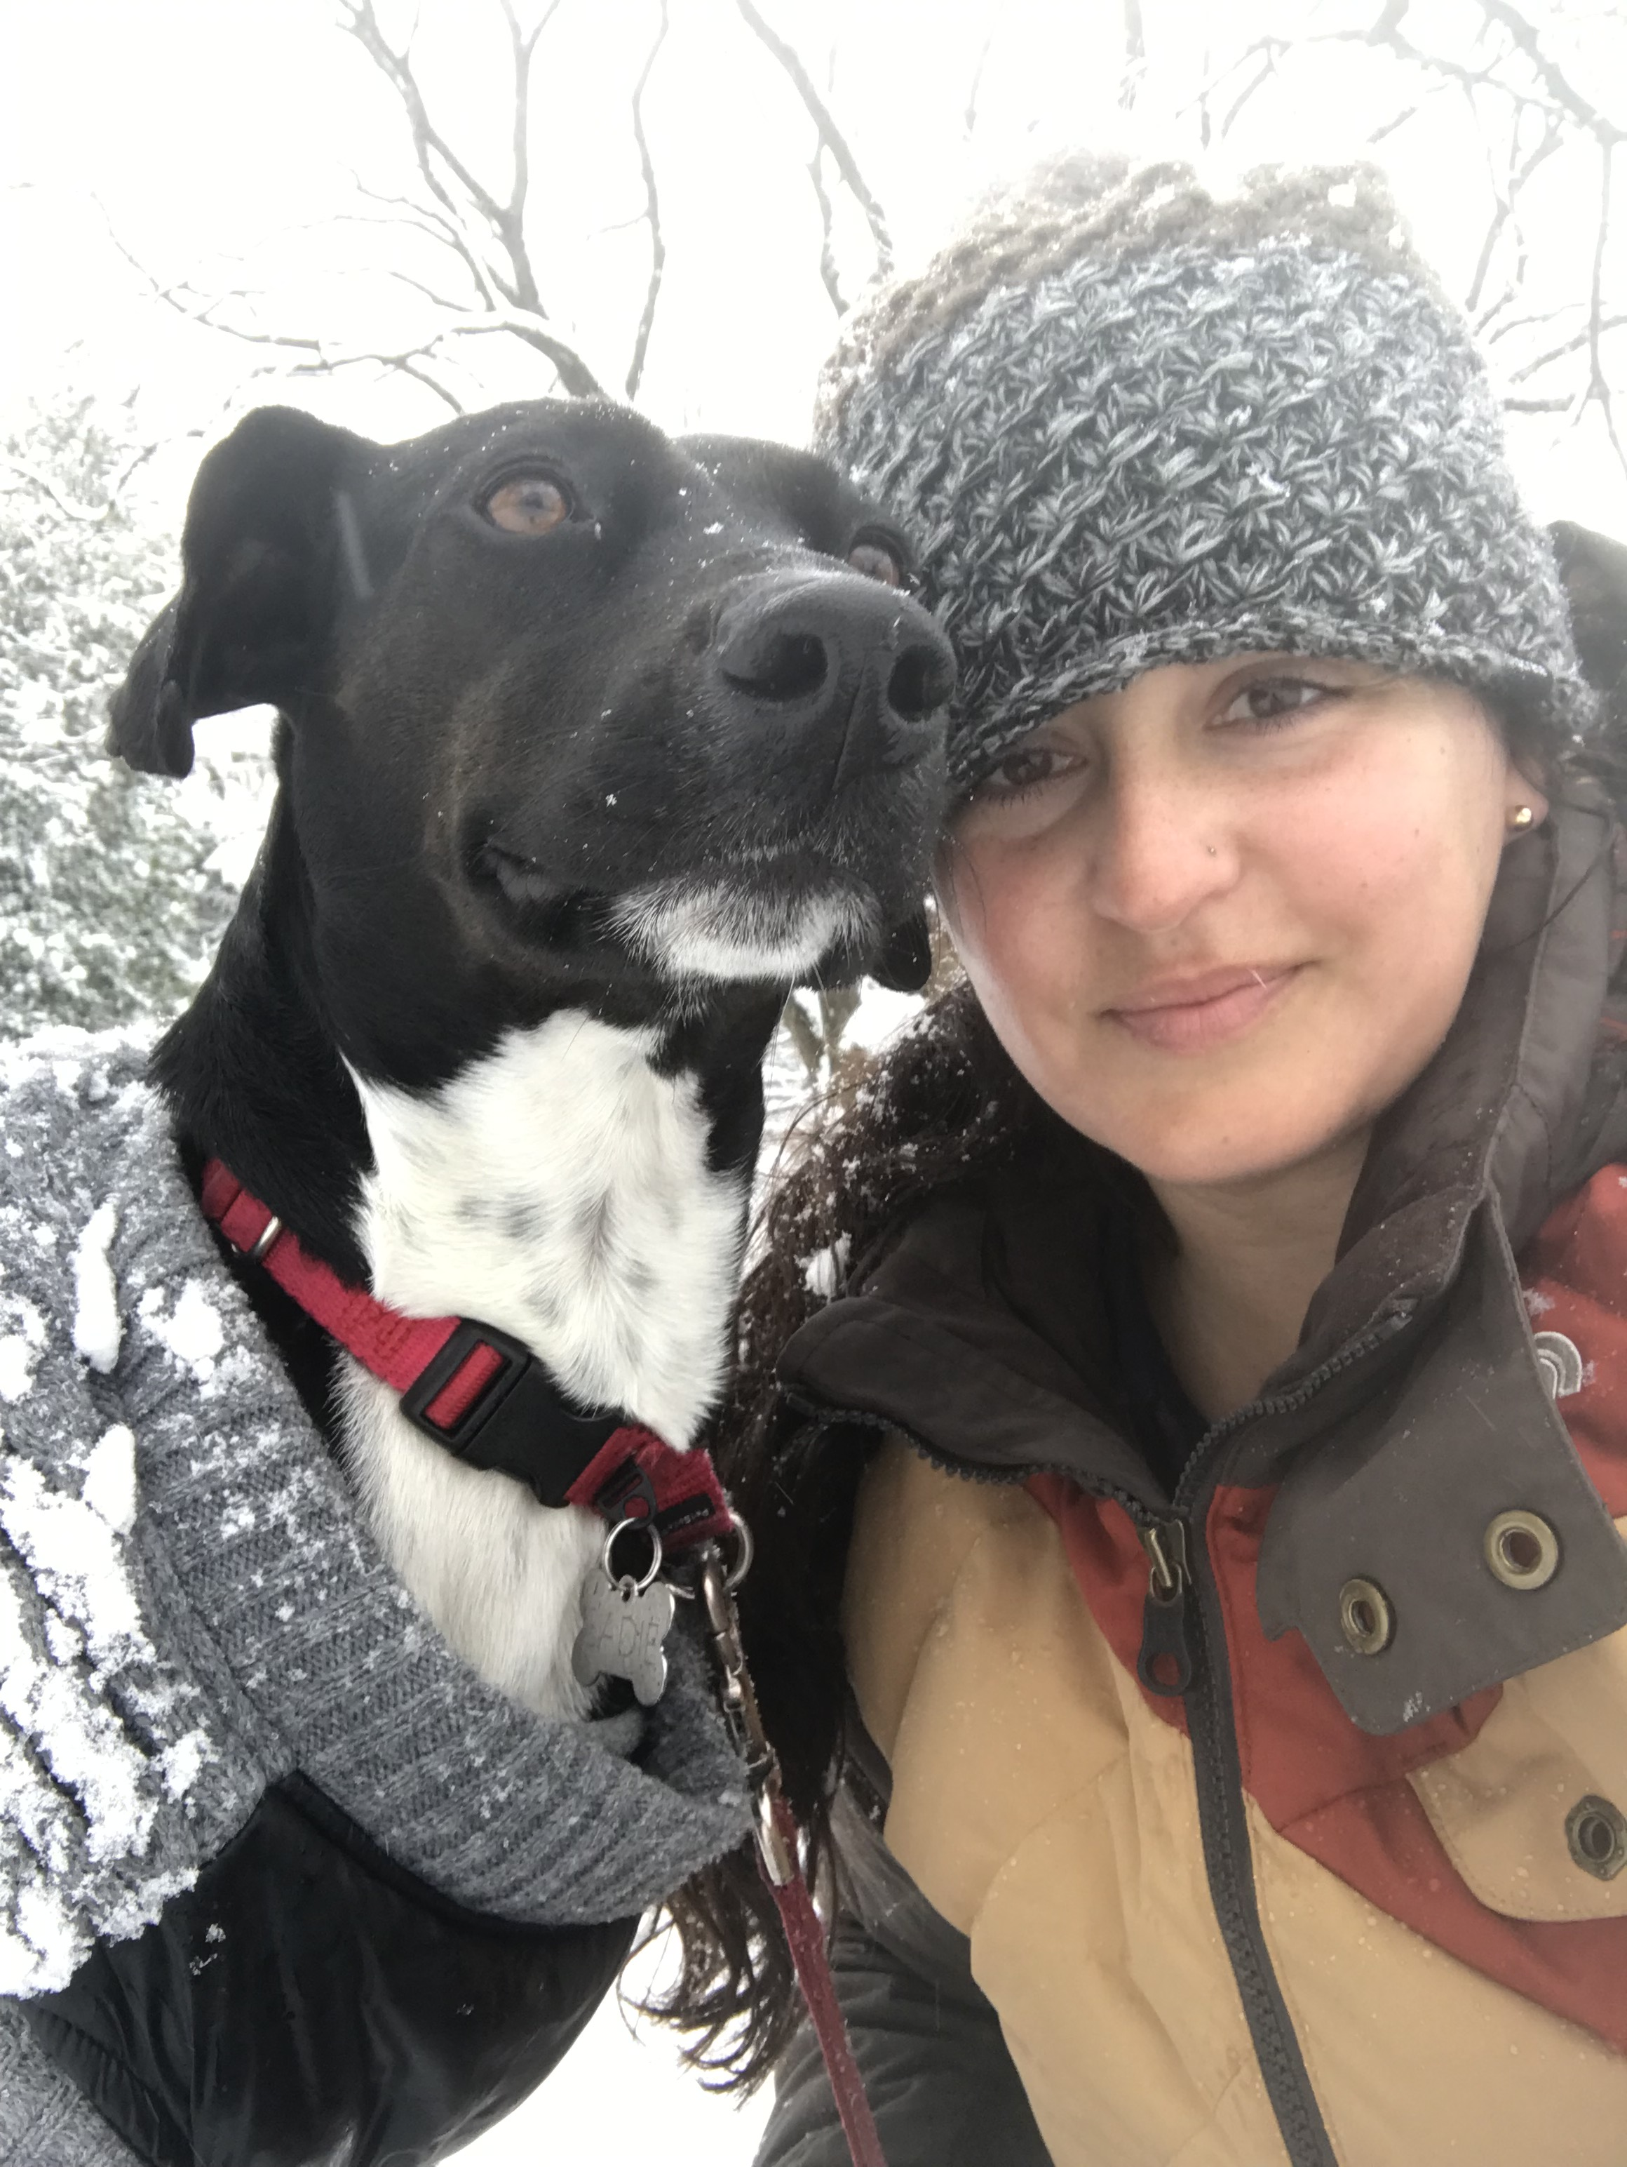
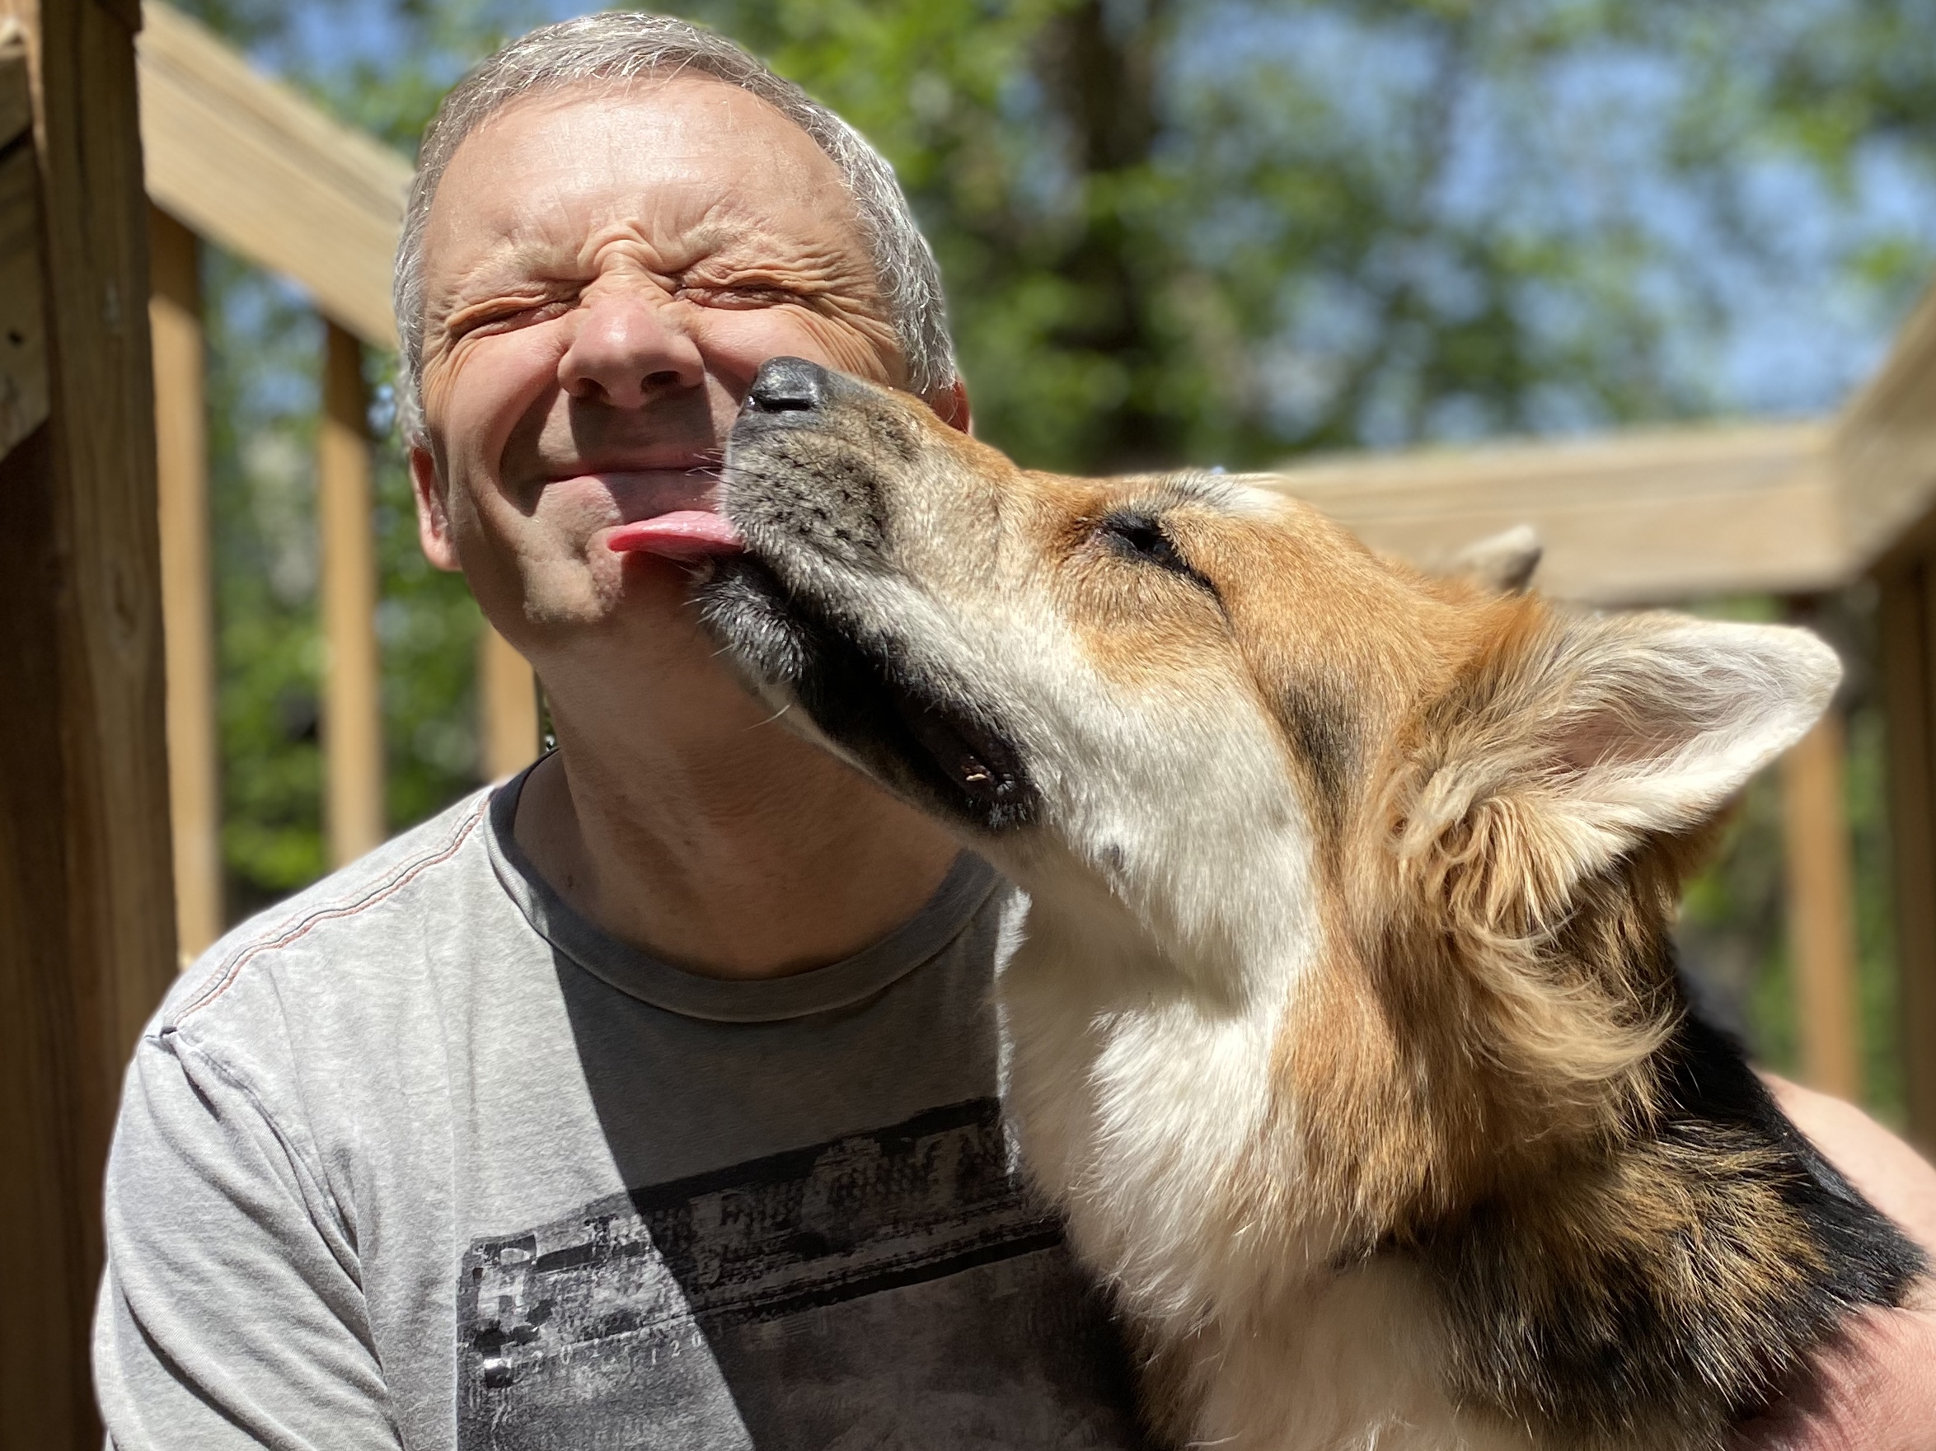

Hyperspectral algorithms for PACE OCI water leaving reflectances and UV penetration depths
Alexander Vasilkov (SSAI)
Zachary Fasnacht (SSAI)
Pawan K. (PK) Bhartia (NASA GSFC),
Joanna Joiner (NASA GSFC),
Jhoon Kim (Yonsei University, Seoul, Korea),
Wenhan Qin (SSAI),
Robert Spurr (RT Solutions)
David Haffner
SSAI
Omar Torres
NASA GSFC
Jungbin Mok (UMD)
Patricia Castellanos
NASA GSFC
Nickolay Krotkov, PI
NASA GSFC
Notes:
Hello, my name is Nickolay Krotkov.
I work at Atmospheric Chemistry and Dynamics Laboratory at NASA Goddard Space Fligt Center in Maryland.
I am PI of PACE research project to retrieve hyperspectral ultraviolet water leaving reflectances and penetration depths.
Our team bring­s together a wide range of experience which is relevant to the OCI and the PACE mission.
The team has extensive backgrounds in UV ocean optics, aerosols, satellite trace gas retrievals, radiative transfer, data assimilation, and surface aerosol and trace gas measurements.
Next slide

Slide 2
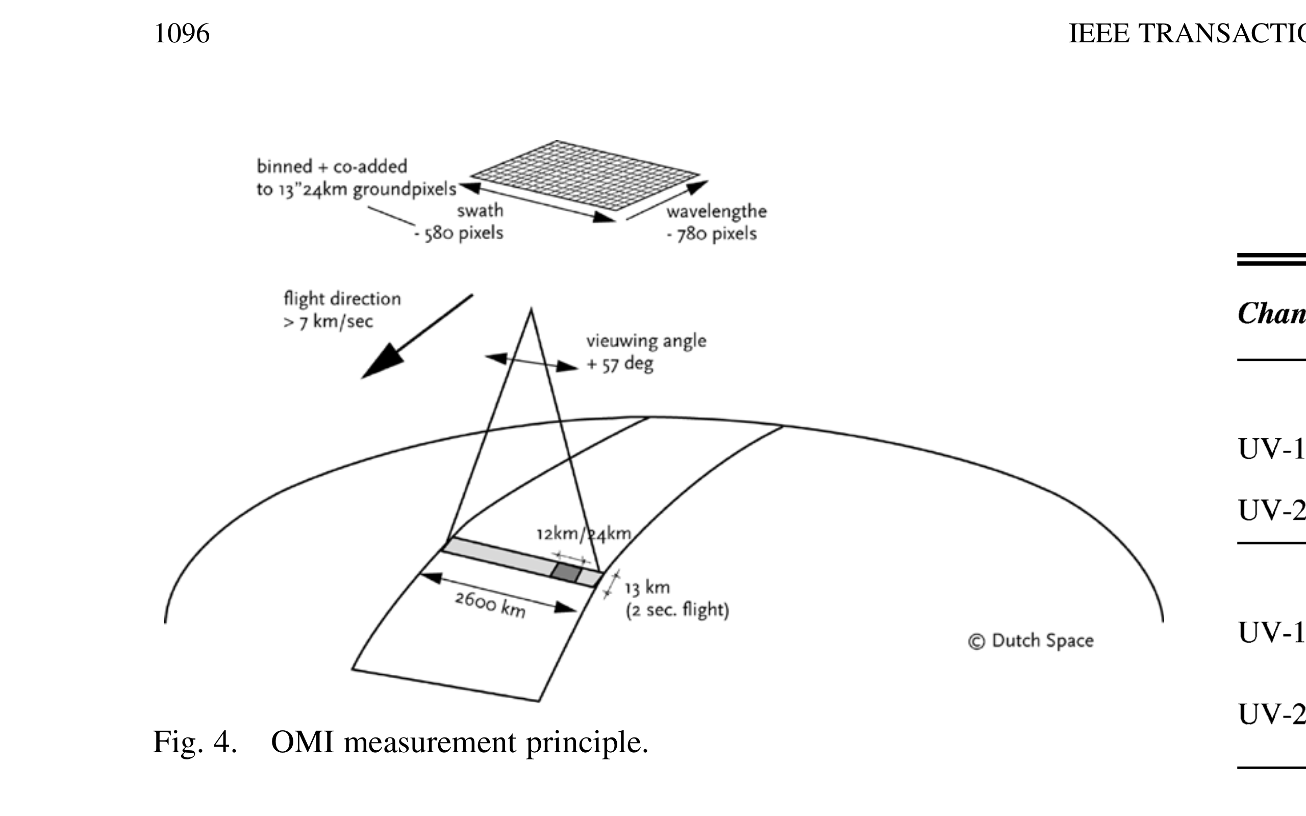
Aura Ozone Monitoring Instrument (OMI)
Joanna Joiner (US ST lead), Pieternel Levelt (Netherlands), Johanna Tamminen (Finland)
Dutch-Finnish “Push broom” spectrometer
2D CCD
detector
Global daily measurements of ozone (O₃);
trace gases: SO₂, NO₂, HCHO, BrO, OCLO;
cloud optical centroid pressure and effective fraction;
Geometry-dependent Lambertian Equivalent surface Reflectivity (GLER) accounting for Cox–Munk slope distribution with water-leaving radiance;
UV absorbing aerosols:
(smoke, dust, ash);
solar spectral irradiance;
surface UV irradiance.
500nm
Wavelength:
0.15nm/pixel ~0.5 nm FWHM
Swath
~270
OMI UV-B Erythemal-weighted dose
24 km OMI 2004-
3.5km TROPOMI 2018-
13km OMI
5.5km TROPOMI
2018 USGS WILLIAM T. PECORA award to the OMI ST:
“For sustained team innovation and international collaboration to produce daily global satellite data that revolutionized air quality, stratospheric chemistry, and climate research”
https://prd-wret.s3.us-west-2.amazonaws.com/assets/palladium/production/atoms/files/OzoneOMI_citation.pdf
Notes:
Our team has previously developed retrievals of ozone, other trace gases, clouds, aerosols and surface UV radiation using measurements from Dutch – Finnish Ozone Monitoring Instrument (OMI) launched in 2004 on board Aura satellite.
OMI is the first “push broom” spectrometer with spectral coverage in the UV and blue regions of the spectrum.
OMI spectral resolution of is much higher than that of OCI.
OMI is very well calibrated, with a 1% uncertainty and 1-2% absolute accuracy.
Here is an example of the surface UV-B product from earlier this month.
European TROPOspheric Monitoring Instrument (TROPOMI) continues OMI measurements with considerably better ground resolution and signal-to-noise.
Our team is involved in TROPOMI validation. We expect TROPOMI to overlap with PACE mission.

Slide 3
Project Objectives
Demonstrate hyperspectral UV-VIS R_{rs}(𝛌) retrievals using:
  Satellite UV-Vis spectrometers:
    LEO : Aura/OMI (2004 →) and S5P/TROPOMI (2018 →);
    GEO: Korean GEMS (2020 →) and NASA TEMPO (2022 ↑);
  Forward linearized RT model (VLIDORT) with water-leaving reflectance supplement;
  GMAO GEOS-5 aerosol modeling and analysis system.
Evaluate R_{rs}(𝛌) retrievals and GMAO aerosol optical properties using:
  Ground-based UV aerosol absorption retrievals;
  In-situ buoy (MOBY) data;
  SeaWiFs, MODIS & VIIRS R_{rs} retrievals in the visible up to 500nm.
3. Develop OCI algorithms for Level 2 geophysical products:
  Underwater UV irradiance;
  Biological action spectra-weighted UV penetration depths.

Slide 4
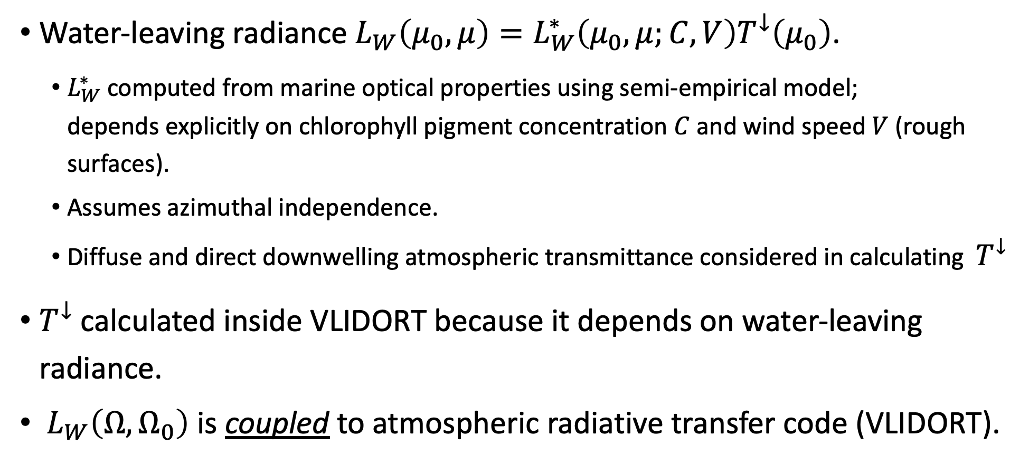
VLIDORT Coupled Atmosphere-Ocean RT model
Water-leaving radiance $L_{W}\left(μ_{0},μ\right)=L_{W}^{∗}\left(μ_{0},μ;C,V\right)T^{↓}\left(μ_{0}\right)$.
  $L_{W}^{∗}$ computed from marine optical properties using semi-empirical model;
  depends explicitly on chlorophyll pigment concentration $C$ and wind speed $V$ (rough surfaces).
  Assumes azimuthal independence.
  Diffuse and direct downwelling atmospheric transmittance considered in calculating $T^{↓}$
$T^{↓}$calculated inside VLIDORT because it depends on water-leaving radiance.
$L_{W}\left(Ω, Ω_{0}\right)$ is coupled to atmospheric radiative transfer code (VLIDORT).
Notes:
I want to provide a few more details regarding the coupled ocean-atmosphere model used in our retrievals.
The key quantity is water-leaving radiance.
It is computed from Case 1 water optical properties using our semi-empirical model that depends explicitly on pigment concentration and wind speed.
We assume it azimuthal independent.
The diffuse and direct downwelling atmospheric transmittances are calculated in atmospheric module of VLIDORT, which is coupled with water-leaving radiance.

Slide 5
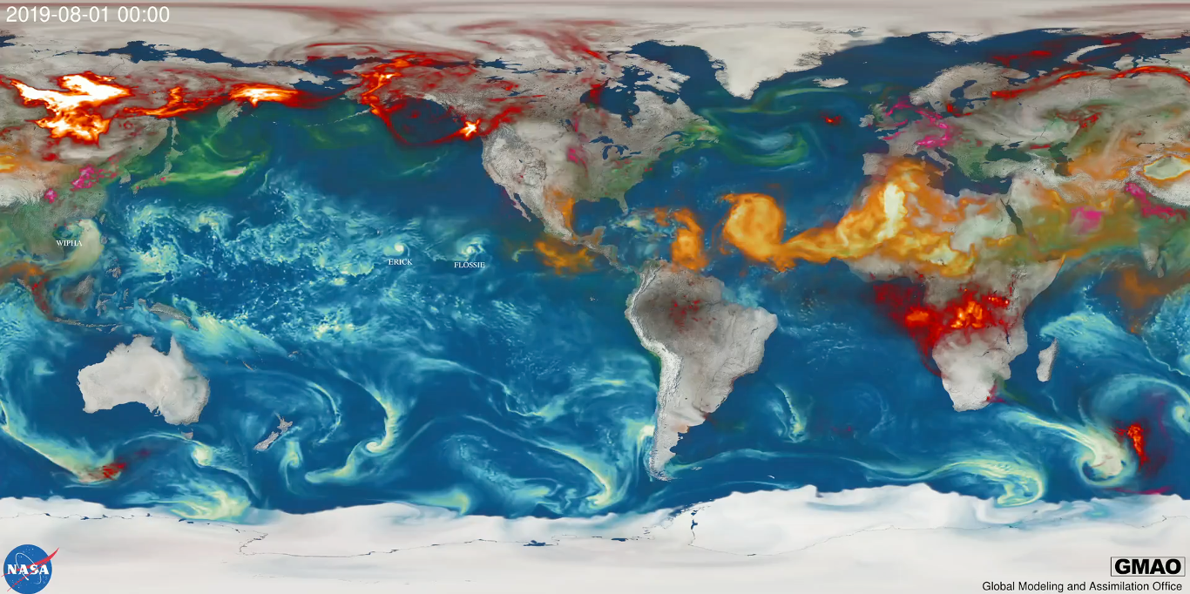
GEOS Aerosol Assimilation
The GEOS modeling and analysis system assimilates MODIS and AERONET observations of AOD at 550 nm
To estimate aerosol optical properties in the UV, we use assumed speciated aerosol optical properties via look-up-tables
Synergistic use of GEOS assimilated AOD in the UV water leaving radiance retrieval can help with atmospheric correction, as well as evaluate (and improve) the GEOS UV aerosol optical property assumptions
Assimilated speciated 550 nm AOD for August 2019 through January 2020. MODIS and AERONET observations are used to constrain the simulation of AOD. MODIS observations are also used to predict fire emissions.
Notes:
The GEOS-5 modeling and analysis system assimilates MODIS and AERONET observations of AOD at 550 nm.
To estimate aerosol optical properties in the UV, we use assumed speciated aerosol optical properties recorded in look-up-tables.
Synergistic use of GEOS assimilated AOD in the UV
AND water leaving radiance retrieval can help with atmospheric correction,
as well as evaluate (and improve) the GEOS UV aerosol optical property assumptions

Slide 6
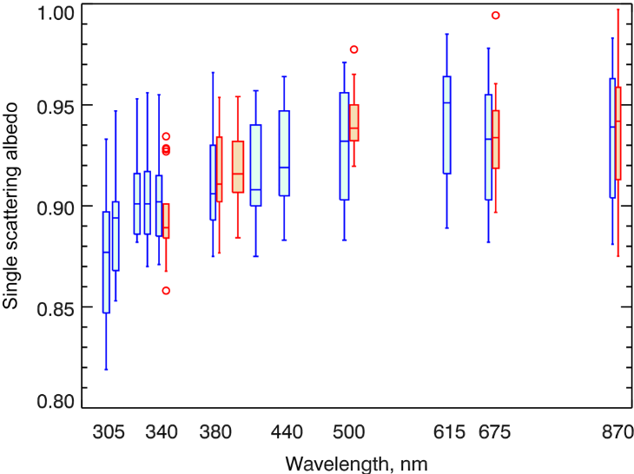
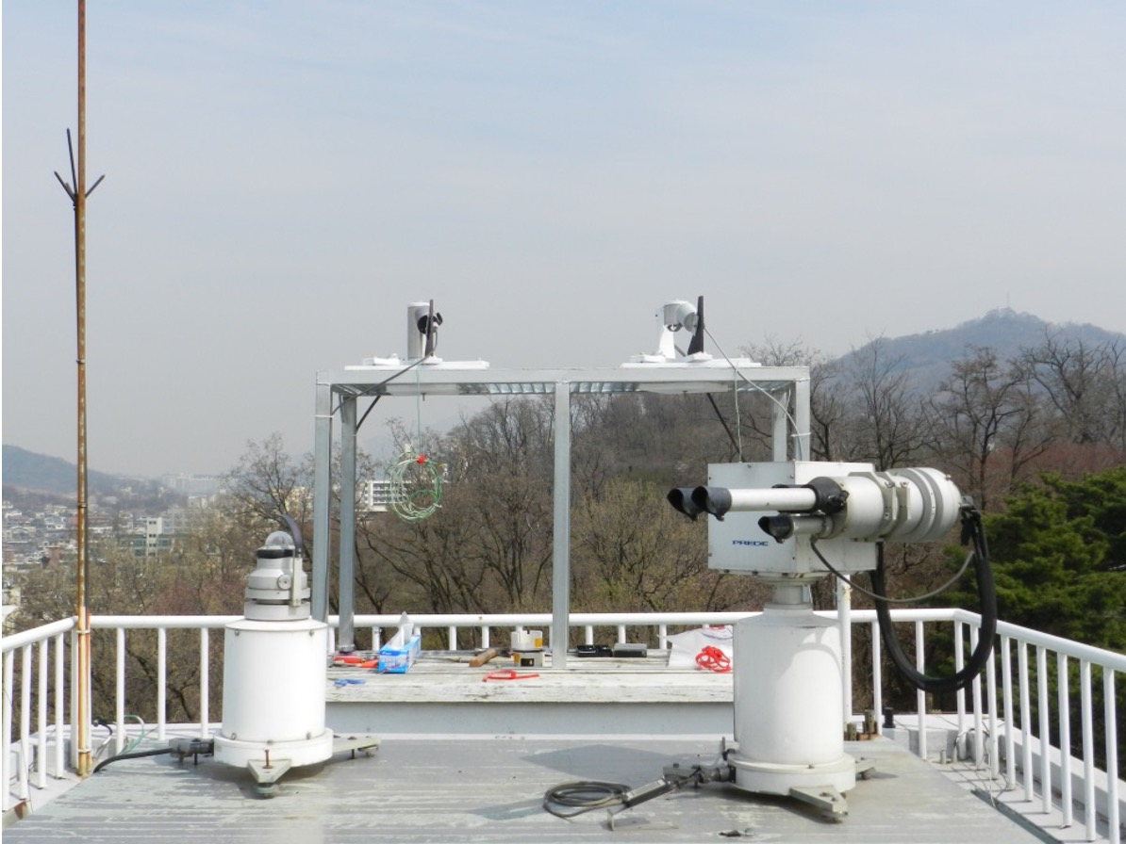
Verification of UV-VIS aerosol absorption models
Our modified UV- and VIS-MFRSR at Yonsei Univ. in Seoul, South Korea Since 2016
MFRSR UV-VIS-NIR SSA retrievals (blue) and independent SKYNET retrievals (orange)
are in good agreement [Mok et al., AMT 2018].
Notes:
This slide shows one example of our aerosol SSA retrievals using synergistic measurements from co-located AERONET, SKYNET, UV- and VIS-Multifilter Rotating Shadowband radiometers.
We use PANDORA trace gas absorption spectrometer to correct for gaseous absorption due to ozone and NO2.
Our SSA and AAOD retrievals agree well with independent AERONET retrievals in the visible and SKYNET retrievals in UV.
The site at Yonsei University in Seoul, South Korea experiences wide range of aerosol conditions from local sources to long-range transported dust and pollution aerosols.
We also conduct similar aerosol measurements at Izana observatory in Tenerife, Canary Islands.

Slide 7
First OMI R_{rs}(𝛌) retrievals
South Pacific - Case 1 water
OMI “gold” measurements
  No clouds and low AOD (sea salt)
  Glint avoided
  Spectrally smoothed TOA reflectances
  (5nm box-car)
Forward model
  VLIDORT ocean-atmosphere transmittance coupling
  Case 1 ocean water IOP model (Vasilkov et al., 2005; Fasnacht et al., AMT 2019)
  MODIS C_{HL} and MERRA-2 aerosols, winds, sfc. Pressure
  Jacobians of TOA rad for Lw – currently F.D., analytical to follow
R_{rs} retrieval
  TOA reflectance fitting retrieval technique;
  Assumes ~1% noise error in all OMI reflectances.
GMAO assimilated AOD at 550nm in July 2008. The circle shows location of first OMI R_{rs} retrievals for Case 1 waters.
Notes:
To demonstrate our OMI retrievals of WLRs we selected open ocean region in the South Pacific.
We use OMI “gold” measurements with no clouds, glint avoided and lowest AOD.
We spectrally smoothed OMI measurements with 5nm box-car filter
And retrieved WLRs from near UV 330nm to 500nm at 5nm steps by matching OMI-measured and forward model simulated TOA reflectances
Our VLIDORT forward model input parameters included:
Case 1 ocean water IOP model extended into UV
MODIS Chl
MERRA-2 AEROSOL optical properties, extended into UV, surface pressure and wind speed.
We estimated retrieval uncertainties assuming 1% OMI measurement noise.

Slide 8
OMI measured TOA(𝛌) reflectance smoothed to OCI resolution (5nm)
OCI resolution
Ozone absorption
Raman RRS
Varying boxcar smoothing widths from 1-5 nm. The size of the Ca H and K Fraunhofer features diminishes rapidly as smoothing is applied, and a notable distortion and spectral shift in the Fraunhofer features occurs as the smoothing width is increased from 3 to 5 nm (OCI resolution).
Measured on June 2, 2006 over clear scene in south equatorial Pacific with low Chl=0.04 [mg/m³] and AOD₄₆₅ ~0.03 at the original spectral resolution (0.45-0.6 nm - black) and with the 5nm boxcar smoothing applied (red).
Notes:
Spectral plot shows OMI TOA reflectance measured on June 2, 2006 over clear scene in south equatorial Pacific with low Chl=0.04 [mg/m³] and AOD₄₆₅ ~0.03 at the original spectral resolution and with the 5nm boxcar smoothing applied (red).
Overall TOA reflectance features a broad maximum in the mid-UV at between 330 and 340nm due to both atmospheric Rayleigh scattering and oligotrophic clean water reflectance.
High-frequency spectral structures, such as Huggins ozone absorption at 310-340nm and spectral structures due to non-elastic Rotational Raman scattering filling-in of strong solar Fraunhofer lines are clearly visible at OMI original resolution.
Plot on the right shows spectral smoothing effect from OMI to OCI spectral resolution in the spectral region near Solar strong Ca H and K Fraunhofer lines.
The size of the RRS features diminishes rapidly as smoothing is applied, and a notable distortion and spectral shift in the Fraunhofer features occurs as the smoothing width is increased from 3 to 5 nm (OCI resolution).
Actual OCI resolution and spectral response function could be different from the 5-nm box-car filter assumed here, and we plan applying actual OCI SRFs to the OMI spectra in the future.

Slide 9
OMI retrieved water leaving reflectance: R_{rs}(𝛌)
The Case 1 IOP model was extended to UV using parameterization of particulate matter absorption in UV [Vasilkov et al., Appl. Opt., 2005] and interpolation of the pure water absorption coefficient recommended by Fry [Appl. Opt., 2000].
The model was evaluated using atmospherically corrected DSCOVR/EPIC data [Vasilkov et al., 2019]
The model (grey line) was implemented in VLIDORT v2.8 along with iterative computation of the atmospheric transmittance [Fasnacht et al., AMT, 2019].
OMI retrieval
Case 1 IOP model
Retrieved (filled circles and stars) and theoretically predicted (grey line) R_{rs}. Open circles show retrievals where aerosol effects are unaccounted for; in this case they are marginal. Stars show optional R_{rs} retrievals below 350nm. MODIS and SeaWiFS traditional R_{rs} retrievals are shown as red triangles and blue squares.
Notes:
The Case 1 IOP model was extended into UV using parameterization of particulate matter absorption, CDOM absorption and pure seawater absorption in UV.
The model has been implemented in VLIDORT and used as retrieval initial guess shown as grey line.
Dots show OMI retrievals. Open circles show retrieval where aerosol effects are unaccounted for. In this case they are marginal.
The error bars show estimated uncertainties due to OMI measurement 1% noise.
They increase in UV because of decrease in atmospheric transmittance.
There is reasonable agreement between our model and OMI retrievals in UV.
There is also good agreement between OMI , SeaWiFS and MODIS traditional retrievals in the visible.
Model discrepancies in VIS need further investigation.

Slide 10
Level 2 UV penetration depth algorithm
Surface UV irradiance algorithm from TOMS/OMI/TROPOMI [Krotkov et al., 1998; 2001; Lindfors et al., 2018]
In-water irradiance is calculated using:
  the quasi-single scattering approximation [Vasilkov et al., JGR, 2001] which is sufficiently fast for global processing of multi-year data sets.
  LUTs generated with Hydrolight
  IOP model is an extension of the Case 1 model to UV [Vasilkov et al., Appl. Opt., 2005].
Outputs are downward irradiances convolved with biological action spectra (erythema and DNA) and penetration depths.
Vasilkov et al., Global mapping of underwater UV irradiances and DNA-weighted exposures using TOMS and SeaWiFS data products, JGR-oceans, 2001
Notes:
We will calculate penetration of UV radiation into the ocean on global scale by combining OMI and TROPOMI retrievals of ozone, cloud reflectivity and UV absorbing aerosols with the MODIS and VIIRS ocean color retrievals in the visible.
The algorithm has been previously demonstrated with TOMS and SeaWiFS measurements.
In-water irradiance is calculations using:
(1) the fast quasi-single scattering approximation;
(2) LUTs generated with more accurate Hydrolight code;
(3) Our IOP model is an extension of the Case 1 model into UV
Outputs are spectrally averaged downward irradiances convolved with different biological action spectra and corresponding penetration depths.

Slide 11
Plan of work
Compare our OMI R_{rs}(𝛌) retrievals with Marine Optical buoy (MOBY) hyperspectral in-situ measurements that extend into UV.
Compare OMI with SeaWiFs, MODIS & VIIRS R_{rs} retrievals in the visible bands up to 500nm.
Evaluate GEOS-5 aerosol optical properties in UV.
Transfer OMI calibration to TROPOMI TOA reflectances [Torres et al., 2020] and demonstrate consistent R_{rs}(𝛌) retrievals at high spatial resolution.
Apply R_{rs}(𝛌) retrievals to GEMS hourly L1B measurements to study diurnal dependence.
Develop underwater UV irradiance model and demonstrate with OMI, TROPOMI and GEMS measurements.
Notes:
What we are doing now is comparing OMI retrievals with Marine Optical buoy (MOBY) hyperspectral in-situ measurements that extend into UV.
MOBY in-situ measurements are considered a tool for vicarious calibration for satellite ocean color sensors in the visible.
We also plan to compare OMI WLRs with satellite retrievals from SeaWiFs, MODIS & VIIRS in the visible.
We will continue evaluating GEOS-5 aerosol optical properties in UV
We will transfer OMI L1 calibration to TROPOMI TOA reflectances to demonstrate consistent WLRs retrievals at much higher spatial resolution.
We will then apply our WLR retrievals to GEMS hourly measurements to study diurnal dependence.
We will continue development of our underwater UV irradiance model and demonstrate with OMI, TROPOMI and GEMS measurements.
Thank you for your attention.

Slide 12
Fasnacht et al., A geometry-dependent surface Lambertian-equivalent reflectivity product for UV/Vis retrievals - Part 2: Evaluation over open ocean, Atmos. Meas. Tech., 12, 6749–6769, https://doi.org/10.5194/amt-12-6749-2019, 2019.
Fry, Visible and near ultraviolet absorption spectrum of liquid water: comment, Appl. Opt. 39, 2743–2744, 2000.
Krotkov et al., Satellite estimation of spectral surface UV irradiance in the presence of tropospheric aerosols 1. Cloud-free case, J. Geophys. Res., 103(D8), http://doi.wiley.com/10.1029/98JD00233, 1998
Krotkov et al., Satellite estimation of spectral surface UV irradiance 2. Effects of homogeneous clouds and snow, J. Geophys. Res., 106(D11), 11743-11760, http://doi.wiley.com/10.1029/2000JD900721, 2001
Lindfors et al., The TROPOMI surface UV algorithm, Atmos. Meas. Tech., 11, 997-1008, https://doi.org/10.5194/amt-11-997-2018 , 2018
Mok et al., Comparisons of spectral aerosol absorption in Seoul, South Korea, Atmos. Meas. Tech., 11, 2295-2311, https://doi.org/10.5194/amt-11-2295-2018, 2018
Torres et al., TROPOMI Aerosol Products: Evaluation and Observations of Synoptic Scale Carbonaceous Aerosol Plumes during 2018-2020, Atmos. Meas. Tech. Dis., https://doi.org/10.5194/amt-2020-124 , 2020
Vasilkov et al., Global mapping of underwater UV irradiances and DNA-weighted exposures using TOMS and SeaWiFS data products, JGR Oceans, http://doi.wiley.com/10.1029/2000JC000373, 2001
Vasilkov et al., Assessment of the ultraviolet radiation field in ocean waters from space-based measurements and full radiative-transfer calculations, Appl. Opt., Vol. 44, No. 14, pp. 3863-2869, 2005.
Vasilkov et al., UV Reflectance of the Ocean from DSCOVR/EPIC: Comparisons with a Theoretical Model and Aura/OMI Observations, J. Atm. Oceanic Tech., https://journals.ametsoc.org/doi/pdf/10.1175/JTECH-D-18-0150.1 2019

