Slide 1


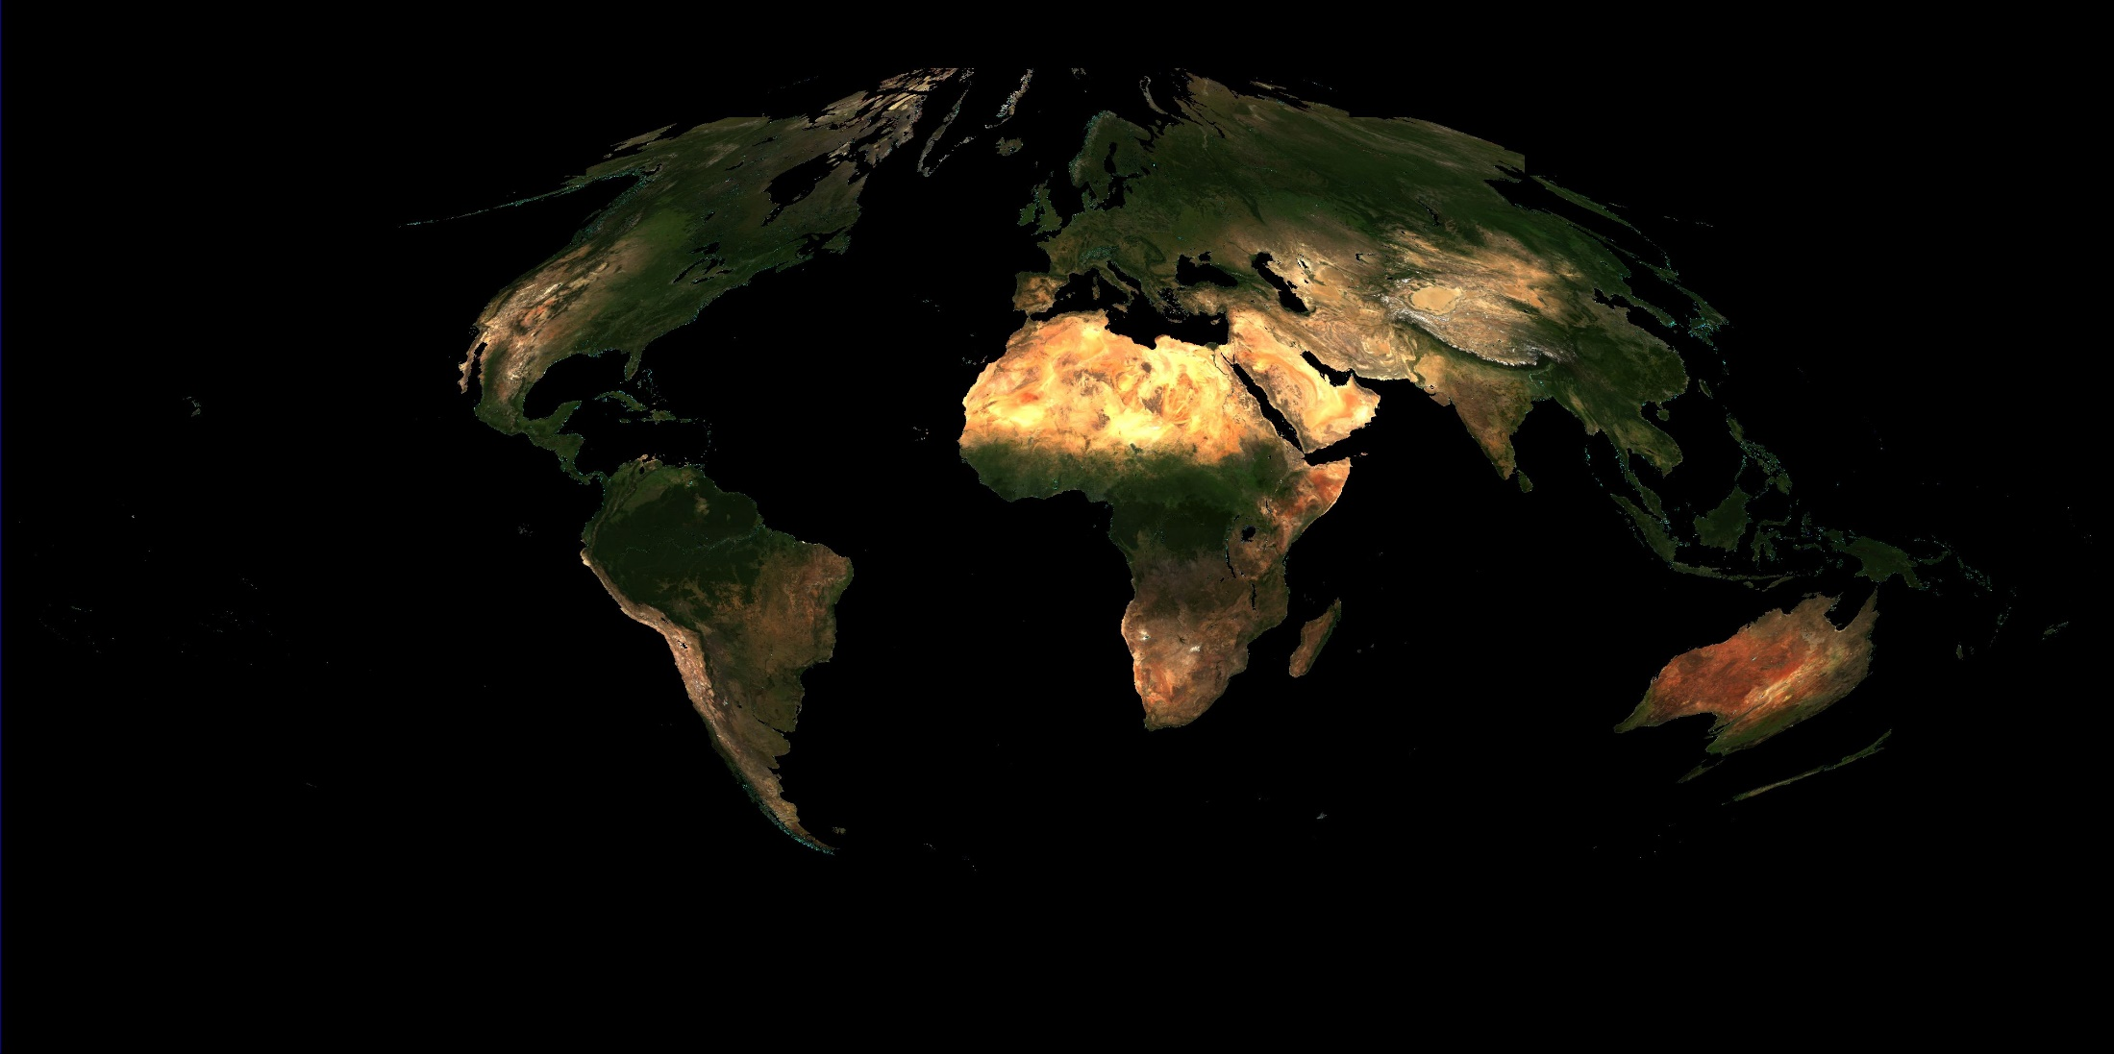

MAIAC Processing of OCI Over Land: High Resolution Aerosol Retrievals and Atmospheric Correction
PI: Alexei Lyapustin, GSFC, code 613
Co-I’s: Y. Wang (UMBC), S. Korkin (USRA), S. Go (UMBC)

Slide 2

Project Objectives
1. Adapt MAIAC algorithm for the atmospheric correction of OCI measurements over land:
  Cloud/snow detection
  Smoke/Dust detection using OCI UV bands
  CWV and Aerosol algorithms
  Extend AC to the full spectrum of bands offered by OCI
2. Prototype and test developed algorithm with TROPOMI data:
  UV-Vis (270-495nm), near-IR (675-775nm) and SWIR (2305-2385nm)
  spectral resolution (< 0.6nm), spatial resolution (< 3.5x7km²)
  spectrally aggregate, and creating prototype of OCI (~7×7km²)
3. Study possibility of extended aerosol retrievals, including height and spectral absorption, from the combination of OCI and polarimetric data (no proposed deliverables)

Slide 3

Introduction of Team
Co-I: Yujie Wang
UMBC
yujie.wang-1@nasa.gov
Co-I: Sergey Korkin
USRA
sergey.v.korkin@nasa.gov
Co-I: Sujung Go
UMBC
sujung.go@nasa.gov
PI: Alexei Lyapustin
NASA GSFC
alexei.i.lyapustin@nasa.gov
Developer of algorithm MAIAC
Over 10 years of work in RT theory and code development (codes SHARM [2000; 2005]; SHARM-3D [2005]; SHARM –IPC [2003]).
Broad expertise in remote sensing (atmospheric aerosol, water vapor; surface reflectance/BRDF/albedo; cloud/cloud shadow detection; snow detection and characterization);
On-orbit sensor calibration, cross-calibration and de-trending [2014b].
Co-developer of algorithm MAIAC
Expert knowledge of remote sensing, sensor calibration, data analysis and validation; development of MAIAC level 2 and level 3 products;
Development of operational version of MAIAC: single thread and parallel processing;
Leading expert in vector radiative transfer (IPOL, SORD).
Support of MAIAC look-up tables, including polarization and spherical geometry;
Atmospheric correction of polarized measurements, development of BPDF (bidirectional polarization distribution function) land models from POLDER.
Will do the main work on algorithm development, prototyping and testing.
Contribute to reports and publications summarizing key findings
At Yonsei, was responsible for the pre-operational algorithm and code for aerosol retrievals from GEMS;

Slide 4

Multi-Angle Implementation of Atmospheric Correction (MAIAC): General Information
Status:
  MODIS: C6 available since May 2018; code for C6.1 re-processing in June
  VIIRS: this summer
  Geostationary: AHI-8 HIMAWARI well developed; ABI coming soon
  PACE
  Products (gridded – 1km MODIS: ~1-2km PACE):
  Atmosphere: WV, CM, AOD, type (background/smoke/dust); spectral imaginary refractive index (k, b) for smoke and dust;
  Land Surface: spectral BRDF (RTLS at 0.47, 0.55, 0.66, 0.87, 1.24, 2.13μm, naturally gap-filled), hyperspectral SR (BRF);

Slide 5

MAIAC Features
Grid TOA L1B data to 1km fixed grid – work with polar-orbit data as “geostationary-like”;
Sliding window algorithm – store 4-16 last days of measurements in memory;
RT with fully coupled BRDF model;
Accumulate surface-related information for each grid cell (spectral BRDF, spatial variability, spectral ratios etc.) → improved cloud/snow detection and global aerosol retrievals over dark and bright surfaces
Use Dynamic Minimum Reflectance Method to Characterize Surface Spectral Ratios,
SRC = R_{0.47}/R_{2.13}
b₂
b₁
SRC
1 2 3 4 5 6 7 8 9
month

Slide 6
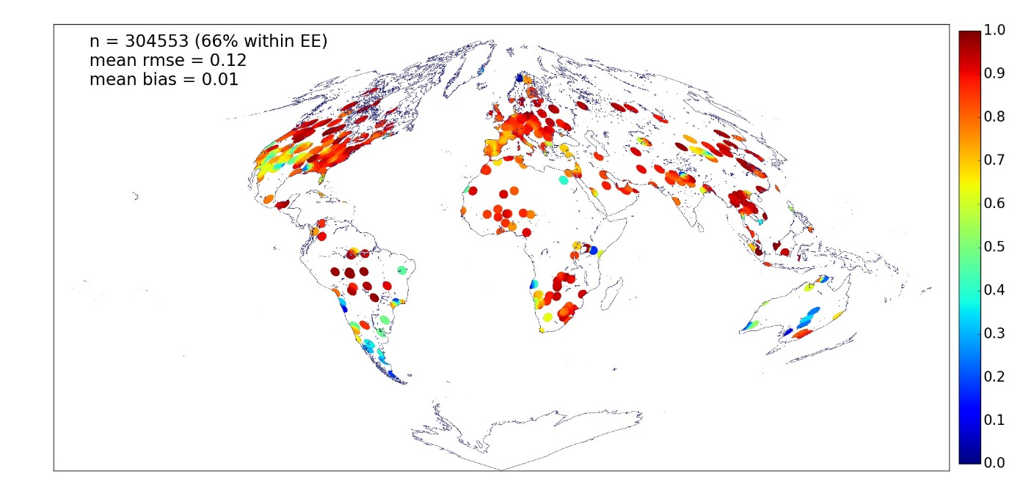
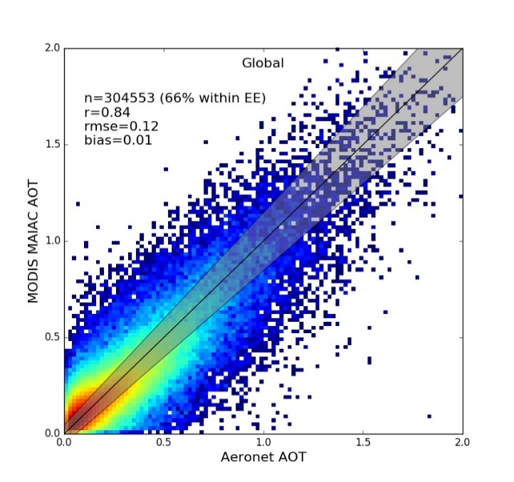
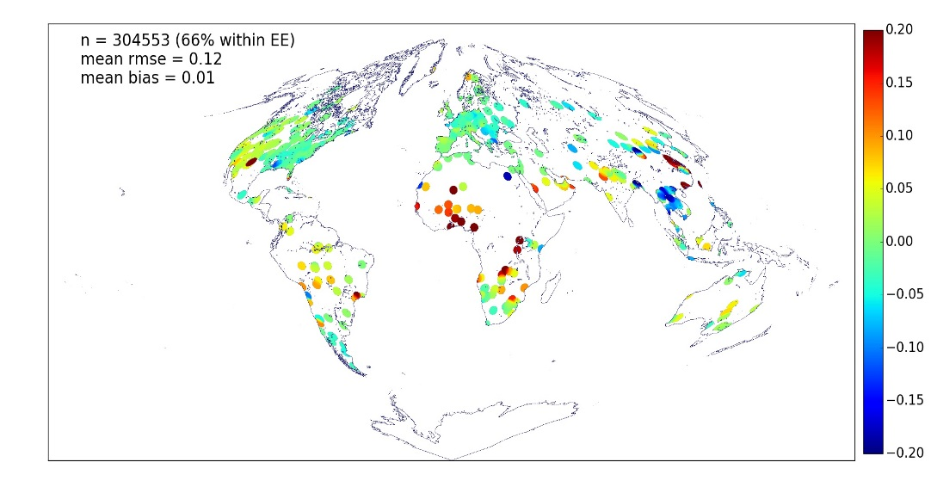
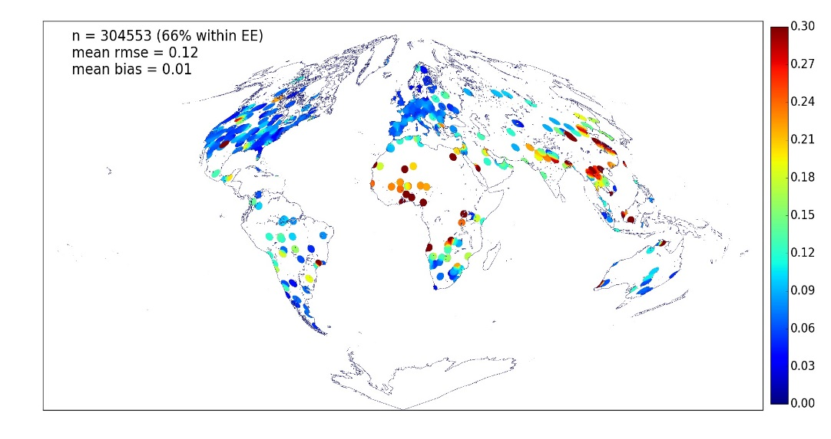

Aerosol Validation: AERONET
Lyapustin, A., et al..: MODIS Collection 6 MAIAC Algorithm, AMT, 2018
(2000-2016)
EE = ±0.05 ±0.1AOD
R
Bias is regionally clustered. Will be fixed in C6.1.
bias
rmse
Notes:
spatial averaging window of 7×7km2
0.05±0.1AOD (or 10%) for 67% measurements, which is an improvement compared to ~20% accuracy of the standard Dark Target (DT) [Levy et al., 2013] and Deep Blue (DB) [Hsu et al.., 2013] products.
lowest dependence on surface brightness and view geometry in comparison to MODIS DB and DT [Mhawish et al., 2018; Jethva et al., 2019; Tao et al., 2019].
minimal winter bias due to a superior snow detection (see Cooper et al., 2018).

Slide 7
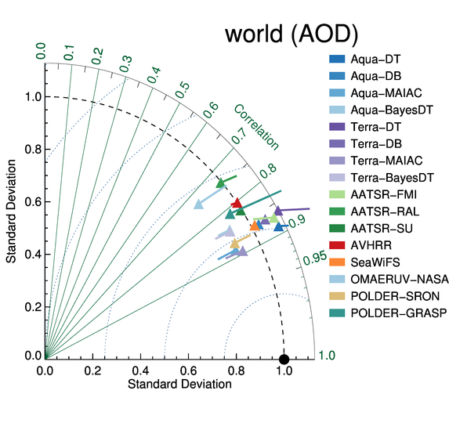

Global Over Land Inter-Comparison
1×1°, time-resolved
DB
DT
MAIAC
Nick Schutgens & AEROSAT team
MAIAC shows the best correlation and rmse against AERONET among operational aerosol products

Slide 8
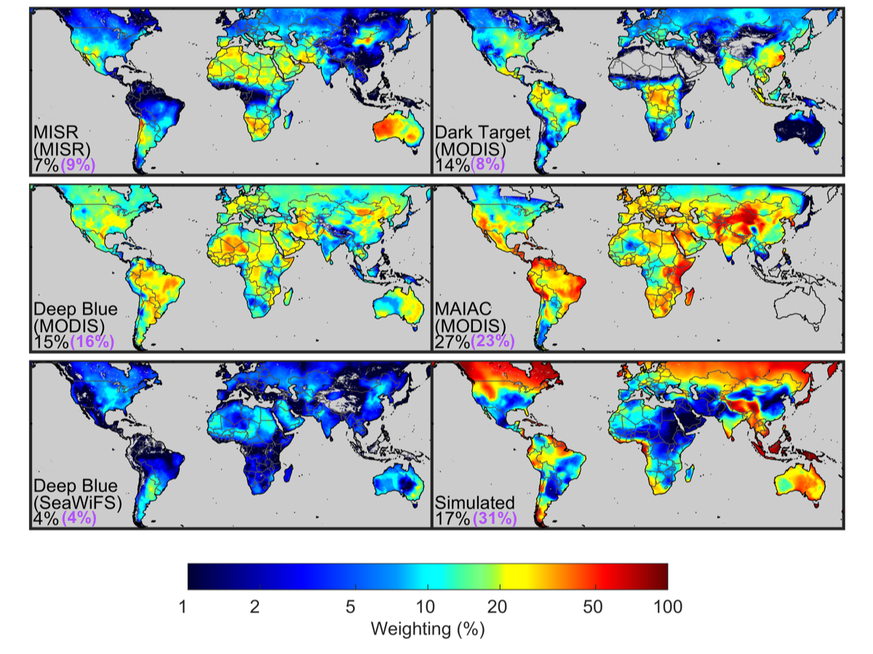

Air Quality and Exposure Assessment for Health Studies
Algorithm Weighting for Global Estimates of PM_{2.5}
Weights ~
accuracy & coverage
MAIAC: 27%
DT: 14%
DB: 15%
MISR: 7%
From: M. Hammer, A. van Donkelaar, R.V. Martin et al., Improved Global Estimates of Fine Particulate Matter Concentrations and Trends Derived from Updated Satellite Retrievals, Modeling Advances, and Additional Ground-Based Monitors, ES&T, in review.

Slide 9
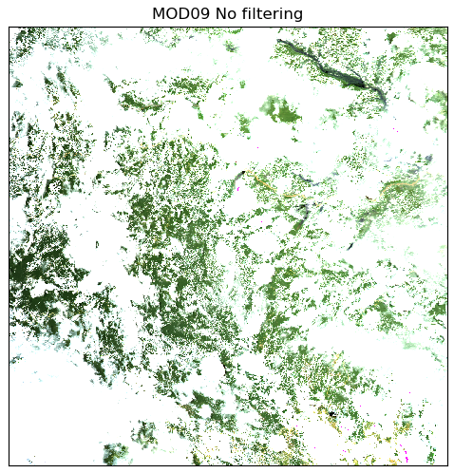
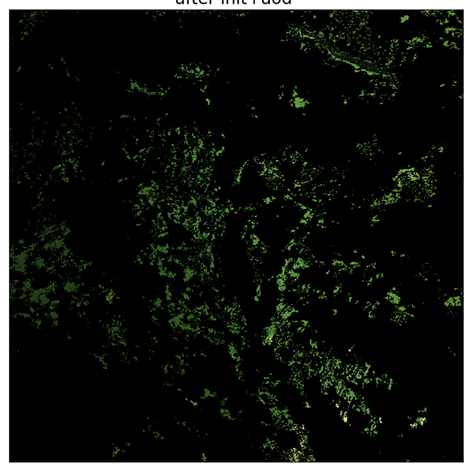
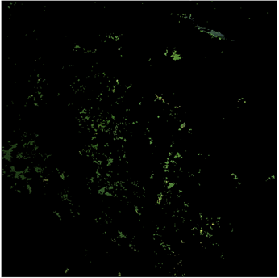
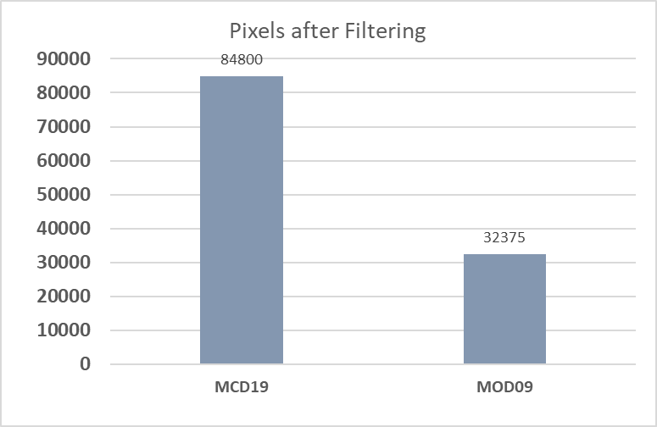
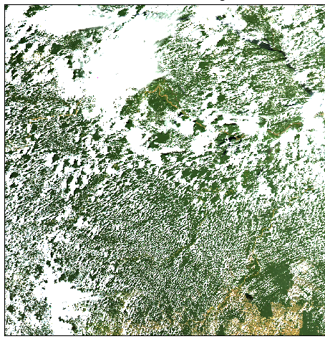
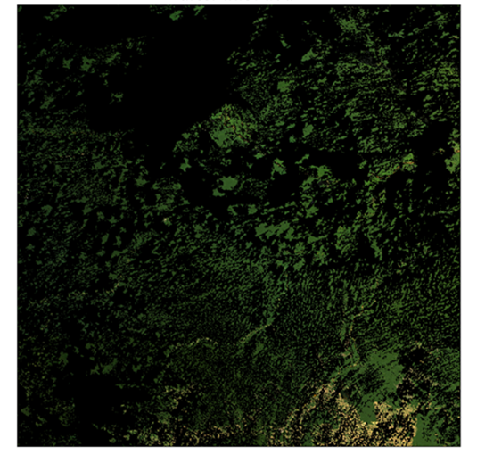
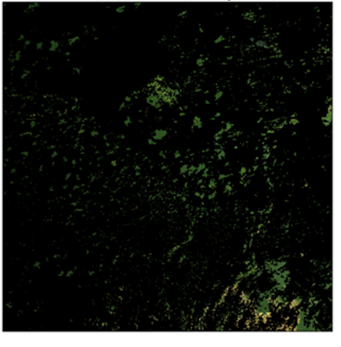
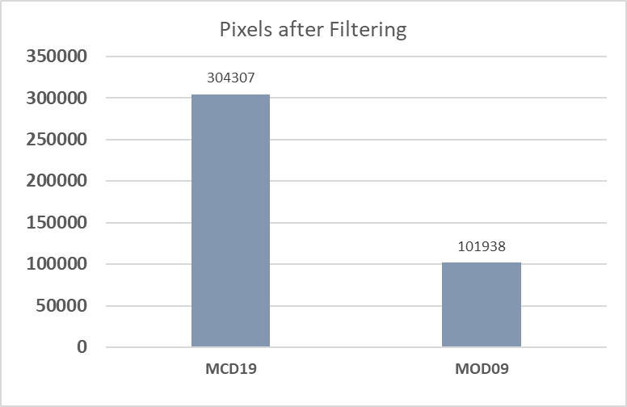

Surface Reflectance Validation
MCD19 MOD09
Feng, Z., A. Lyapustin et al., 2020. " Near-global Evaluation of MODIS Multi-Angle Implementation of Atmospheric Correction (MAIAC) Daily Surface Reflectance Product“, Rem. Sens. Env, in review
QA filters for MCD19A1
1) QA. AODLevel=low(0), 2) QA.AdjacencyMask=Clear, 3) QA.AlgorithmInitializeStatus=initialized(0)
QA filters for MOD09
1) Cloud: 0, 2) shadow: 0, 3) Cirrus: 00, 4) Adjacency to cloud: 0, 5) AOD: 00/01,
6) Internal cloud flag, 7) Fire flag, 8) MODLAND QA bits: 00, 9) band1qa/band2qa: 00, 10) Atm. Corr. Corrected: 1
Notes:
9
Standard QA analysis of atmospheric correction based on time-space variability

Slide 10

Processing Diagram
Full MAIAC processing (on grid) for core bands (0.47, 0.55, 0.66, 0.87, 1.24, 2.13μm), followed by hyperspectral atmospheric correction (on swath)
Is Snow Detected?
4. Retrieve Snow sub-pixel Fraction and Snow Grain Size
1. Grid L1B Data and Split in Tiles (0.47, 0.55, 0.66, 0.87, 1.24, 2.13μm)
2. Retrieve
Water Vapor
(NIR Algorithm)
3. LWS Tests
Cloud Mask1
Aerosol Type
Cloud Mask2
Is SRC initialized?
New Granule
No
11. Hyperspectral atmospheric correction (350-890nm, 5nm)
Use MODIS Dark Target Algorithm (over DT)
Initialize with climatology AOD (bright surface)
Yes
8. Atmospheric correction of core bands.
Backup: Lambertian retrieval
5. Stat. AOD Filter
3×3 smoothing
Adjacency Mask and Filter
4. Retrieve B3 AOD
for a given aerosol type
(background/smoke/dust)
7. Retrieve SRC
6. Mask Shadows
Queue of K days
Queue stores spectral SR for core bands and BRDF F_{v}, F_{g} kernels for each observation.
A Queue memory stores spectral BRDF coeffs.; SRC; 3×3 spatial contrast @ 0.47 and 0.66; NDVI etc. for each grid cell
9. Retrieve BRDF
10. Update Queue

Slide 11

OCI vs TROPOMI
Spectrometer | UV-VIS-NIR | SWIR
Spectral range[nm] | 340-890 | 940, 1038, 1250, 1378, 1615, 2130, 2260
Spectral resolution[nm] | 2.5 | - (discrete)
Nadir view (@ground) | 2663 km | 2663 km
Spatial res. [km²] | 1x1 | 1x1
Spectro meter | UV |  | UVIS |  | NIR |  | SWIR
 | B1 | B2 | B3 | B4 | B5 | B6 | B7 | B8
Spectral range[nm] | 270-300 | 300-500 |  |  | 675-775 |  | 2305-2385
Spectral res.[nm] | 0.45- 0.5 |  | 0.45-0.65 |  | 0.34-0.35 |  | 0.23
Nadir view (@ground) | ~2600 km
Spatial res. [km²] | 28x7 (28x5.5) | 3.5x7 (3.5x5.5) |  |  |  |  | 7x7 (7x5.5)
* TOA 20° North in northern hemisphere, TOA 20° South in southern hemisphere to avoid ocean surface glint
[Input/output data speciﬁcation for the TROPOMI L01b data processor, issue 9.0.0, 2018-04-01]
Hyperspectral AC: we will use the high spatial resolution (1km) MAIAC MODIS Aqua (VIIRS) cloud mask, water vapor and aerosol information as an ancillary data;

Slide 12

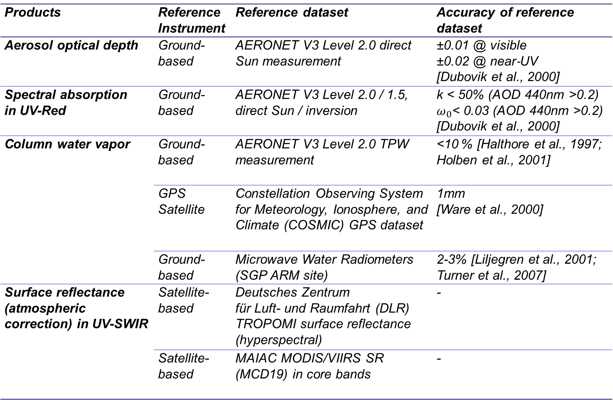
Validation Plan
Products | Reference Instrument | Reference dataset | Accuracy of reference dataset
Aerosol optical depth | Ground-based | AERONET V3 Level 2.0 direct Sun measurement | ±0.01 @ visible ±0.02 @ near‐UV [Dubovik et al., 2000]
Spectral absorption in UV-Red | Ground-based | AERONET V3 Level 2.0 / 1.5, direct Sun / inversion | k < 50% (AOD 440nm >0.2) $ω_{0}$< 0.03 (AOD 440nm >0.2) [Dubovik et al., 2000]
Column water vapor | Ground-based | AERONET V3 Level 2.0 TPW measurement | <10 % [Halthore et al., 1997; Holben et al., 2001]
 | GPS Satellite | Constellation Observing System for Meteorology, Ionosphere, and Climate (COSMIC) GPS dataset | 1mm [Ware et al., 2000]
 | Ground-based | Microwave Water Radiometers (SGP ARM site) | 2-3% [Liljegren et al., 2001; Turner et al., 2007]
Surface reflectance (atmospheric correction) in UV-SWIR | Satellite-based | Deutsches Zentrum für Luft- und Raumfahrt (DLR) TROPOMI surface reflectance (hyperspectral) | -
 | Satellite-based | MAIAC MODIS/VIIRS SR (MCD19) in core bands | -

Slide 13

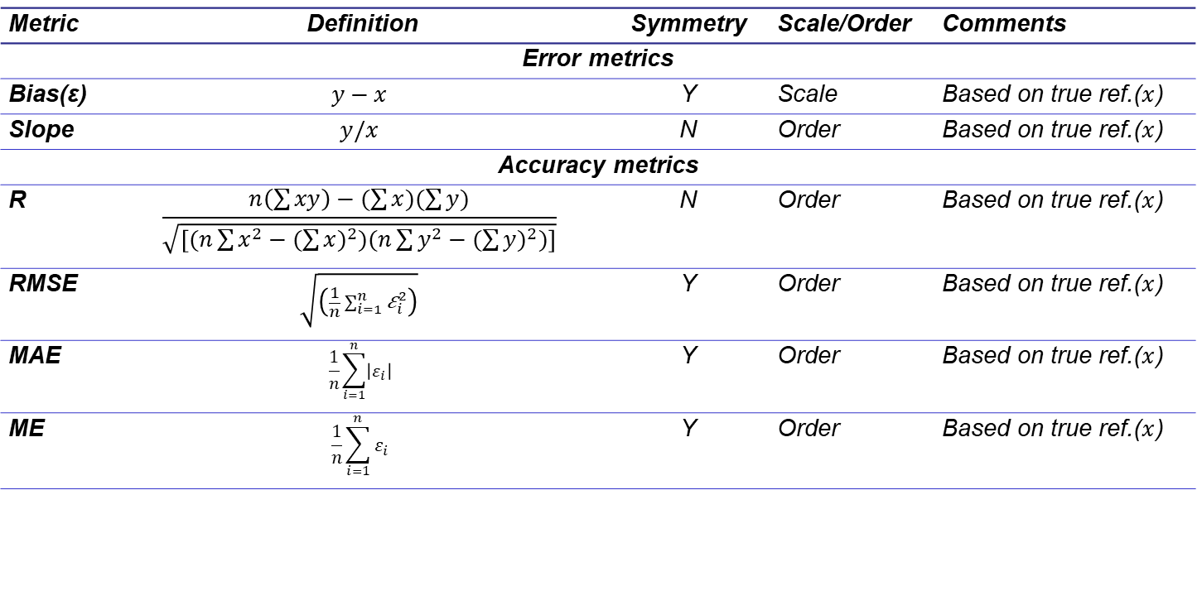
Performance Metrics
1. Basic metrics
Based on [Morley et al., 2018]
Metric | Definition | Symmetry | Scale/Order | Comments
Error metrics
Bias(ε) | $$y−x$$ | Y | Scale | Based on true ref.($x$)
Slope | $$y/x$$ | N | Order | Based on true ref.($x$)
Accuracy metrics
R | $$\frac{n\left(\sum{xy}\right)−(\sum{x})(\sum{y})}{\sqrt{\left[(n\sum{x^{2}}−{(\sum{x})}^{2})(n\sum{y^{2}}−{(\sum{y})}^{2})\right]}}$$ | N | Order | Based on true ref.($x$)
RMSE | $$\sqrt{\left(\frac{1}{n}\sum_{i=1}^{n}{{\text{ε}}_{i}^{2}}\right)}$$ | Y | Order | Based on true ref.($x$)
MAE | $$\frac{1}{n}\sum_{i=1}^{n}{\left|ε_{i}\right|}$$ | Y | Order | Based on true ref.($x$)
ME | $$\frac{1}{n}\sum_{i=1}^{n}{ε_{i}}$$ | Y | Order | Based on true ref.($x$)
2. Uncertainty evaluation
  Assessment of posterior error: based on AERONET, GPS, etc.
  Theoretical modeling of prognostic expected error (Sayer et al., 2020) (TBD)

Slide 14

Summary
  Project Objectives:
    Develop MAIAC-based algorithm for the atmospheric correction of OCI measurements over land
    Prototype and test developed algorithm with TROPOMI data
    Study possibility of extended aerosol retrievals, including height and spectral absorption, from the combination of OCI and spectropolarimetric data
  Products:
    Atmosphere:
      CM; WV; AOD; spectral imaginary refractive index (k, b) for smoke and dust;
    Land Surface:
      K_{iso}, K_{vol}, K_{geo} – coefficients of RTLS BRDF model (0.47, 0.55, 0.66, 0.87, 1.24, 2.13μm).
      Hyperspectral SR (BRF): ~80-100 values per pixels for 350-890nm range with 5nm step in atmospheric windows

