Slide 1

PACE measurements of Sargassum macroalgae
A project funded by NASA ROSES2019 A.38 NNH19ZDA001N-PACESAT
Project PI: Chuanmin Hu, University of South Florida
Project co-PIs: Brian Lapointe, Florida Atlantic University
Gustavo Goni, NOAA AOML
Contact: huc@usf.edu
https://optics.marine.usf.edu

Slide 2
PACE measurements of Sargassum macroalgae
Outline
What we know, what we can do
What we don’t know, what we can’t do
What PACE can do

Slide 3
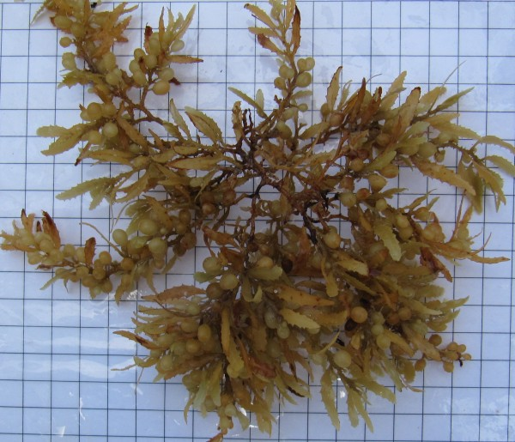
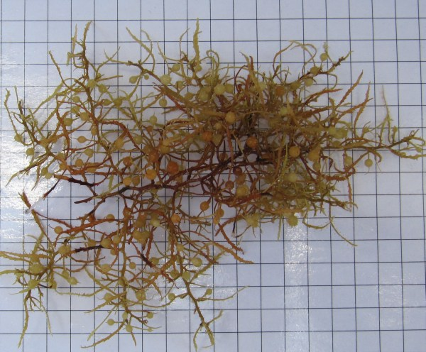
Sargassum – what is it?
A brown macroalgae that reproduces vegetatively
Sargassum clumps are ~ 10-20 cm in size
1 cm² squares
S. fluitans
S. natans
Photo credit: Amy Siuda

Slide 4
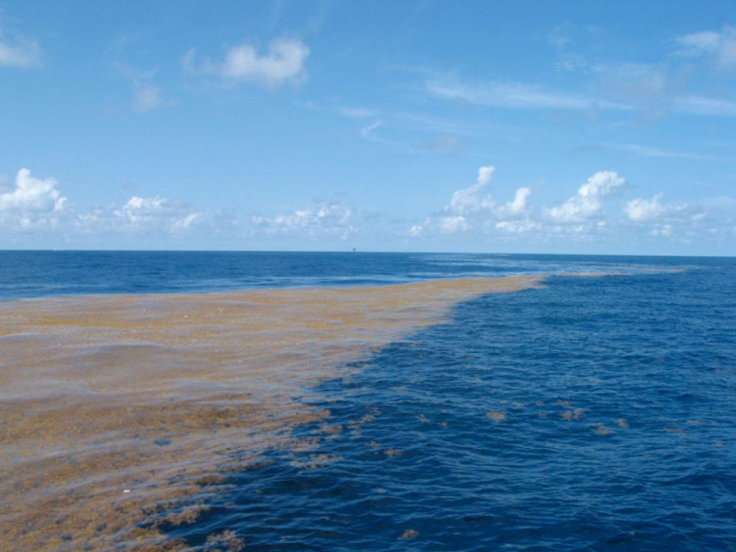
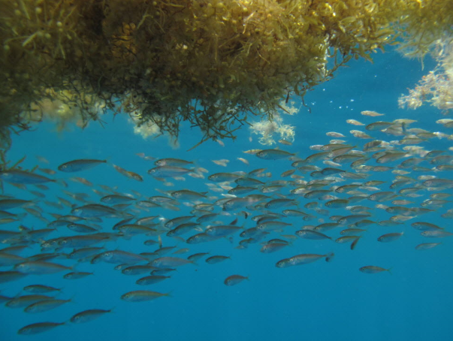
Sargassum – what is it?
A brown macroalgae that reproduces vegetatively
An important habitat
Food and shade to many animals (fish, young turtles, shrimp, crab, etc.), and it also supports sand dunes and shoreline stabilization
“Golden floating rainforest of the Atlantic Ocean” (The Sargasso Sea Alliance)
Notes:
Add Dirk Aurin video?

Slide 5
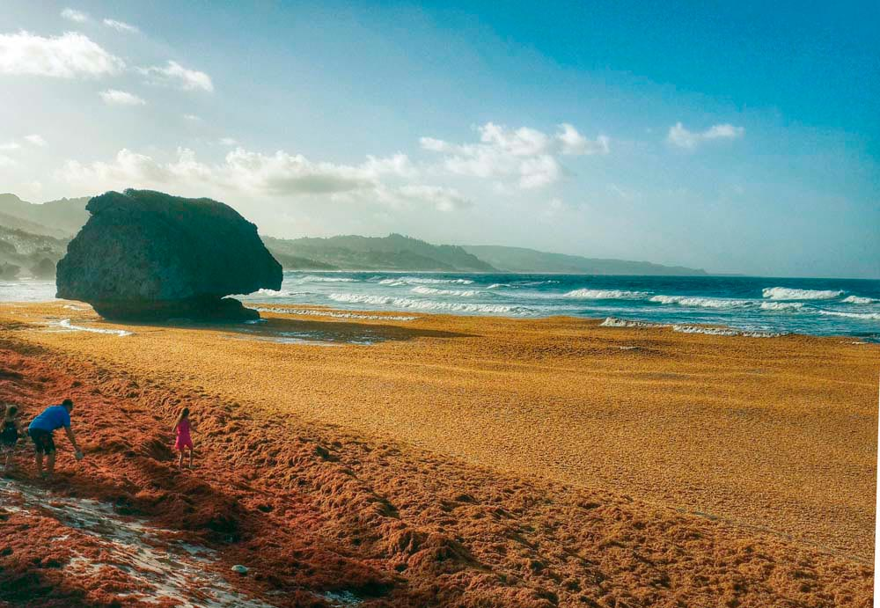
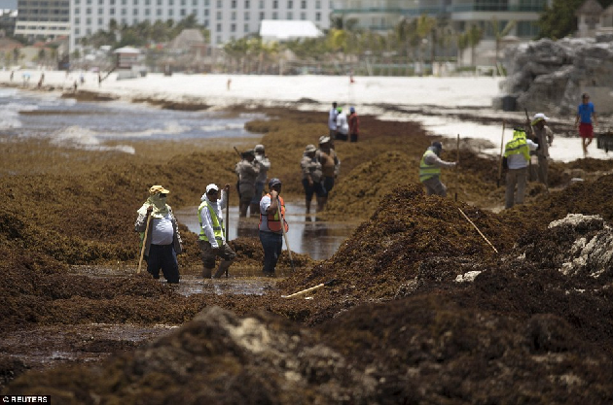
Sargassum – what is it?
A brown macroalgae that reproduces vegetatively
A beach nuisance
Smells bad, attracts insects,
Smother turtle nesting sites, causing turtle and fish mortality
Negative impact on tourism and economy

Slide 6
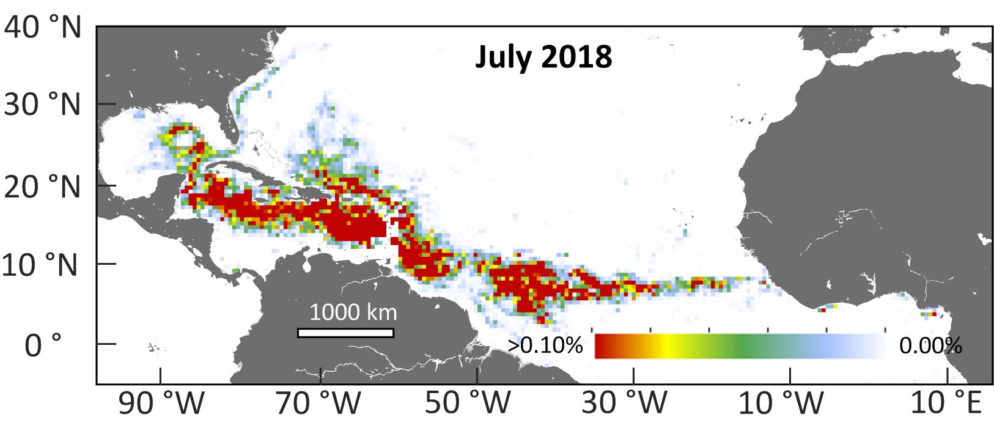
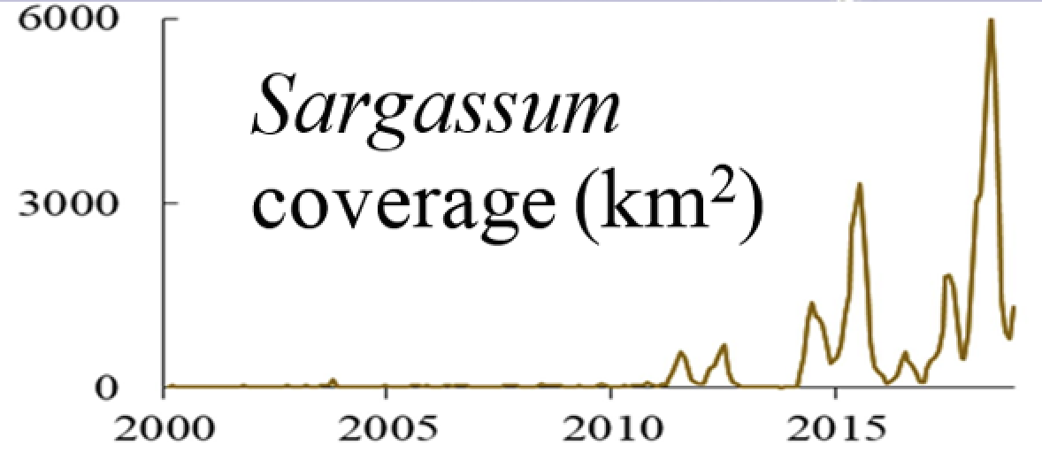

Where is it – the GASB
From Wang et al. (2019)
Sargassum area (km²)

Slide 7
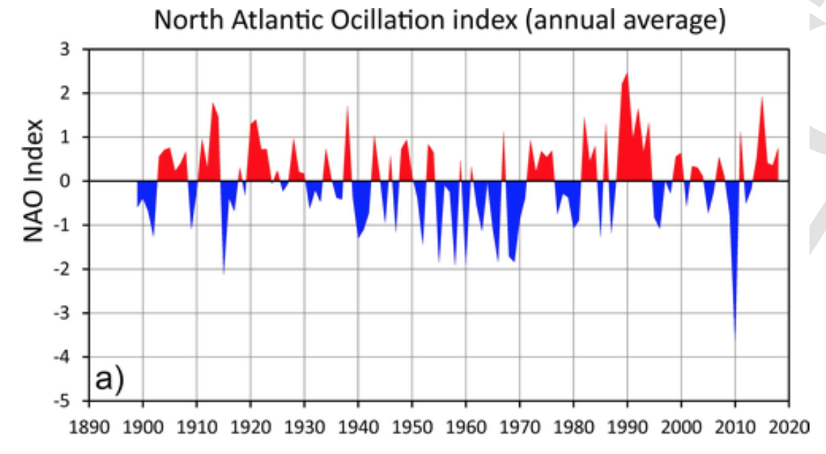
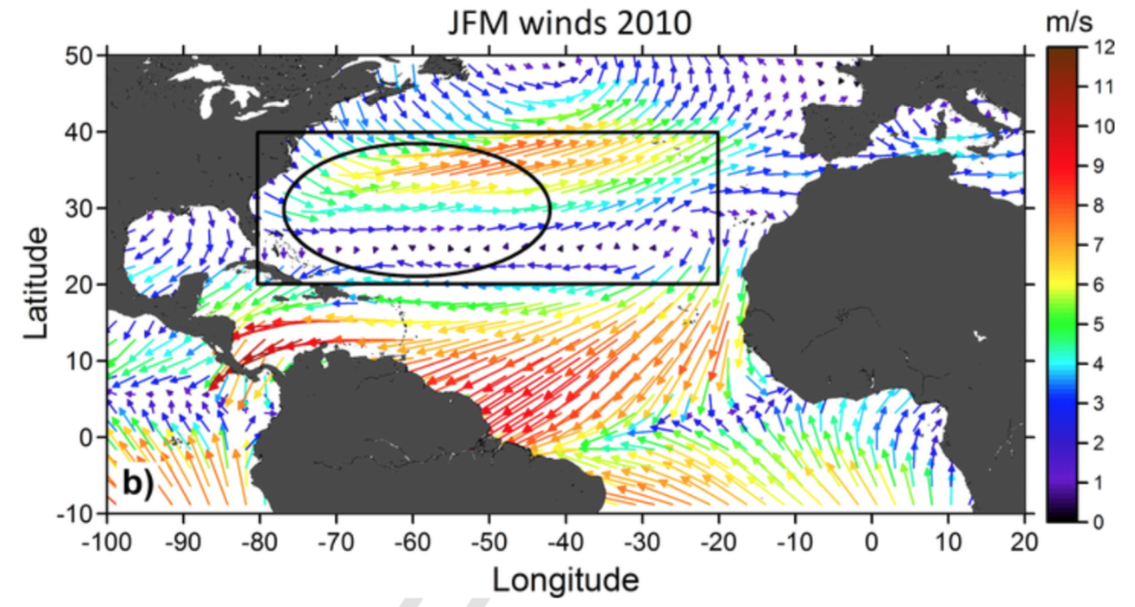
Why?
Some hypotheses, but picture not completely clear
From Johns et al. (2020)
Abnormal winds and currents brought new seed populations to the tropics

Slide 8
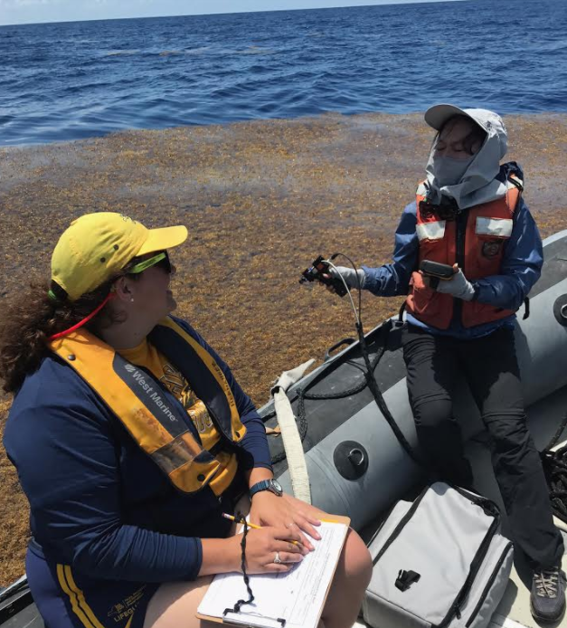
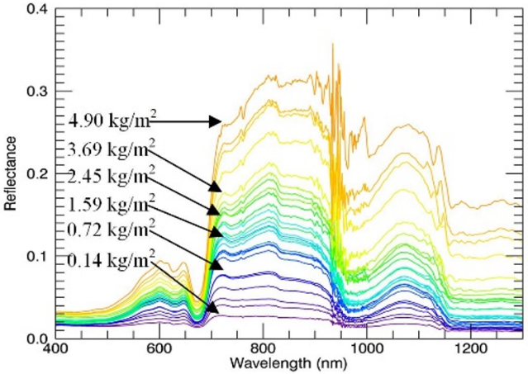
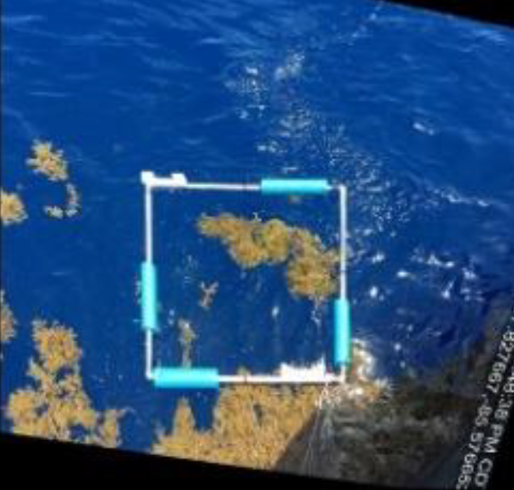
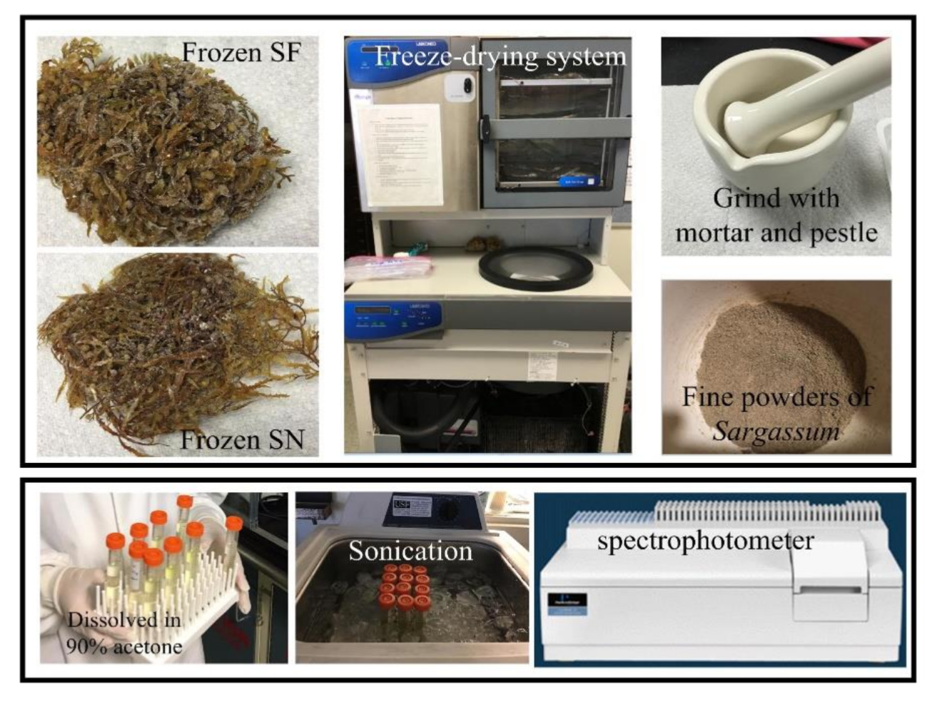
What can we do now?
Field and laboratory measurements, remote sensing
Wang et al. (2018, GRL)

Slide 9
What can we do now?
Field and laboratory measurements, remote sensing

Slide 10
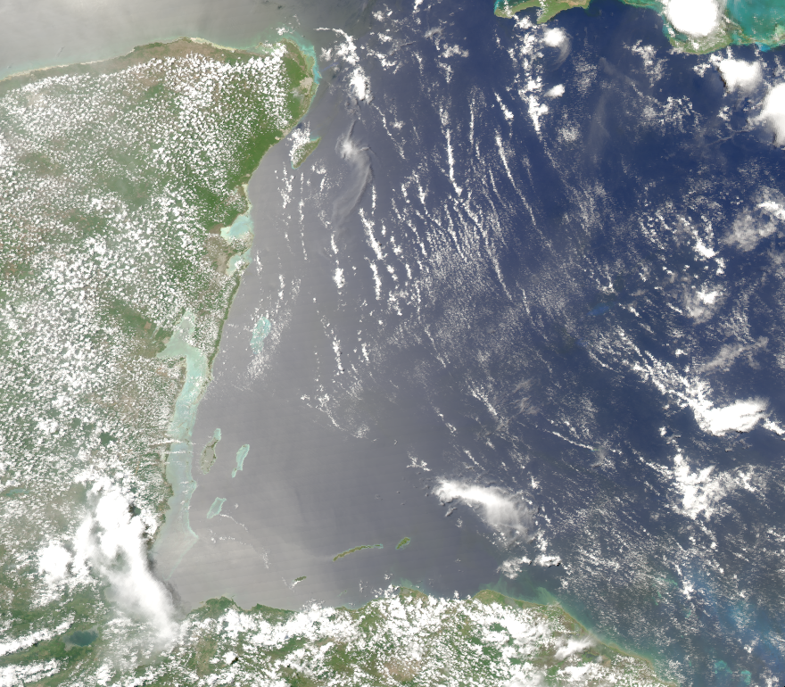
What can we do now?
Field and laboratory measurements, remote sensing
Remote sensing to scale up field and lab measurements
6/10/2019

Slide 11
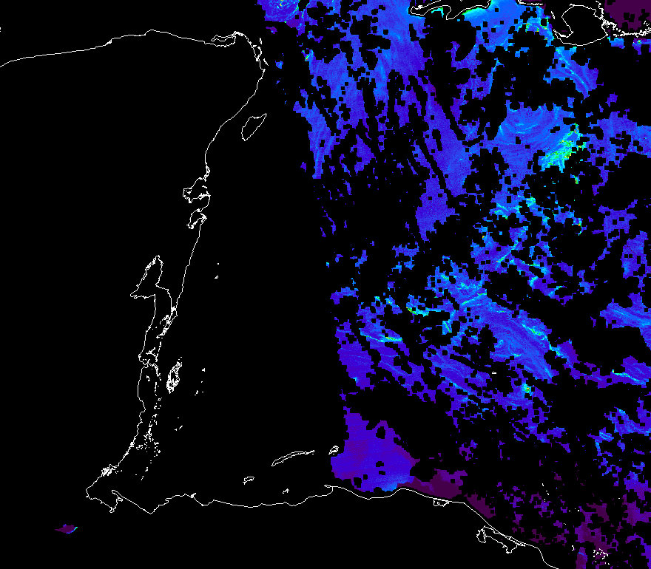
What can we do now?
Field and laboratory measurements, remote sensing
Remote sensing to scale up field and lab measurements
6/10/2019

Slide 12
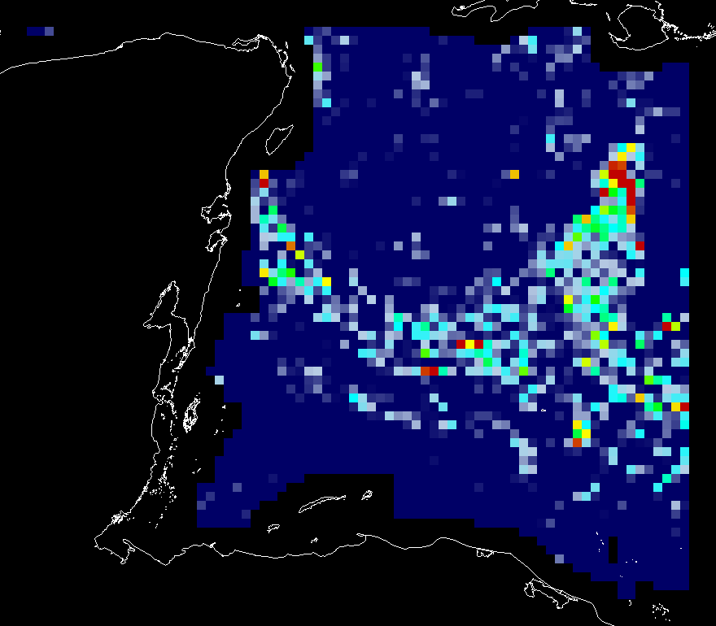
What can we do now?
Field and laboratory measurements, remote sensing
Remote sensing to scale up field and lab measurements
6/10/2019

Slide 13
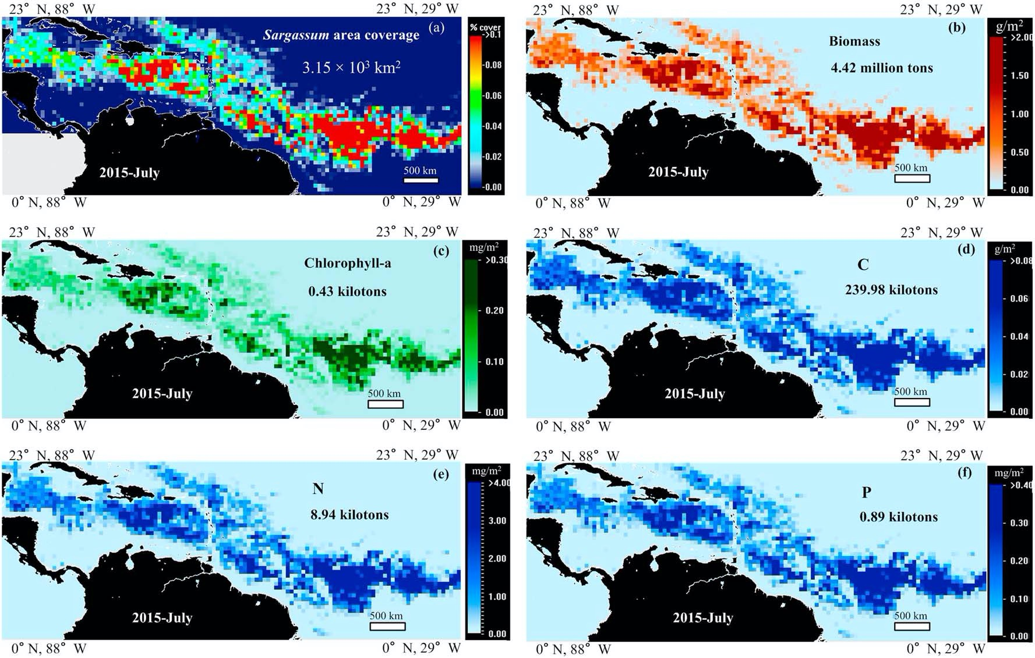
What can we do now?
Field and laboratory measurements, remote sensing
Remote sensing to scale up field and lab measurements

Slide 14
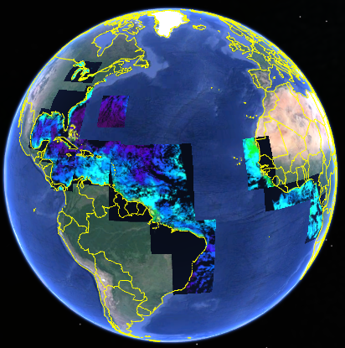
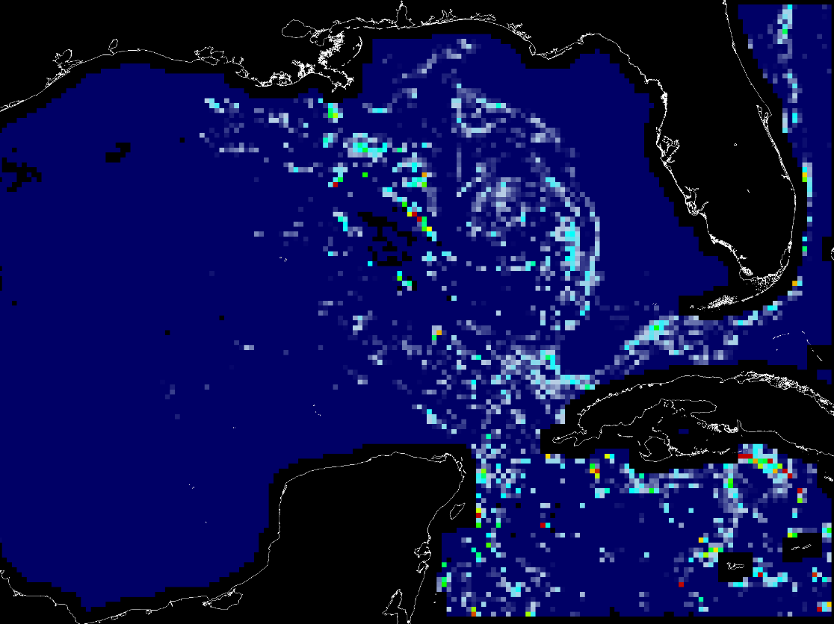
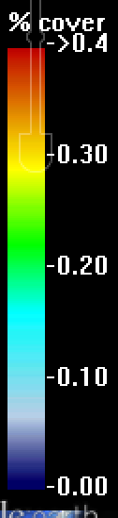
What can we do now?
Monitor, track, and forecast
Sargassum Watch System (SaWS)
Gulf of Mexico, Caribbean Sea, Central Atlantic
https://optics.marine.usf.edu/projects/saws.html
Week of May 14 – 20, 2019
A mouse click on the GE button under SaWS images will bring both the image and surface currents to a user’s Google Earth environment

Slide 15
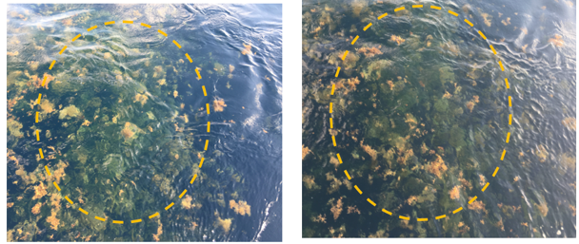
What can we not do now?
Some remaining challenges
Sargassum submerged in water

Slide 16
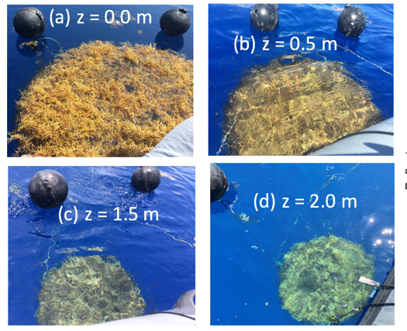
What can we not do now?
Some remaining challenges
Sargassum submerged in water

Slide 17
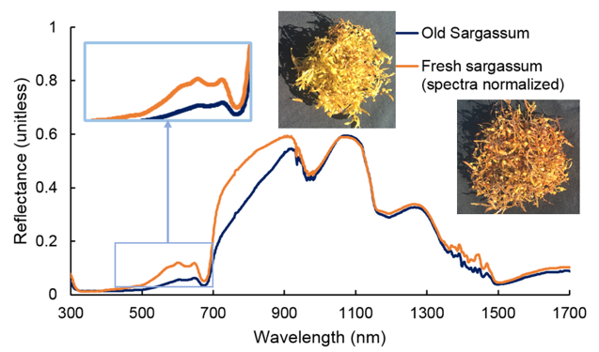
What can we not do now?
Some remaining challenges
Even at surface, Sargassum has different colors – so what?

Slide 18
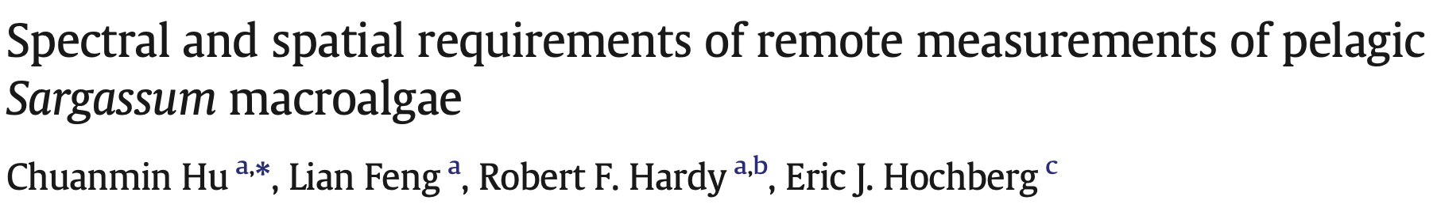
What can PACE do?
Address the challenges using hyperspectral data
Objectives
Reduce uncertainties in Sargassum estimates
Decipher color changes
(RSE, 2015)
PACE analog data to be used in the project

Slide 19
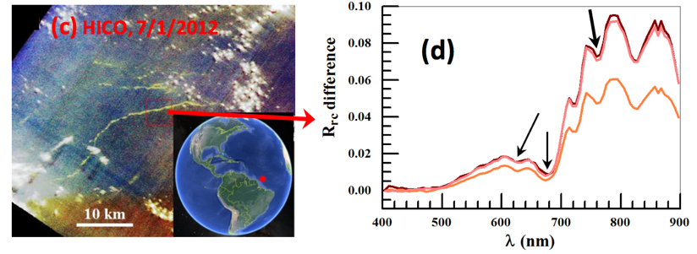
What can PACE do?
Address the challenges using hyperspectral data
Example with HICO

Slide 20
PACE measurements of Sargassum macroalgae
Summary
Significant advances have been made on Sargassum measurements and remote sensing – thanks primarily to NASA OBB and Ecoforecast programs
Our knowledge on Sargassum distributions and temporal changes has also advanced (e.g., discovery of the GASB)
Several technical challenges still remain, including uncertainties due to submersed Sargassum and understanding of changes in color tones
PACE hyperspectral data should provide unprecedented capacity to address these challenges through offering extra bands and higher SNRs

