Slide 1
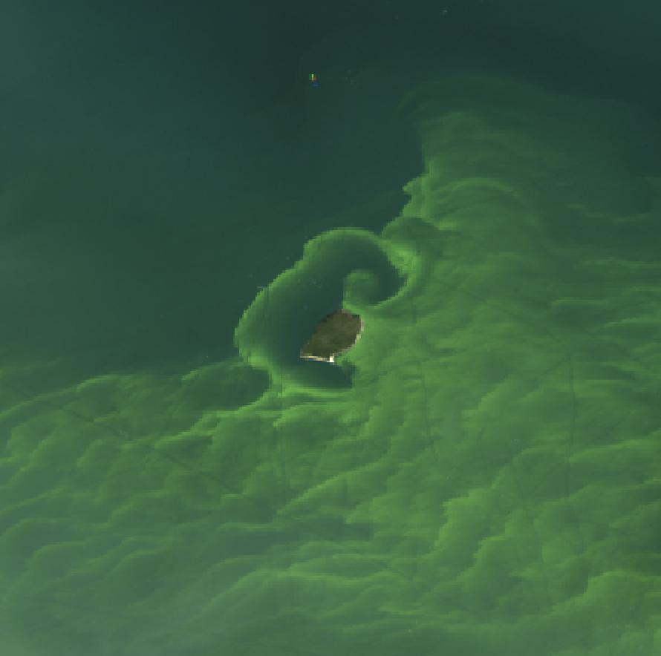

Maximizing Utility of PACE in Coastal and Major Freshwater Ecosystems: Advancing Science for Societal Benefits
Nima Pahlevan
Science Systems and Applications Inc. (SSAI)
NASA Goddard Space Flight Center / Code 619

Slide 2


Team
Brandon Smith
Caren Binding
Emmanuel Boss
Raphe Kudela
Rick Stumpf
Stephanie Uz

Slide 3
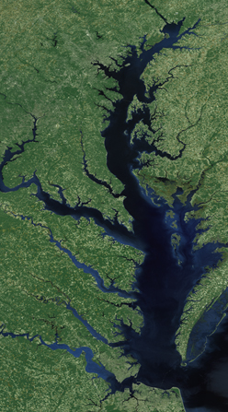
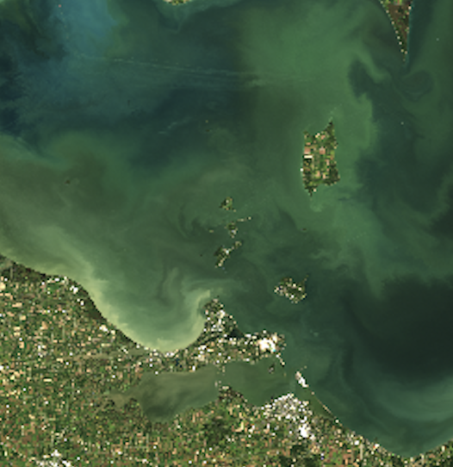
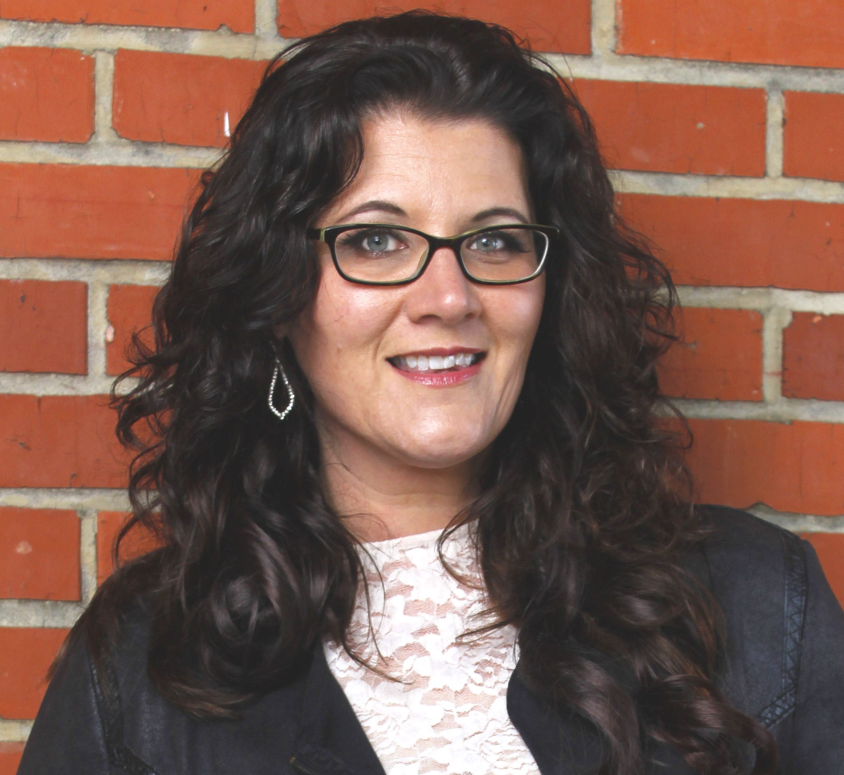
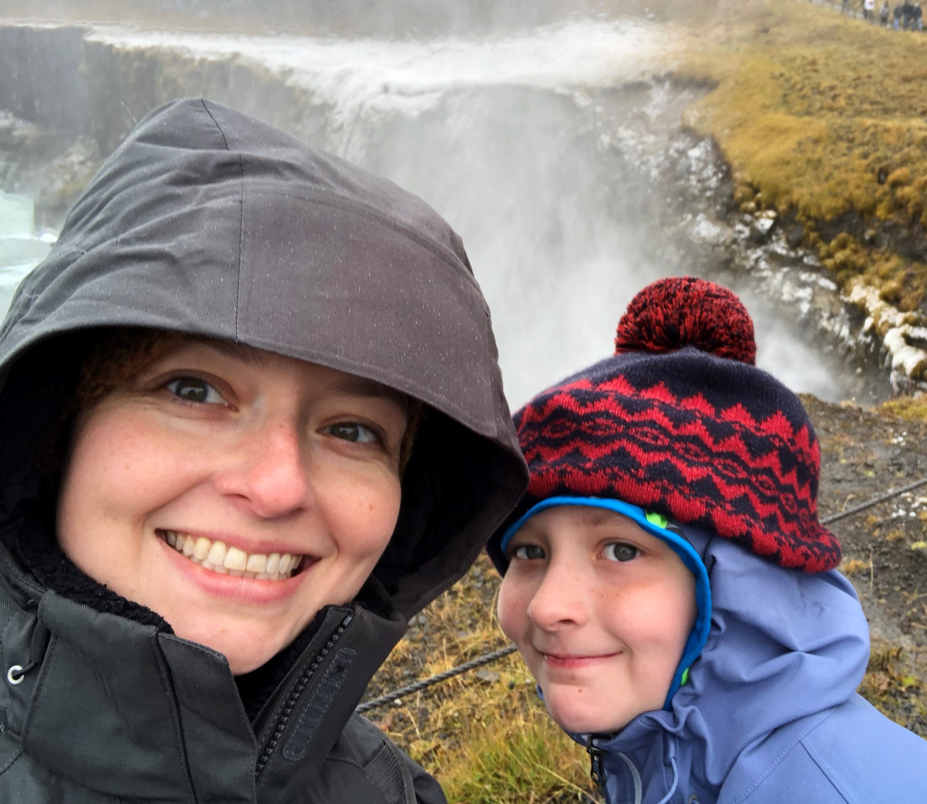
The Objective
Provide stakeholders with consistent, reliable and advanced ocean color products to improve decision-making concerning harmful algal blooms (HABs) and water quality monitoring
Chesapeake Bay
Jennifer Wolny
MD DNR
Western Lake Erie
Ruth Briland
OH EPA
Todd Egerton
VA Department of Health

Slide 4
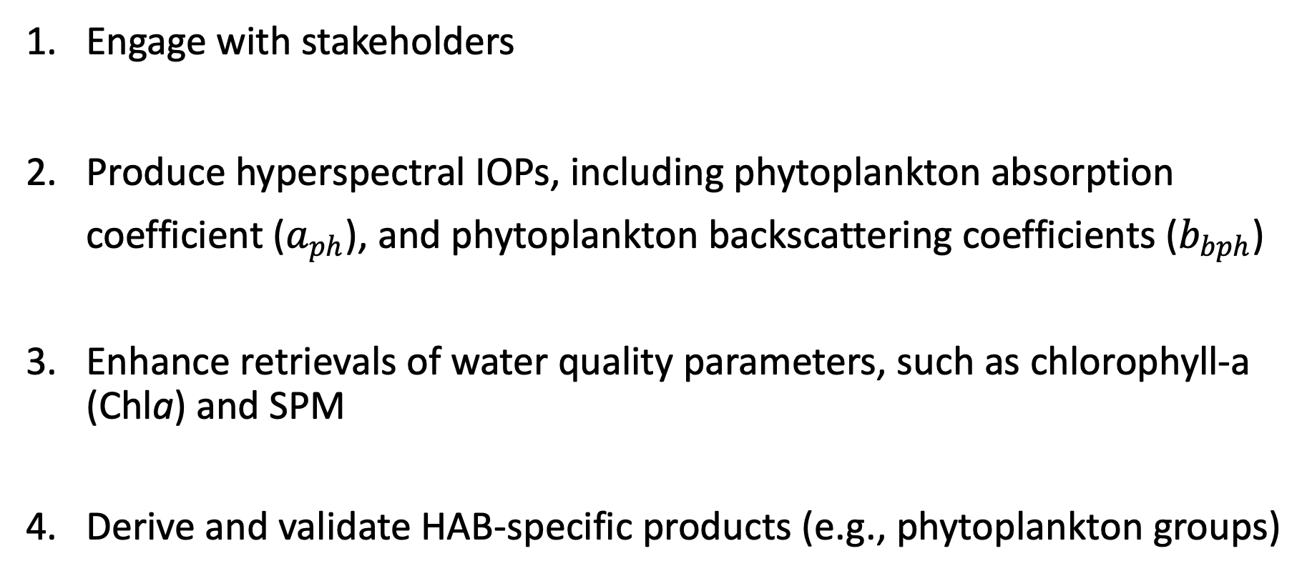
Specific Objectives
Engage with stakeholders
Produce hyperspectral IOPs, including phytoplankton absorption coefficient ($a_{ph}$), and phytoplankton backscattering coefficients ($b_{bph}$)
Enhance retrievals of water quality parameters, such as chlorophyll-a (Chla) and SPM
Derive and validate HAB-specific products (e.g., phytoplankton groups)

Slide 5
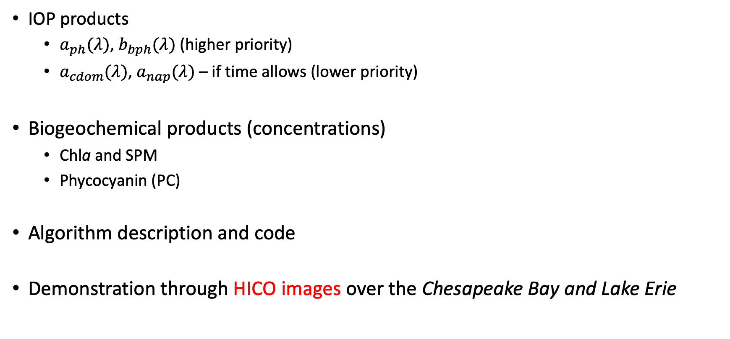
Deliverables:
IOP products
  $a_{ph}(λ)$, $b_{bph}(λ)$ (higher priority)
  $a_{cdom}(λ)$, $a_{nap}(λ)$ – if time allows (lower priority)
Biogeochemical products (concentrations)
  Chla and SPM
  Phycocyanin (PC)
Algorithm description and code
Demonstration through HICO images over the Chesapeake Bay and Lake Erie

Slide 6
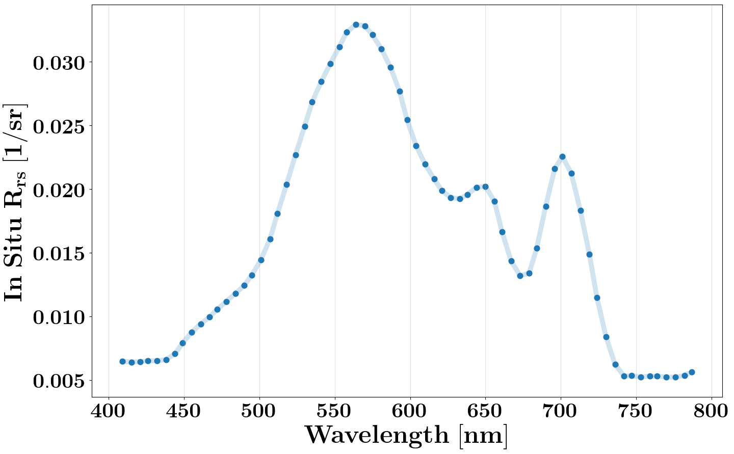

Methods: Forward modeling & inverse problem
Input Space
F⁻¹
$$IOPs$$
Chla
SPM
PC
Output Space
F
One-to-one Mapping
One-to-many Mapping
Inherent Optical Properties (IOPs)
  a_{ph} , b_{bp} , a_{nap} , a_{cdom} , VSF, …
Pigment concentrations
  Chla, phycocyanin (PC), phycoerythrin (PE), …
Other quantities/parameters
  Suspended particulate matter (SPM)
  Acquisition geometry
Notes:
The components that determine the color of water in coastal areas… L_w is related to abs/backscattering as shown

Slide 7
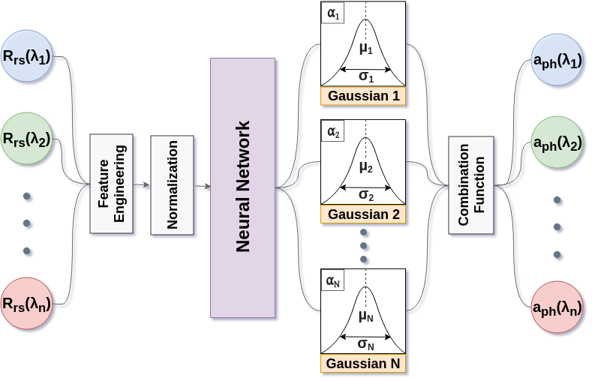
Mixture Density Networks (MDNs)
Pahlevan, N., Smith, B., Schalles, J., Binding, C., Cao, Z., Ma, R., Alikas, K., Kangro, K., Gurlin, D., Hà, N., Matsushita, B., Moses, W., Greb, S., Lehmann, M.K., Ondrusek, M., Oppelt, N., & Stumpf, R. (2020). Seamless retrievals of chlorophyll-a from Sentinel-2 (MSI) and Sentinel-3 (OLCI) in inland and coastal waters: A machine-learning approach. Remote Sensing of Environment, 240, 111604

Slide 8
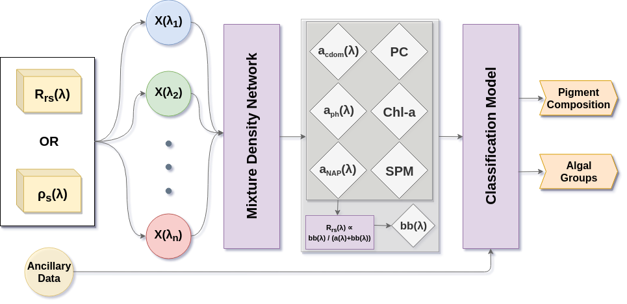
General Scheme:
Simultaneous Multiparameter Retrievals

Slide 9
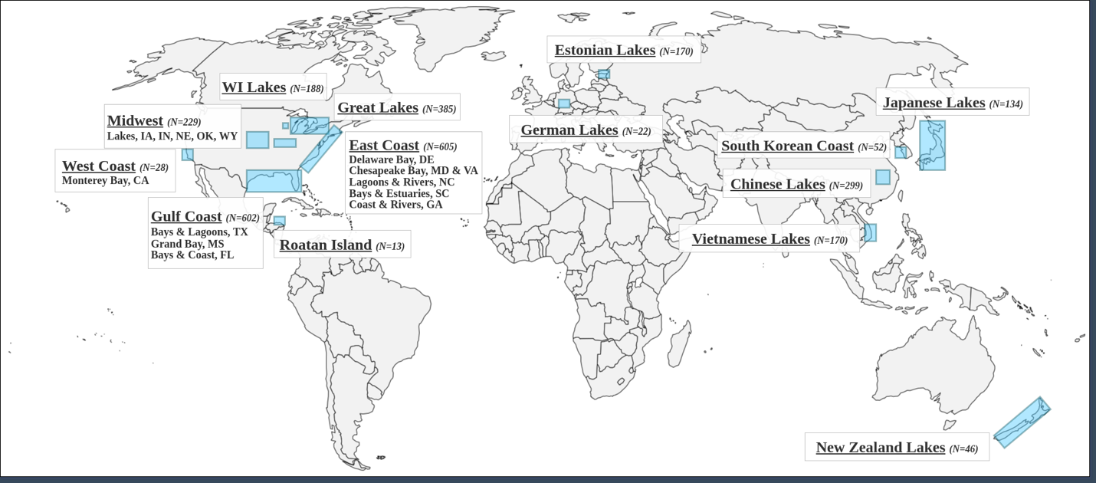
Field data (subset)
~ 4500 in situ hyperspectral R_{rs} (400-800 nm) – Chla/TSS/a_{cdom}
  Data Contributors
  Krista Alikas
  Caren Binding
  Ronghua Ma
  Daniela Gurlin
  Wesley Moses
  Moritz Lehmann
  Nguyen Ha
  Natascha Oppelt
  Mike Ondrusek
  John Schalles
  KIOST
  Bunkei Matsushita

Slide 10
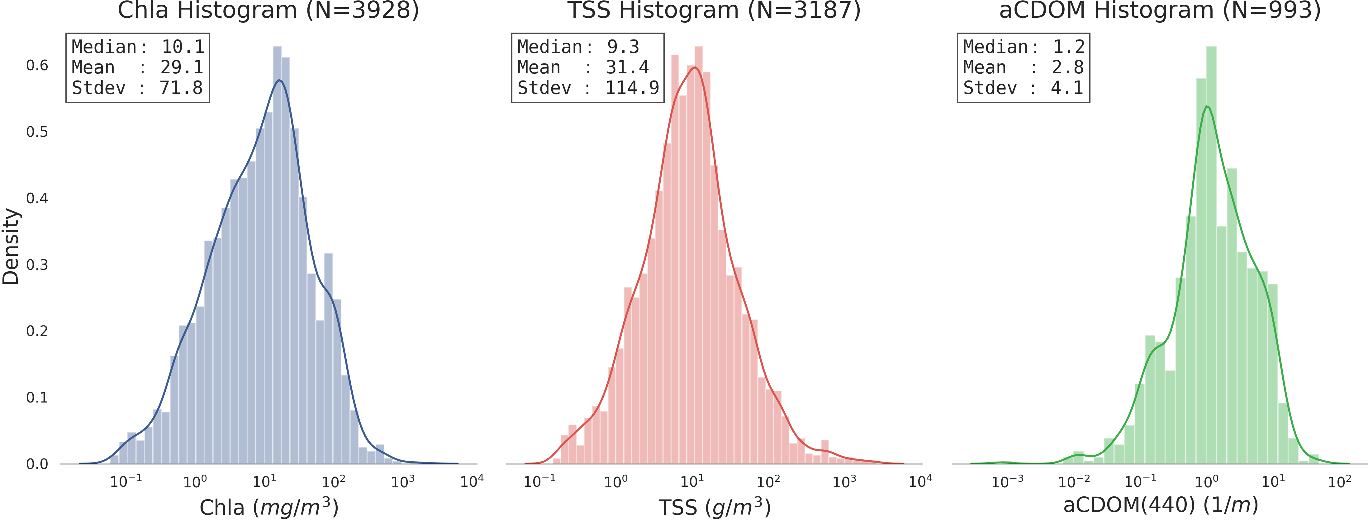
Field data (subset)

Slide 11
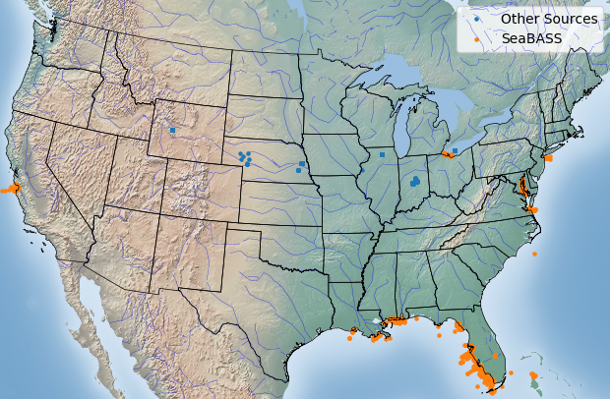
Field data
~ 1250 in situ hyperspectral R_{rs} – a_{ph} (400-700 nm)
  Data contributors (inland; N ~ 530)
  Caren Binding
  Daniela Gurlin
  Bunkei Matsushita
  Lin Li
  Ronghua Ma
  SeaBASS PIs (coastal; N ~ 720)
  Chuanmin Hu
  Richard Gould
  Alex Gilerson
  Richard Zimmerman
  Kendal Carder
  Bob Arnone
  Frank Muller Karger
  Zhongping Lee

Slide 12
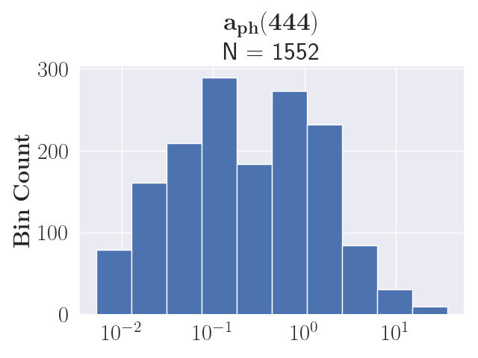
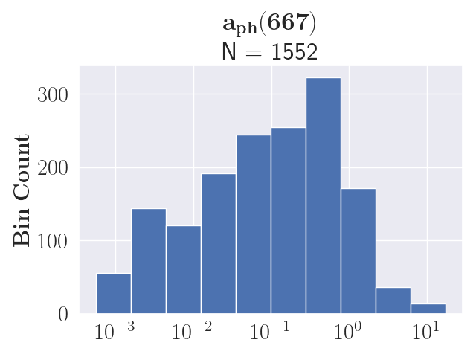

Field data
~ 1250 in situ hyperspectral R_{rs} – a_{ph} (400-700 nm)

Slide 13
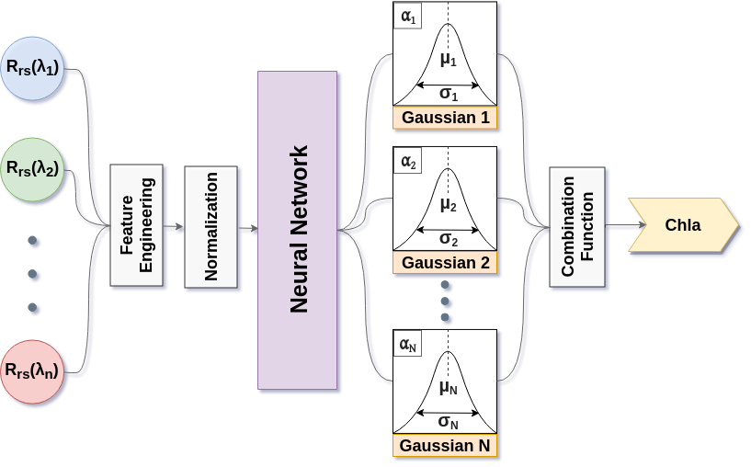
HICO Demonstration
Input: HICO-simulated R_{rs} spectra (409 – 787 nm; 67 channels)
50% of the data (N = 2000) for training and the rest for validation/testing
Five-layer NN with 100 neurons per layer

Slide 14
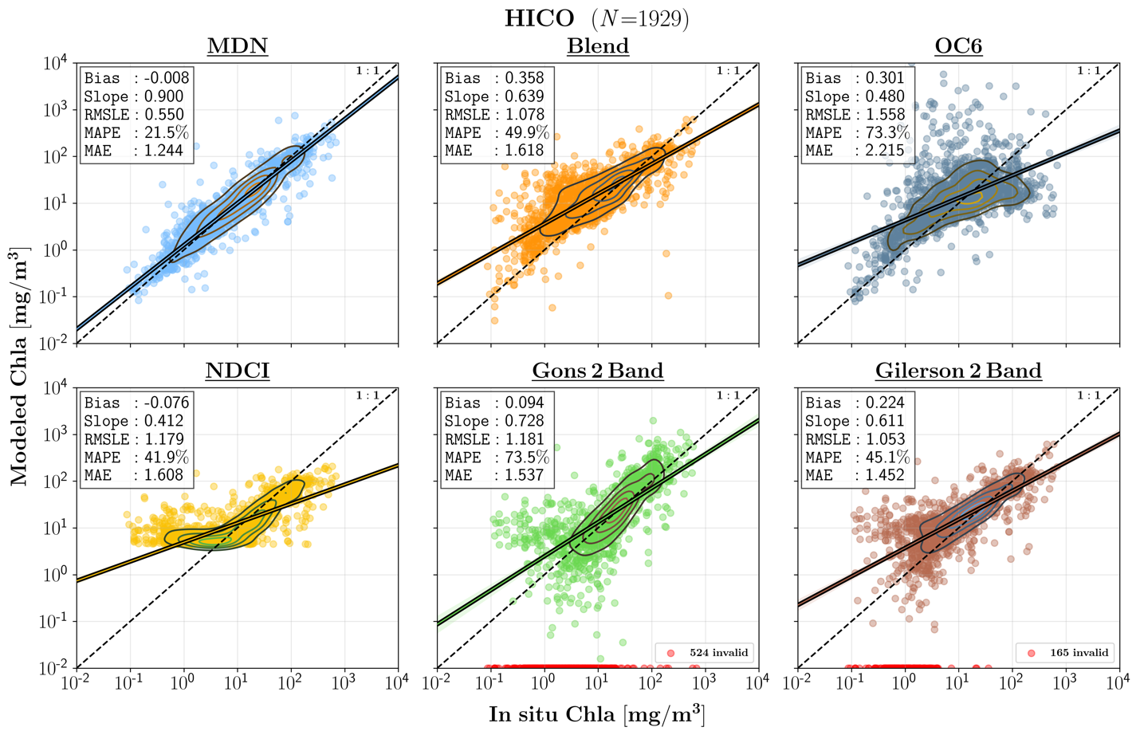
Preliminary Performance Evaluation (Chla; N =1929)
(Smith et. al. 2018)
(O’Reilly & Werdell 2019)
(Mishra & Mishra 2012)
(Gons et. al. 2002)
Gilerson et. al. 2010)

Slide 15
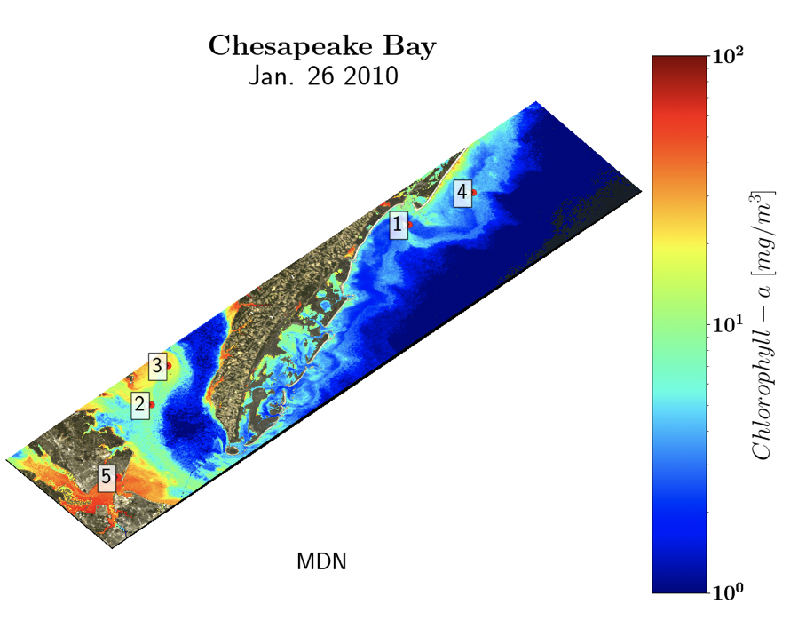
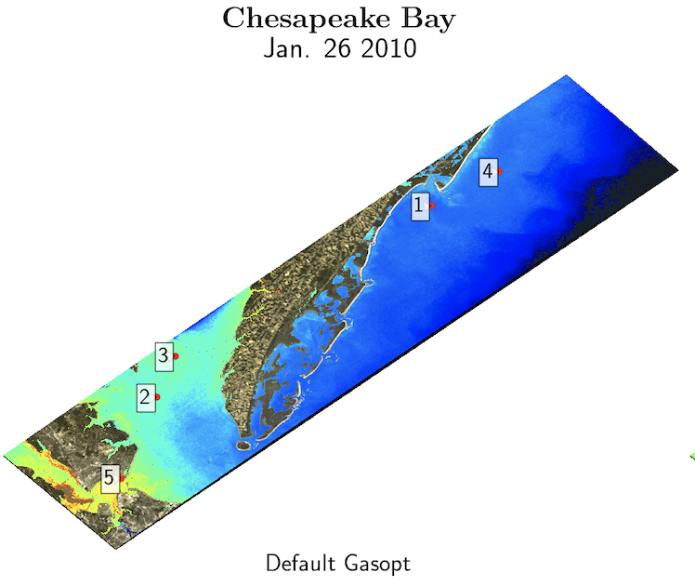
Demonstration (HICO-derived Maps)
Apply trained MDN models to atmospherically corrected HICO images
TOA
->
SeaDAS
->
R_{rs}
->
MDN
->
MDN
Chla
OCI
Ibrahim et. al. (2018)

Slide 16
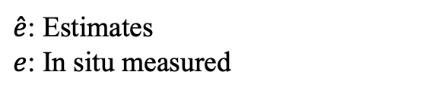

Performance Metrics
$$Bias= {100 ×sign\left(z\right) (10}^{|Z|}−1) where Z=Median \left(\log_{10}(\hat{e}/e\right))$$
$Error= {100 × (10}^{Y} −1 ) where Y=Median |\log_{10}(\hat{e}/e)$|
$SA=Arccos \left[\frac{{\hat{ρ}}_{w} . ρ_{w}}{\left\|{\hat{ρ}}_{w}\right\| \left\|ρ_{w}\right\|}\right]$ where 0 < SA < 90 deg
Type II linear regression slope
From Morley et. al. 2018
$\hat{e}$: Estimates
$e$: In situ measured
Interpretation:
Error and Bias are both expressed in %.
Similarity Angle (SA) is used to gauge the strength of a model to retain the spectral shape

Slide 17
Validation Data
Available
  Field reflectance/IOP data – representing inland/coastal waters
  Phytoplankton groups and species are available at the mid/lower Chesapeake Bay
  Some phytoplankton group data in western Lake Erie
Needed
  Phycocyanin data
  Co-located a_{ph}/b_{b} / phytoplankton / environmental / ancillary data

Slide 18
Go PACE!
Look forward to working with you all!

