Slide 1

The PACE-MAPP algorithm: Coupled aerosol and ocean products from combined polarimeter and OCI SWIR measurements
5/18/2020

Slide 2




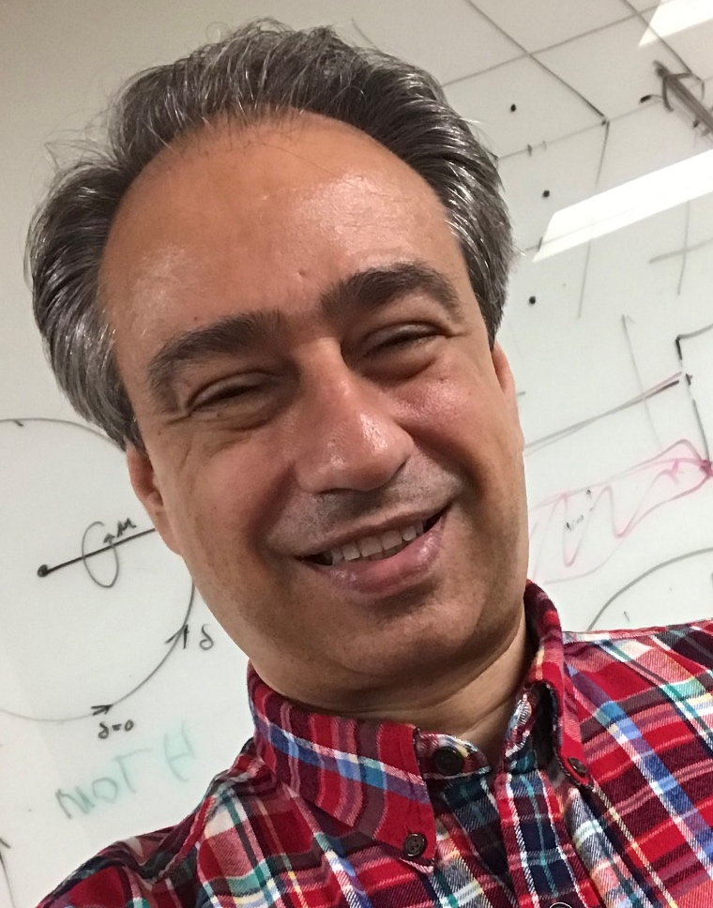

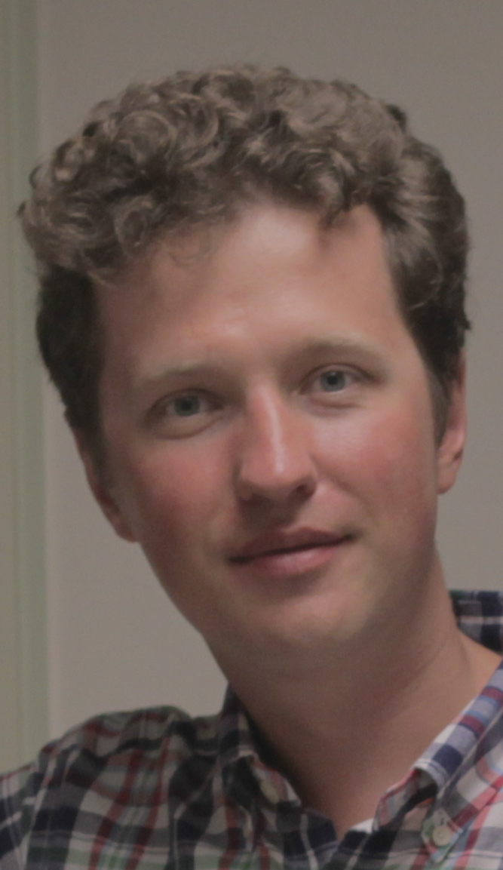
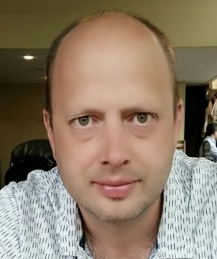

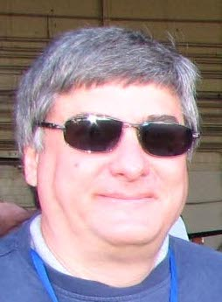
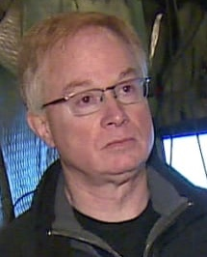

PACE-MAPP team
PI
  Snorre Stamnes
Co-Investigators
  Jacek Chowdhary
  Sharon Burton
  Xu Liu
  Bastiaan van Diedenhoven
  Otto Hasekamp
  Johnathan Hair
  Richard Ferrare
  James Allen
  Ed Chemyakin
Collaborators
  Chris Hostetler
  Yongxiang Hu

Slide 3
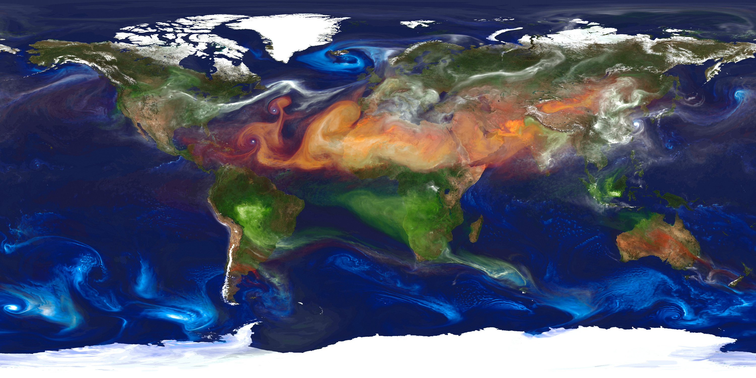

PACE-MAPP Objectives
  Produce accurate aerosol optical and microphysical properties and ocean properties using SPEXone, HARP2, and OCI (SWIR channels).
  Use a coupled atmosphere-ocean vector radiative transfer model
  Use accurate but fast Mie/SS/T-matrix LUTs
PACE-MAPP is a multi-instrument algorithm: SPEXone, HARP2, OCI (SWIR channels)
Aerosol VIS-NIR-SWIR properties: fine mode (absorbing), sea salt, and dust
Bio-optical model including Stratified Spheres (SS)
Collaborate with PACE bio-optics/geochemistry scientists on coastal zones/challenging regions
Thin cirrus correction

Slide 4
PACE-MAPP products
Type of Deliverable | Specify Deliverable | Discipline | Applicable PACE Sensor(s) | Input Data for Deliverable | Citation – prior work
Numerical model | Bio-optical model | Ocean color, atmosphere, ocean | OCI HARP2 SPEXone | Multi-Angle Total Radiance and Polarimetry OCI SWIR | Chowdhary et al., 2006, 2012, 2019.
Numerical Model | Aerosol model | Atmosphere, ocean, land |  |  | Stamnes et al., 2018.
Numerical model | Thin cirrus model | Atmosphere, ocean, land |  |  | Diedenhoven et al., 2012, 2013. Yang et al., 2015.
PACE-MAPP algorithm | Coupled atmosphere-ocean retrieval algorithm for aerosol, thin-cirrus, ocean color ap & bbp spectra | Ocean Color Algorithm, Aerosol Algorithm, Cloud Algorithm, Applications (coastal zones, NPP, AQ, DRE) |  |  | Stamnes et al., 2018. Cairns et al., 1999. Chowdhary et al., 2006, 2012, 2019. Diedenhoven et al., 2012, 2013. Yang et al., 2015.

Slide 5
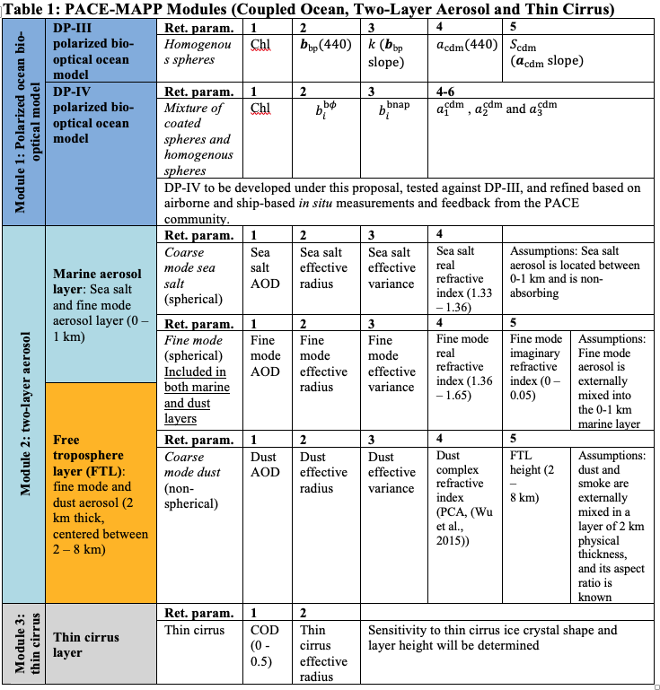
Chowdhary, Liu, Allen, Chemyakin
Emphasize importance of collaboration with PACE bio-optics and bio-geochemistry community
Stamnes, Burton, Chemyakin
van Diedenhoven

Slide 6
PACE-MAPP aerosol/thin cloud products
Aerosol optical and microphysical properties
  Fine mode AOD (aerosol optical depth), SSA (single-scattering albedo, quantifies absorption), real refractive index, effective radius (size), and effective variance (size distribution width).
  Seasalt AOD, effective radius and effective variance (CRI assumed).
  Dust AOD, effective radius and effective variance (CRI modeled according to Hasekamp/SRON model, with updates from Chowdhary, Schuster and Moosmüller).
Thin cirrus optical and microphysical properties
  Thin cirrus optical depth (< 1.0) and effective radius.
  Sensitivity to shape and height will be assessed.

Slide 7
PACE-MAPP ocean products
Bio-optical model:
  Principal Components Analysis (PCA) used to parameterize bbp, ap, acdm spectra.
  A mixture of homogeneous and stratified spheres (SS) will be used (Organelli et al., 2018; Allen et al. 2020 (in prep)).
  SS may improve retrieval of particulate size and number concentrations.
Water-leaving radiance product
  PACE polarimeter-retrieved aerosol microphysical properties will improve water-leaving radiances.
  Coupled atmosphere-ocean vector radiative transfer + optimal estimation will enable uncertainty estimates.
IOCCG 2006+, Chowdhary et al., 2019
IOCCG 2006+++, Susanne Craig et al., 2020 (https://doi.pangaea.de/10.1594/PANGAEA.915747)

Slide 8
PACE-MAPP performance metrics
Uncertainties/error budget computed via optimal estimation theory
  Rodgers (2000), Liu et al. (2009), Stamnes et al. (2018).
  Improve uncertainty estimates by treating measurement noise for a given instrument as correlated via a Markov process (Knobelspiesse et al., 2012).
Performance of aerosol and ocean retrieval parameters will be assessed using synthetic data for our aerosol + bio-optical model for the PACE observing system (SPEXone + HARP2 + OCI SWIR channels).
Simulated data is a necessary but insufficient first step, e.g. for testing sensitivity of PACE measurements to thin cirrus OD, effective radius and shape.
Real data will be used to test the real-world performance of the aerosol and bio-optical models using PACE analog data (i.e. from RSP airborne polarimeter):
  Comparison against in-situ ap and bbp data from SABOR and NAAMES field campaigns.
  Comparison against HSRL (lidar) AOD and in-water bbp and Kd.

Slide 9
PACE-MAPP data requirements
NAAMES, SABOR, ACEPOL, ACTIVATE
  RSP (polarimeter)
  HSRL-1, HSRL-2 (lidar)
  AirSPEX, AirHARP (ACEPOL)
  AERONET comparisons
IOCCG 2006+/+++ datasets
  Chowdhary et al., 2019
  Susanne Craig et al., 2020 (https://doi.pangaea.de/10.1594/PANGAEA.915747)
  In-situ ap and simulated bbp spectra, UV-VIS-NIR; includes some limited bbp data from NOMAD.
  Work with PACE SAT/OBPG to extend this dataset if needed with in-situ bbp spectra and/or LISST data.

Slide 10
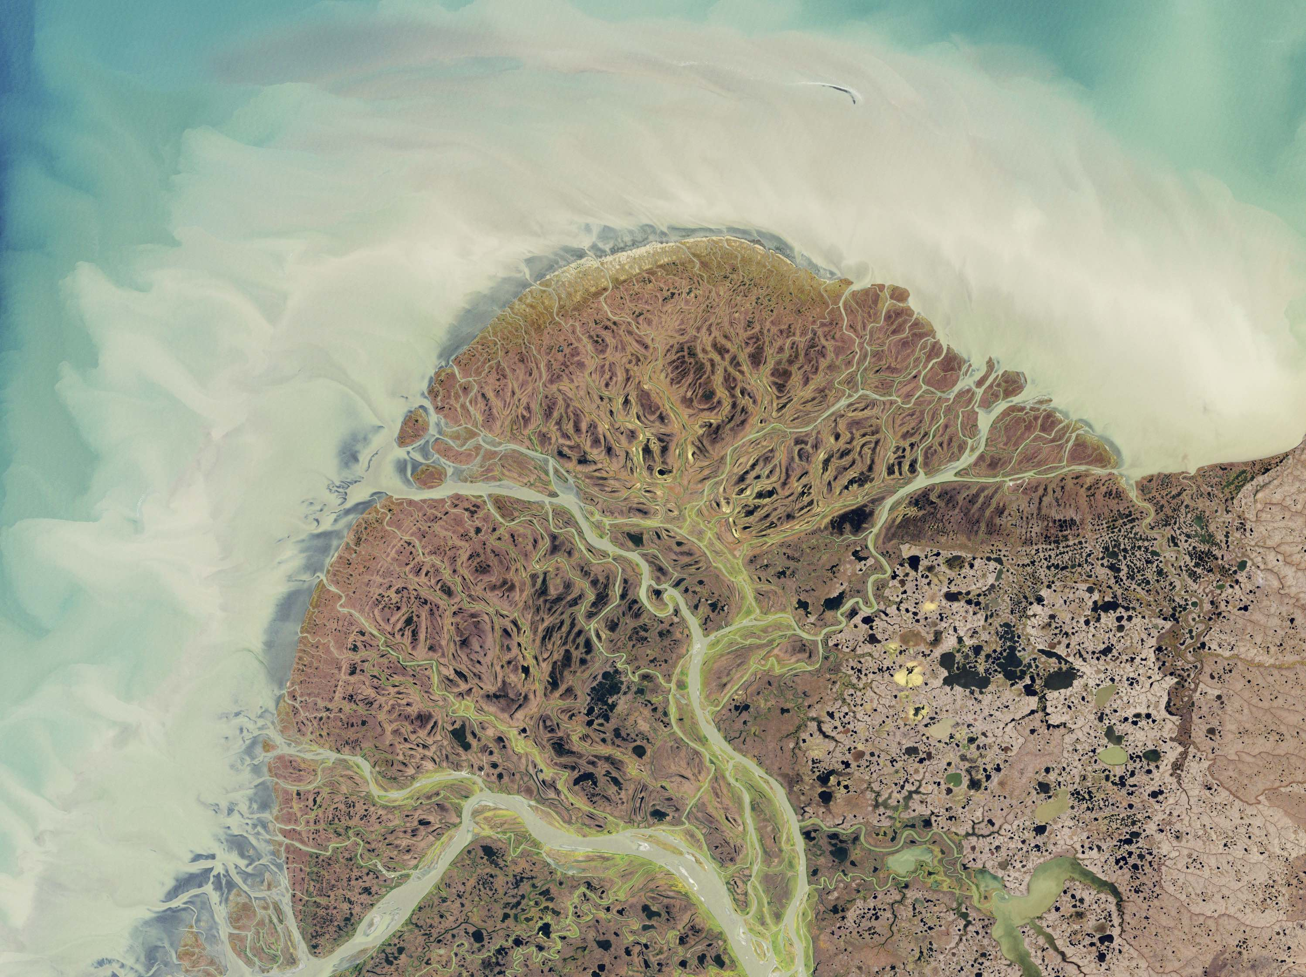
PACE-MAPP software requirements
PACE-MAPP Bio-optical, Aerosol and Thin-cirrus “Modules” will cover 355 - 2300 nm, which makes it applicable to:
  SPEXone (PACE)
  HARP2 (PACE)
  OCI SWIR (PACE)
  RSP (airborne polarimeter, PACE-like data)
  HSRL-1 and HSRL-2 (airborne ocean lidars for validation)
PACE-MAPP initial design:
  Operationally target nadir-track (collocated OCI, SPEXone, and HARP2 data), and/or
  specific challenging or important regions (coastal zones: Chesapeake Bay and along the North Slope of Alaska; dust and smoke in the ORACLES region, etc.) using the greater SPEXone swath.
  Can be used as a tool to test other PACE operational algorithms.
  Modular design allows for parts of it to be adopted (e.g. bio-optical model, aerosol model, thin cirrus model).
  Requesting from PACE/OBPG a dedicated resource of 1,000 cores (<$50k in 2022?).

Slide 11
Collaboration opportunities
Extension to UV (Jacek Chowdhary, Susanne Craig)
  UV wavelengths will not be a focus by PACE-MAPP due to aerosol/ocean complexities that need to be carefully studied:
    Aerosol model (BrC vs BC).
    Bio-optical model: CDOM, pigmented algal particles (IOCCG 2006+ dataset).
Dust aerosol model (Chowdhary)
  Dust aerosol model will be improved by working together with Chowdhary, Schuster and Moosmüller.
PACE Applications/Early Adopters
  NOAA/CIRES/GSFC JEDI (hybrid ensemble-variational framework) assimilation of PACE aerosol products (Mariusz Pagowski, da Silva, Kleist).
    Improve climate, weather and AQ forecasts.
  Chesapeake Bay and surrounding area: PACE coastal products can improve water quality forecasts.
    Jessica Turner, Friedrichs, Friedrichs (Kd, TSS, particle size, water clarity).
    Mike Ondrusek, Kovach (TSM and Chl concentrations, bbp and Kd).
    Stephanie Schollaert Uz et al. (Rrs, Kd, absorption of phytoplankton and NAP, water clarity, HAB and other water quality parameters).

Slide 12
Thank you
Questions, comments, suggestions and potential collaboration opportunities
  Email: snorre.a.stamnes@nasa.gov

