Slide 1

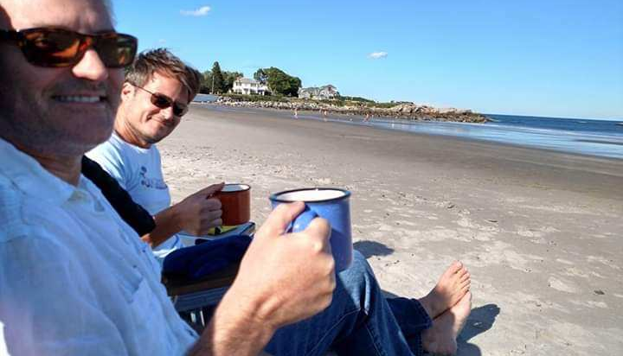

A semi-analytical ocean color model and inversion algorithm for PACE
PI: Mike Twardowski
Co-I: Tim Moore
Key Collaborators
Alberto Tonizzo (Consultant)
Srinivas Kolluru (future postdoc…)
International Collaborators
Kevin Ruddick (RBINS, Belgium)
Vittorio Brando (CNR, Italy)
John Hedley (Numerical Optics, UK)

Slide 2
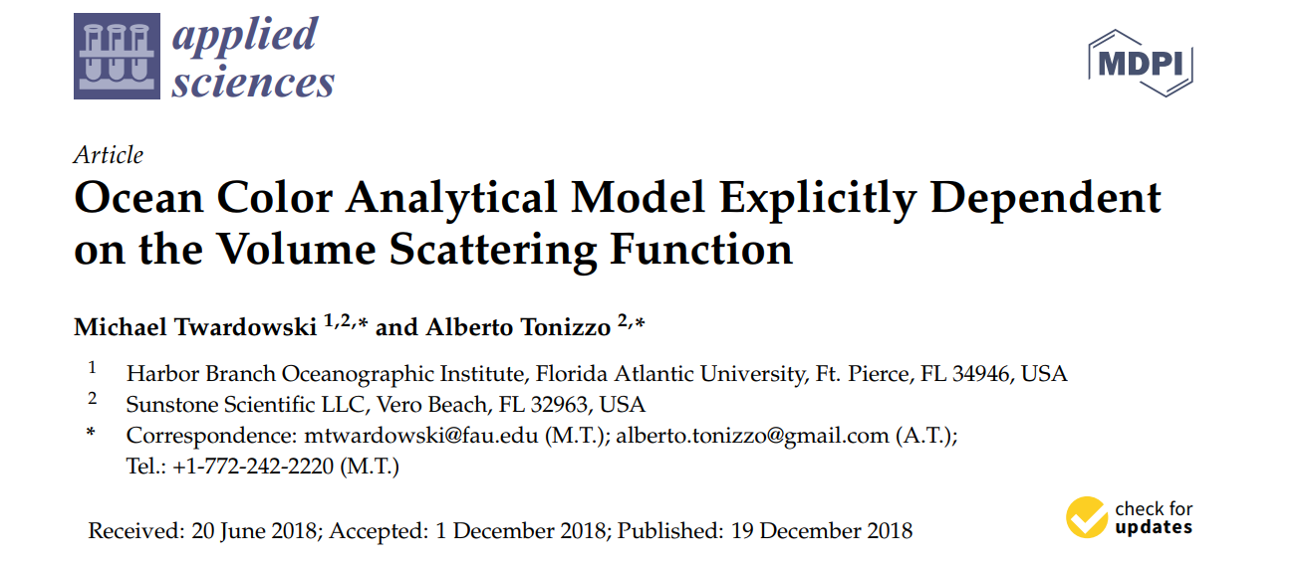
Overall Project Objective
Provide validated inversion algorithms for PACE based on the natively hyperspectral semi-analytical
ZTT (Zaneveld-Twardowski-Tonizzo) model
Applied Sciences, special issue on Ocean Optics, 8, 2684
Notes:
Explicitly includes in-water BRDF and volume scattering function (VSF) dependency

Slide 3
Minimum expected products for PACE
BRDF algorithm for any spectral range, resolution
Phytoplankton absorption spectra
Dissolved and detrital absorption spectra
Backscattering spectra
Backscattering ratio
Chlorophyll

Slide 4



ZTT (Zaneveld-Twardowski-Tonizzo) model
water Raman contribution
(Westberry et al. 2013)
$$r_{rs}\left(θ_{s},θ_{v},φ,V,a,b_{b},β\right)$$
$$≅ r_{rs,Raman}\left(θ_{s}′,a,b_{b}\right)$$
$$+\frac{1}{\left.{\overline{μ}}_{d}(θ_{s}^{′},V,\frac{b_{b}}{a}\right)}\frac{β\left(ψ\right)}{b_{b}}{\left[\frac{a}{b_{b}}\left(1−\cos\left(θ_{v}\right){{Ψ_{K_{Lu}}(ψ)\overline{μ}}_{∞}(\frac{b_{b}}{a})}^{−1}\right)+f_{L}(ψ,λ)\left(1−{{\tilde{b}}_{b}}^{−1}\right)+{{\tilde{b}}_{b}}^{−1}\right]}^{−1}$$
shape function for upwelling component of path radiance
backscattering ratio
b_{b}/b
average cosine of downwelling light field
( ${E_{d}}/{E_{od}})$
absorption
over backscattering
coefficients related to diffuse attenuation of radiance in viewing direction
phase function in backward direction
(Twardowski and Tonizzo 2017)

Slide 5

Key aspects of ZTT model
Close approximation of RTE
Additional terms relative to simple approximations of
$r_{rs} ∝$ b_{b}/a
  Additional degrees of freedom for a more accurate solution
Unknowns are a, b_{b}, β_{p}(ψ)/b_{bp} , and ${\tilde{b}}_{bp}$
  Strong performance when setting β_{p}(ψ)/b_{bp} and ${\tilde{b}}_{bp}$ as constants
  Water contribution independently considered in IOPs
Applicable to any spectral range, resolution
Readily amenable to inversion

Slide 6
Project Objectives
Develop BRDF correction algorithm from ZTT
Additional validation assessments of the ZTT model, including comparisons with full hemispherical upwelling L_{u}(θ_{s},θ_{v},φ)
Develop ZTT inversion approach to solve for spectral absorption and backscattering and subcomponents, i.e., aph, adg, etc
  Assemble and vet enhanced hyperspectral libraries of IOP subcomponents, primarily aph
  Pursue improved computational approach for inversion
  Assess ZTT inversion performance and quantify uncertainties for IOP products with high quality data sets
  Assess ZTT inversion performance with PACE simulated data sets, including both OCI and polarimetry data as inputs
Pursue polarized version of ZTT model
Transition algorithms for operational implementation for PACE

Slide 7
Assessment of BRDF conversion with ZTT
135/45 degree plane
526 nm
21 stations from:
Ligurian Sea 2009
Ligurian Sea 2008
Monterey Bay 2006
BIOSOPE (So. Pacific Gyre) 2004
Tonizzo et al., in prep

Slide 8
Assessment of ZTT inversion (multi-spectral)
SABOR 2015
b_{bt}/a_{t}
b_{bp}
a_{t}
ZTT inversion
a_{ph} model
MAPE
B95
GSM
C02
GIOP
wavelength (nm)
wavelength (nm)
wavelength (nm)
b_{bp}/b_{p} constant at 0.006
β_{p}(ψ)/b_{bp} constant after Sullivan&Twardowski (2009)
ZTT inversion has not been optimized yet
Other data sets we are working with:
BIOSOPE (So. Pacific gyre) 2004
Tonizzo et al. closure data set (SORTIE+OCVAL)
NOMAD
VIIRS cal/val 2019
Synthetic data sets
Closure analyses needed on all data sets in order to parse errors associated with inversion from errors inherent to data set
Moore et al., in prep

Slide 9
Summary Comments
Looking forward to working with PACE SAT subgroups covering inversion testing, polarimetry, phytoplankton composition, and data set consolidation
Looking forward to working with NASA OBPG on implementation
Looking forward to in-person discussions, hopefully in the not too distant future!
Thank you!
mtwardowski.@fau.edu
mooret.@fau.edu

