Slide 1

Remote sensing of cloud properties using
PACE SPEXone and HARP-2
PI: Bastiaan van Diedenhoven

Slide 2
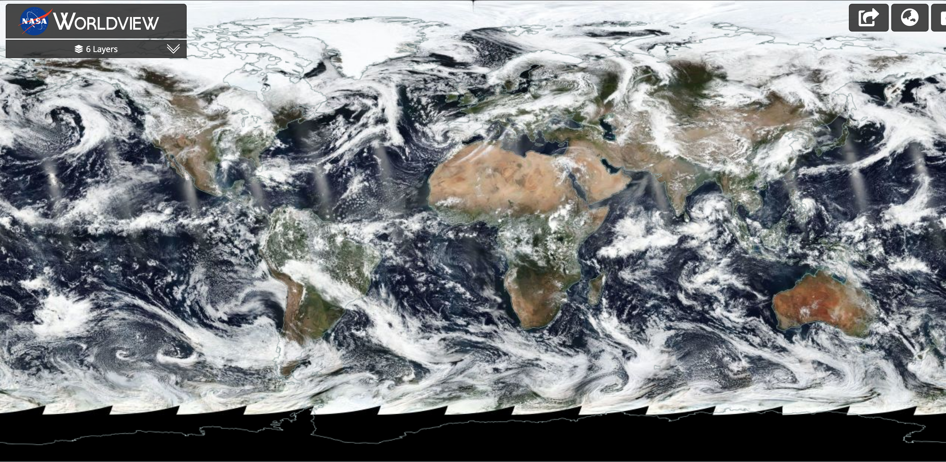

Slide 3
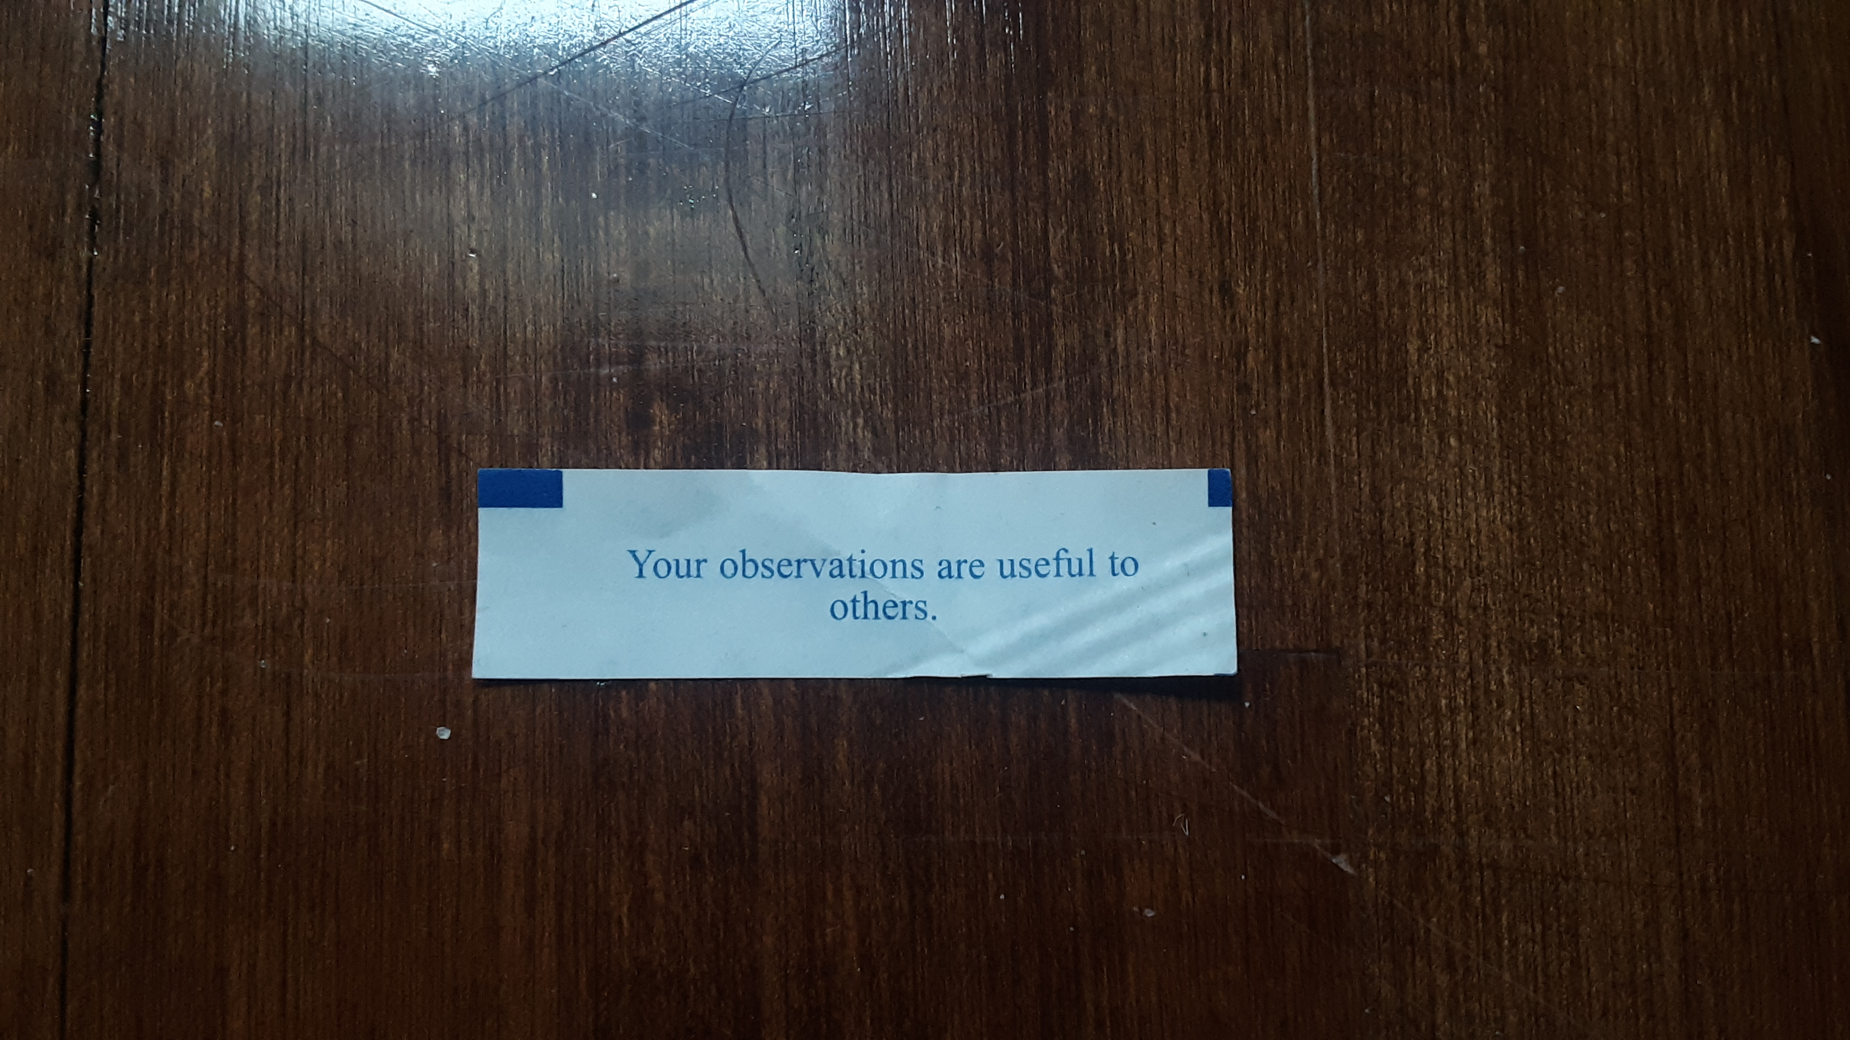

Slide 4
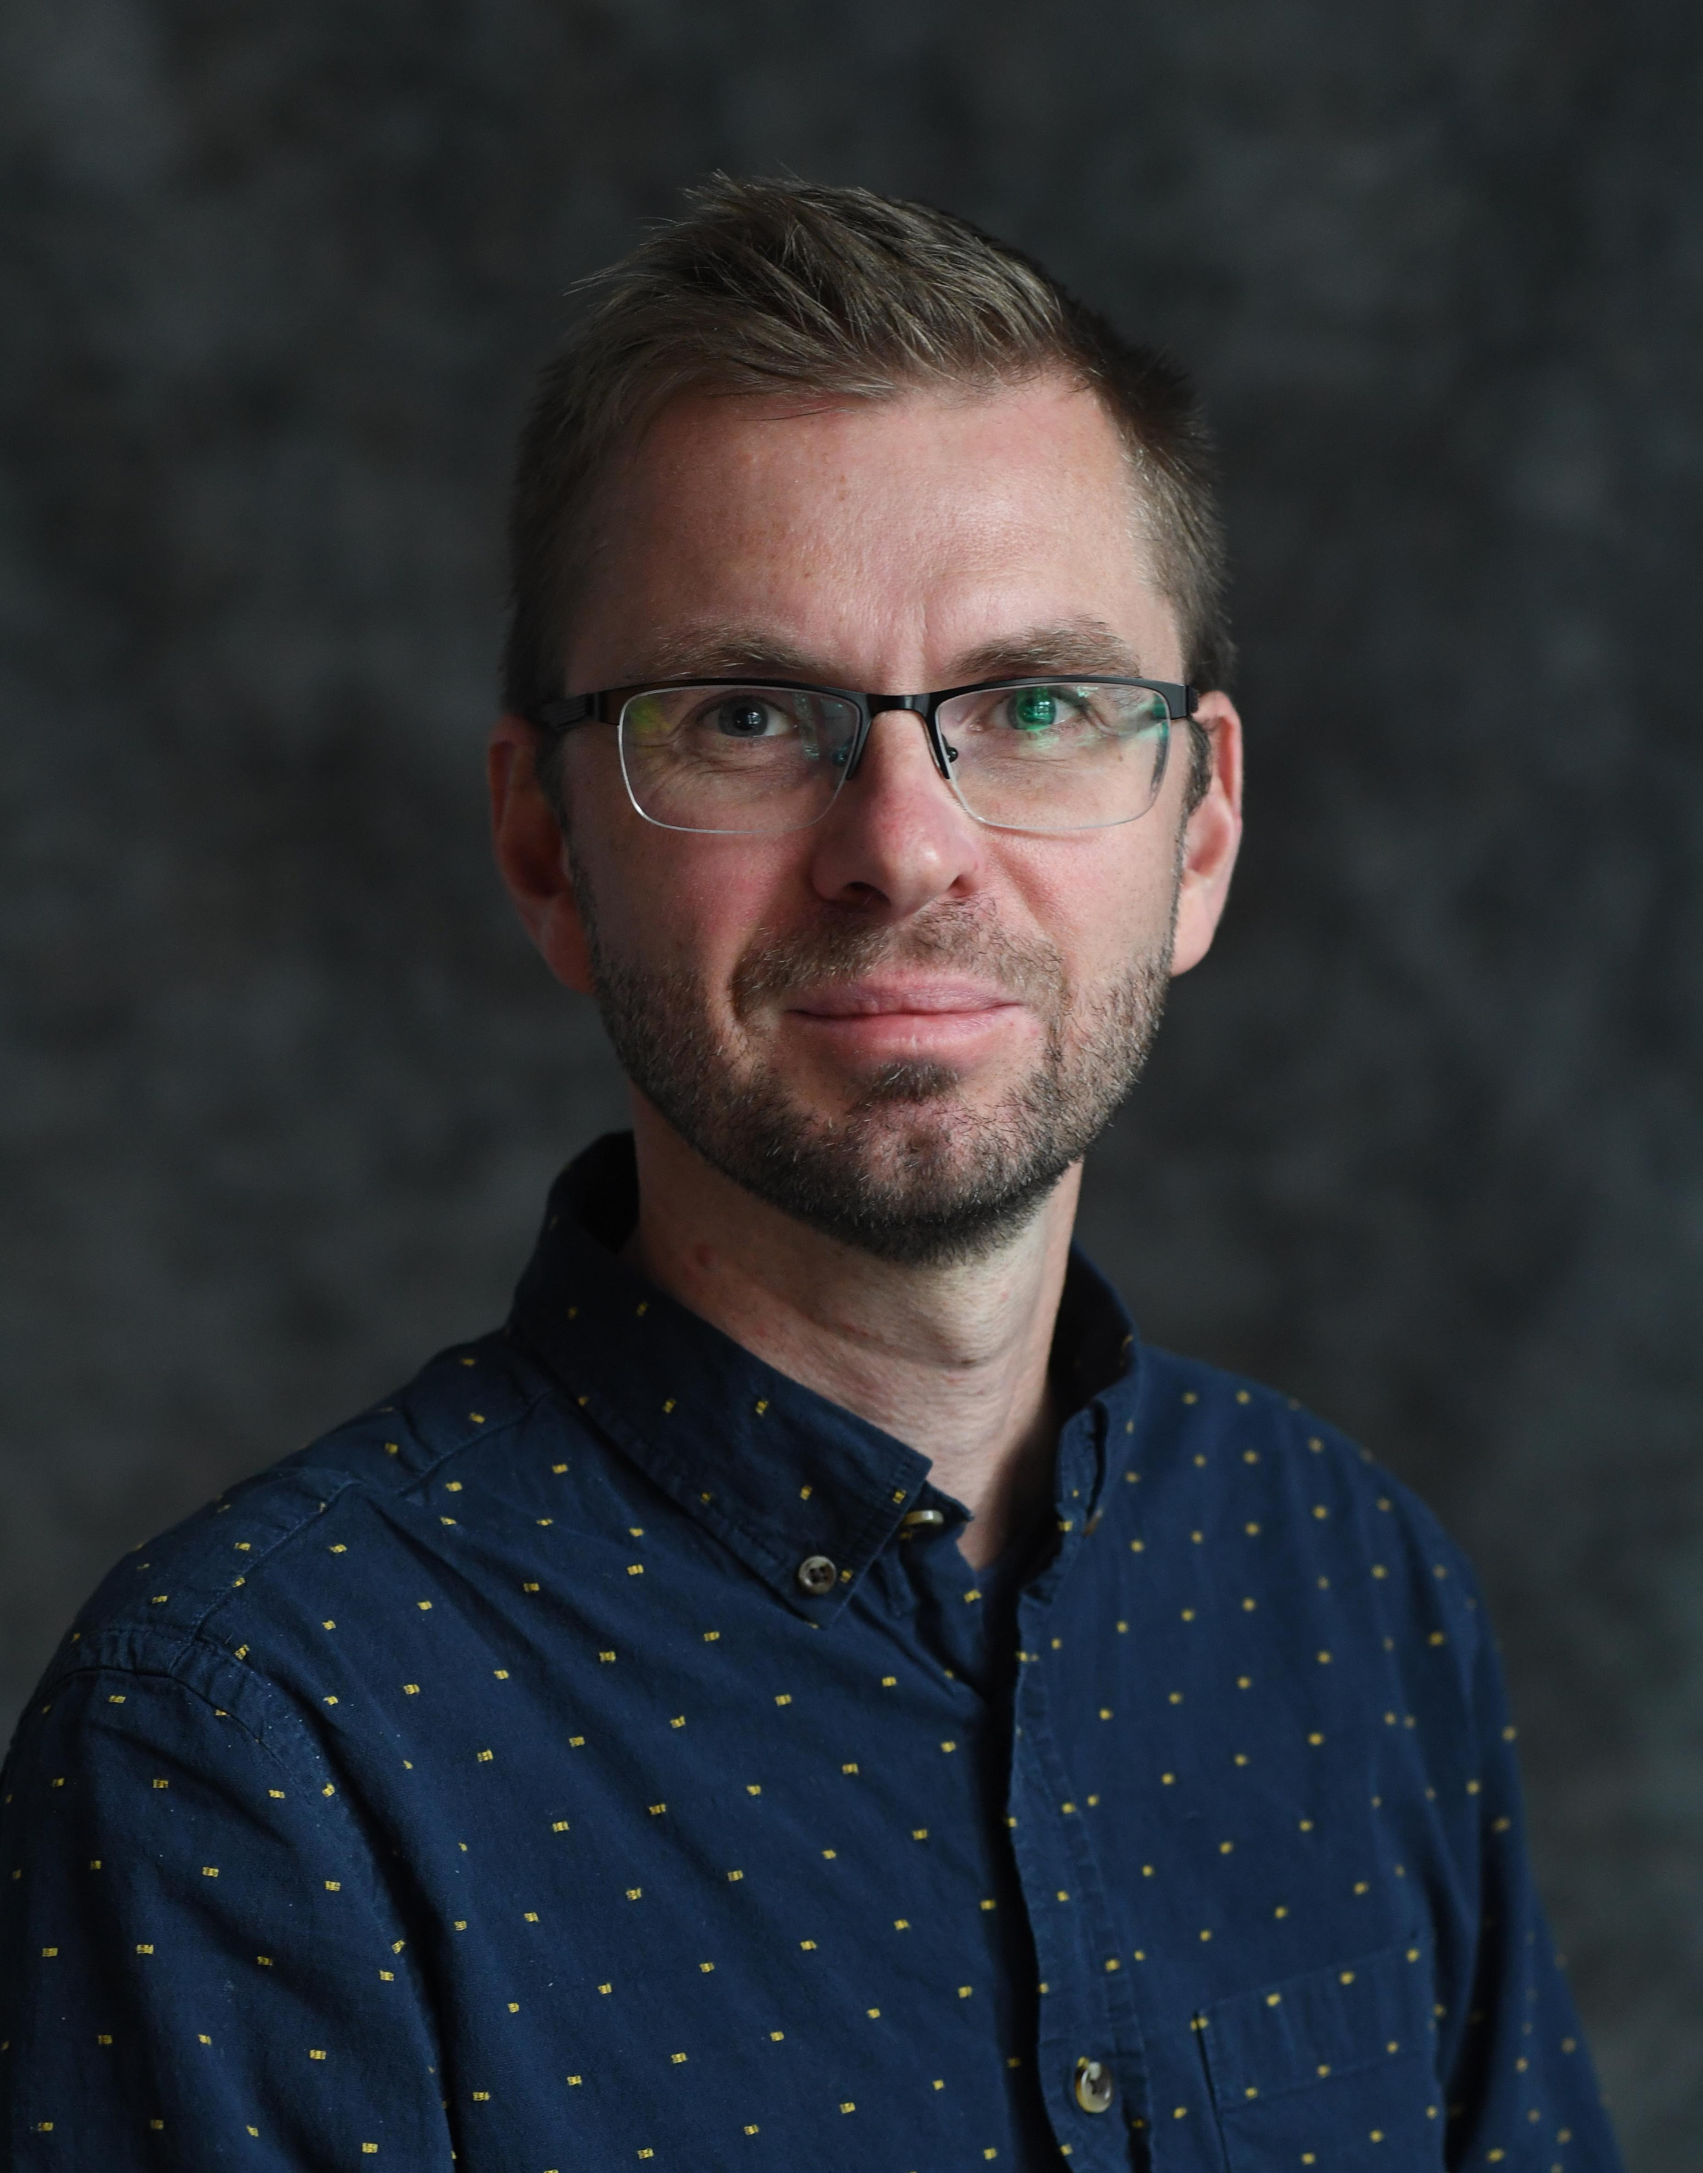
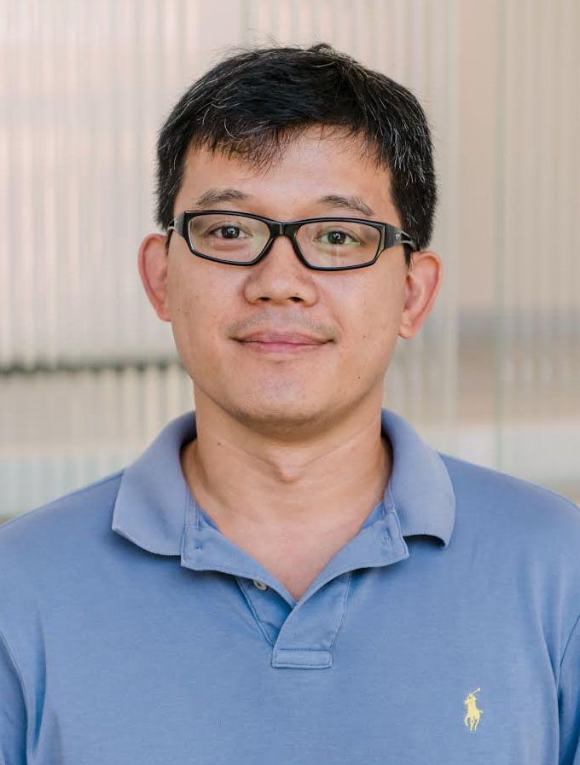


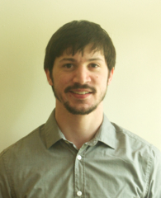

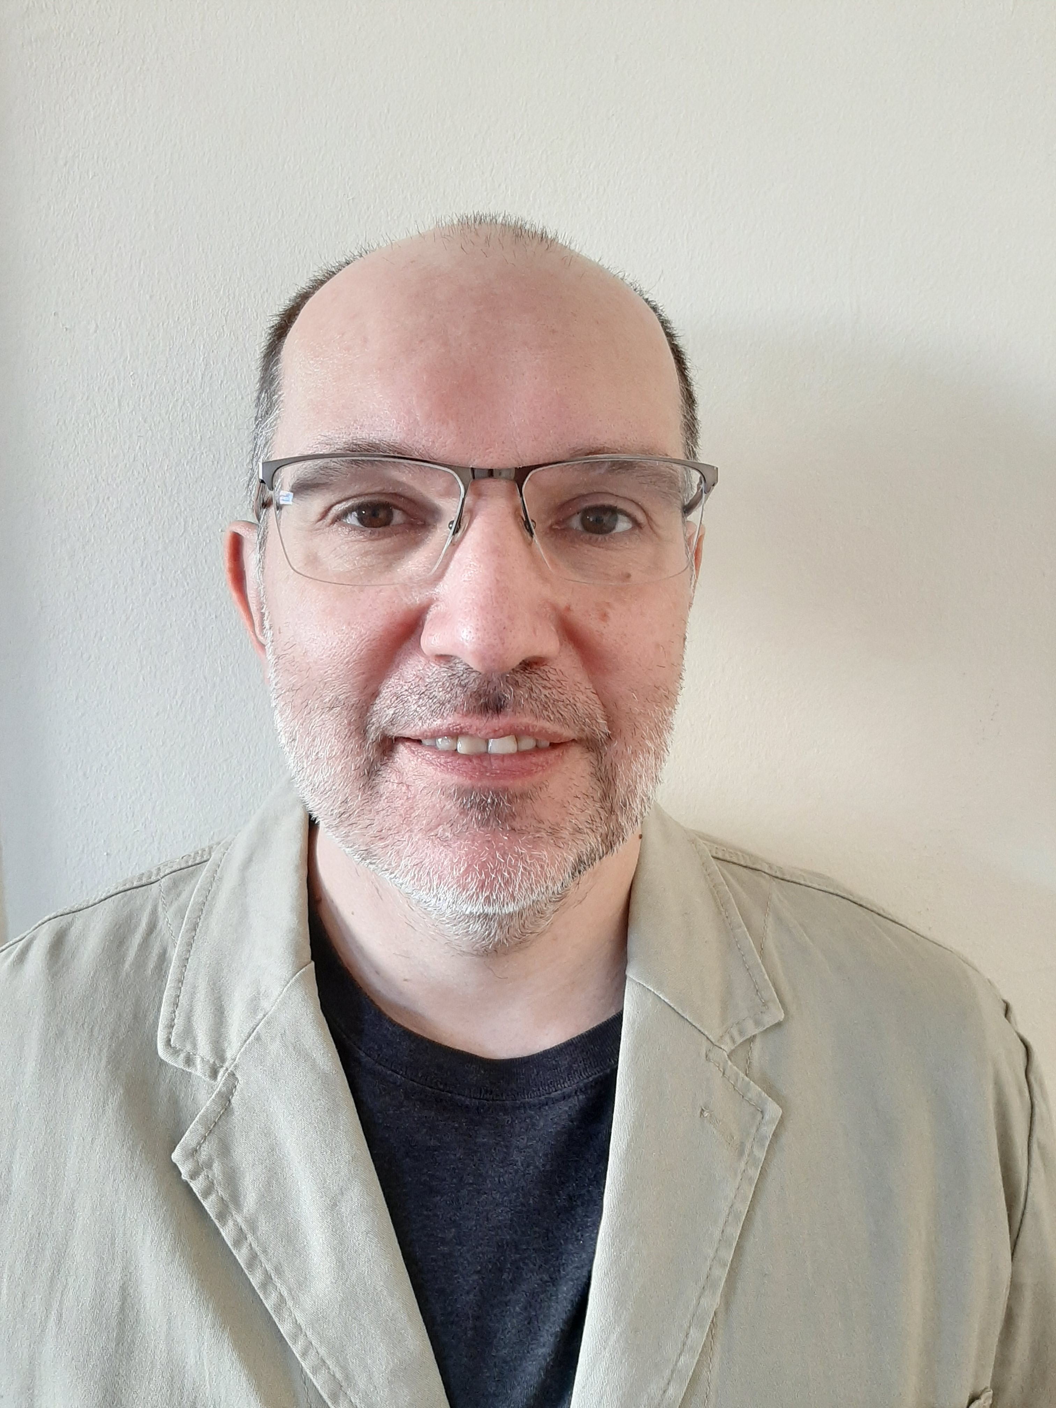
Zhibo Zhang: co-I, UMBC PI
Management, simulated measurements
Bastiaan van Diedenhoven: PI
Management, liquid & ice clouds, cloud phase, cloud thickness & fraction
Mikhail Alexandrov: co-I
Liquid droplet size distribution, cloud fraction
Dan Miller: co-I
Simulated measurements & retrieval evaluation
Collaborators:
Otto Hasekamp
Vanderlei Martins
Steve Platnick
Kerry Meyer
Igor Geogdzhayev: co-I
Programming assistance

Slide 5
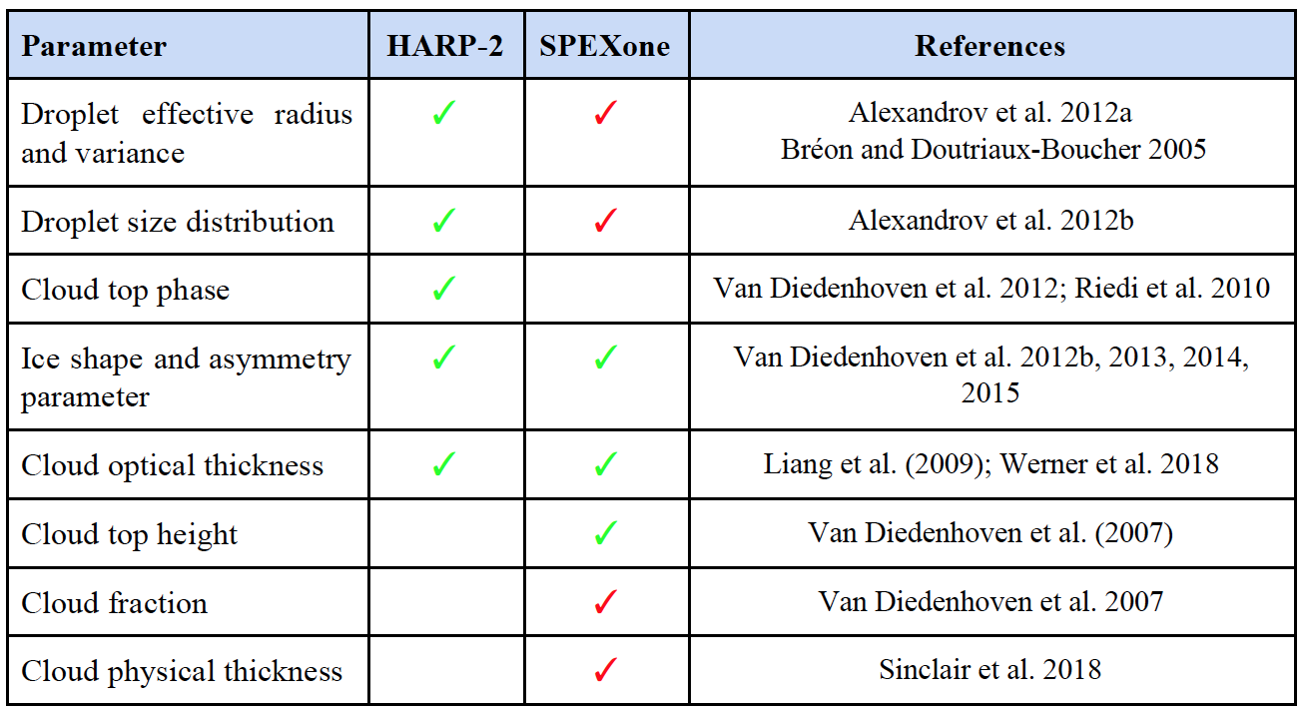
√: readily implementable (strong heritage from POLDER & RSP)
√: experimental/needs evaluation
, 2020
2019

Slide 6
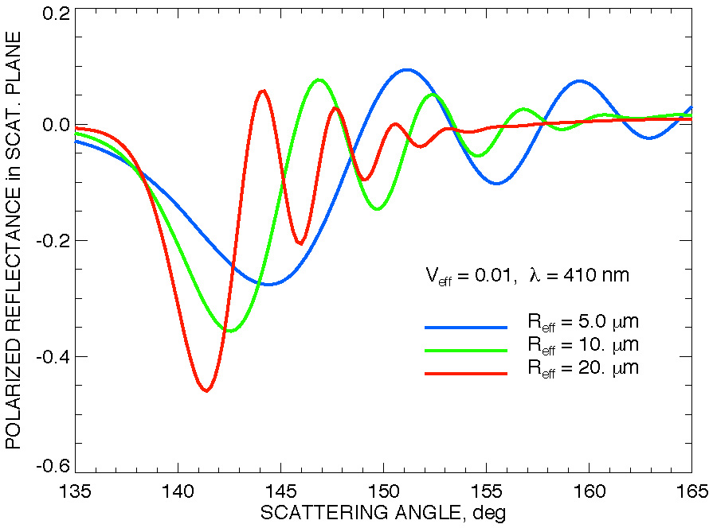
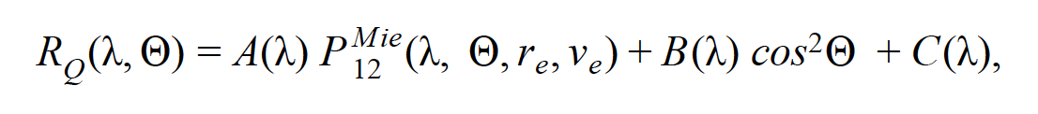
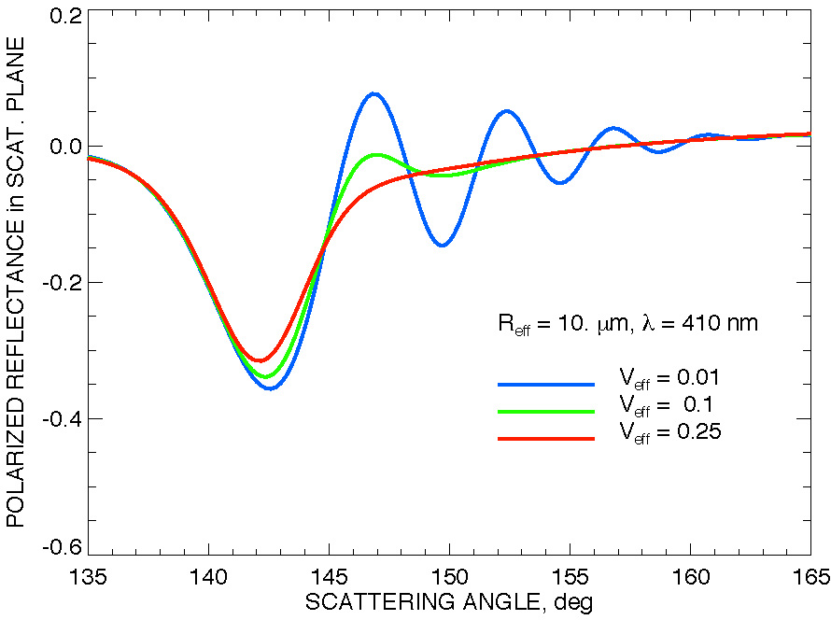
HARP-2 Droplet size distribution
Varying effective radius
Cloud top droplet size distribution (effective radius & variance) inferred from polarized reflectances
Very simple and robust retrieval based on P₁₂ elements from Mie calculations (no radiative transfer!)
Insensitive to 3D RT, inhomogeneity
Algorithms available for RSP, airHARP, POLDER
At single wavelength, needs ~2˚ angular resolution (HARP @ 670 nm pixel-level)
Varying effective variance

Slide 7
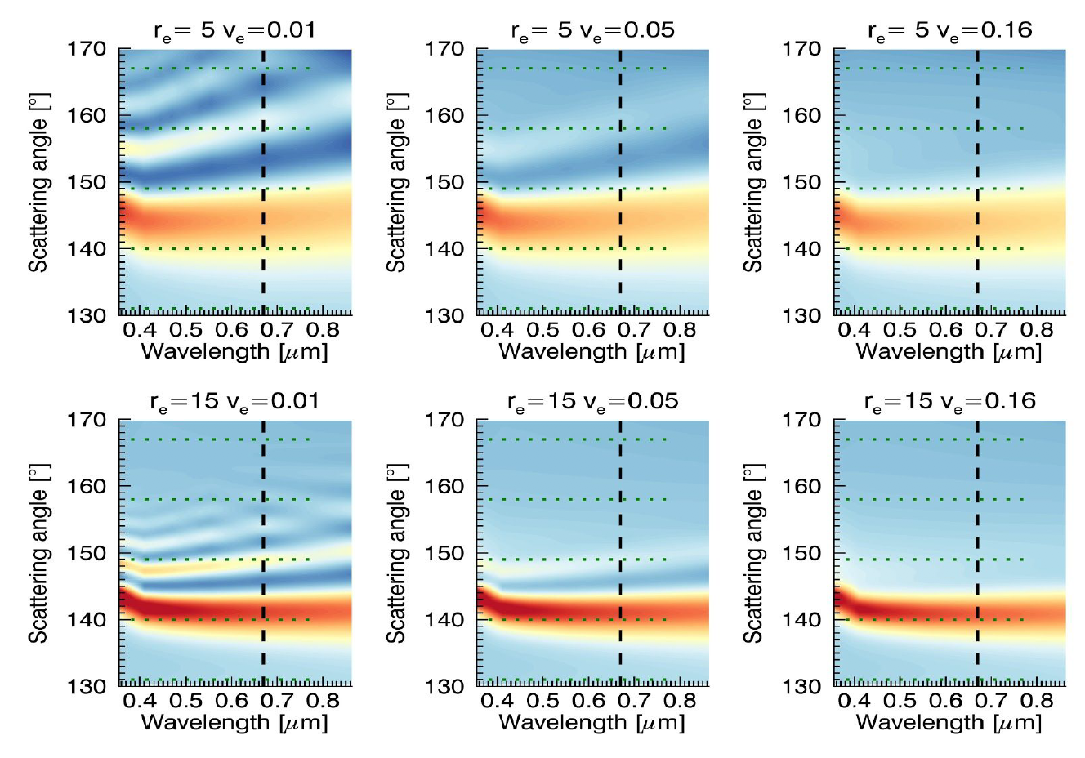
SPEXone Droplet size distribution
Explore compensating limited angular sampling by spectral sampling
Example
sampling by SPEXone
Sampling by HARP

Slide 8
Non-parametric droplet size distribution
Sinclair et al., in preparation
Increasing rain water path
Measured cloudbow is convolution of cloudbows from different drop sizes
“Rainbow Fourier Transform”: mathematical de-convolution of observed cloudbow structure
Applied to pixel-level HARP-2 data (and maybe SPEXone)
(Alexandrov et al., JQSRT 2012)
Figure show RSP retrieved droplet size distributions, where large mode increases as radar retrieved rain water path increases

Slide 9
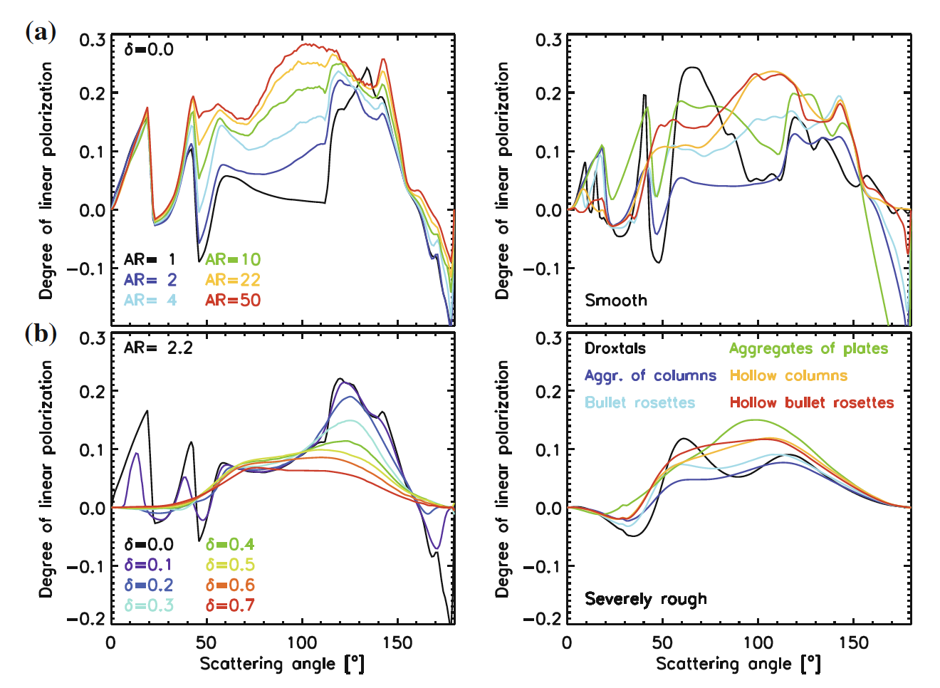
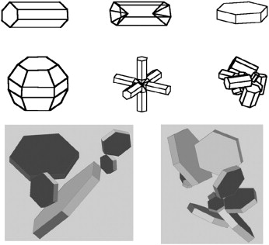
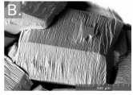
Ice clouds
Ice crystals large > geometric optics approximations > phase matrix size invariant
Ice crystal shape inferred from polarized reflectance
  General shape (top)
  Roughness or distortion (bottom)
Too many degrees of freedom!

Slide 10
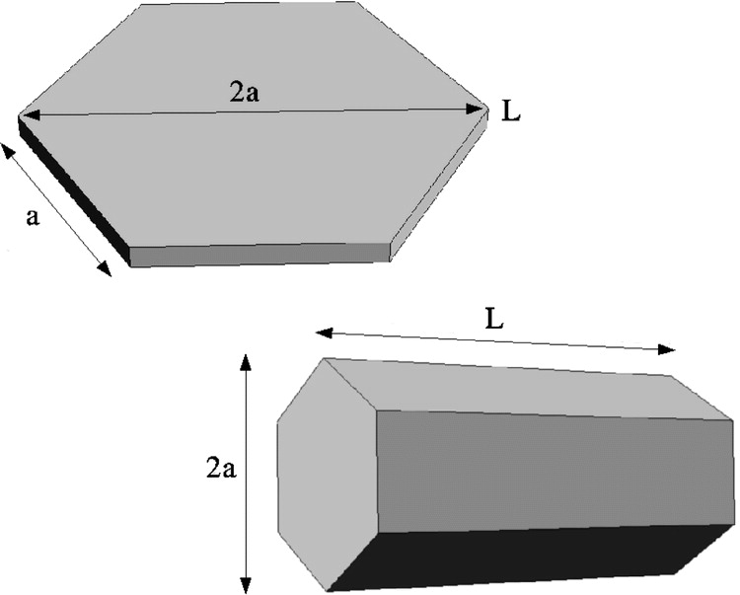
Ice clouds
van Diedenhoven et al., AMT, 2012
Ice crystals large > geometric optics approximations > phase matrix size invariant
Ice crystal shape inferred from polarized reflectance
  Aspect ratio (top)
  Roughness or distortion (bottom)
Reduced degrees of freedom!

Slide 11
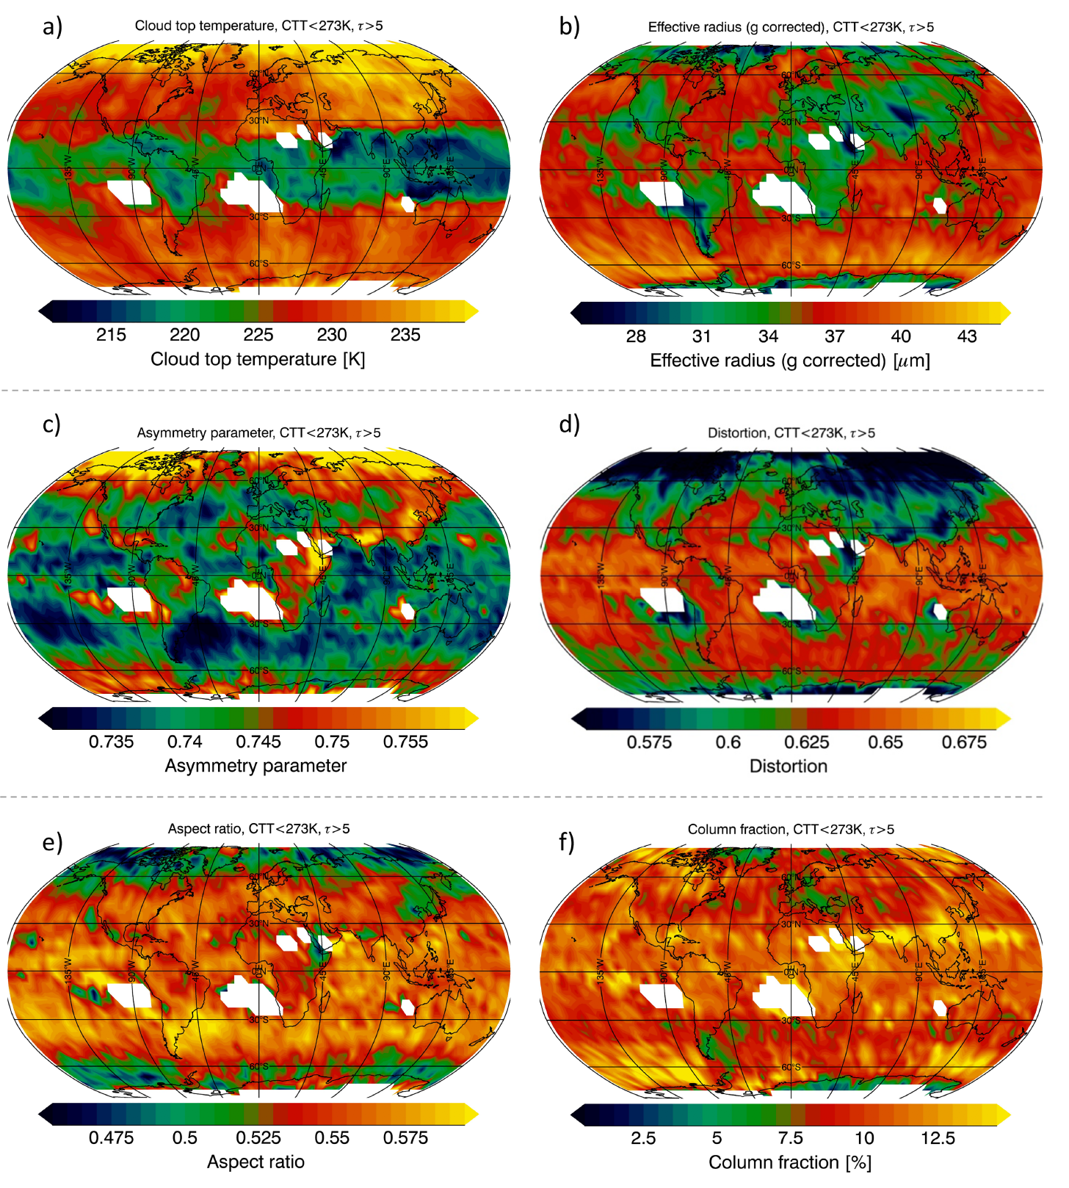
Ice clouds
Algorithm applied to RSP and POLDER available
Explore using similar approach as for liquid clouds (only using P₁₂)
Ice crystals shape constraints scattering properties > crucial for ice cloud optical thickness and effective radius from OCI
van Diedenhoven et al., JGR, 2020

Slide 12
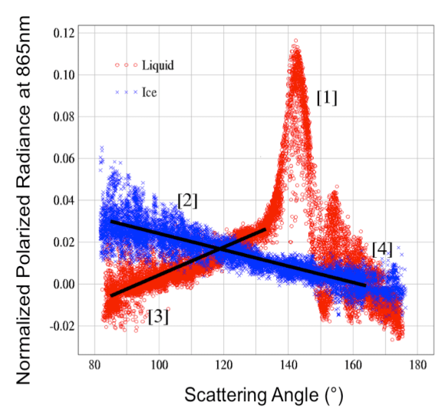
Cloud top phase
Parol et al.
Liquid
If cloudbow detected > liquid in cloud top!
“Liquid index” quantifying deviation of observed polarized reflectances 125˚-155˚ from straight line (van Diedenhoven, JAS, 2012)
Ice

Slide 13
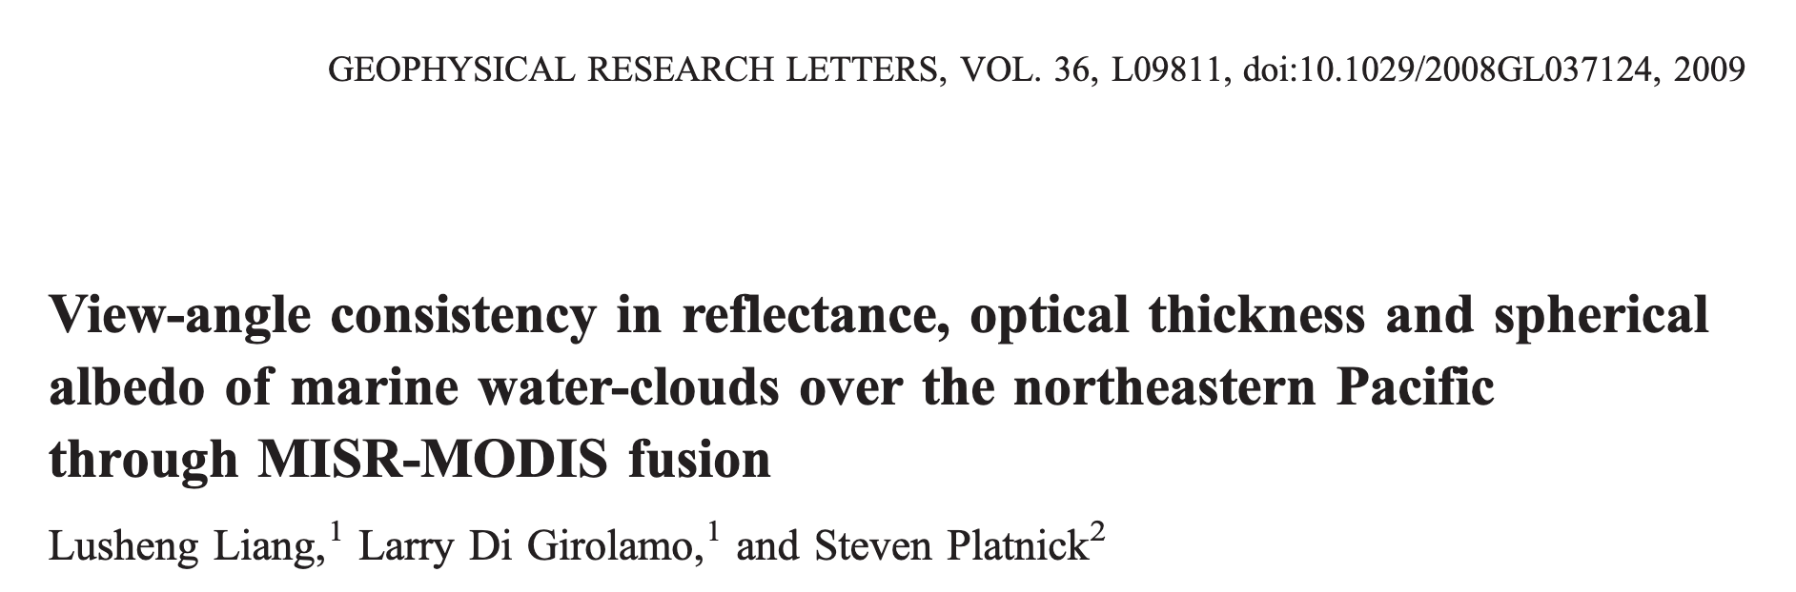
Multi-angle optical thickness
Optical thickness retrievals retrieved independently from each HARP-2 and SPEXone viewing angle
Variation contains information on cloud inhomogeneity (Liang et al. 2009)
Aim for algorithm consistency with OCI retrievals

Slide 14
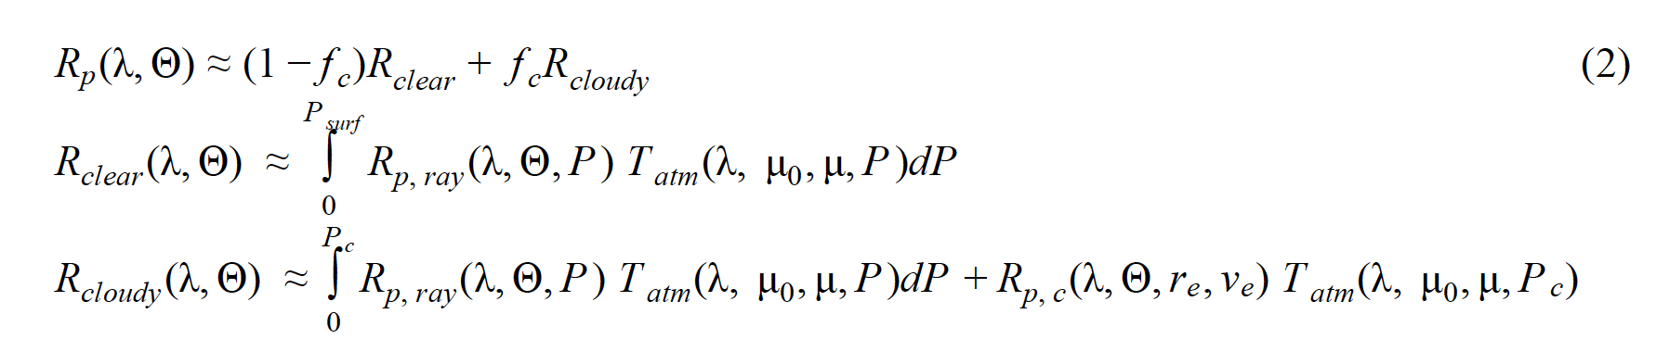
SPEXone cloud top pressure and cloud fraction
Based on simple polarized radiative transfer in
  O₂ A band
  UV (Rayleigh scattering)
Different terms in equations below are constrained or negligible in O₂ band and UV regions, leaving cloud fraction f_{c} and cloud top pressure P as only unknows
cf. van Diedenhoven et al., JGR, 2007

Slide 15

SPEXone cloud physical thickness
Total light path
Polarized light path
O₂ A band absorption for fully cloud-covered pixels:
  Polarized light does not penetrate clouds > sensitive to cloud top
  Total light penetrates cloud > sensitive to cloud top and thickness
Needs polarized reflectances on high spectral resolution, which may be possible from SPEXone (van Harten et al. 2014)
cf. Sinclair et al., RSE, 2019

Slide 16
Evaluation: Simulated measurements
Evaluation: Available data
Aim for flexible algorithm that can also be applied to RSP, airHARP, SPEXairborne, POLDER, CubesatHARP, 3MI, future A&CCP polarimeters
Simulations based on available large-eddy simulations (LES) of various cloudy scenes with domains on the order of 10-100 km.
1D (Doubling-Adding) and 3D (MSCART) vector radiative transfer
Investigate:
  Errors from collocating multiple views to surface instead of cloud top
  Inhomogeneity within polarimeters’ FOV
  Multi-angle cloud optical thickness
  Cloud top height, thickness and fraction retrievals (3D VRT in O₂ A band and UV)

Slide 17
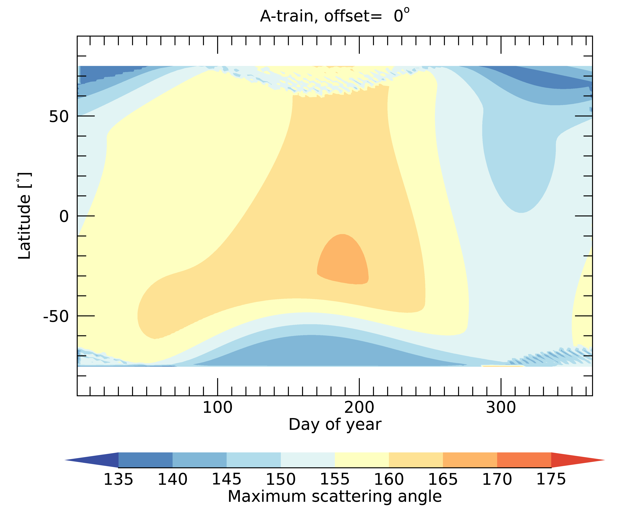
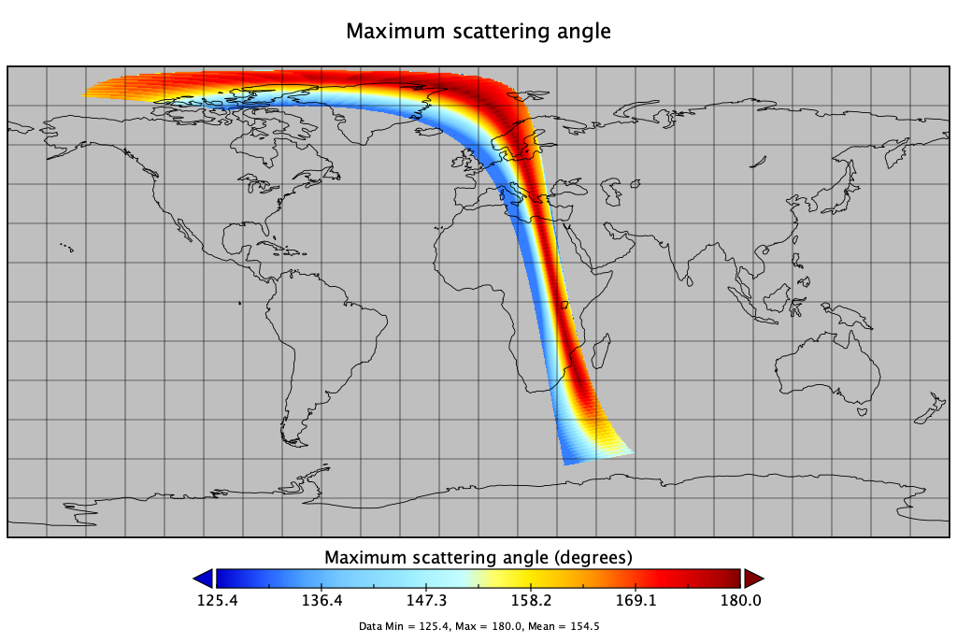
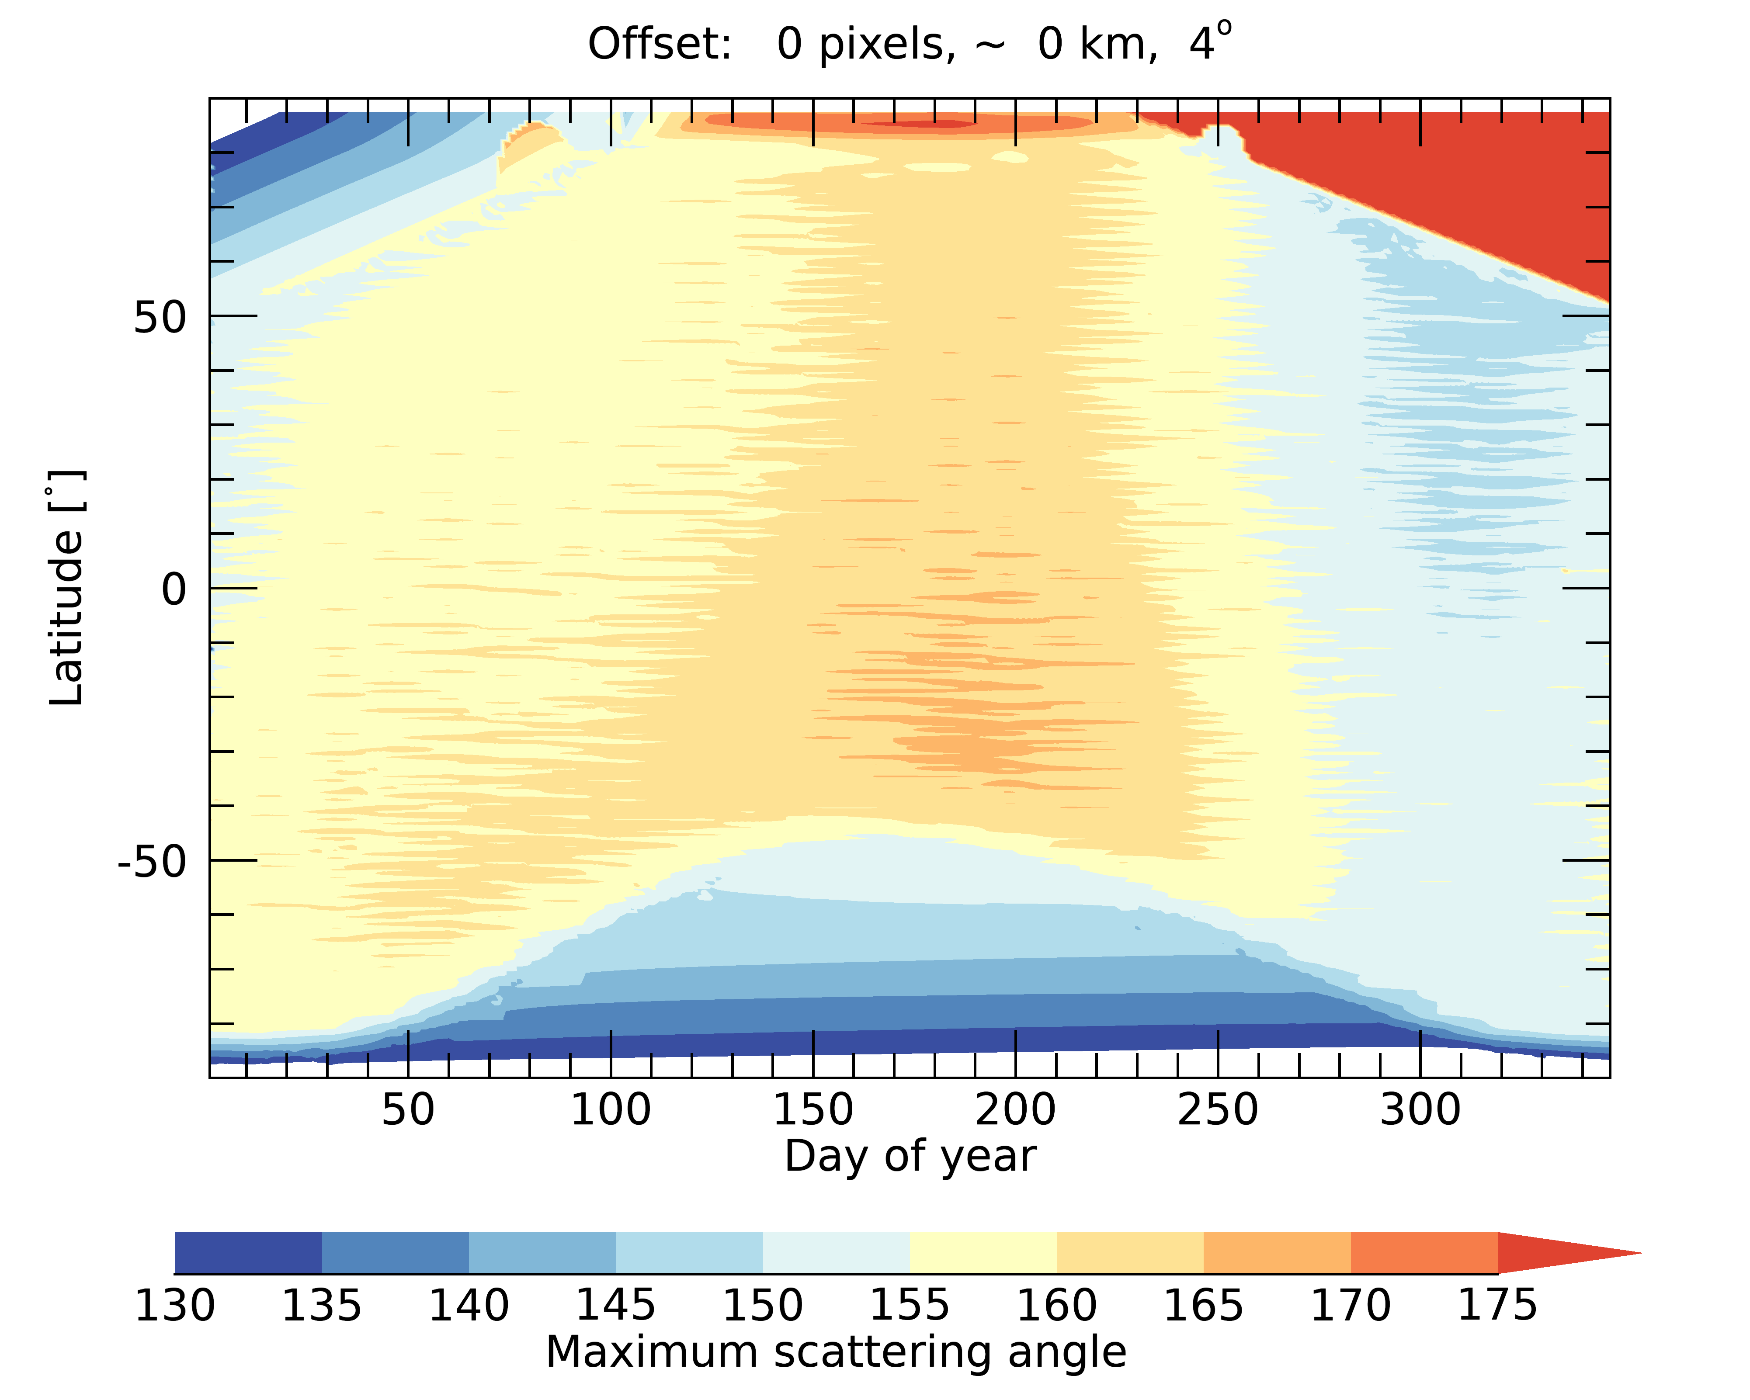
Scattering angle range sampling
Maximum scattering angle simulations
Availability of products depends on sampled scattering angle range
Model scattering angle ranges to map expected product availability
Much work already done related to A&CCP
For middle of swath
Maximum scattering angle from POLDER obs.
May not be needed if already calculated by PACE project
artifact
Generally sufficient scattering angle ranges sampled at East side of swath
For middle of swath

Slide 18
