Slide 1
Pace Project Manager andrÉ Dress
Plankton, Aerosol, Cloud, ocean Ecosystem (PACE)
Mission Overview
June 2, 2020

Slide 2
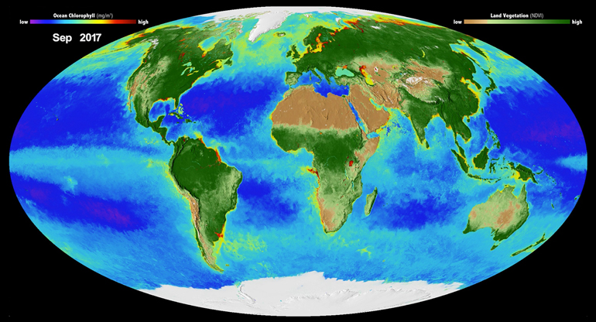
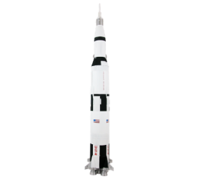

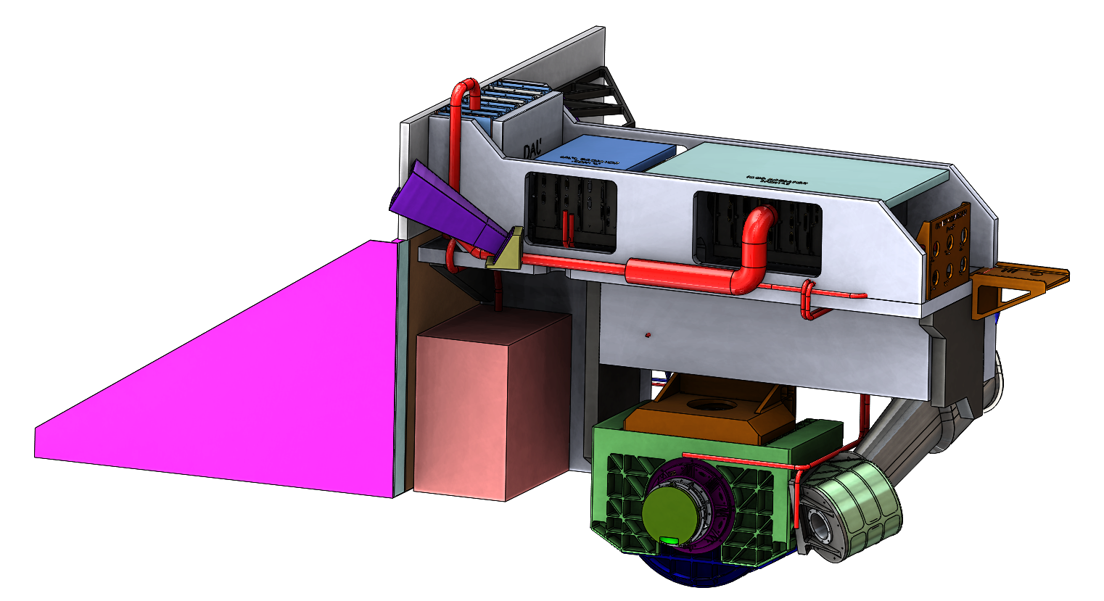
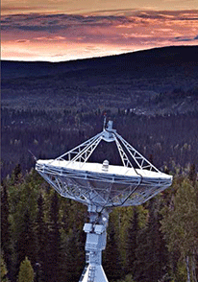
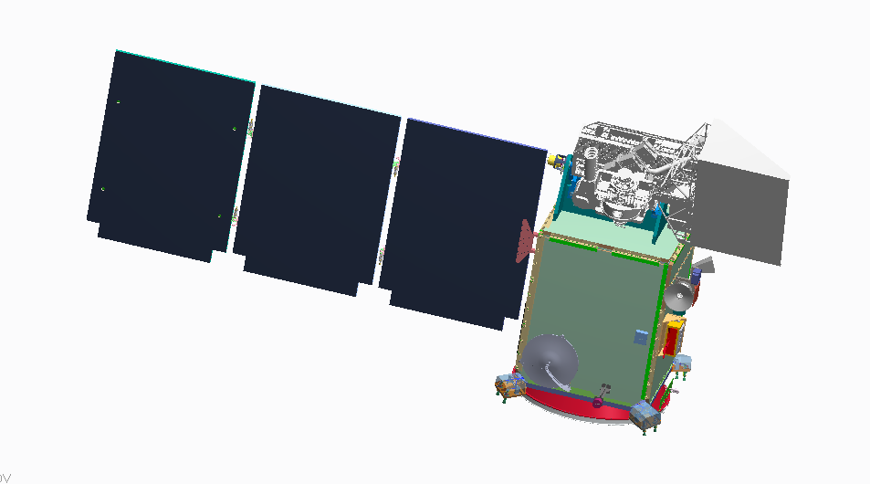
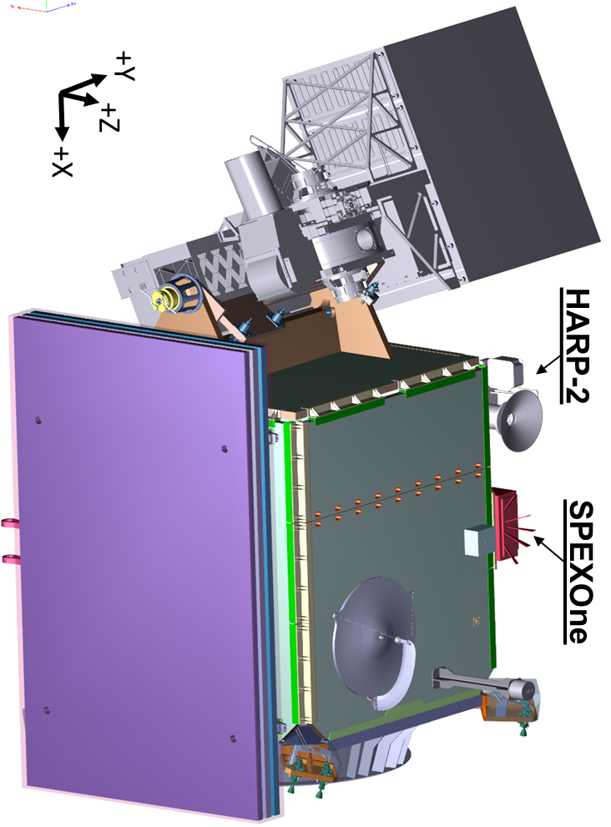

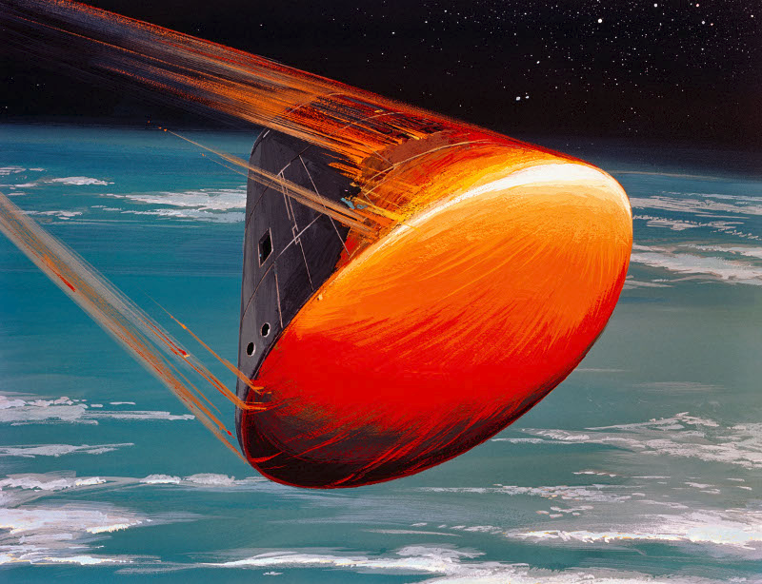
Plankton, Aerosol, Cloud, ocean Ecosystem (PACE)
PACE Science
New opportunities to monitor fisheries and respond to toxic algae blooms, and key ocean and atmosphere data for forecasting air quality and weather that will improve our understanding of Earth’s climate.
Mission Elements (Organization)
Competed Science Team (NASA ESD)
Vicarious Calibration (NASA ESD)
Science Data Analysis (GSFC)
Ocean Color Instrument (GSFC)
Spacecraft – (GSFC)
Polarimeters – (SRON, UMBC)
Mission Operations – (GSFC)
Launch services (LSP-SpaceX)
Mission Complement:
HyperSpectral Scanner
Two Polarimeter Instruments
Spacecraft Earth Pointing Platform
OBPG Science Data Segment (SDS)
Vicarious Calibration System
You Are Here
June 2020
Key Mission Parameters
98° inclination; ~676.5 km altitude
  Sun-Sync (1pm MLT AN),
  2 day global coverage
Class C Mission
PRD Dec. 2022/LRD Mar. 2023
3 years^{Ͳ} Phase E & Controlled Reentry
10 years fuel*
OCI
CDR
Observatory I&T
Spacecraft
PDR
Grd &
SDS
CDR
Phase A
Grd &
SDS
PDR
OCI
PDR
Mission
PDR
Mission
CDR & LV
Award
Launch Readiness Date (LRD) Mar. 2023
Decommission
CY16
CY17
CY18
CY19
CY20
CY21
CY22
CY23
CY24
CY25
CY26
Phase A
Phase B
Phase C
Phase D
Phase E
Phase F
June 16, 2016
July 13, 2017
August 2019
October 2021
June 2023
* Fuel only, design life is 3 years, the extra 7 yrs is ~9% of the required mission fuel budget
^{Ͳ} Baseline Requirement
2-2
December 9-13, 2019

Slide 3
PACE Mission Phases (Past and Future)
Pre-Phase A
Concept studies
Cost and schedule (large uncertainty)
Culminates in a Mission Concept Review
KDP – Key Decision Point (HQ Gate Review)
Jan 2015
KDP A
Concept and technology development to determine what requirements are achievable
Some hardware development to mature the technology and reduce risk
Cost and schedule estimates are updated but with uncertainty
Culminates in a Systems Requirements Review
Phase A
June 2016
KDP B
Preliminary design phase and technology development completion
Requirements should be stable and well defined
Engineering unit development
Cost and schedule baselined (expected high confidence)
Culminates in a Preliminary Design Review
Phase B
July 2017
KDP C
Phase C
Final/Critical design phase and start of major flight build
Requirements verified at the element level
Cost and schedule performance is closely monitored against the baseline
Culminates in a Systems Integration Review
We are here
Aug. 2019
KDP D
Phase D
Final system/observatory level assembly and test
Requirements are verified at the system level
Culminates in a Operational Readiness Review, Launch and early in orbit checkout
Oct. 2021
KDP E
Phase E (36 months)
Operations and Science Data Collection
Culminates in a Decommissioning Review
June 2023
KDP F
Phase F
Decommission/De-Orbit

Slide 4


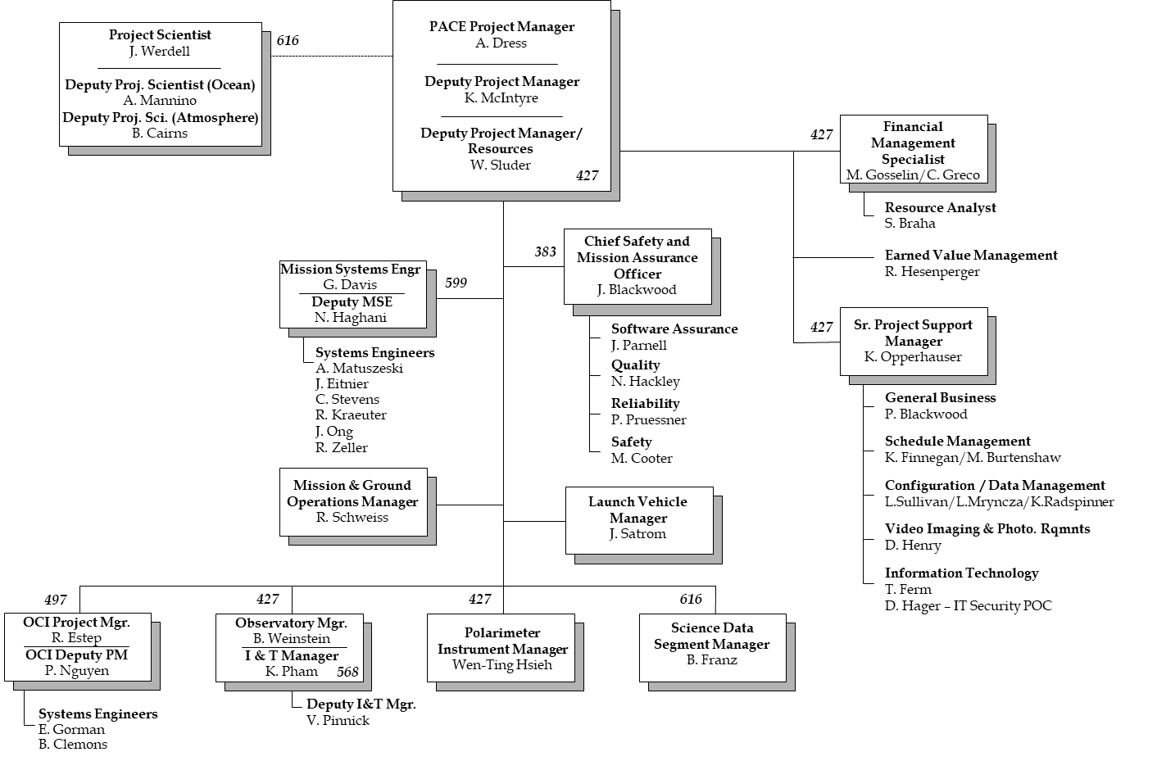

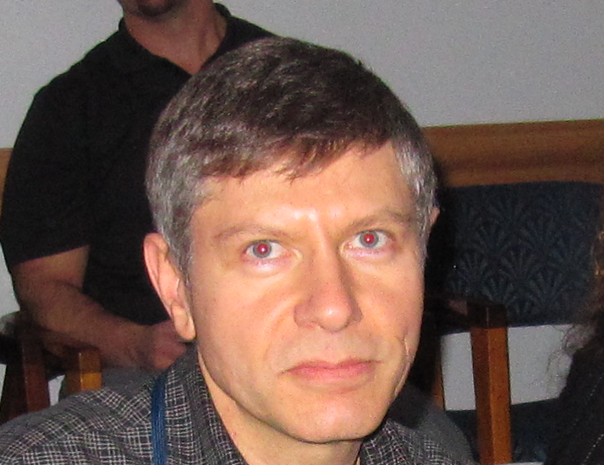











PACE Project Organization Chart

Slide 5


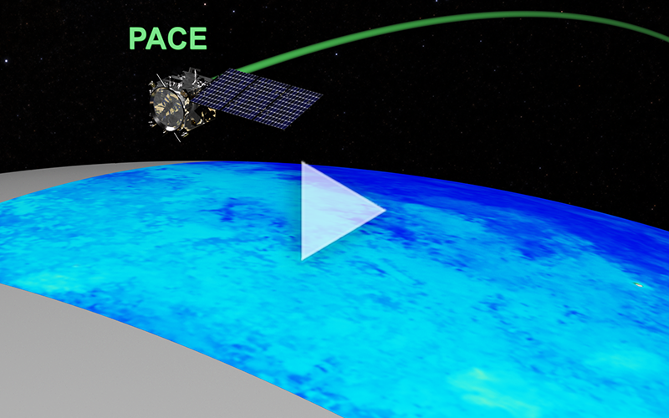


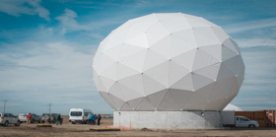

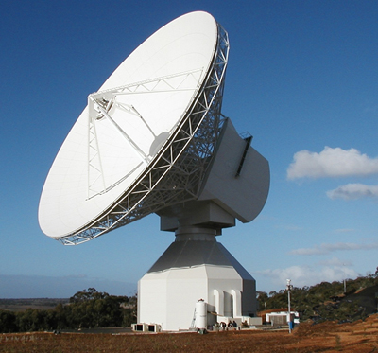
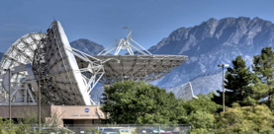
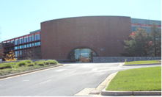
Mission Architecture
Space Segment
TDRSS
GPS
Command & Telemetry
Alaska Fairbanks
PACE
Observatory
Science Data
Science
Data Segment
(GSFC)
Launch
Segment
Mission
Operations
Center (GSFC)
White Sands
Complex
CCAFS
Ground Segment
Fairbanks
Primary T&C,
Science Data
Punta Arenas
Primary T&C,
Science Data
Svalbard
Primary T&C,
Science Data
Wallops Island
Alternate T&C
White Sands
Alternate T&C
Mission
Operations
Center (GSFC)

