Slide 1
OCI Systems Engineer
Eric Gorman
Plankton, Aerosol, Cloud, ocean Ecosystem (PACE)
OCI Overview
June 2, 2020

Slide 2
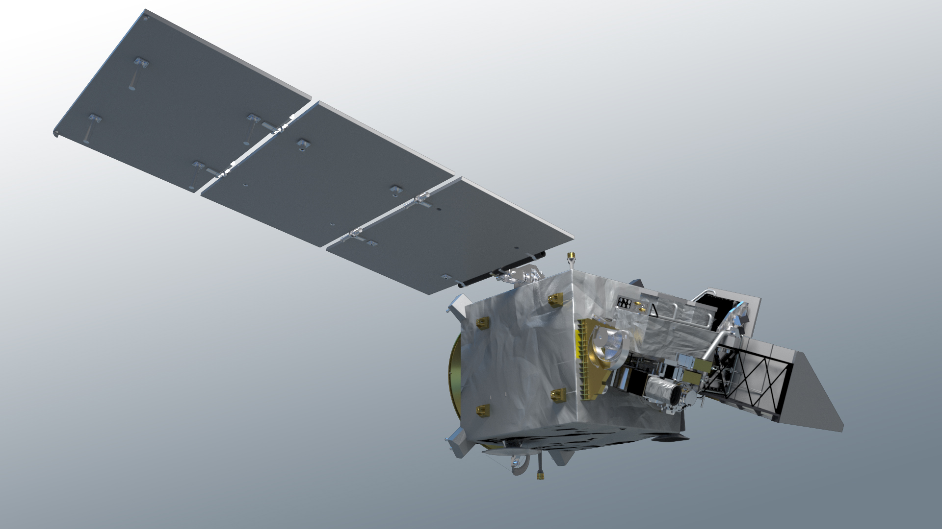
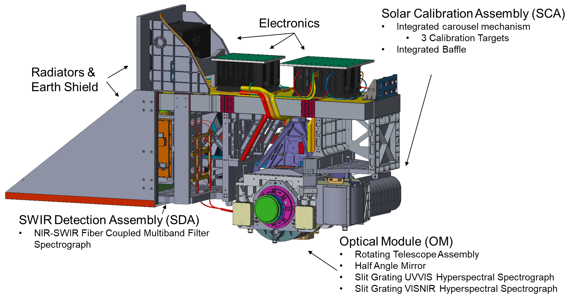
hyperspectral scanning radiometer
340 – 890 nm, 5 nm resolution, 2.5 nm steps
plus, 940, 1038, 1250, 1378, 1615, 2130, and 2250 nm
1 – 2 day global coverage
ground pixel size of 1 km² at nadir
± 20º fore/aft tilt to avoid Sun glint
twice monthly lunar calibration
daily on-board solar calibration
built at NASA Goddard Space Flight Center
Notes:
OCI overview part 1 – general characteristics

Slide 3
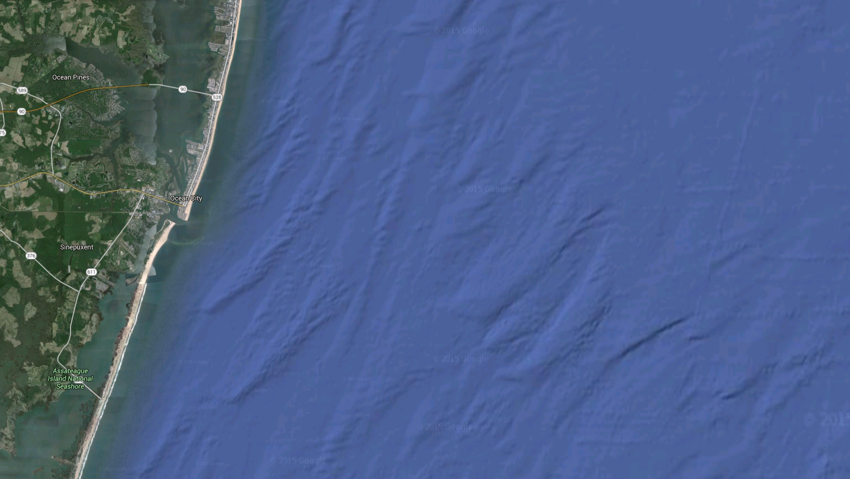
OCI Fundamentals Agenda
Telescope Slit
Rotating Telescope
Slit Grating UVNIR Spectrograph
Time Delay Integration
NIRSWIR Fiber Coupled Spectrograph
Tilt It!

Slide 4
Telescope Slit Ground Image
The telescope images sixteen 1km science pixels onto a slit
16km cross track x 1km along track
The slit is imaged onto the detector of each spectrograph
16 Science Pixels, 1000m Each, 16km Total
Telescope Slit Image
*Approximate Scale

Slide 5
Rotating Telescope
The rotating telescope moves the ground image across the slit in the cross track direction
~1200 science pixels for each telescope rotation
Telescope rotation rate of ~5.7Hz is set to avoid gaps between ground scans

Slide 6

Rotating Telescope and Half Angle Mirror Fundamentals
Rotating Telescope (RT)
  Off Axis Parabola Primary Mirror
  Continuous 360º Rotation ~5.7 Hz
  Sweeps across the full field of regard
Half Angle Mirror (HAM)
  Double Sided Flat Mirror
  Continuous 360º Rotation ~RT/2 Hz
  Reflects ground image from rotating primary mirror onto the stationary slit
RT
RT
RT
Slit
RT
RT
Scan Direction
(West to East)
HAM
HAM
HAM
HAM
HAM
Scene
Scene
Scene
Scene
Scene
Field of Regard +/- 55º

Slide 7
UVNIR Slit Grating Spectrograph
VISNIR Slit-Grating Spectrograph
885nm
Spectrograph wavelengths are selected by a dichroic
600nm
Telescope Slit Image
UVVIS Slit-Grating Spectrograph
A grating spectrally separates the slit/ground image
The same slit/ground image is focused onto each detector in 5nm steps with 5nm bandwidth
605nm
340nm

Slide 8
Time Delay Integration
16 Science Pixels-1000m Each, 16,000m Total
Synchronization of the CCD readout with the rotating telescope enables time delay integration (TDI)
The CCD uses TDI to transfer the charge from pixel to pixel at the same rate of the rotating telescope. This occurs in analog charge space to avoid noise introduced by reading, amplifying, and digitizing the signal
TDI allows the detection system to view the same ground scene for an extended time and build up enough signal to meet SNR while eliminating image striping due to detector pixel gain offsets

Slide 9
Time Delay Integration
Ground scene moving across the slit
On-chip TDI across the detector
The UVVIS & VISNIR spectrographs produce a continuous stream of data
109 spectral bands for each 1km science pixel

Slide 10
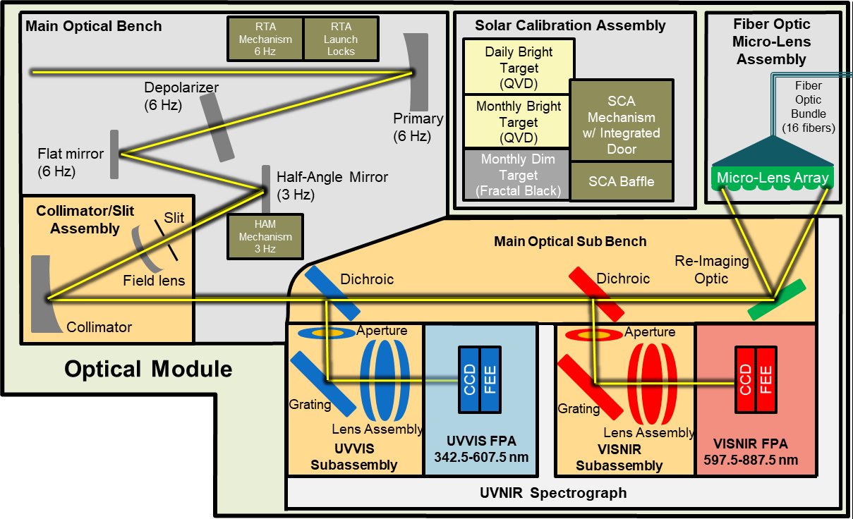
OCI Optical System – Optical Module

Slide 11
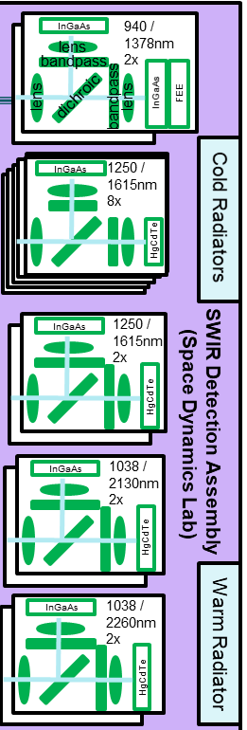
NIRSWIR Fiber Coupled Spectrograph
Telescope Slit Image
Read 1
The slit is imaged onto a micro lens array
Light from the MLA image is fiber coupled to the NIRSWIR bandpass-photodiode focal planes
The FPA readout is synchronized with the rotating telescope
Digital TDI is shown to the right
Read 2
Read 3
Read 4
Read 5
Read 6
Read 7
Read 8
Read 9
Example: TDI 8
Blue – 1st scene
Red – 2nd scene

Slide 12
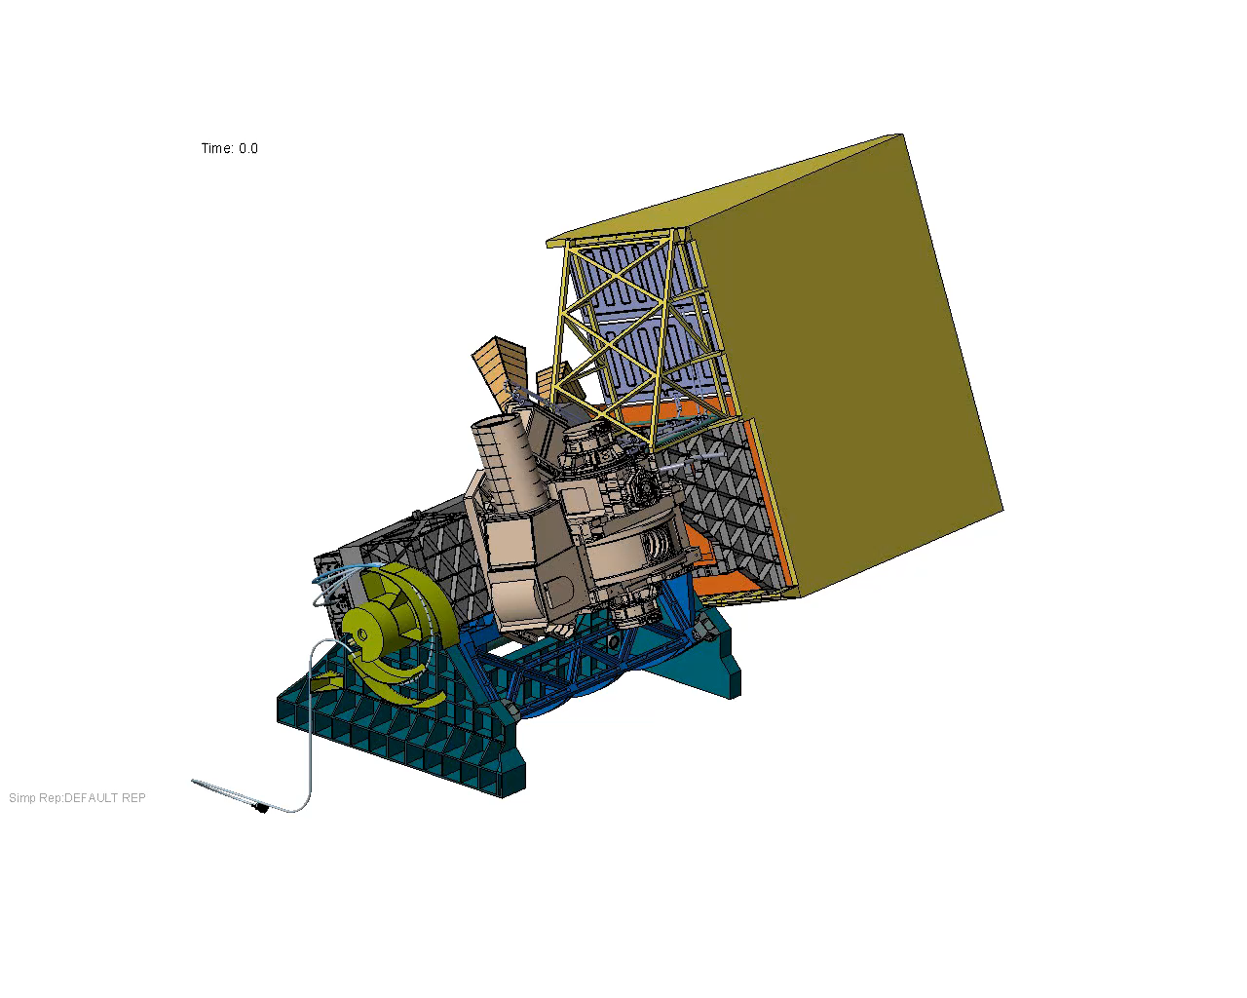
Tilt It!
OCI is mounted to a tilt mechanism system
Around the subsolar point, the nadir boresight is tilted +/- 20 degrees in the along track direction in less than a minute

Slide 13
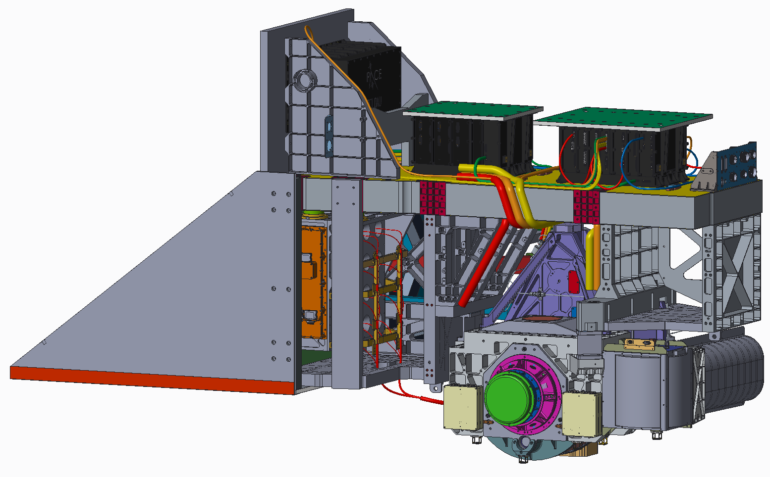
OCI Description (1/2)
Solar Calibration Assembly (SCA)
Integrated carousel mechanism
  3 Calibration Targets
Integrated Baffle
Electronics
Radiators & Earth Shield
SWIR Detection Assembly (SDA)
NIR-SWIR Fiber Coupled Multiband Filter Spectrograph
Optical Module (OM)
Rotating Telescope Assembly
Half Angle Mirror
Slit Grating UVVIS Hyperspectral Spectrograph
Slit Grating VISNIR Hyperspectral Spectrograph

Slide 14
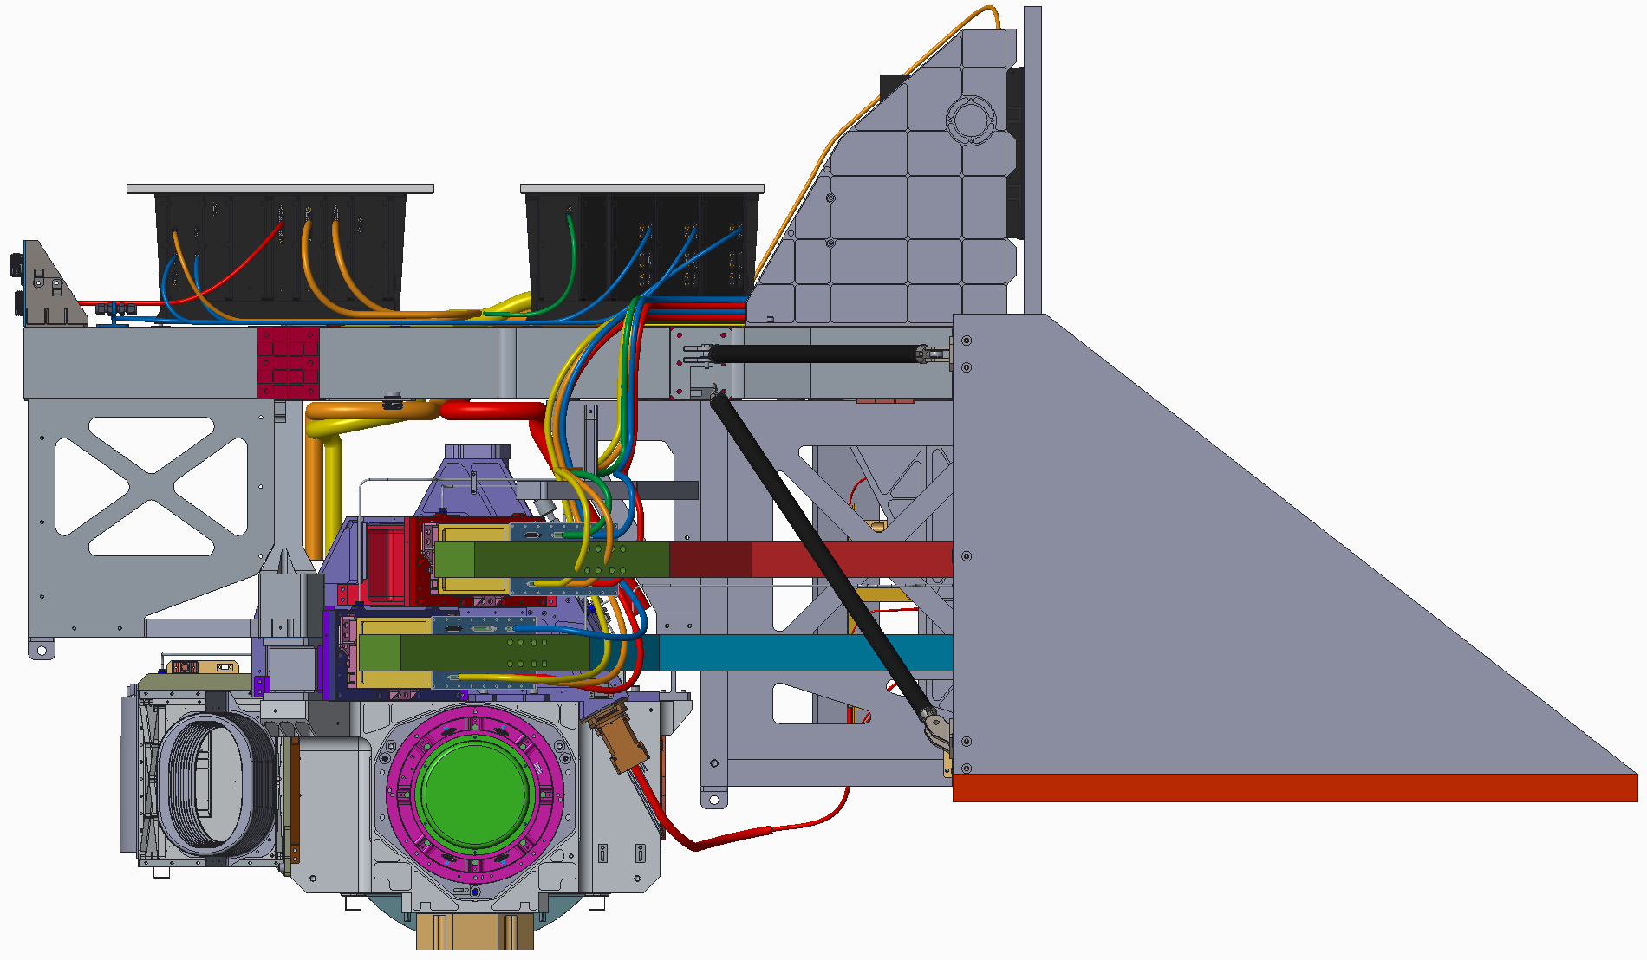
OCI Description (2/2)
Instrument Command & Data Unit
Processor
House Keeping
Thermal Control
Power Distribution
Motor Control Electronics
Data Acquisition Unit
CCD Clock and Bias
SDA Power
Data Processing
UVVIS & VISNIR FPA Loop Heat Pipes
Radiator Earth Shield
UVVIS & VISNIR Focal Plane Assemblies
CCD with On-Chip TDI and Integrated ADC

Slide 15
OCI Engineering Hardware Development Status
Structure
SDA
Electrical System
Harness
ICDU
FSW
MOB
Optical Module
MCE
MOSB
DAU
Red FPA
OCI CPT
OCI TVAC
SDA Integration & Test
Pre-Launch Calibration Pathfinder
Red FPA
MLA&Fiber
Blue FPA
SSM
I&T Backend Infrastructure
ITOS
SWITS
GLAMR
CPT &
Pre-Launch Calibration Hardware
Key
FEDS
GATOR
Not Started
XINA
Radiometers
In Process
Sources
Complete

Slide 16
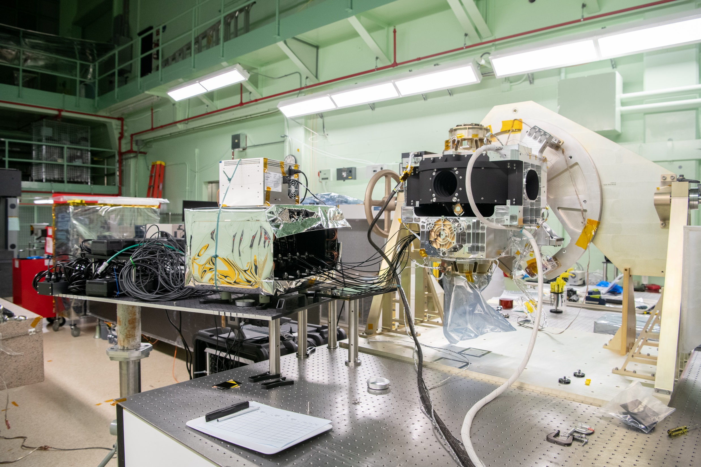
Optical Module Testing

Slide 17
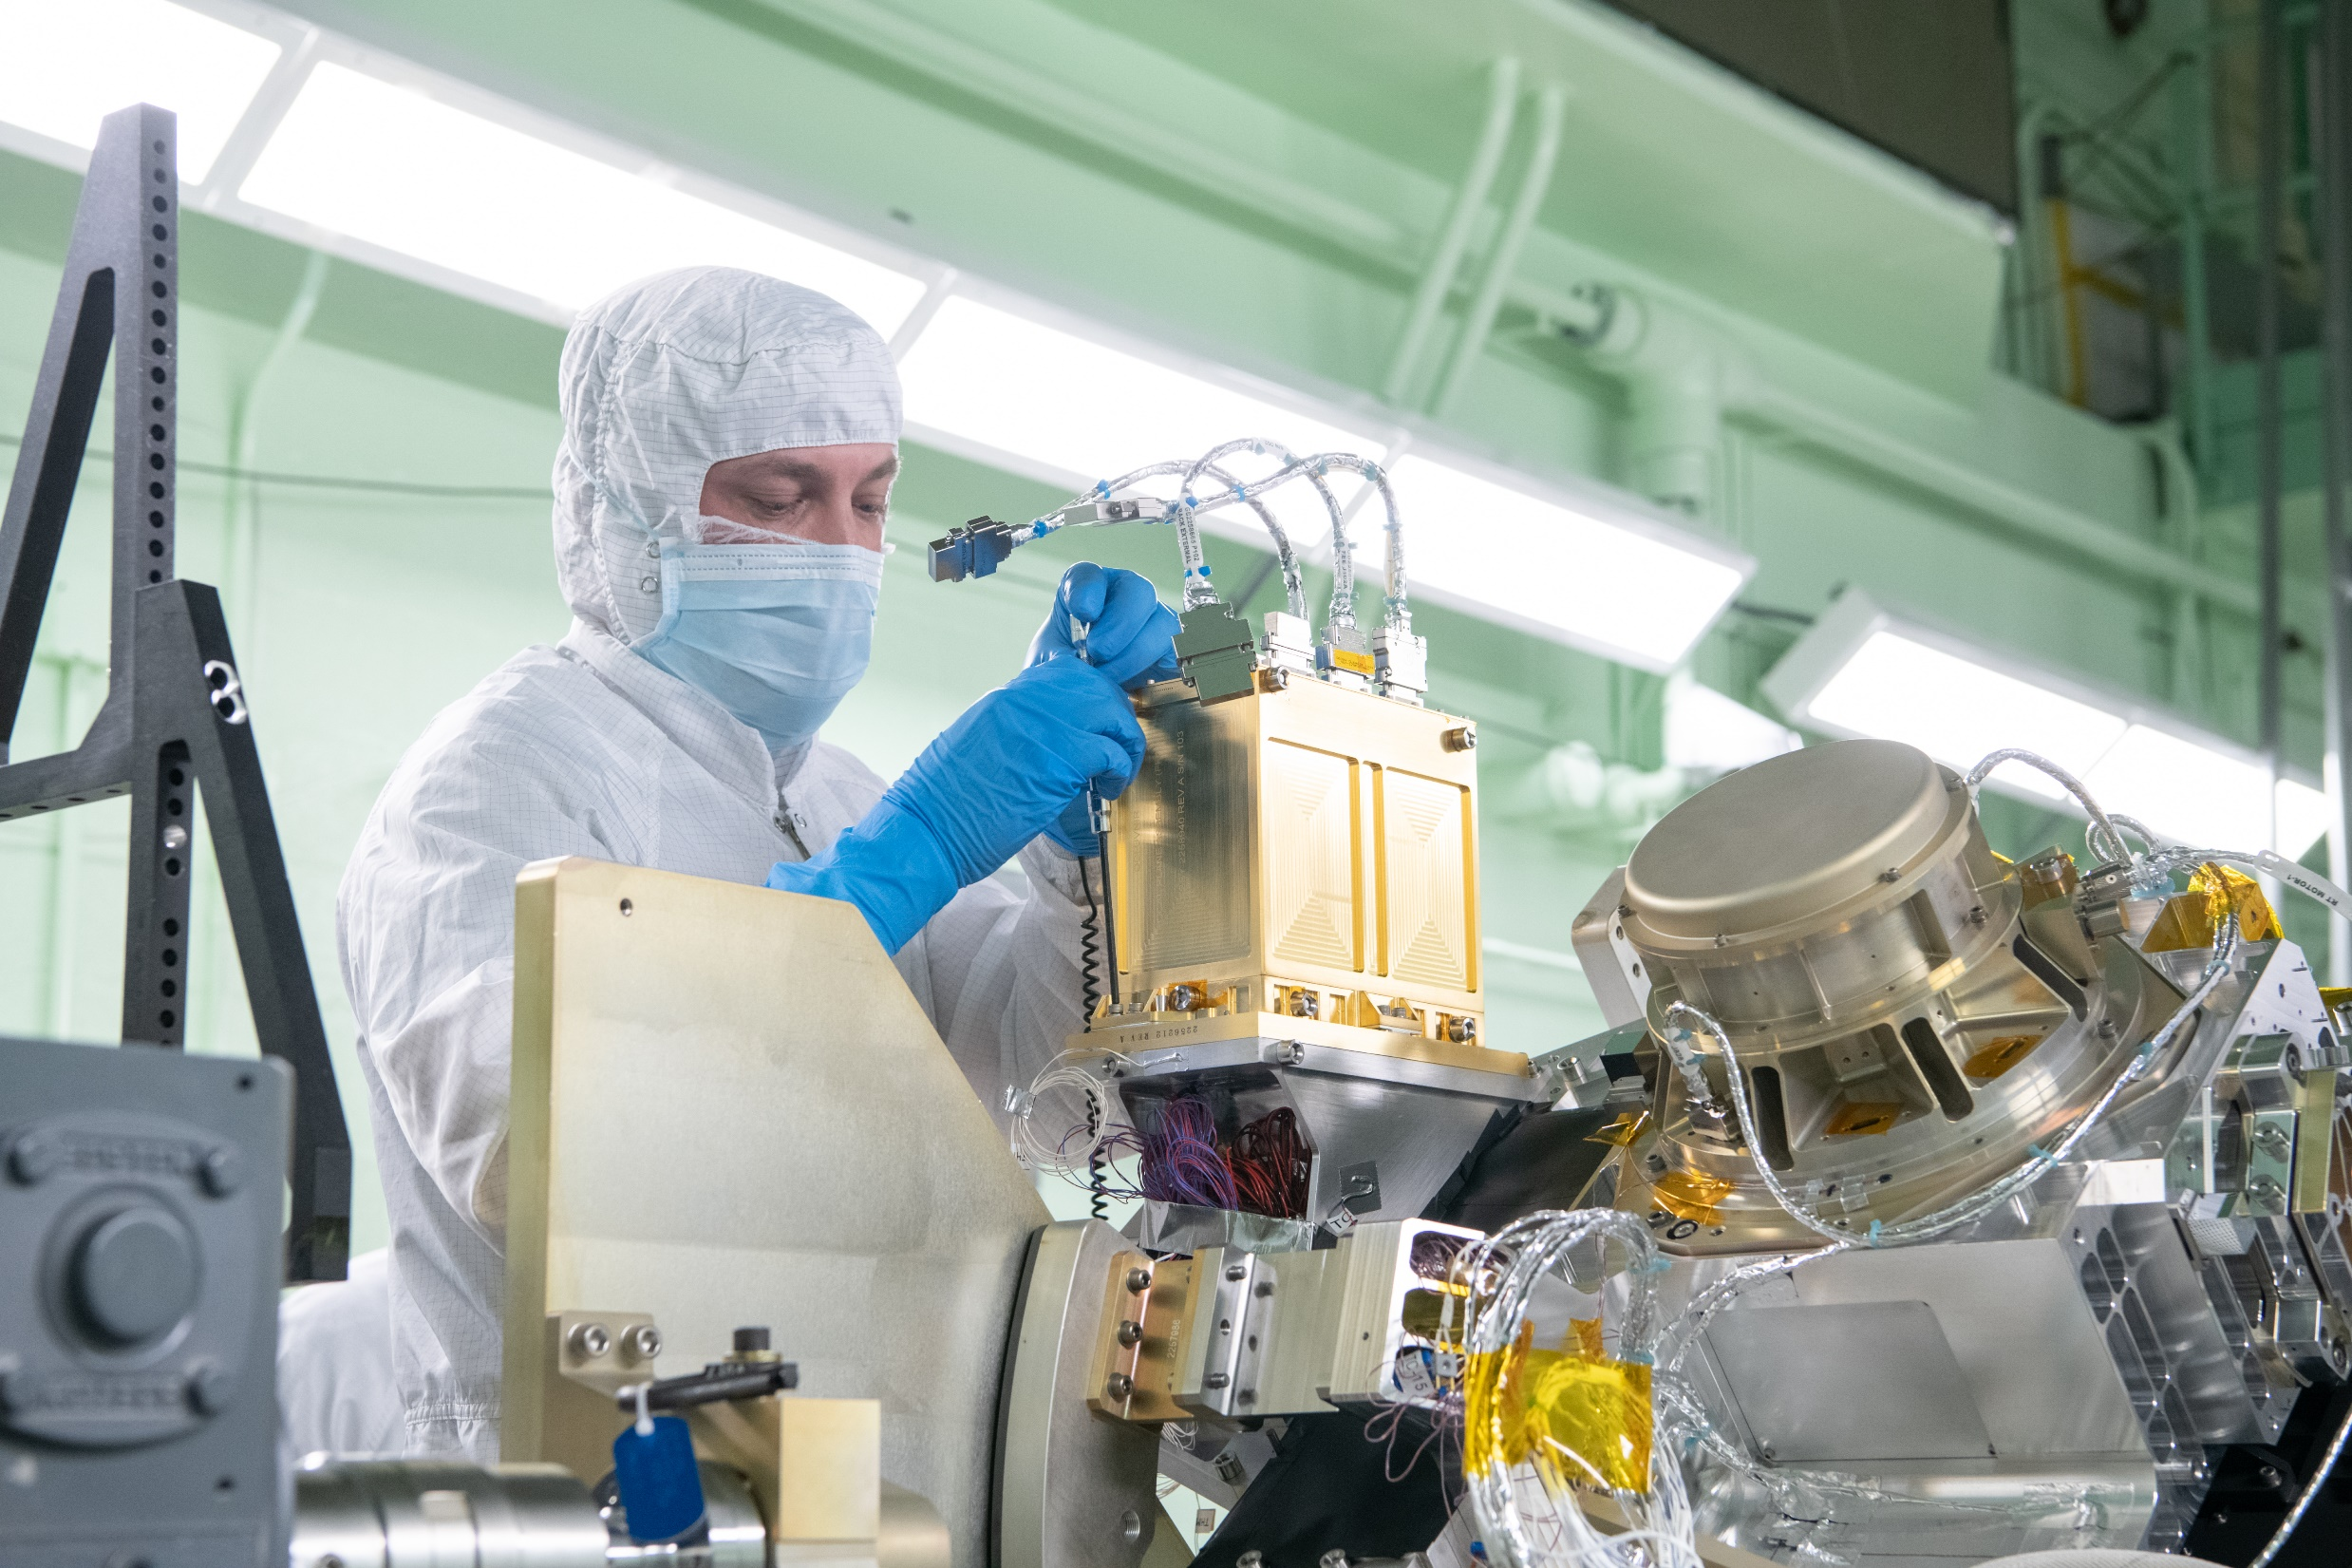
VISNIR Focal Plane Alignment

Slide 18
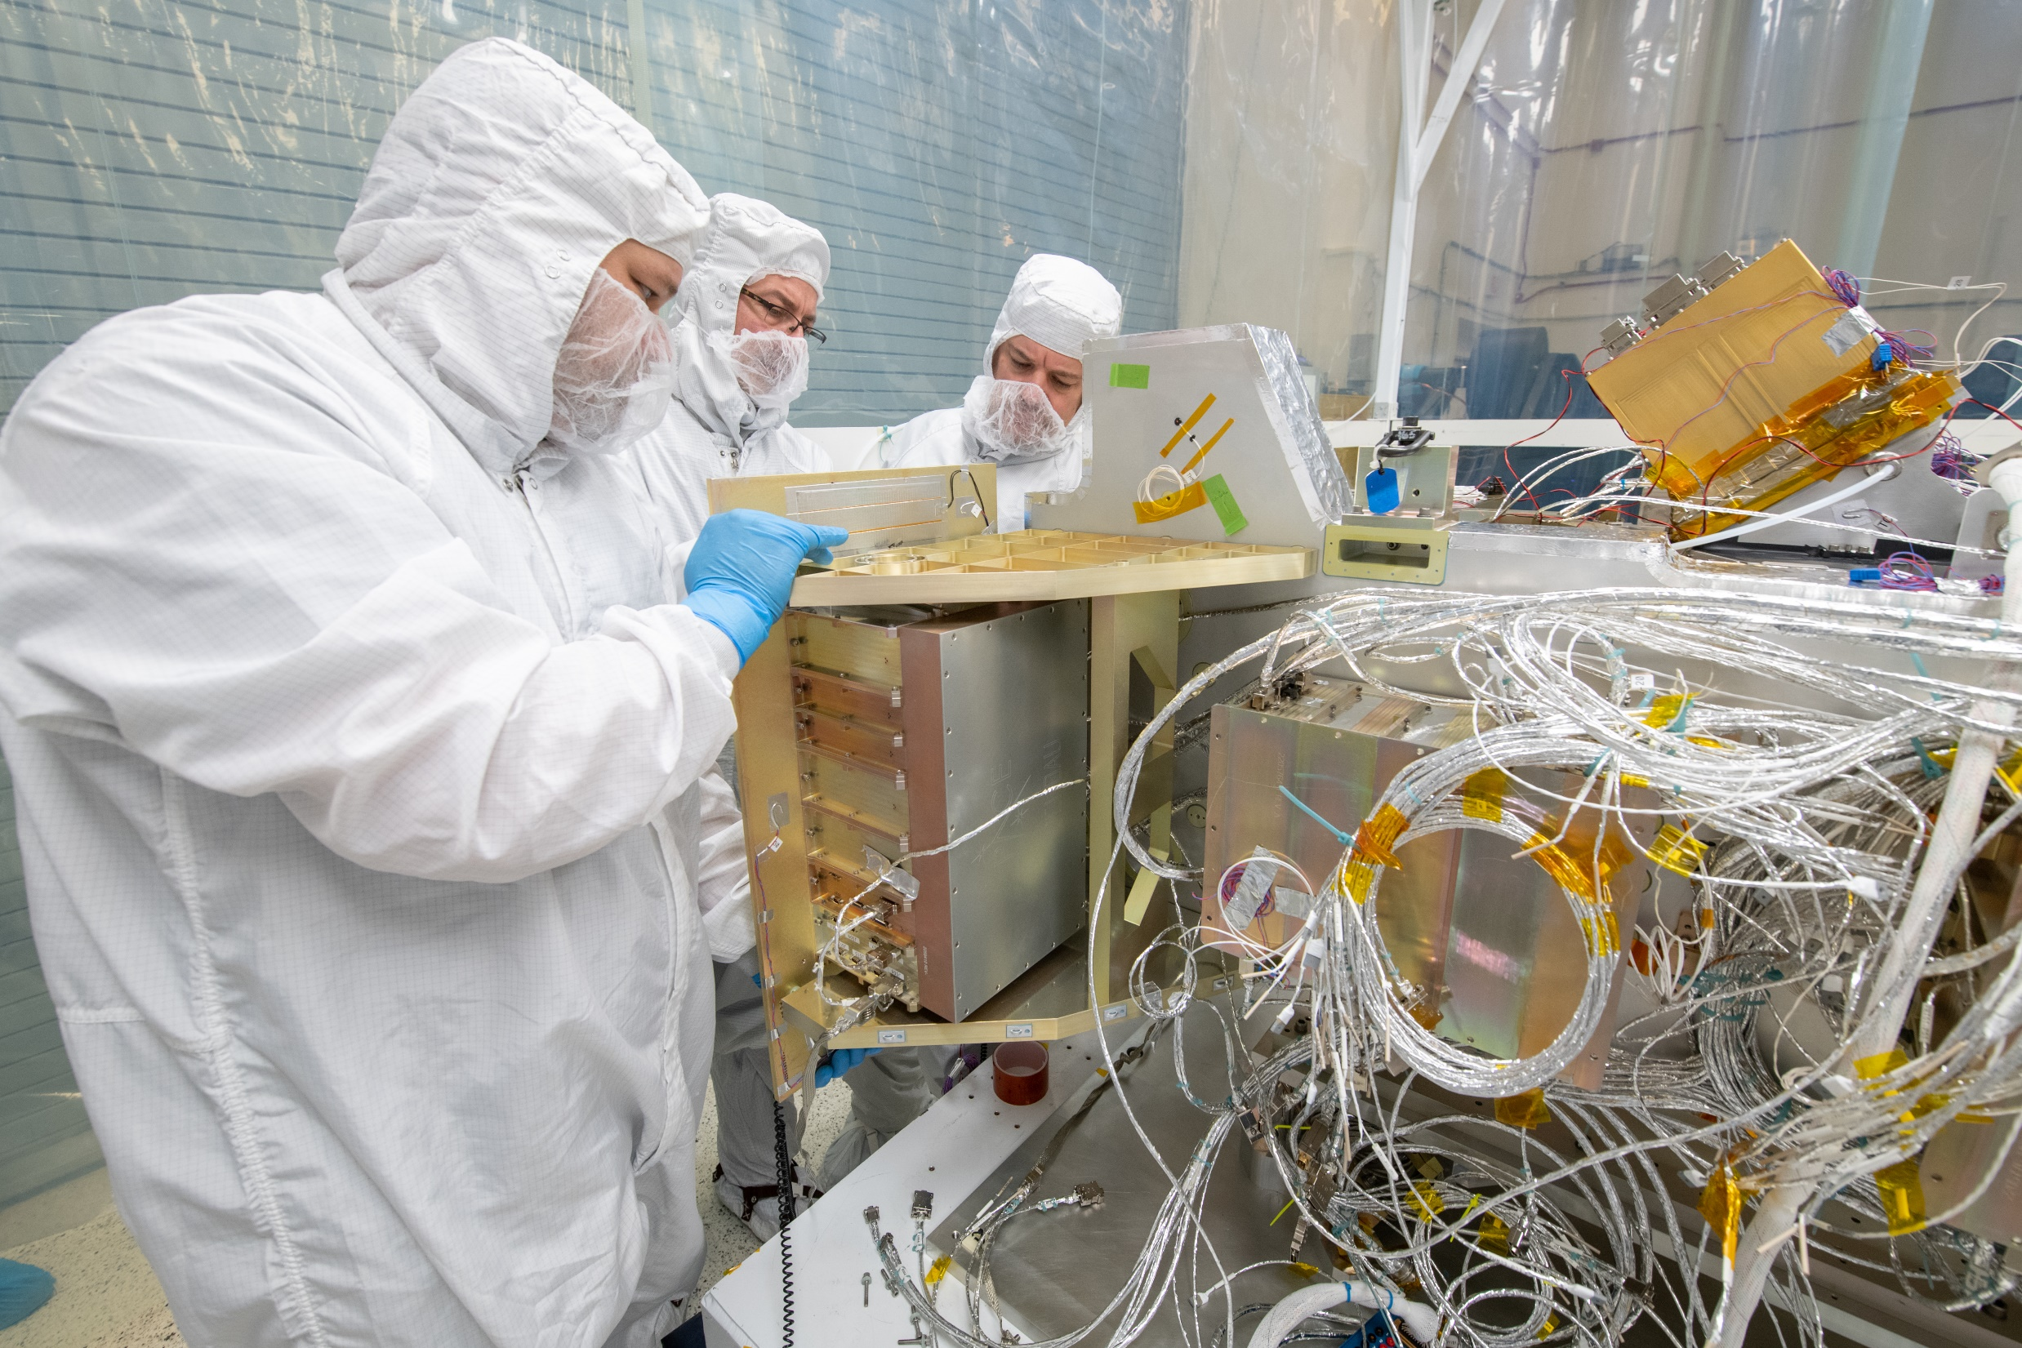
Electronics Integration

Slide 19
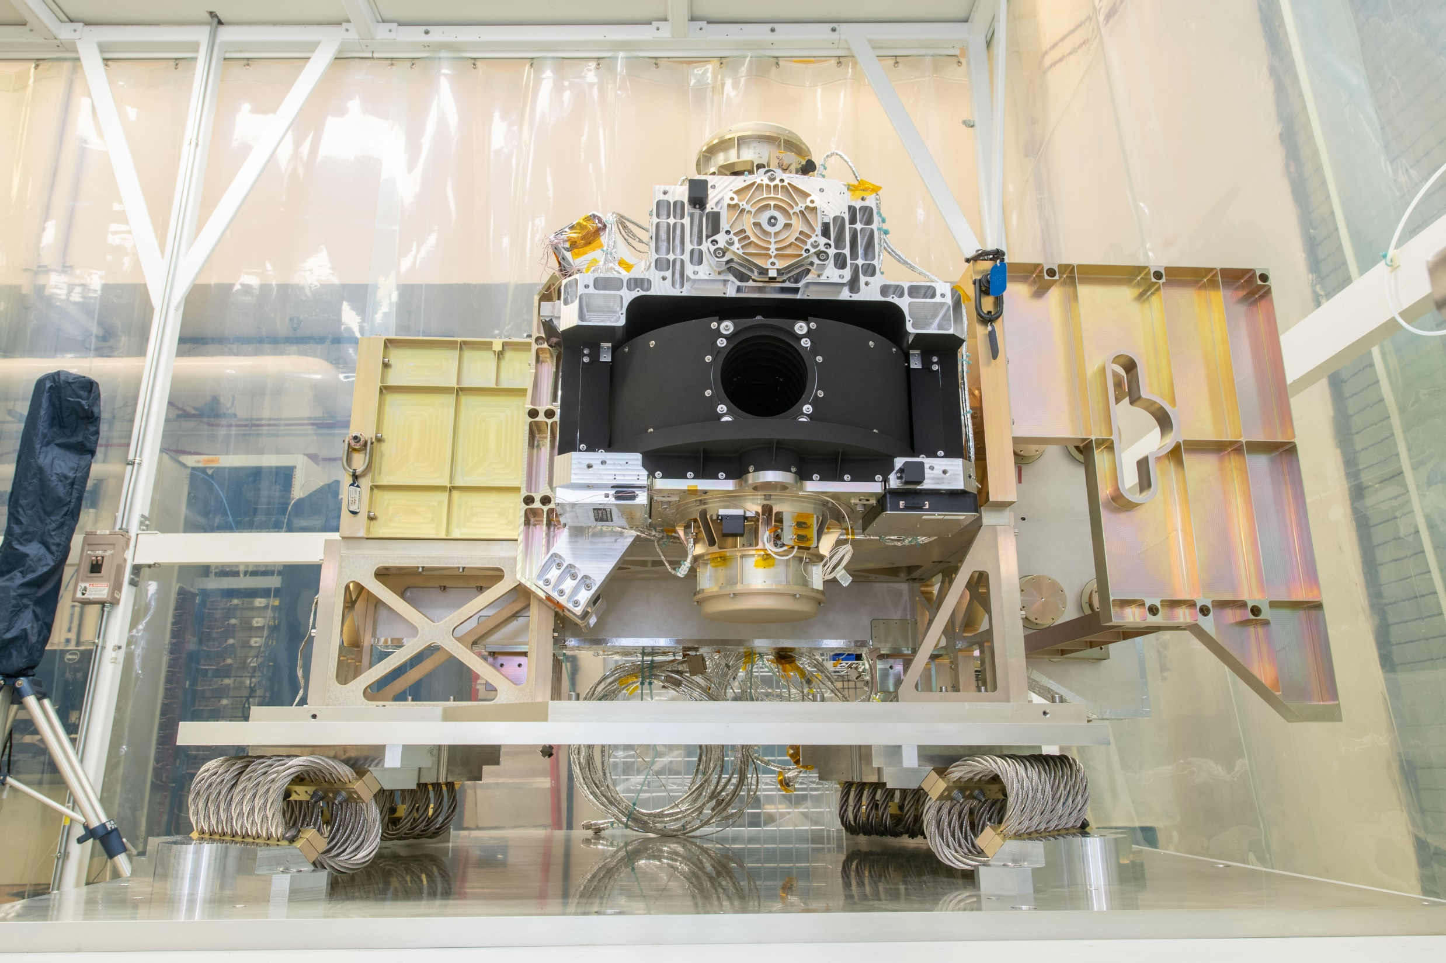
OCI – Ready To Test

Slide 20
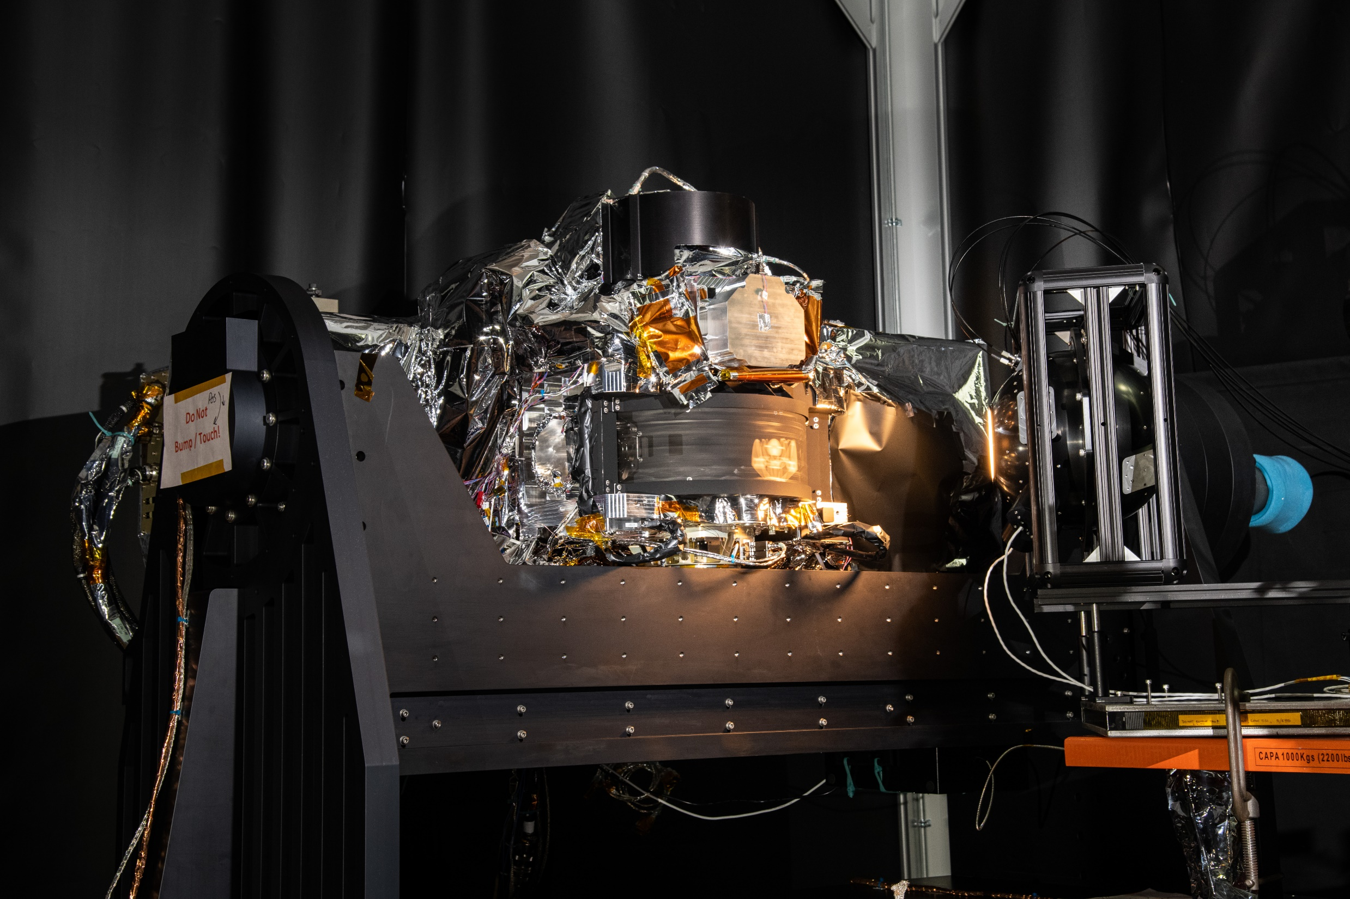
Comprehensive Performance Testing – Ambient

Slide 21
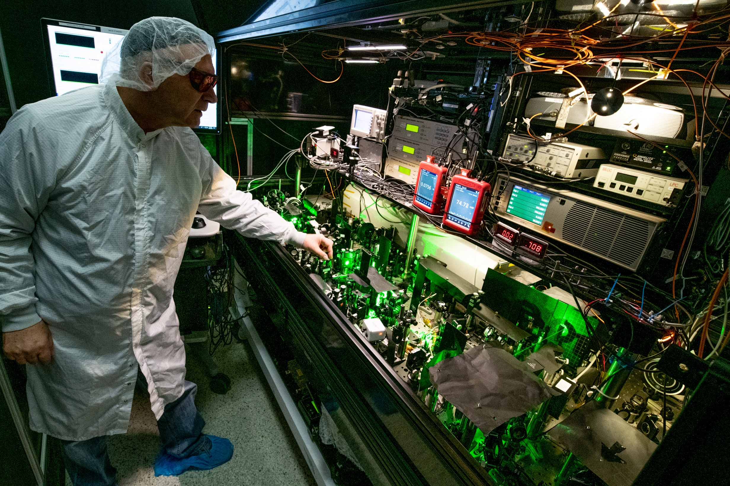
NASA/GSFC – GLAMR Tunable Laser

Slide 22
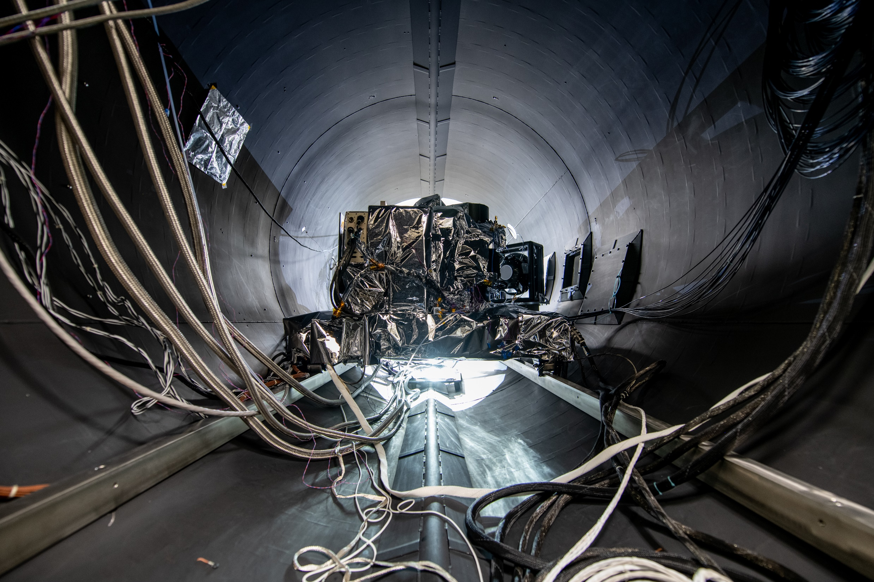
Comprehensive Performance Testing – TVAC

Slide 23
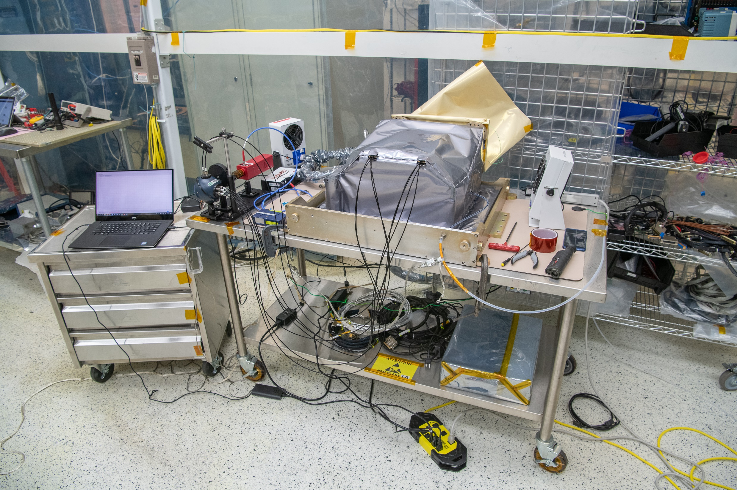
SWIR Detection Assembly – Ready For Integration

Slide 24
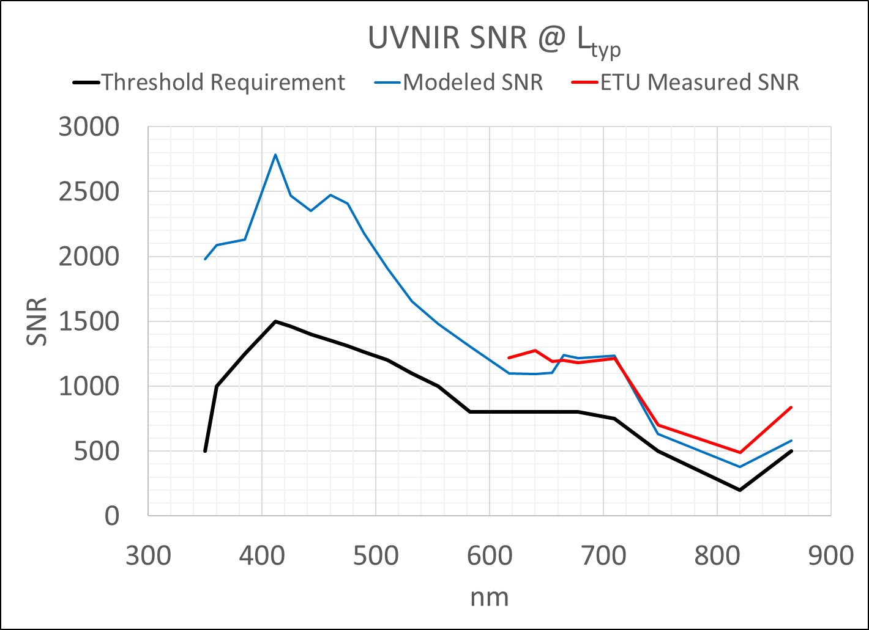
OCI Engineering Hardware Test Results

Slide 25
OCI Flight Hardware Development Status
Structure
SDA
Electrical System
Harness
ICDU
FSW
MOB
Optical Module
MCE
MOSB
DAU
MLA&Fiber
OCI CPT
Environmental Testing
Calibration
Integrate w/ Spacecraft
Red FPA
Blue FPA
I&T Backend Infrastructure
ITOS
SWITS
GLAMR
CPT &
Pre-Launch Calibration Hardware
Key
FEDS
GATOR
Not Started
XINA
Radiometers
In Process
Sources
Complete

Slide 26
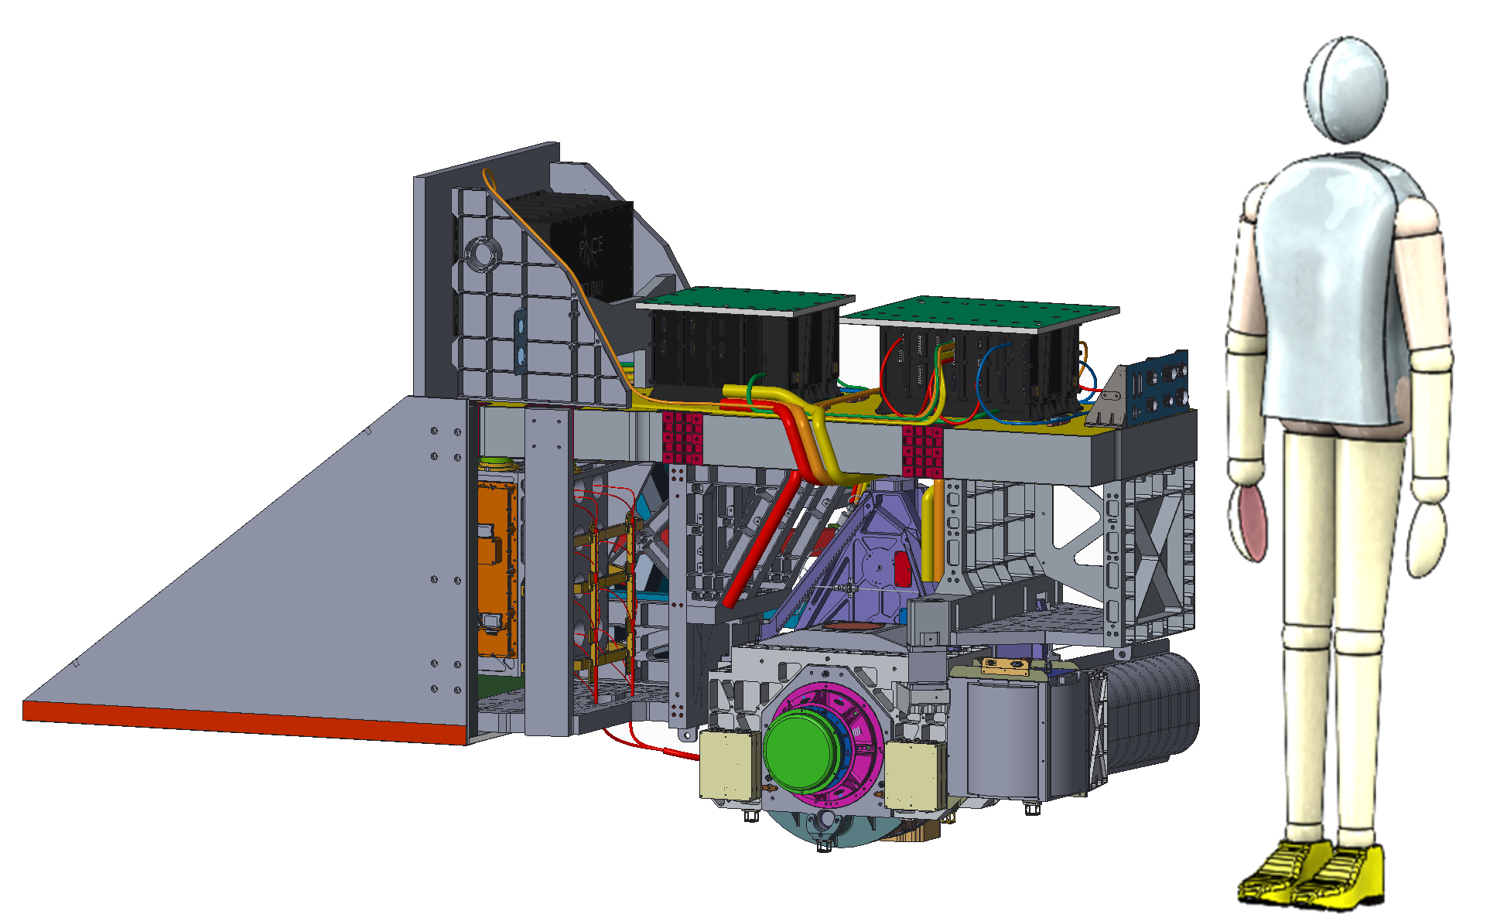
OCI Instrument Specs
Instrument Mass | 260 kg CBE , 305 kg NTE
Instrument Power | 280 W CBE , Orbital Average
Thermal System | Passive Cooling with Loop Heat Pipes
Mechanisms | Rotating Telescope Mechanism (~6Hz) Half Angle Mirror Mechanism (~3Hz) Solar Calibration Mechanism (5000 Cycle)
Deployments | Rotating Telescope Launch Lock
Ground Sample Distance | 1050m at Nadir
Aperture | 93mm
iFOV | 0.08º Along Track x 1.42º Cross Track
UVNIR System EFL | 0.134m
UVNIR System f/no | 1.49
Total Field of Regard | +/- 55º
Dynamic Range | SNR at L_{typ} , No Saturation at L_{max}
UVNIR Bands (nm) | 342.5nm – 887.5nm , 5nm Resolution
NIRSWIR Bands (nm) | 940, 1038, 1250, 1378, 1615, 2130, 2260
UVVIS & VISNIR FPAs | 2 CCDs, 128 x 512, 26 micron Integrated 14 Bit ADC
NIRSWIR FPAs | 16MCT/16InGaAs Photodiodes, < 250 micron analog output to SIDECAR ASIC
Relative Radiometric Accuracy | < 0.5% Pre-Launch 1-sigma
SNR @ L_{typ} | > 1000:1: 340 – 700nm > 600:1: 700 – 865nm > 50:1 940 – 2260nm
On-Board Solar Calibration Assembly | 2 QVD Solar Calibration Targets 1 Fractal Black Solar Calibration Target
Orbital Average Data Rate | Up to 40 Mbps
Cross-Track Rotating Telescope
UVVIS & VISNIR Slit Grating Hyperspectral Spectrographs
NIR-SWIR Fiber Coupled Multiband Filter Spectrograph

